Slide 1
Project: Paperless Replacing Pencil and Paper in Assessments
John Hartzog: Florida Gateway College

Slide 2
Outline
Background
Problems of Paper/Pencil Usage
The Solution
Administrative Benefits of a Paperless System
Student Benefits of a Paperless System
Q & A

Slide 3
Background
Florida Gateway College Test Center
Seating Capacity of 40
Variety of Tests and Related Services Offered
Small Staff
Provides around 18-20,000 Assessments Every Year
CPT/PERT
HESI
FBAT
GED
TABE

Slide 4
Background
Assessments go digital…
TABE PC / TABE Online
Accuplacer
FBAT
Post-Secondary Readiness Test (PERT)
FCAT
Paper and pencil still used with online assessments for scratch work and outlining.

Slide 5
Problems
Test Security Concerns
Paper and Pencil Problems
Set-up and Clean-Up

Slide 6
Test Security
Collection and Disposal
All scratch must be collected after each test session
Student leaving or self-disposal of paper
Students using their own scratch
Keeping disposed paper secure

Slide 7
Pencil & Paper Problems
Paper Limitation Issue
Pencil breaks
Cost and purchase of supplies
Noise Concerns

Slide 8
Set-up & Clean-up
Set-up
Paper and Pencil Distribution
Clean-up
Clean desktops
Collect and Dispose Paper
Sharpen Pencils

Slide 9
Solution : Boogie Board
Eliminates the need for paper
Helps reduce student test anxiety
Decrease supply cost
Diminishes set-up and clean-up for staff

Slide 10
Good-Bye Paper
5 x 7 Notepad
Write with a stylus or capped ink pen
Reusable: Endless supply of digital paper
Long Lasting: 8-10 year battery life

Slide 11
Test Anxiety
Pre-Assessment Play-Time
Nonstop Testing
Ask for more paper
Pencil breaks
Keeps students focused and attentive
Gives them a fresh start from mistakes

Slide 12
Money Talk$
Cost of Test Supplies Yearly
Paper $350-500 a year
Pencils $ 60-80 a year
Erasers $15-20 a year
Total Cost over 8 years: $3400- $4800
Boogie Board Cost
40 Boards with Stylus and Case: $1900
Cost Savings to College $1500 - $2900
Expected to increase with introduction of certification and licensure exams.

Slide 13
Time Savings!
Set-up Assessment Area
40 Stations at FGC
Set-up Time 20-30 minutes
Initialize computes
Distribute paper and pencil
Clean-up
Collection and disposal of paper
Sharpening pencils
Redistribute paper
Clean-up 10-15 minutes
Total Time Savings: 30-45 minutes a day

Slide 14
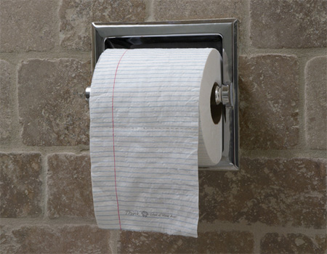
Conclusion
You still need paper for some things; but not to test at Florida Gateway College.

Slide 15
Q & A

