Slide 1
AFC Technology Commission Presents: Ten Tips & Tricks for Zoom Conferences & Meetings
Matthew White

Slide 2
Who Is Matt White?
Director of Distributed Systems
Chipola College
2020 AFC State President

Slide 3
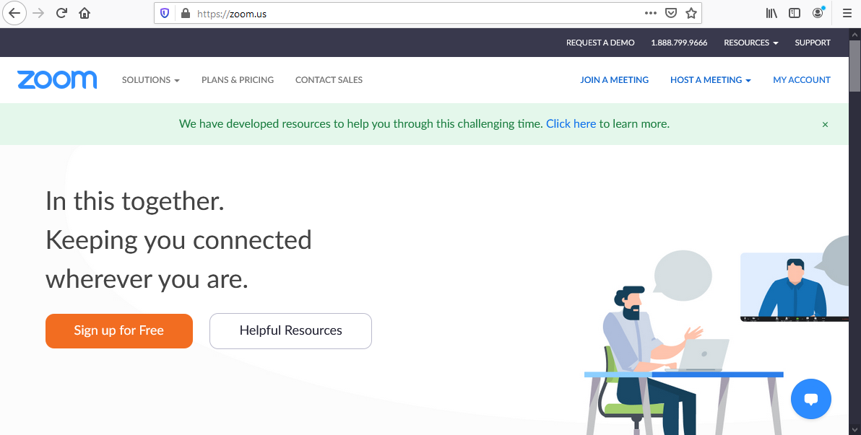

Slide 4
To Zoom or not to Zoom? That is the question…

Slide 5
Tip # 1 – Should You Use Zoom
The Good
Easy to setup and use
Well known
Gallery view
Virtual backgrounds
The Bad and the Ugly
Zoombombing
Security concerns: privacy, software
Some organizations block the use of Zoom
Use what you feel comfortable using and what your organization allows.

Slide 6
Tip # 2 – Secure Zoom
Keep your meeting links off social media (if possible)
Do not use your Personal Meeting ID (PMI) to host public events. Instead, generate a random ID.
Choose "only host" for screen sharing control during a meeting (default setting now)
Only allow signed-in users to join a meeting
Use the "lock" feature to prevent random users from joining in. You might also want to consider using the Waiting Room.
If you are zoombombed, hover over the user's name in the Participants menu to bring up a "remove" option.
Keep the Zoom software updated

Slide 7
Tip #3 – Check Your Settings
Settings Online
Set a picture for your profile (must have a Zoom account) (DEMO)
Check meeting settings (DEMO)
Settings in App
Audio: “Mute microphone when joining a meeting“
Video: “Turn off my video when joining a meeting”

Slide 8
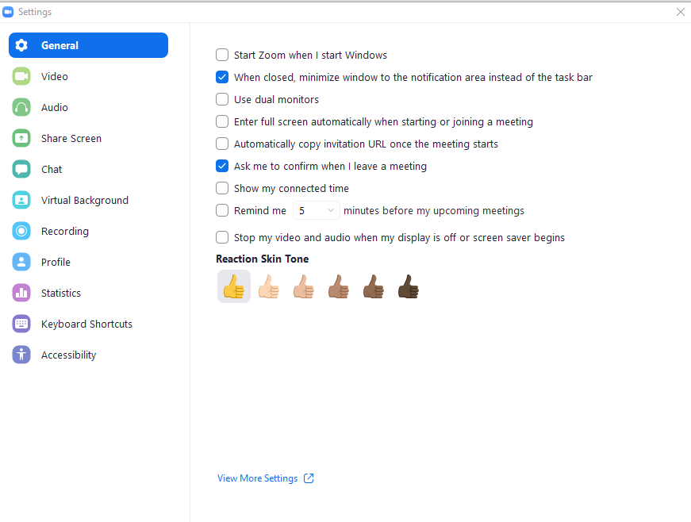

Slide 9
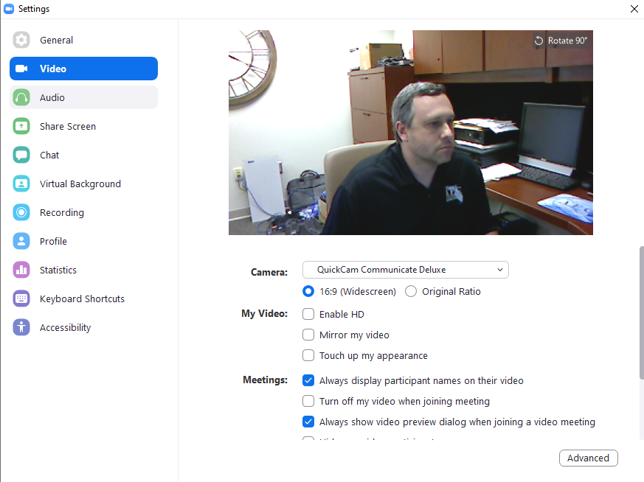

Slide 10
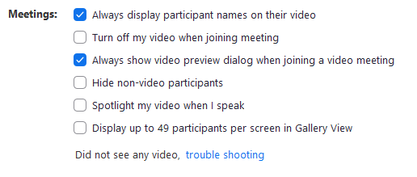

Slide 11
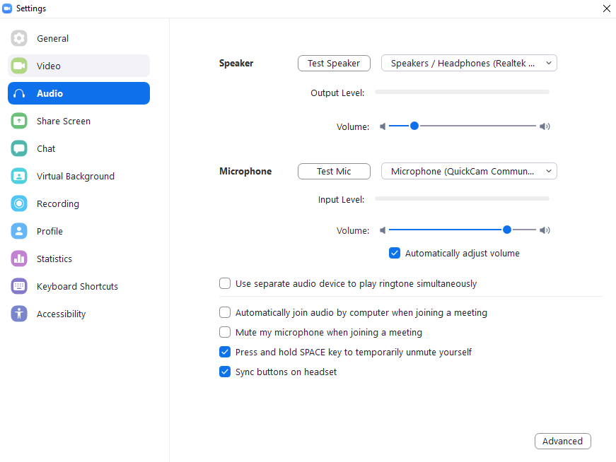

Slide 12
Tip #4 – Use Outlook to Send Invites
Schedule meting in Zoom
Copy invite
Open a new appointment in Outlook
Paste invite into email, configure time, add people to the meeting invite
DEMO

Slide 13
Tip #5 – Test Audio and Video

Slide 15
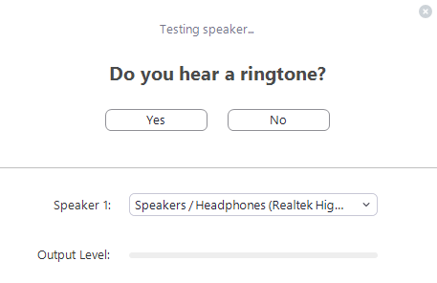

Slide 16
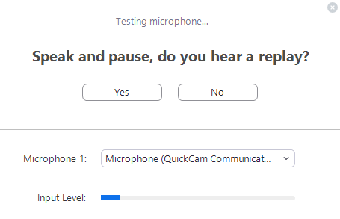

Slide 17
Tip #6 - Adjust Your Screen View
Switch between Gallery View and Speaker view at top right of screen
Fullscreen view – Open Chat and Participants windows in separate monitor
Pro Tip: Hide Nonvideo participants: Settings > Video > Meetings, and check Hide nonvideo participants

Slide 18
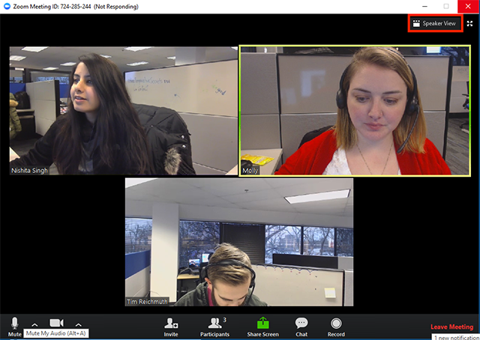

Slide 19
Tip #7 – Mute, Mute, Mute

Slide 20
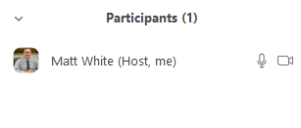

Slide 21
Tip #8 – Don’t Forget About the Chat
Keep the Chat dialog open
Can open in a separate window in full screen
When sharing your screen, open it from the top bar

Slide 22
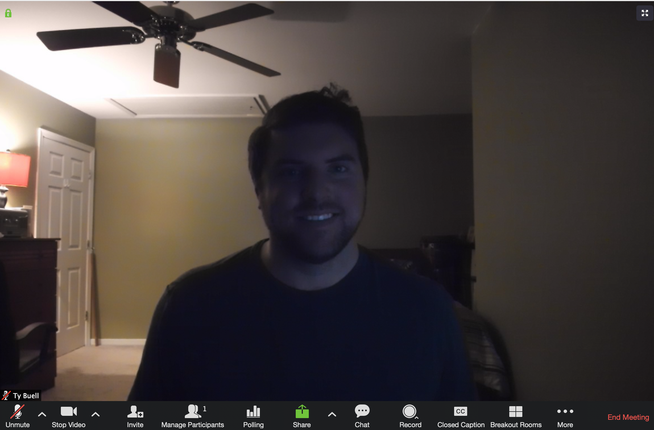
Tip #9 – Have Good Lighting
Don’t have a window in the background or bright light source behind you
Put the light source in front of your computer

Slide 23
Tip #10 - Virtual Backgrounds
Does depend on computer power if not using green screen
Pro Tip: In Settings > Video, check “Touch up my appearance,” and Zoom will soften the focus on your camera, theoretically minimizing any issues with your skin.

Slide 25
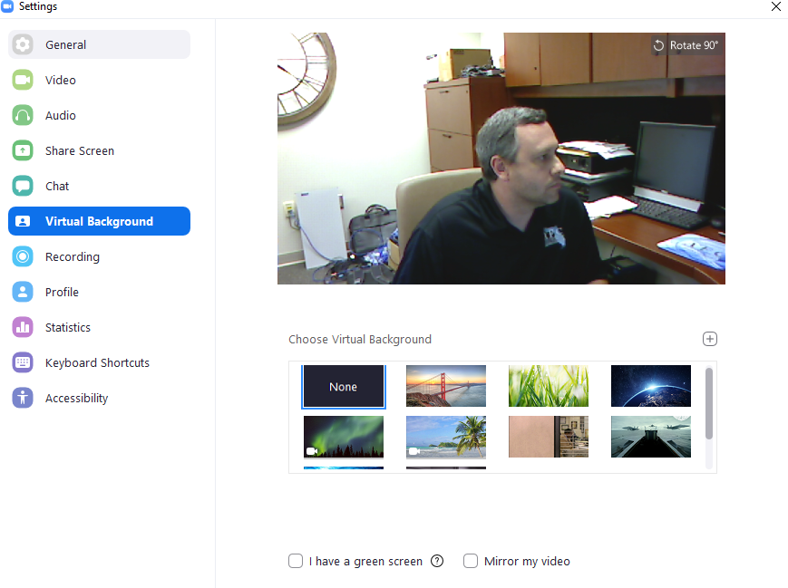

Slide 26
Bonus: Advanced Tips

Slide 27
Keyboard Shortcuts
Settings > Keyboard Shortcuts and select “Enable Global Shortcut.”
Quick Invite – Mac: ⌘Cmd+I PC: Alt+I
Start Recording Meeting – Mac: ⌘Cmd+Shift+R PC: Alt+R
Pause/Resume Recording – Mac: ⌘Cmd+Shift+P PC: Alt+P
Start Screen Sharing – Mac: ⌘Cmd+Shift+S PC: Alt+Shift+S
Pause/Resume Screen Sharing – Mac: ⌘Cmd+Shift+T PC: Alt+T
Mute Audio – Mac: ⌘Cmd+Shift+A PC: Alt+A
Turn Off Video – Mac: ⌘Cmd+Shift+V PC: Alt+V
Mute Everyone – Mac: ⌘Cmd+Ctrl+M PC: Alt+M

Slide 28
SnapCamera
Free
Allows crazy overlays

Slide 29
Zoom Resources
Best Practices for Securing Your Zoom Meetings
Best Practices for Securing Your Virtual Classroom
https://snapcamera.snapchat.com/

Slide 30
Questions? Other Tips and Tricks?

