Slide 1

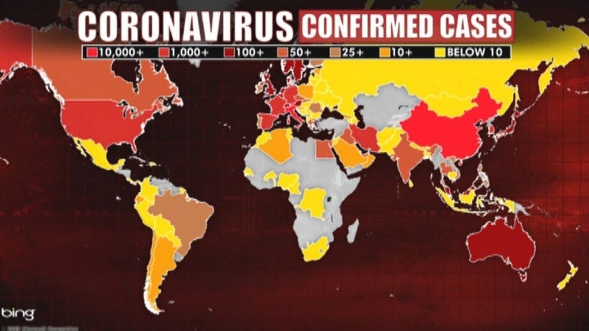

Maintaining Mental Health and managing anxiety DURING A GLOBAL PANDEMIC
May 27, 2020
Dr. Douglass A. Lobo
Sophrosyne (σωφροσύνη)

Slide 2

AGENDA
Keys and tips to maintain mental health balance
Strategies to improve anxiety management
Online resources for staff and students
The importance of human interactions, relationships, and kindness
The power of positivity in difficult times
Opportunity to ask questions

Slide 3


Slide 4

Best Ways To Persuade People That What You Are Saying Has Validity
Show them the data
Share a meaningful/impactful/powerful story with them that illustrates the point
Have them experience it

Slide 5
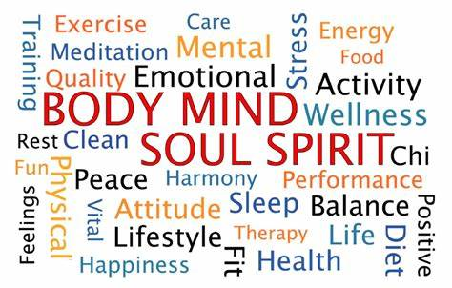

What is Mental Health?
Mental health includes our emotional,
psychological, and social well-being. It affects
how we think, feel, and act. It also helps
determine how we handle stress, relate to
others, and make choices.
MentalHealth.Gov, 2020

Slide 6
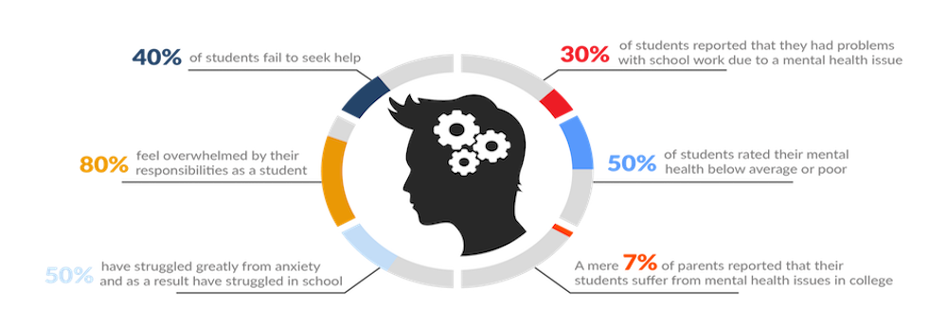
Mental Health Issues that Face College Students
COLLEGESTATS.org, 2018

Slide 7
According to the World Health Organization what percentage of first-year college students struggle with a mental illness?
35%
Auerbach et al., 2018

Slide 8

What are the top two reasons that a college student seeks out a counselor on a college campus?
They are:
Anxiety
Depression
However, there is some disagreement on which one is first:
Depression: 21.2%
Anxiety: 18.6% (1)
Anxiety: 24.1%
Depression: 18.6% (2)
Auerbach et al., 2018
Center for Collegiate Mental Health, 2017

Slide 9
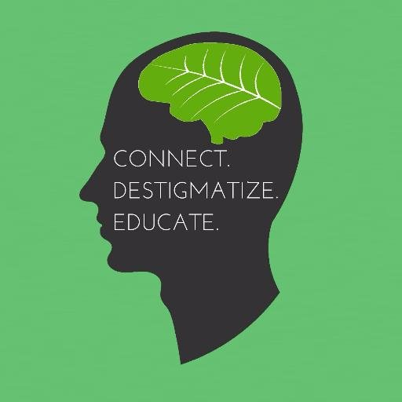
What are some Reasons that you might Seek out a Counselor on a College Campus?

Slide 10
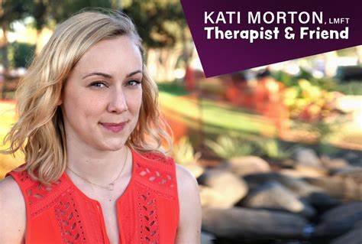
YouTube Helpful Videos on Depression and Anxiety
The Six Must Know Signs of Depression:
https://binged.it/2Zd76rs
Five Easy Tips to Beat Anxiety
https://binged.it/30cmBxe

Slide 11
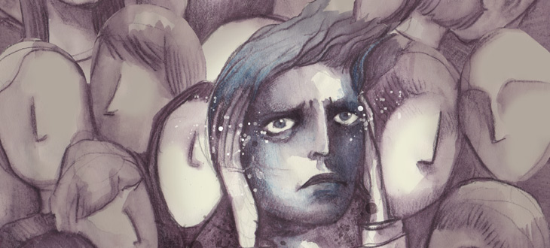
WHAT IS ANXIETY?
Anxiety is an emotion characterized by feelings of tension, worried thoughts and physical changes like increased blood pressure.
People with anxiety may have recurring intrusive thoughts or concerns. They may avoid certain situations out of worry. They may also have physical symptoms such as sweating, trembling, dizziness or a rapid heartbeat.
Adapted from the Encyclopedia of Psychology

Slide 12
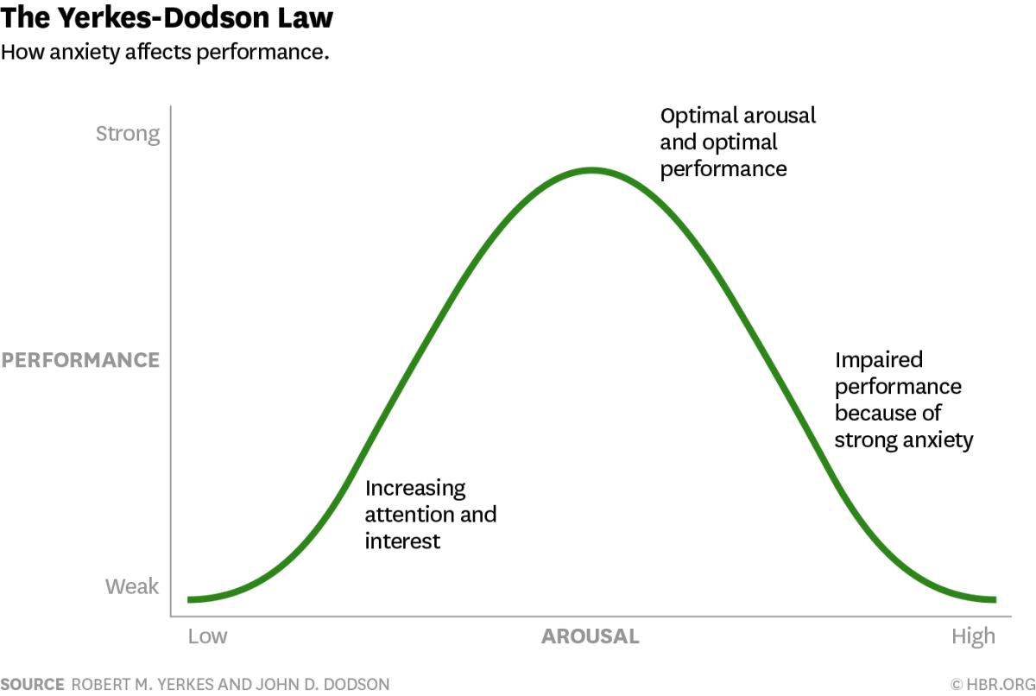
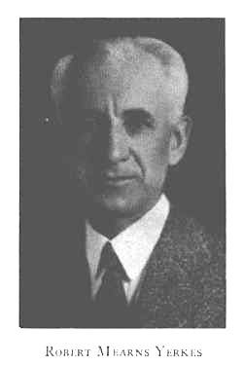
Yerkes-Dodson Law: Performance Anxiety Curve
.

Slide 13
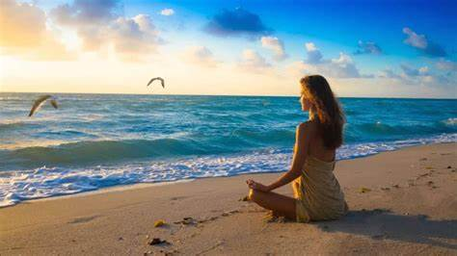
What are some ways to reduce anxiety/stress?
Get Enough Sleep
Eat Well
Exercise
Avoid Unnatural Energy Boosters
Get Emotional Support
Don’t Give Up Your Passions
Try Not To Overload Yourself
Avoid Relaxing With Alcohol
Breathe
Establish A Routine
Read
Journal Writing

Slide 14
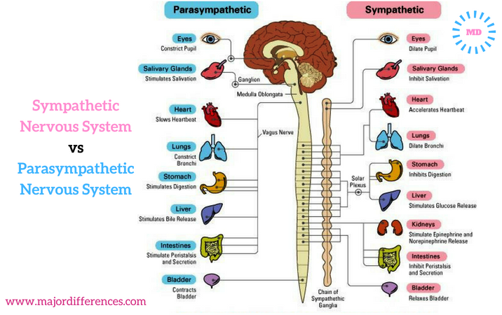
THE BIOLOGY OF ANXIETY
Sympathetic nervous system functions to mobilize the body’s “fight-or-flight” response
Parasympathetic nervous system functions to control the homeostasis (calming) of the body.
They are antagonistic: when one is working the other isn’t.

Slide 15

THE IMPORTANCE OF BREATHING
Deep breaths engage the parasympathetic (calming) nervous system.
Take four deep breaths.

Slide 16
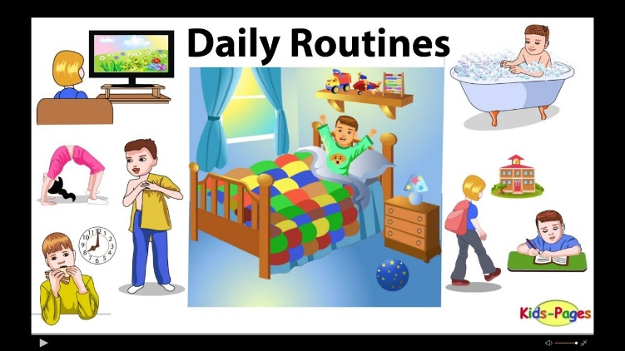
Routine and Structure are Extremely important in Maintaining Mental Health
Wake up and go to sleep at the same time every day
Get enough sleep (at least seven hours each day)
Drink plenty of water
Exercise for at least 30 minutes every day
Eat healthy
Practice Mindfulness Meditation (more on that later)
Make positive self-statements (at least five each day)

Slide 17

Five Minute Quick Anxiety Reduction – Guided Mindfulness Meditation
https://www.youtube.com/watch?v=MR57rug8NsM

Slide 18
Example of Sophrosyne (Life-Balance) Worksheet
Actions/Feelings | Saturday 5/4/19 | Sunday 5/5/19 | Monday 5/6/19 | Tuesday 5/7/19 | Wednesday 5/8/19 | Thursday 5/9/19 | Friday 5/10/19
Mindfulness/Meditation At least one (1) time per day
Exercise At least 30 minutes a day
Positive self-talk At least five (5) times a day
Eating healthy At least 50% (percent of meals)
Sleeping Well (at least seven hours a day)
Feeling sad
Feeling anxious
Put one (1) tally mark each time you engage in that activity during the day. The idea is to obtain balance in your life (Sophrosyne). When feeling sad or anxious place a tally mark, and try to do one of the above activities (Mindfulness/Meditation, Exercise, Positive self-talk, or Practicing what your “Best self” would do).

Slide 19
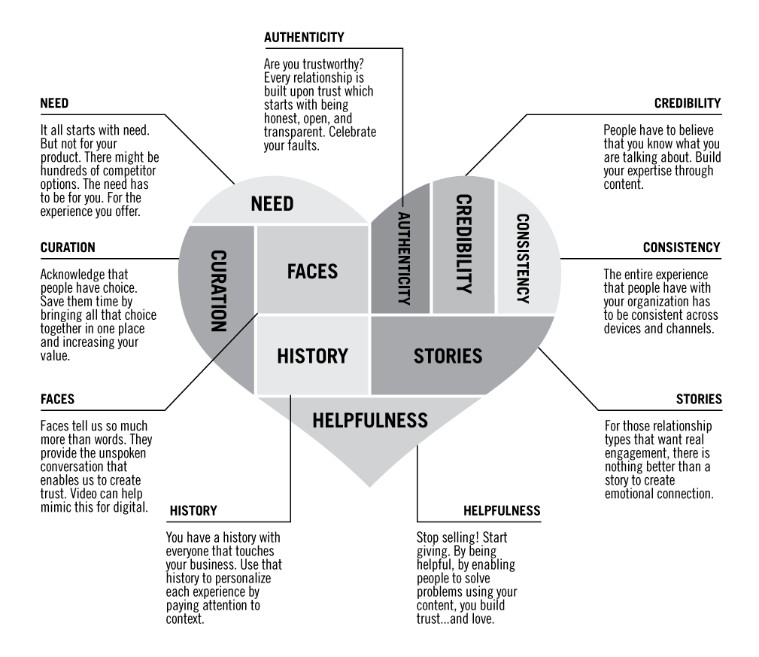
The Power of Relationships

Slide 20
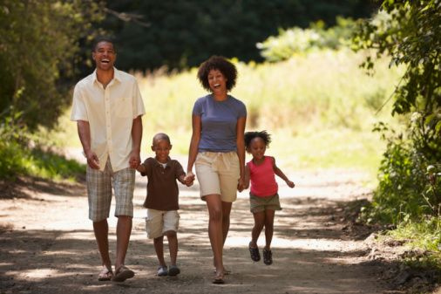
The Power of Relationships: FAMILY

Slide 21

The Power of Relationships: BUSINESS

Slide 22
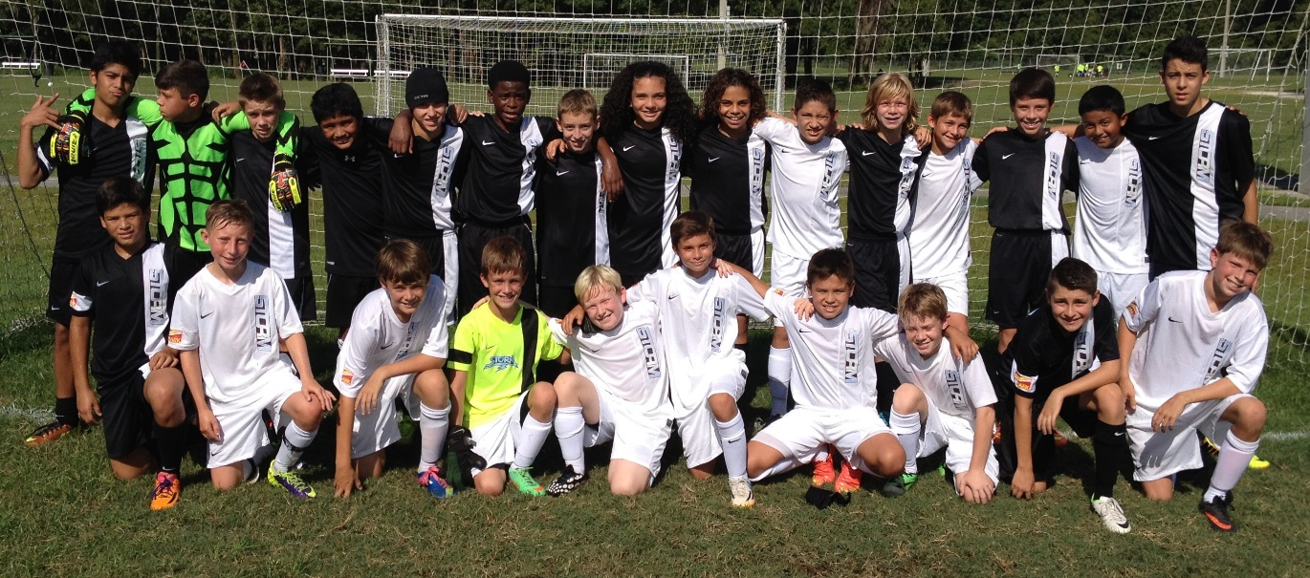
The Power of Relationships: SPORTS

Slide 23

The Power of Relationships: EDUCATION

Slide 24
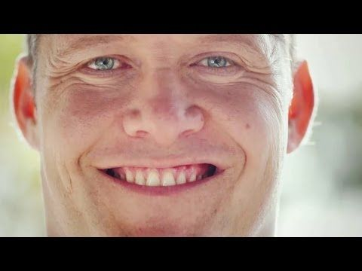
Chris the Farmer Video
https://binged.it/2Z1l3ZN

Slide 25
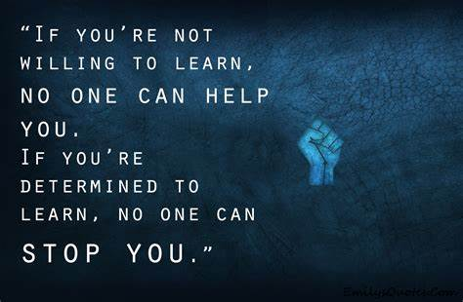
The Power of the 3Ps
Patience
Persistence
Positivity

Slide 26
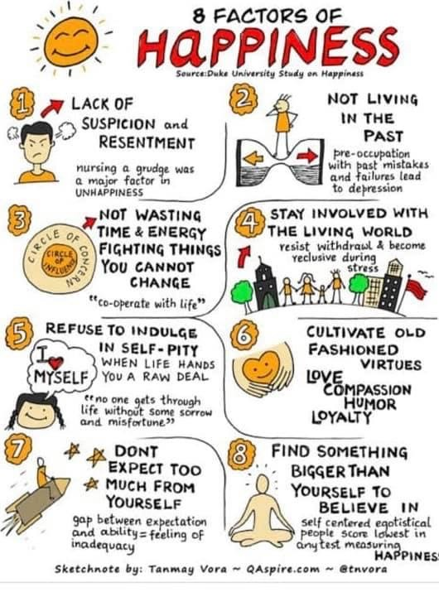
Contact Information: (douglasslobo@sjrstate.edu)
Doug Lobo, Ed.D., LMHC
douglasslobo@sjrstate.edu

Slide 27

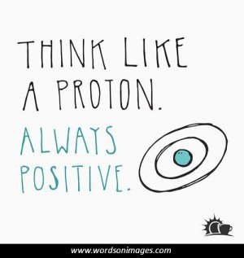
Questions, Comments, Feedback
And remember:

