Slide 1
MAKING TIME WORK FOR YOU!
Charlene Latimer
CPEC/Region III Webinar
May 28, 2020
This Photo by Unknown Author is licensed under CC BY-SA

Slide 2
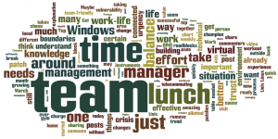

Slide 3
Time/life management
Effective time management is an age old issue even in the best of circumstances.
COVID-19 has presented new challenges as we attempt to manage professional and personal life in a remote world.
Speaker Rory Vaden stated that typical time management strategies will no longer work – Time Management is now emotional.
We need to re-think and re-design how we manage our lives!
Top Ten Practical strategies for working remotely.
“When we are no longer able to change a situation…we are challenged to change ourselves.” Viktor Frankl

Slide 4
This Photo by Unknown Author is licensed under CC BY-SA-NC

Slide 5
I’m Late! I’m Late! For a very important date. Alice in wonderland
Top ten strategies for managing ourselves with the time we have!

Slide 6
Working at home - What does your space look like?
A
B
This Photo by Unknown Author is licensed under CC BY

Slide 7
10 - Home/work environment
Creating a physical space
Away from the main household traffic (if possible)
Make it comfortable – good lighting, proper tools, keep it clean
Be “dressed” for work
Make sure family respects your work time
Take short breaks & lunch
“leave” work on time – don’t be a workaholic
Home network is up to speed and secure

Slide 8
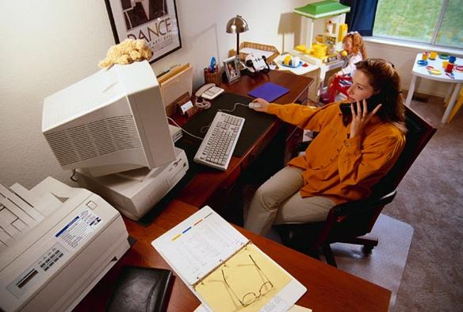
This Photo by Unknown Author is licensed under CC BY

Slide 9
9 - communication
Professional and respectful
Watch the facial expressions,
what are you wearing
Vary the format – lessen “zoom fatigue”
Email
Phone
Video conferencing (skype, zoom, webex, etc.)
Keep it real – let others know you are at home (there may be noise)
Keep schedule up to date – let others know your availability

Slide 10
8 -Beyond juggling - balance Five Rebalancing strategies
Alternating – I want to have it all, but just not all at once.
outsourcing – I want to have it all, not do it all.
Bundling – I want to get more mileage out of the things I do by combining activities.
Techflexing – I want to use technology to accomplish more, not be a slave to it.
Simplifying – I don’t want it all.
Focus on College success; constance staley

Slide 11
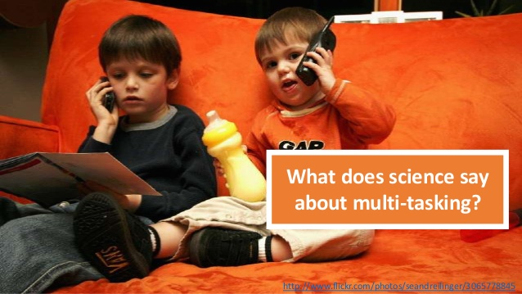
7 - Just say No
To – Multi - tasking instead “single task it”
“Be like a stamp and stick to one thing until it delivers” delatorro mcneal
This Photo by Unknown Author is licensed under CC BY
Notes:
Multi-tasking is really switching back and forth between tasks. Research by Fox, Rosen and Crawford (2009) found that students who multitask take much longer to complete tasks.

Slide 12
6 - procrastination

Slide 13
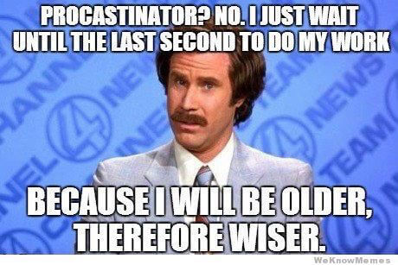
Procrastinate – who me?
What are some of the most common reasons we procrastinate?
Lack of motivation or interest
Fear – afraid to succeed or fail
Perfectionism
overwhelmed
Overcoming procrastination
Know your time wasters/distractions
Channel your energies into some other task
Chunking
Reward yourself
“just do it” or Not

Slide 14
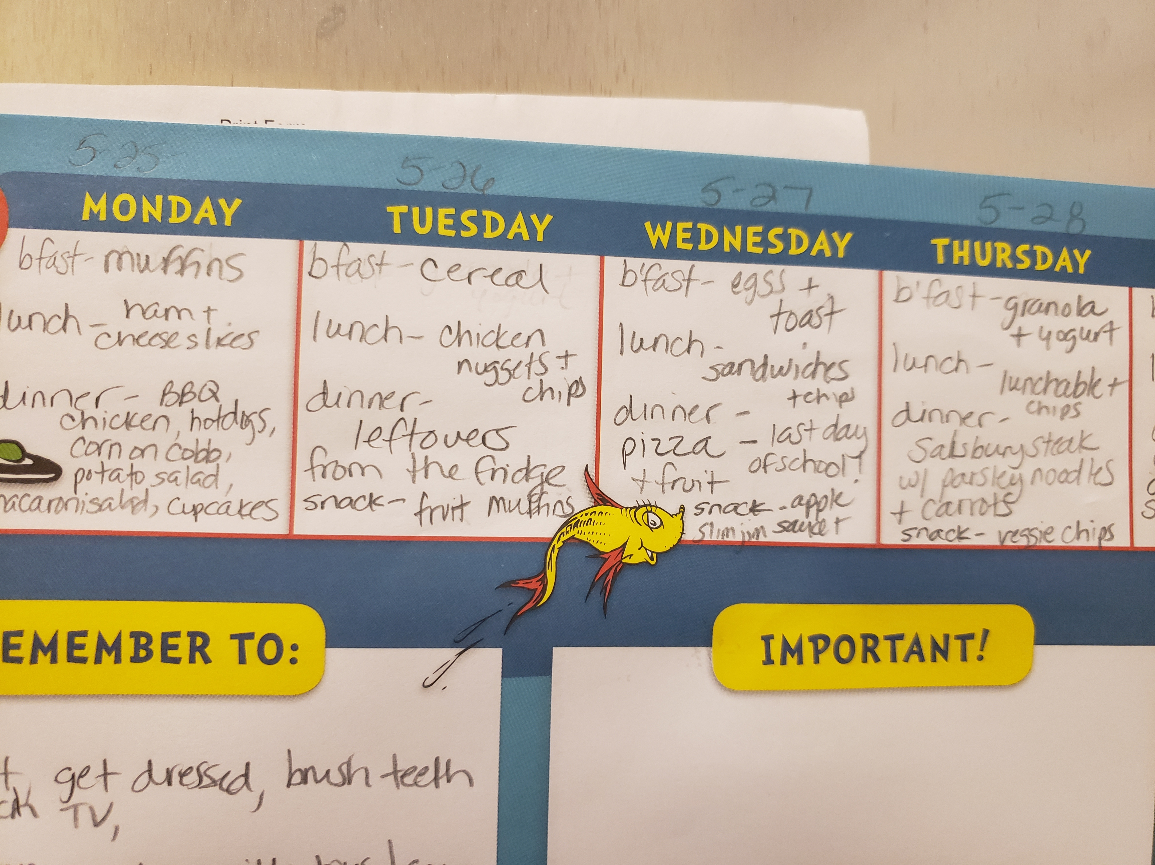
5 - Reducing time on household chores
Share the load – find out what tasks family like, then let them have the leadership of that task.
Rethink your appliances – Which ones are most efficient (microwave, convection oven, food processor, AIR Fryer, etc.).
If you delegate – reduce expectations on the level of quality and quantity.
Support local restaurant employees - order in once a week.
Guide to Feeling Good – the Allen group newsletter

Slide 15
4 - Learn to be FAB: flexible, adaptable, bendable. Dr. Rowland, TCC
Make small adjustments in your schedule
Don’t get lost in the details
Try not to be overwhelmed
Remember your motivation
Have a sense of humor
Remember the more important things/people
Notes:
Last week at the SDC – panel speaker

Slide 16
3 - Take a mini Break (and step away from the computer)
Mindful activities
Mindless but fun activities
Write a card, email to encourage someone
Power nap or do stretches
Sit on the lanai/porch and ponder life
Take a walk w/the dog, kids
Eat a healthy snack
Water the plants/kids/dog
Lead a family break or let each family member be in charge of a quick activity
Dance like no one is watching
Sing like you’re in the shower/car
Watch a quick youtube video
Put a load of laundry in the wash
Virtual coffee break with a co-worker or friend
Notes:
Mental and physical reset technique.

Slide 17
Just for laughs

Slide 18
Unplug and play
Suggestions from my DSC Colleagues
Family BOARD GAME NIGHT
Ride bikes together
Eating dinner outside
Putting kids in charge of an activity (designing an at home camp theme)
Start a garden (no yard start a kitchen garden)
Family hobby (Group Puzzle)
Notes:
To keep the work life balance make time to spend with your family.

Slide 19
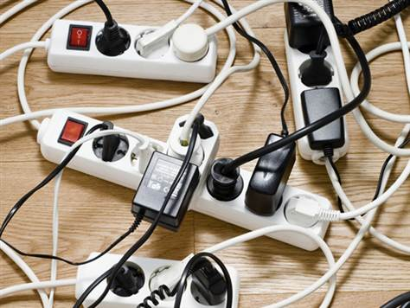
If you must be plugged in
Listen to podcasts – npr’s wow in the world
Fun, family movie
Zoom time with family & friends
This Photo by Unknown Author is licensed under CC BY-SA

Slide 20
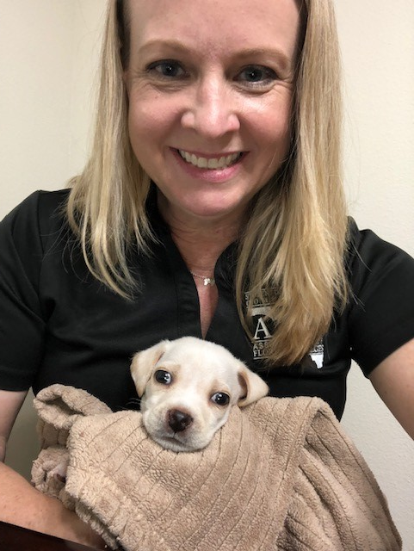
Make time for the furry friends
Notes:
Foster a pet. Spend more time with the pet you have.

Slide 21
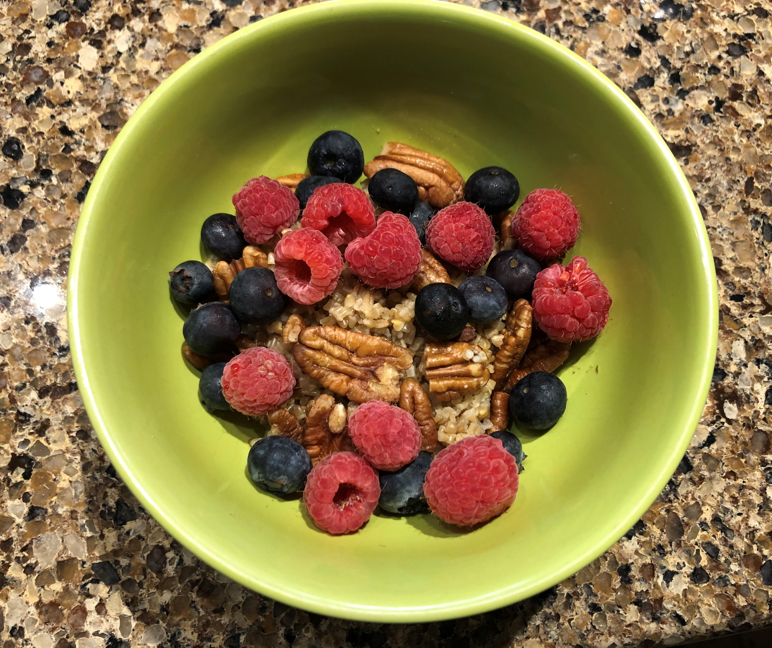
2 - Staying healthy (you can’t perform well if your body/brain are on “E”)
Eating
Breakfast – to kick start the day
Prepare foods in advance (family prepare together, snack area for children)
Rethink your drink – stay hydrated with water!
Working out
Dance party w/karaoke
Typical 30 minutes – three days a week
Chair exercises, walk in place, stretches
Sleeping
Have a sleep routine
Reduce your technology 1 hour before going to bed, put timer on tv

Slide 22
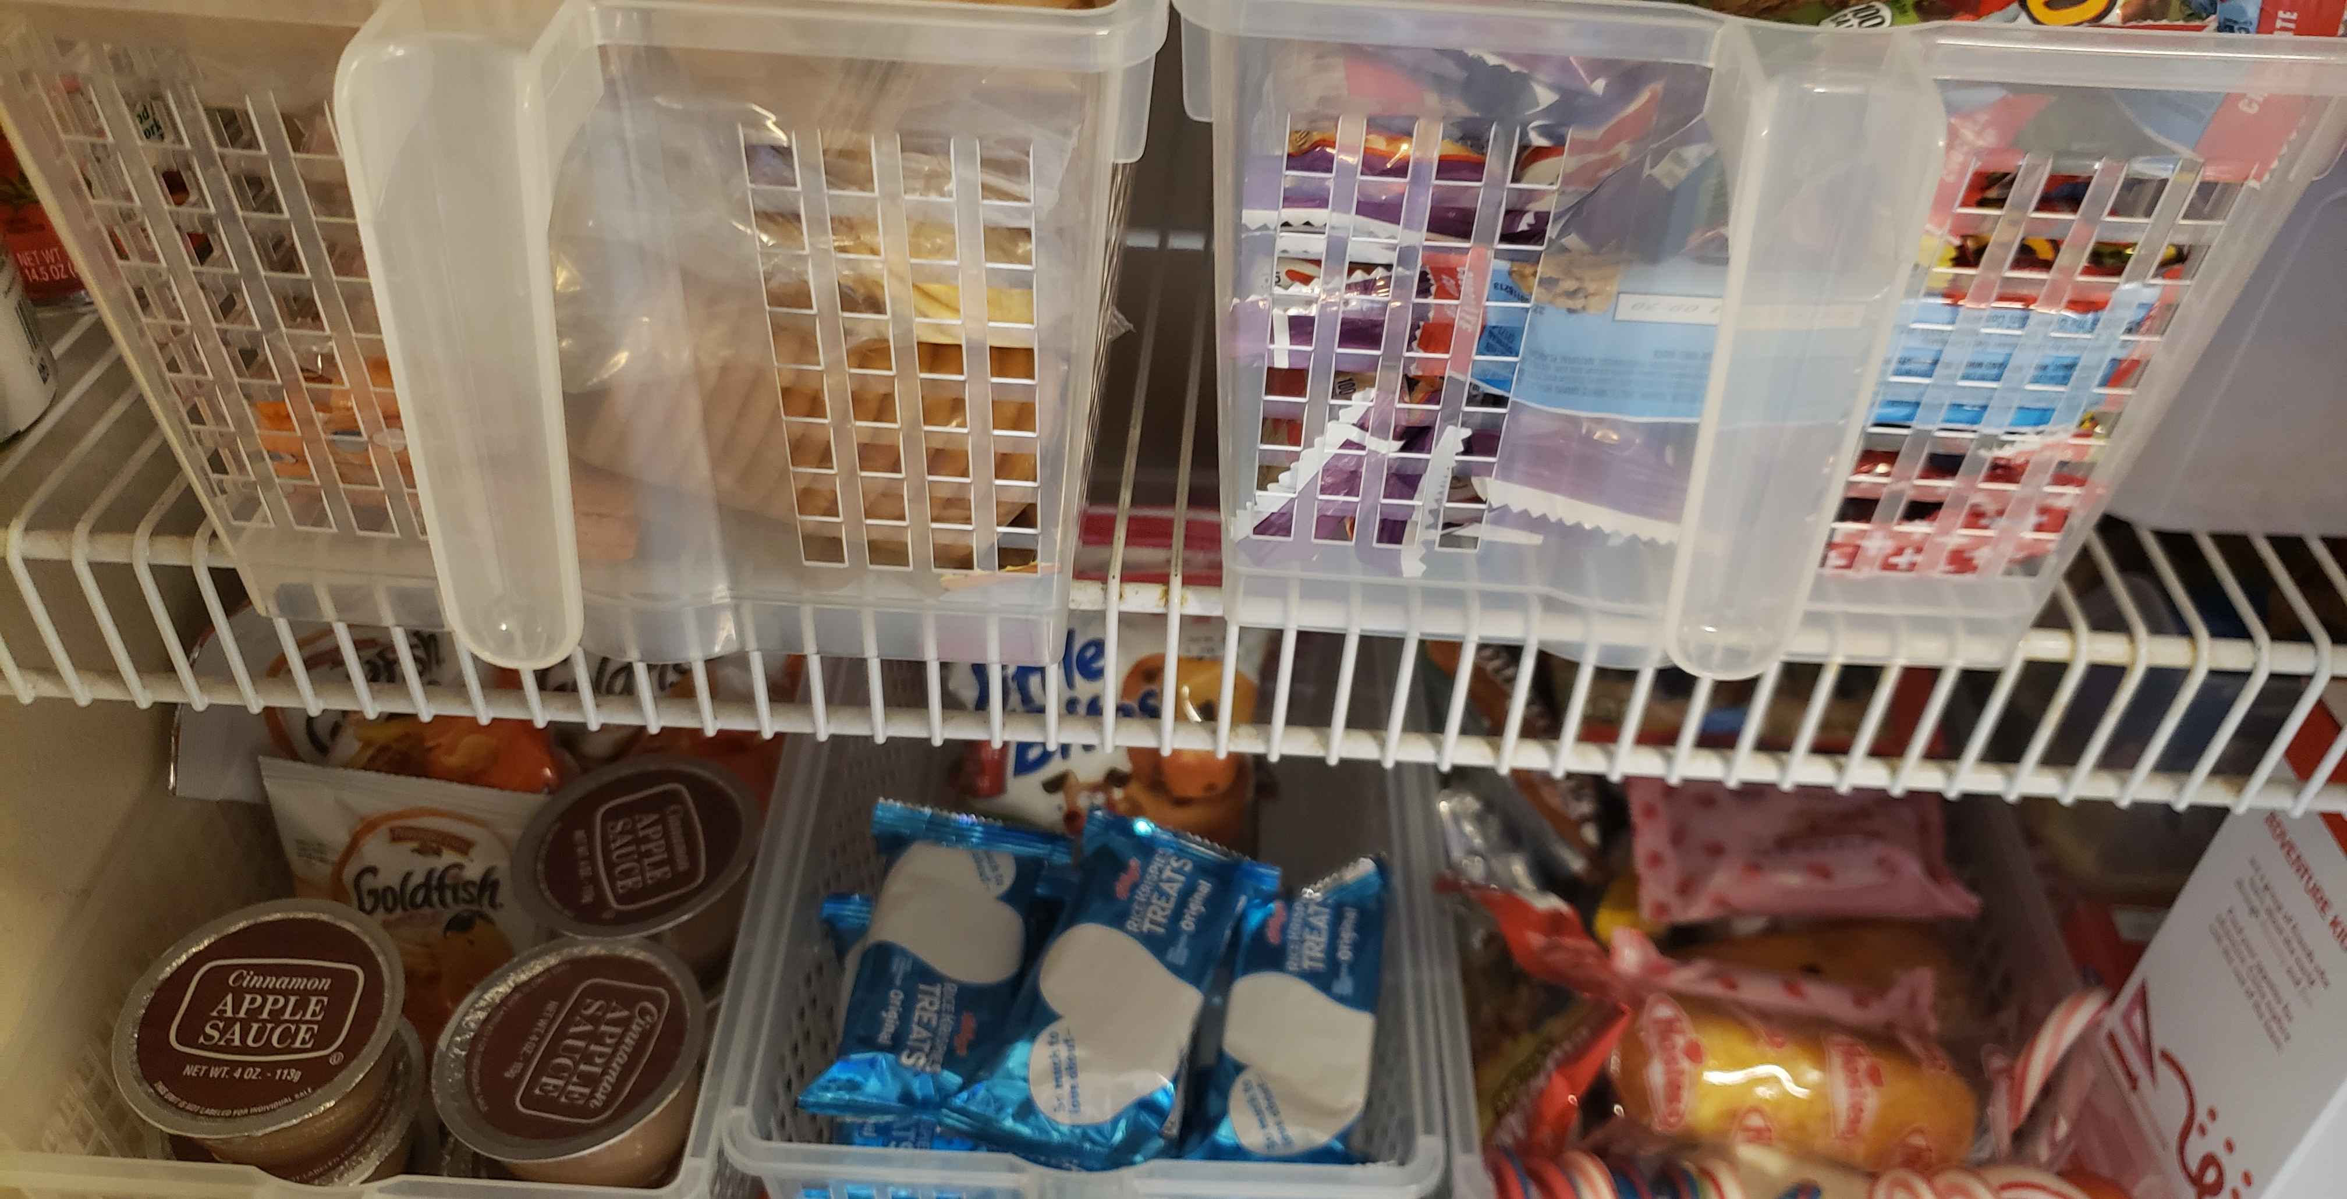

Slide 23
Schedule /routine
Schedule your work day – stick to it. Children should have a schedule also.
Know your work/family deadlines.
Set goals – with rewards.
Link your actions to goals.
Make small adjustments to schedule when necessary.

Slide 24
Classic Time Management strategies
The List
Easy to do
Feel a sense of accomplishment
Paper or electronic

Slide 25
Classic Time Management strategies

Slide 26
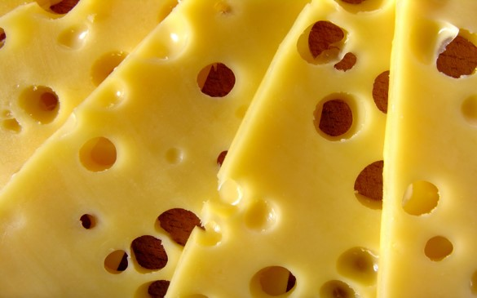
More ideas
The Swiss Cheese Approach
Whenever you find yourself with some free time, do a small part of a larger task
T

Slide 27
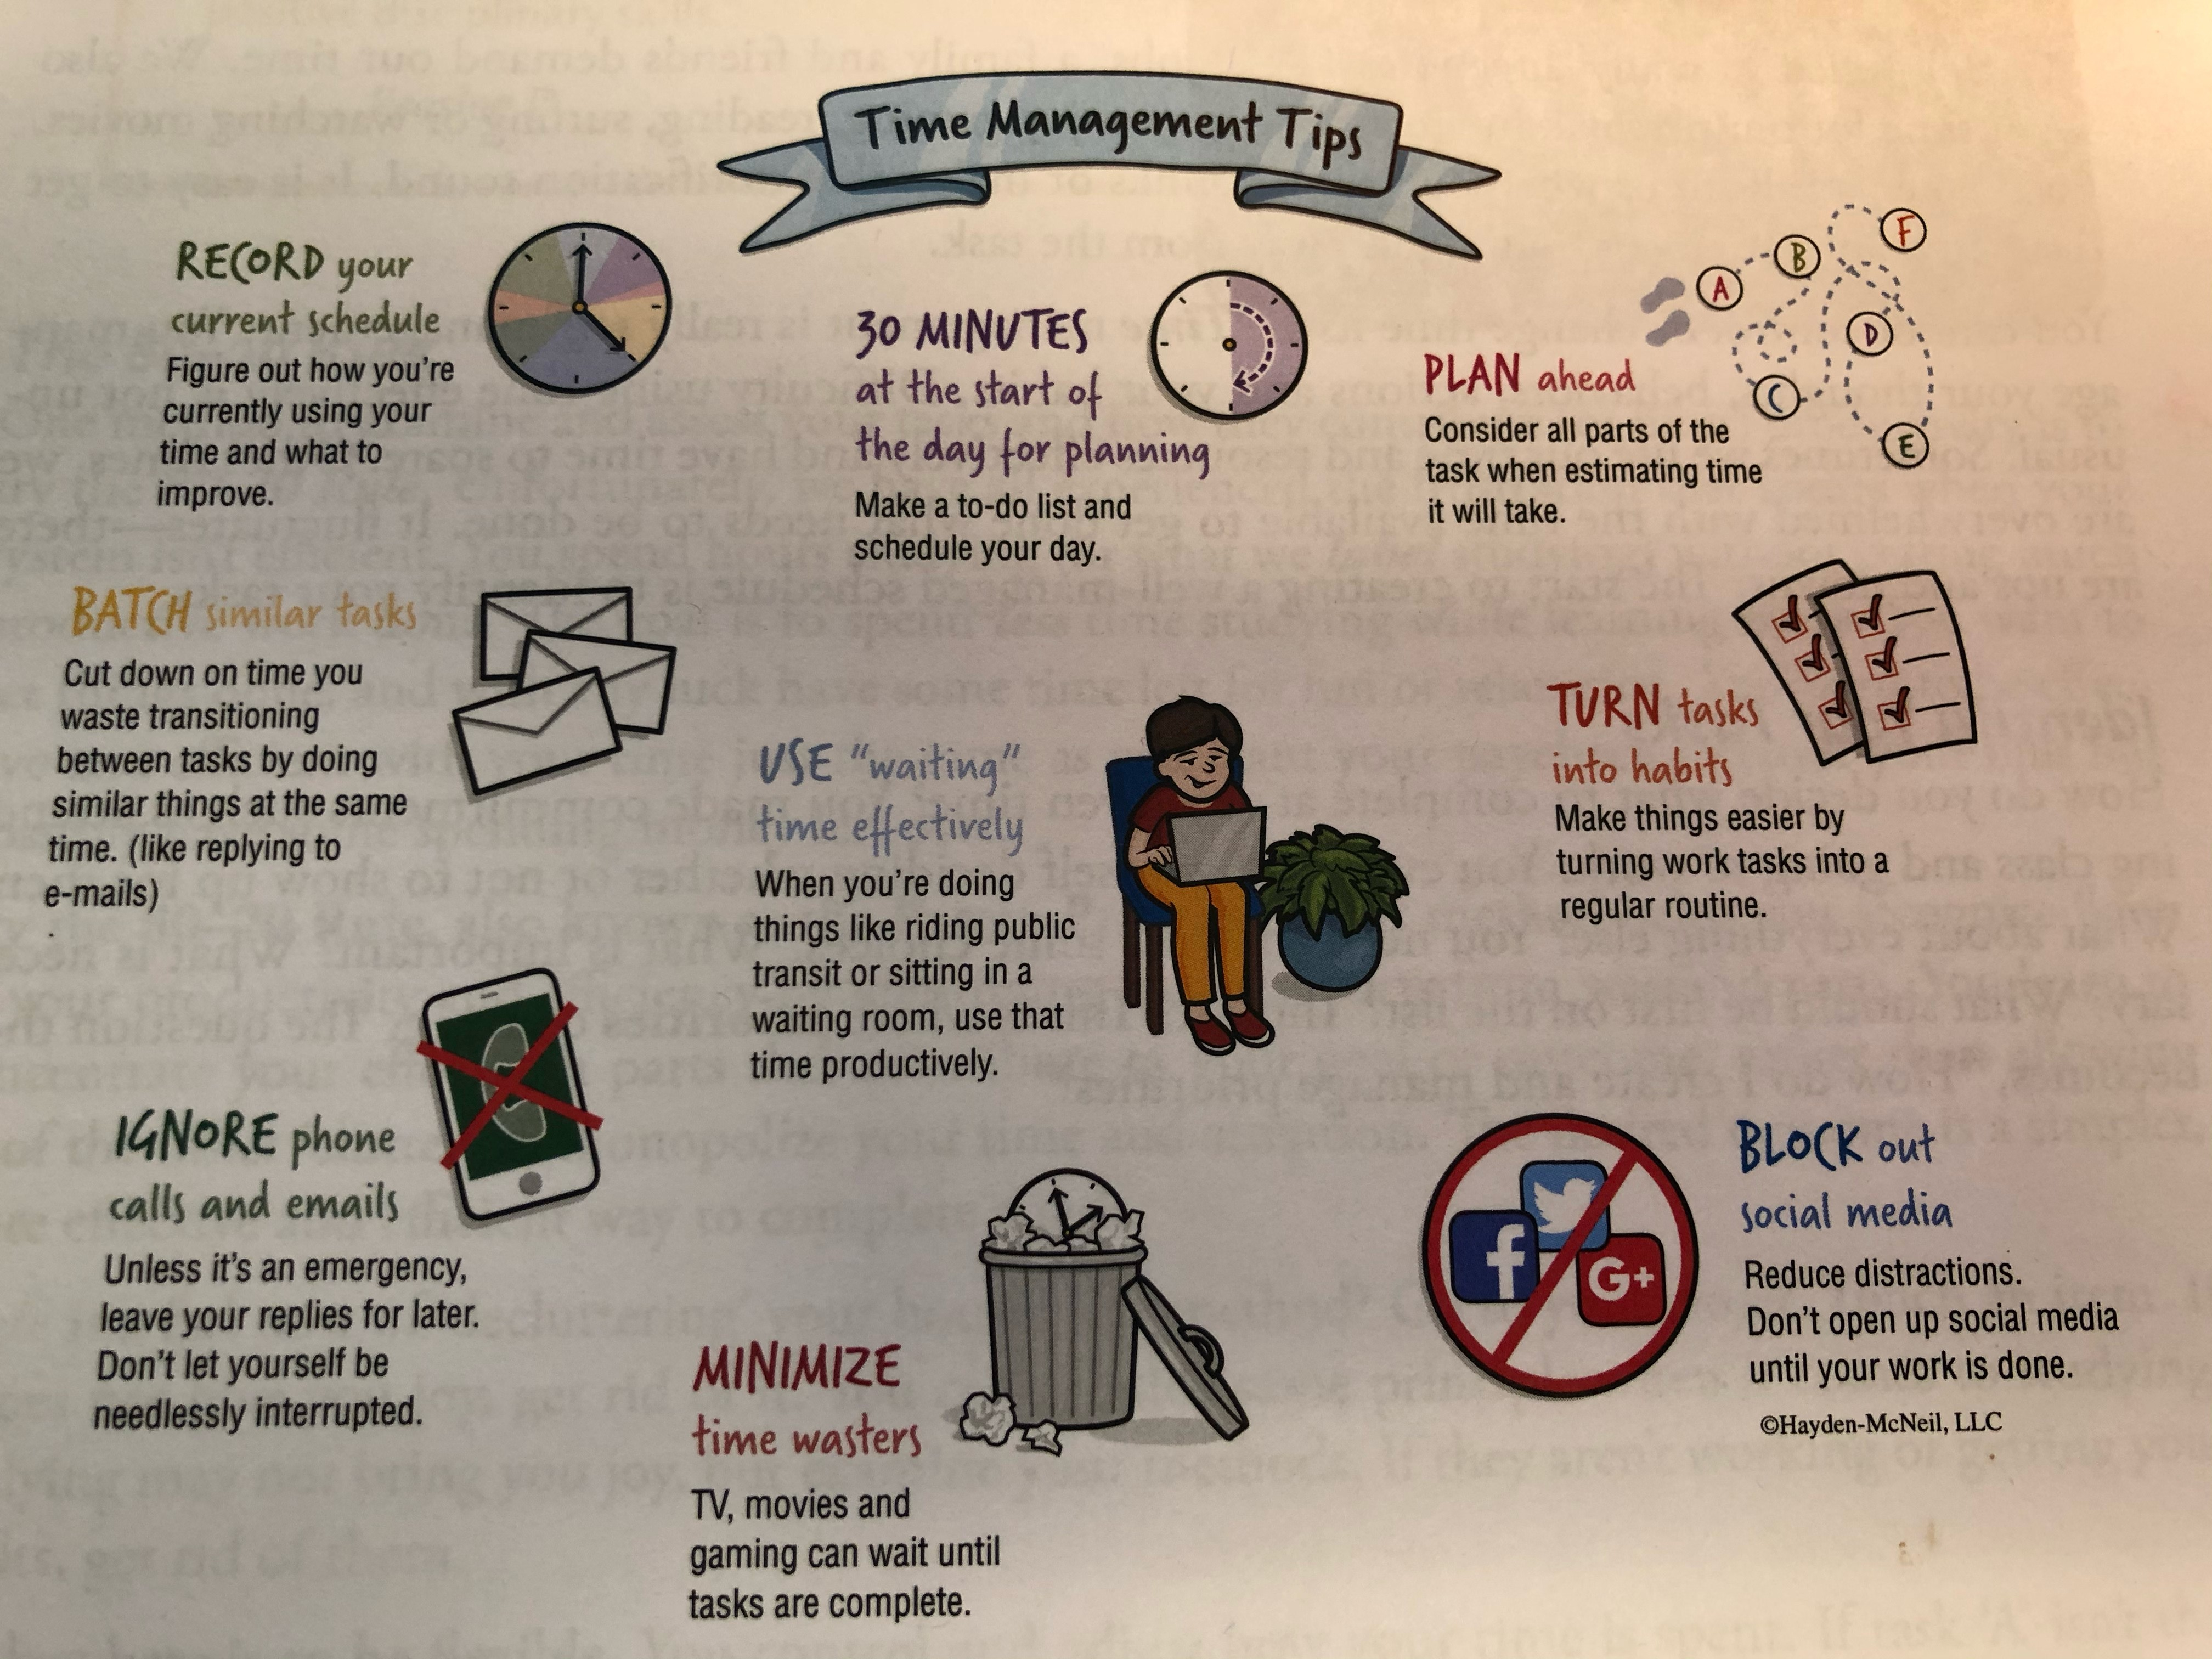

Slide 28
How to multiply your time
Notes:
When you have tasks you can do the three things listed.

Slide 29
references
Staley, c. (2015). Focus on college success, 4th ed. Boston, ma. Cengage. Page 130
Life Works – Morneau Shepell, introduction to Working remotely
Leonard, K. (2019). Empower yourself, 2nd ed. Plymouth, mi. Macmillan. Page 80
Harrison, c. (2013). Student success in college, 1st ed. Boston, Ma. Cengage. Page 95
https://youtu.be/OrCzpjqurdI Mom imitating kids
https://www.youtube.com/watch?v=GBM2k2zp-MQ 15 Strategies
https://www.youtube.com/watch?v=y2X7c9TUQJ8 How to Multiply Your Time
https://www.facebook.com/JimGaffigan/videos/594041711195828/

