Slide 3
It’s GRRATE!!
The Wide World of Science
The goal of this project is to increase the number of STEM technicians.

Slide 4
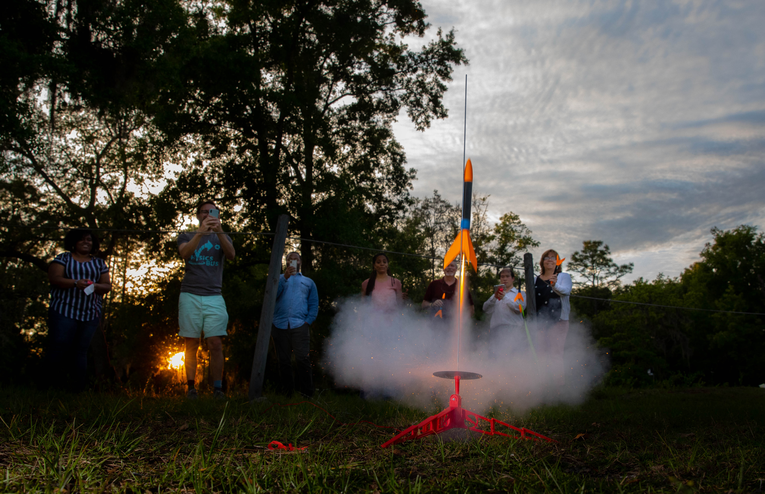
Program Description – ISC1006
Notes:
SFCOLLEGE.EDU/GRRATE Learn entry-level STEM skills through Robot, rocket, or guitar building! Students will apply science, technology, research, engineering, arts, and math skills while building any of the three projects. Class includes a field trip to NASA. This is a project-based course with three experiential learning project options: guitar building, robotics, and rocketry. Students will gain knowledge in the areas of Science, Technology, Research, Engineering, Arts and Mathematics while building a guitar, robot, or rocket. The course aims to emphasize collaboration with industry partners to expose students to careers available in STEM fields, and to connect students with industry so they obtain firsthand knowledge of requirements for developing a successful career.

Slide 5
GRRATE's online presence:
www.sfcollege.edu/grrate

Slide 6
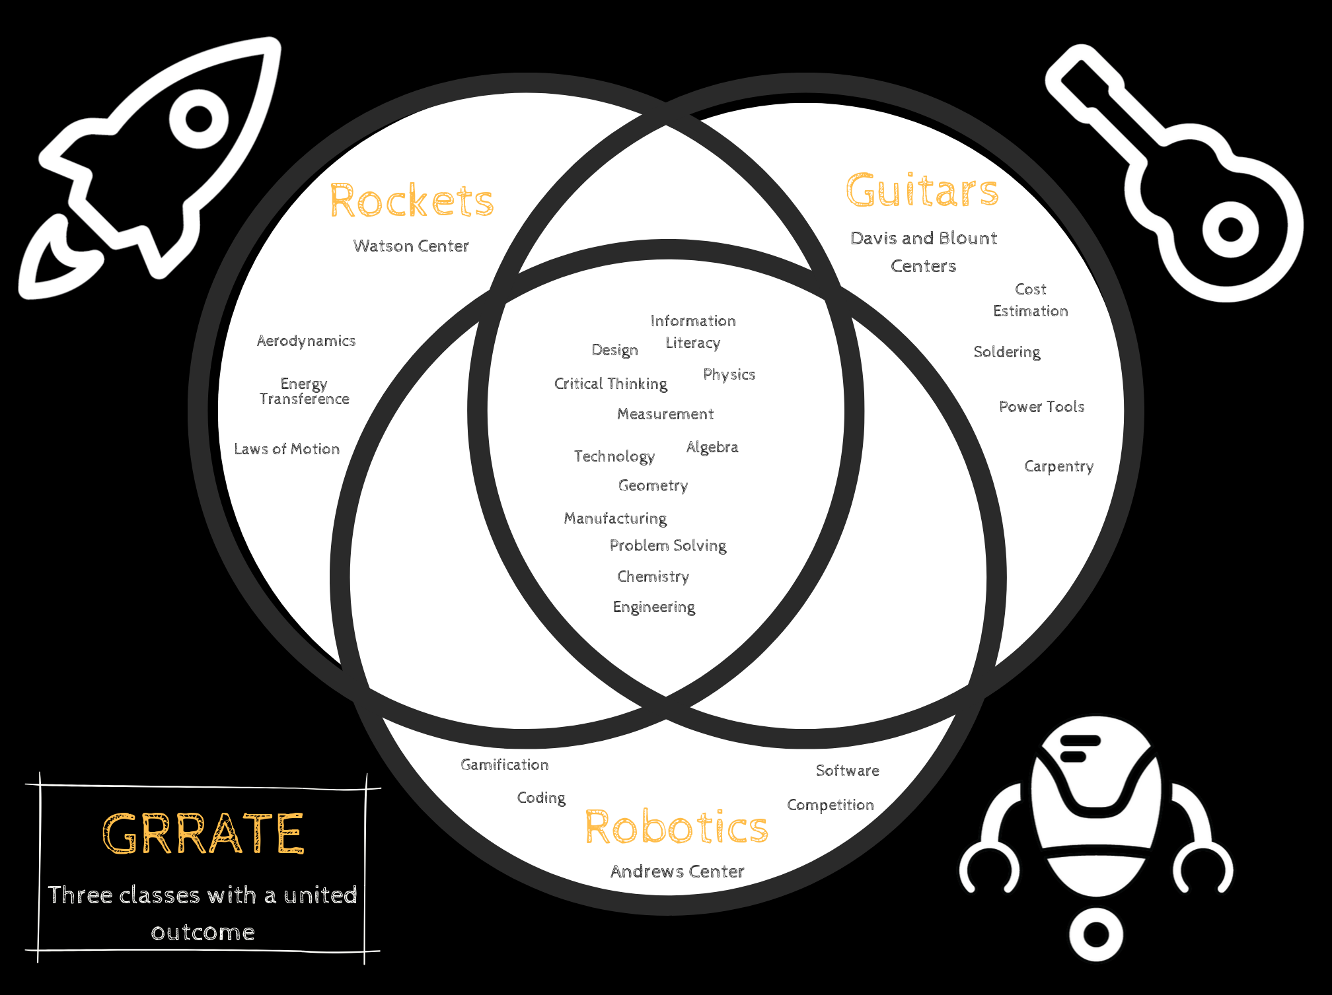
Notes:
As you can see from this diagram there are common skills across all three course sections which are being taught, but they each have a few skills specific to the project itself. For example, the Robotics course includes computer coding, the Rocketry portion teaches Aerodynamics, and the Guitar class exposes students to using hand tools and soldering.

Slide 7
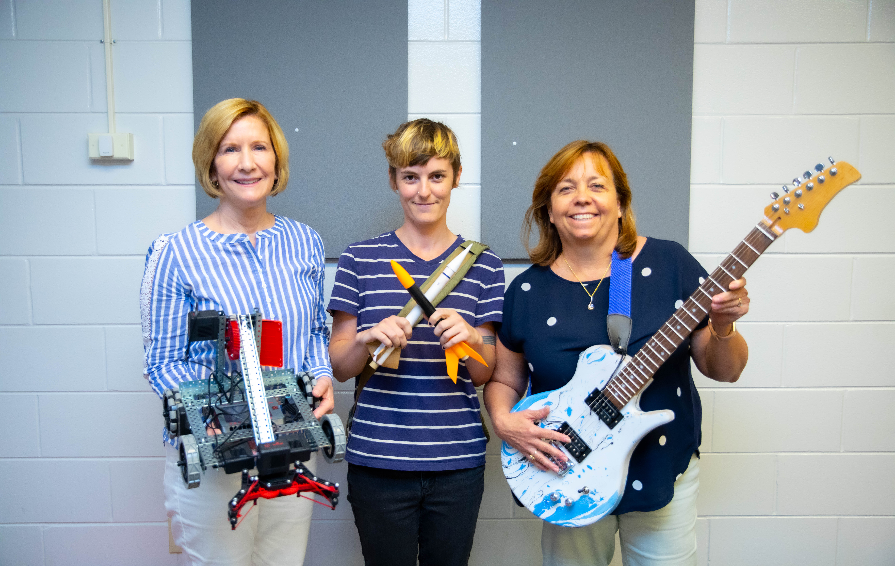
Grant Objective 1:
Create and implement a project-based research and analysis course with three interchangeable hands-on experiential learning options: guitar building, robotics, or rocketry.
Notes:
Through this grant a college credit course was created and is located at our rural campus locations. Each campus location's course has a different project, although they all are housed under one course number.
Create and implement a project –based research and analysis course with three interchangeable hands-on experiential learning options: guitar building, robotics, or rocketry

Slide 8
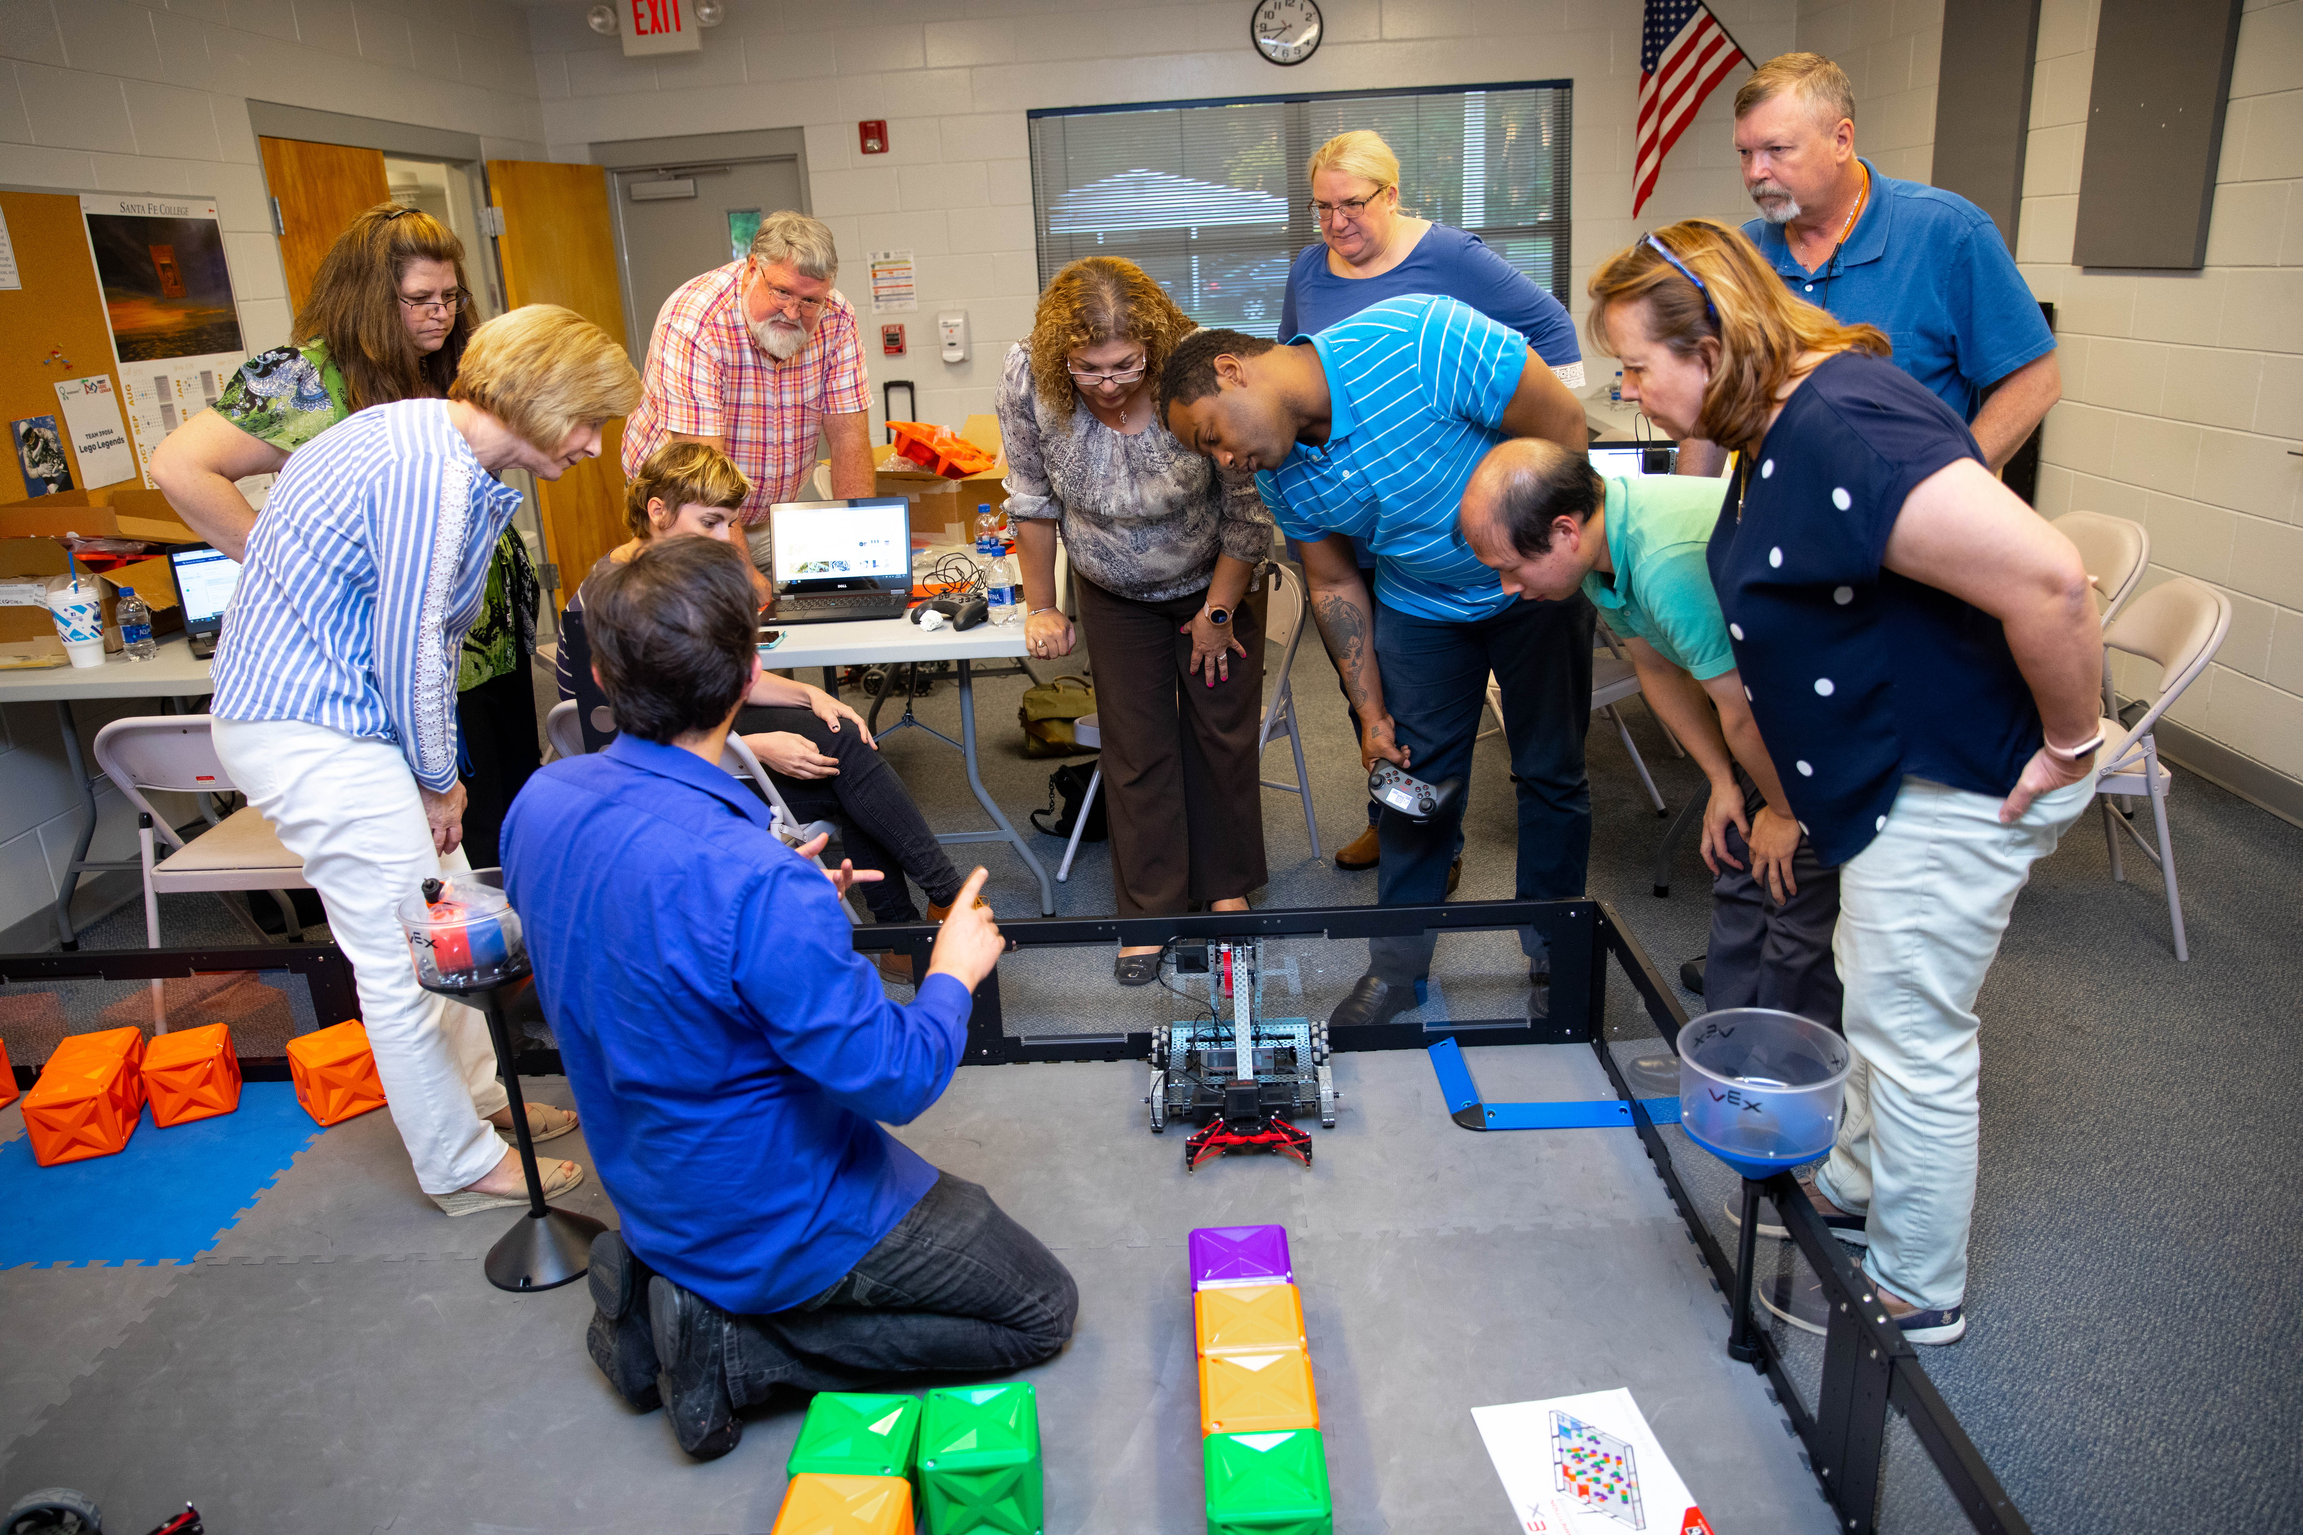
Grant Objective 2:
Provide faculty professional development to ensure consistent implementation of the pedagogy at three rural educational centers.
Notes:
We provided three extensive professional development courses for the grant team, interested faculty, community partners, interested staff at each of the centers in the spring of 2019. By inviting staff from the rural centers we were able to get buy-in to the project and to gather location specific feedback. We had the team from Guitarbuilding.org come and do a PD for over 40 hours for 11 participants. The robotics training was held over 4 evenings for a total of12 hours exposing participants to coding, robot building, competition skills, and more. The Rocketry training was a 12 hour program building rockets from kits along with making several types of handmade rockets. We launched water rockets, kit rockets, and hand built rockets to great success. Measurement was one of the STEM skills that was stressed in all of the professional development trainings.

Slide 9
Grant Objective 3:
Engage a minimum of three local businesses in development and implementation of career exploration presentations and / or videos.

Slide 10
Grant Objective 4:
4. Evaluate the change in STEM career attitudes and intentions of program participation through a pre- and post-test research study
https://miso.fi.ncsu.edu/articles/s-stem-survey

Slide 11
Key Challenges: Student Related
Engaging underrepresented students
Low enrollment
Marketing the class to diverse populations
Notes:
Solution: We have made interactive displays located near advisor's office in each of our rural locations. We will be going into our College Success Classes to explain the course and its objectives. We are making connections with high school guidance offices for their dual enrolled students and to create excitement for incoming freshman.
The Beta test was a summer camp for Upward Bound students over 8 days. We were able to see what worked and saw what didn’t work.
Engaging underrespresented students and capturing intended audience.

Slide 12
2019/Spring 2020 Demographics

Slide 13
Key Challenges: Faculty Related
Helping faculty understand inclusive teaching methodology
Aligning overarching goals in 3 disparate curricula
Challenging the status quo of course design while creating an interdisciplinary STEM-oriented course without prerequisites
Establishing the course as a part of SF’s curriculum
Notes:
1,2,3. Solution - Weekly meetings with faculty using video chats allows all faculty at each of our locations an opportunity to share techniques, classroom experiences, and pedagogy. We have introduced Growth Mindset teaching practices in these meetings which will help build self confidence in students 4. To establish the course took many months of a team of subject matter experts working with curriculum frameworks and then getting it approved by the college’s curriculum review committee and then approved for inclusion into our college’s catalog. This process was detailed and tedious, but the results allowed this course to get approved as a college elective which is fully financial aid fundable. This is a key component for our low income students allowing them to take this exploratory STEM course. STEM Guitar had a developed plan that we could adopt. VEX Robotics has a developed plan that we could adopt and “tweak” to use in the program. The Rocketry program had to be developed. All of the classes had some common core values to teach, so this gave some guidelines for developing all programs. (knowledge in the areas of Science, Technology, Research, Engineering, Arts and Mathematics; exposure to industries and STEM education)

Slide 14
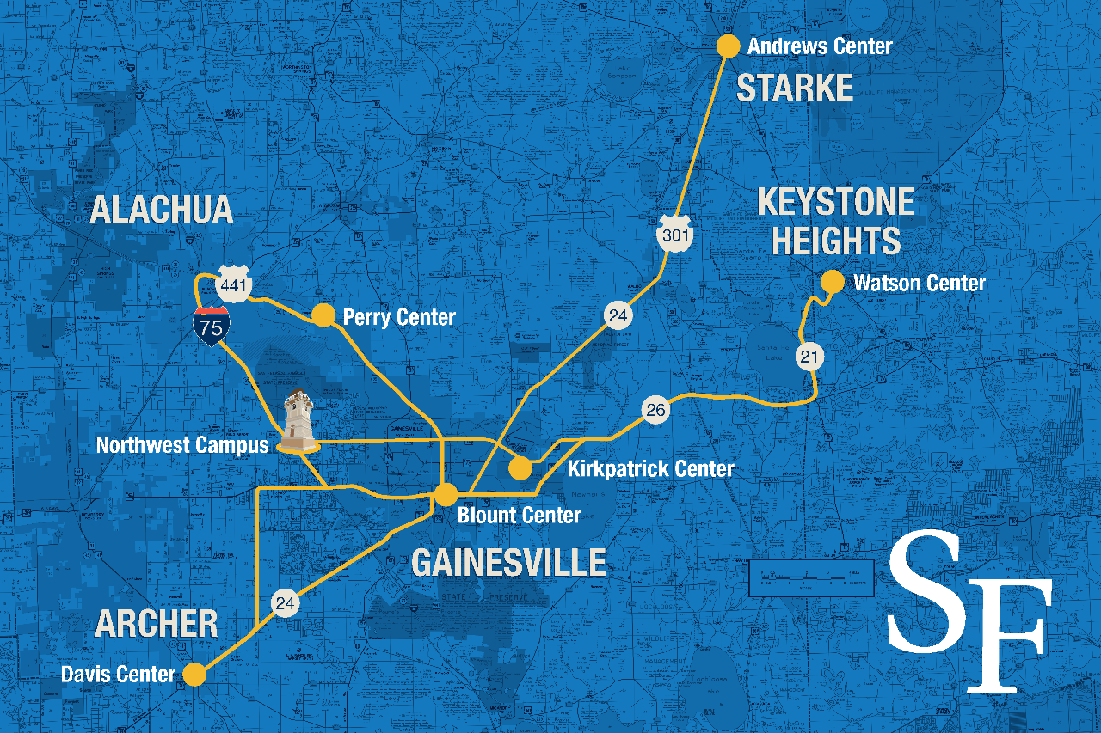
Key Challenges: Facilities Related
Using technology to organize unified program from 4 different centers in 4 different towns
Notes:
Solution: Creativity with locations, equipment, and then modifying curricula with space issues/limitations in mind. Learning what works best will be an ongoing opportunity for us to improve facilities, curriculum, learning outcomes
Solution: We use video conferencing for the Grant team weekly meetings, faculty weekly meetings, and the monthly steering committee meetings. This solution brings us all together easily which previously would have been difficult for all team members to get together due to the large distances between campus locations.
Our three locations in rural area are in the far reaches of our service district. The Andrews Center is located in rural Bradford County with a county population of 27,000 residents. The Watson Center is in Keystone Heights, FL with a population of 1500 and the Davis Center is in rural southwestern Alachua County with a population of just over 1000 residents.

Slide 15
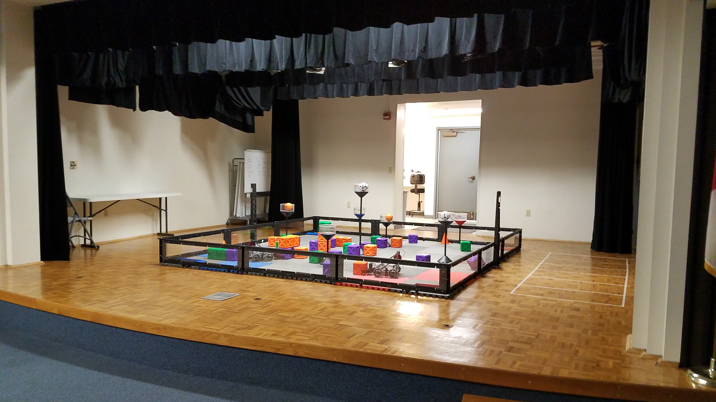
Adapting to and modifying the existing classroom space available at our rural centers.

Slide 16
Challenges: Administrative Related
Creating Professional Development classes for instructors
Finding qualified and available instructors
Getting the word out about the new class to campus partners
Notes:
Solution: Professional Development courses were offered to the ATE grant team and potential instructors. One week- 50 hours for STEM Guitar at the Blount Center; four days – 3 hours - 12 total hours for Rocketry at the Watson Center and the same time, 4 days/total 12 hours, for Robotics at the Andrews Center. All of the classes were filled with interested instructors.
Solution: Meeting with department chairs and presenting at department meetings to increase faculty participation
Solution: Presenting at Advising Team general meeting to share the course information with advisors at our main campus to attract students to the rural locations for these courses as they are ONLY offered at our remote locations.

Slide 17
Challenges: COVID-19
° How have we responded & adjusted?
Notes:
Online instruction
keeping students engaged
capturing results of the semester for research
proposed idea to finish guitars, have a rocket shoot

Slide 18
FUTURE PLANS
New instructor
Professional development trainings
Refining classroom space
Strengthening course curricula for online delivery
Recruitment for fall & spring semesters
Utilizing social media & web presence more
Future grant submissions
www.sfcollege.edu/grrate​
Notes:
We have added a section of this course at our downtown Gainesville campus location in order to attract more underrepresented students into STEM courses and potentially STEM careers.
new instructor
her background, involvement in community, minority status
strengthen online curriculum/presence for fall semester
new possibilities for future grants?

Slide 19
Notes:
interested in partnering?
interested in teaching this at your school? We have curriculum developed! Validated survey to use! Online modules and videos.
interested in any of our PDs?

Slide 20
Funding for this project has been made available through an Advanced Technical Education Foundation Grant through the National Science Foundation. Grant number: 1800955
This Photo by Unknown Author is licensed under CC BY-SA

