Slide 1
AFC Technology Commission &
Campus Safety Commission Presents:
Best Practices for
Working from Home Safely
Matthew White
Ron Kielty

Slide 2
Matthew White
Director of Distributed Systems
Chipola College
Ron Kielty
Interim Associate Vice President of Information Technology/ IT Manager/CIO
College of Central Florida

Slide 3
Internet Connection

Slide 4

Good, Stable Connection is Preferred

Slide 5

Internet Speeds
Suggested Min: 5 Mbps down
Upload speeds are much lower
Satellite internet has high latency – not good for phone calls, video meetings, gaming
https://www.speedtest.net/

Slide 6
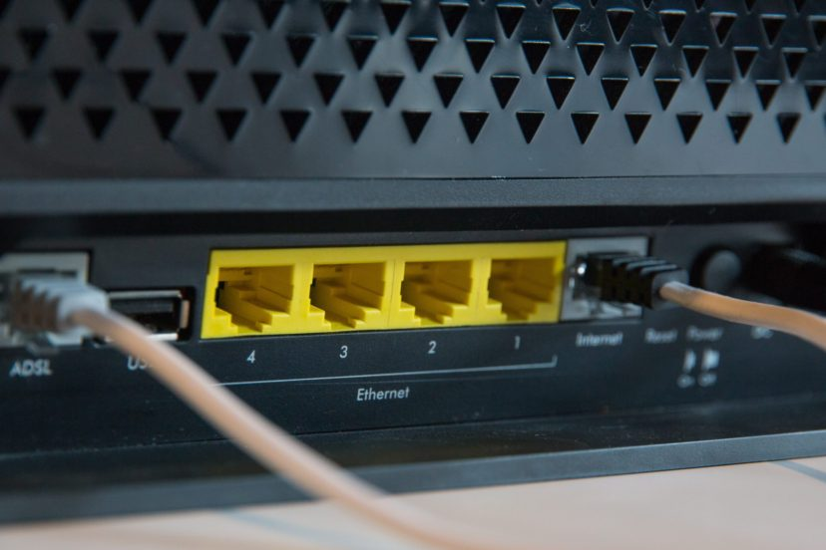
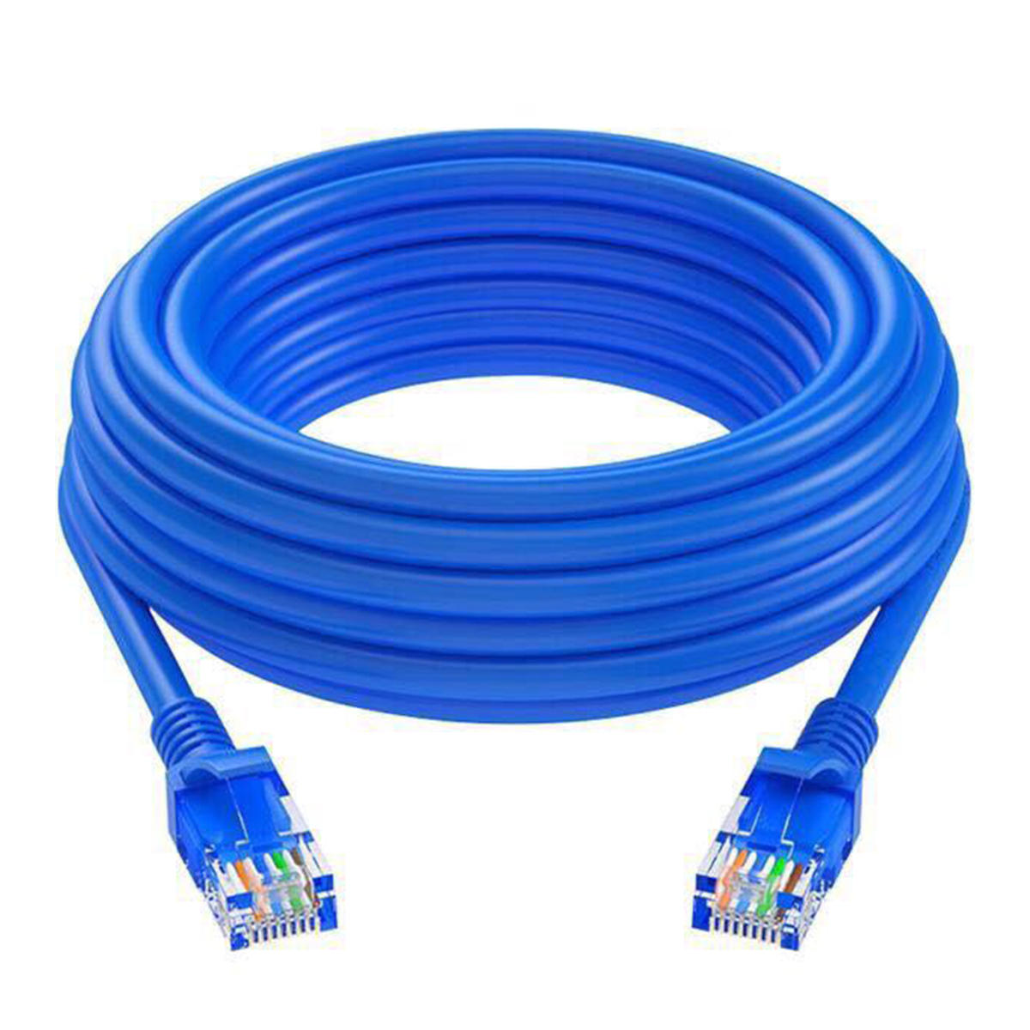
Wired vs Wireless
If you can wire your computer to your router, wire it!
CAT5, CAT5e, or CAT6 ethernet cable

Slide 7
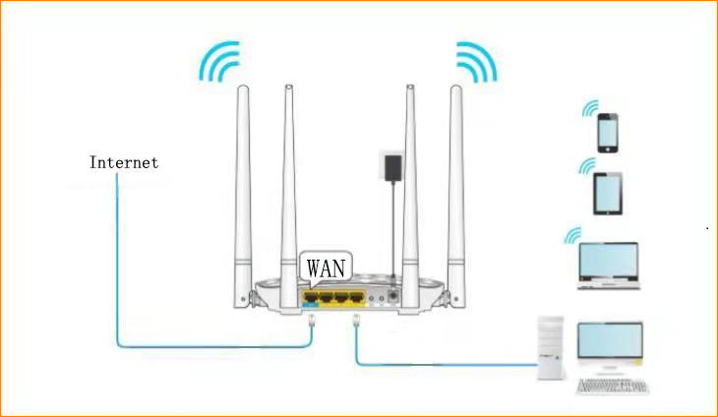
LAN

Slide 8
Wireless Security
Use WPA2-Personal or WPA2-PSK security (should be default)
Change admin password for wifi router from default (usually during setup)
Change wireless password from default (usually during setup)
Do NOT use open wireless (no pw to connect) unless you have VPN software

Slide 9
My Internet is Slow…
(Troubleshooting)

Slide 10
Where is the problem?
What devices do you have? Modem/wifi or modem and separate wifi router?
Run a test from speedtest.net, write down ping/down/up speeds. Are the results comparable to what you are paying for or normally get? If speedtest results are normal it could be the site you are going too.
Plug laptop or computer directly into internet modem/router with an ethernet cable. Run speedtest and compare to first results. If dramatically better, problem is in your wireless router or your wireless router is older and not fast enough.

Slide 11
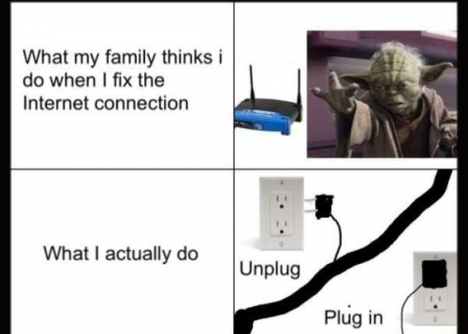
Wireless is slow or doesn’t work sometimes
If rebooting your wifi router fixes the problem, it’s time for a new one.
Wifi routers (not from ISP) usually last 3 years

Slide 12
Other Internet Troubleshooting
What other devices are using your internet? TVs, gaming consoles, security cameras, potentially neighbors
Login to the admin feature for your modem or wifi router and see what devices are connected
Change your wifi password to kick anybody off that may have hacked

Slide 13
Security – 10 Tips
Over to you Ron

Slide 14
Tip #1 - Lock your device before walking away

Slide 15
Tip #2 - Use corporate services for e-mail, messaging, and all other work

Slide 16
Tip #3 - Stay vigilant

Slide 17
Tip #4 - Keep Work Data on Work Computers

Slide 18
Tip #5 - Block the Sight Lines

Slide 19
Tip #6 - Encrypt Sensitive Data in Emails and on Your Device

Slide 20
Tip #7 - Lock Your Doors

Slide 21
Tip #8 - Never Leave Your Devices or Laptop in the Car

Slide 22
Tip #9 - Don’t Use Random Thumb Drives

Slide 23
Tip #10 - Use a USB Data Blocker when Charging Up at a Public Phone Charging Station.
https://www.amazon.com/PortaPow-3rd-Data-Blocker-Pack/dp/B00T0DW3F8/ref=sr_1_3?dchild=1&keywords=data+blocker&qid=1589292325&refinements=p_85%3A2470955011&rnid=2470954011&rps=1&s=electronics&sr=1-3

Slide 24
Bonus Tips

Slide 25

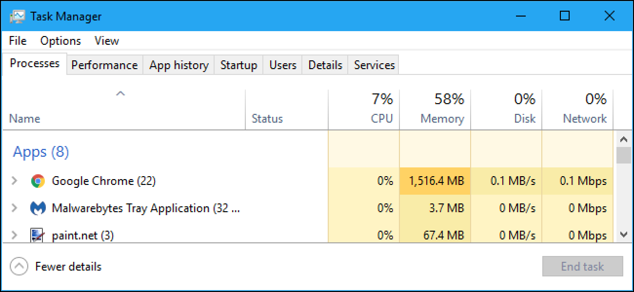
My Computer is Slow
Use Task Manager to see what’s using up your resources: Right click on the task bar at the bottom of your desktop, choose Task Manager
Demo

Slide 26
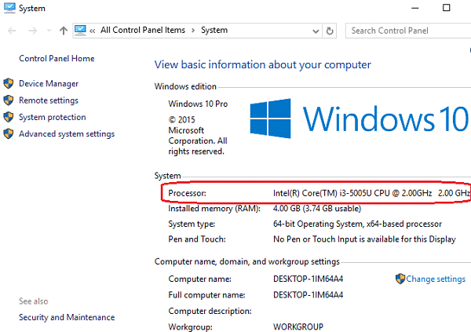
What are my computer specs?
Open Control Panel, Go to System
OS
Processor
Installed memory
System type

Slide 27
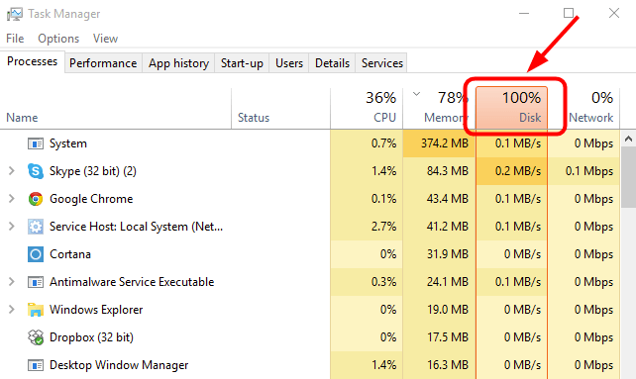
Disk Usage and Windows 10
Spinning hard drives struggle with Windows 10
5,400 or 7,200 RPM
Need Solid State Drive (SSD)
Cheap way to increase performance in older laptops

Slide 28
What specs for a new computer?
OS: Windows 10 version 1909/1903
Processor: Intel i3/i5/i7/i9 (min i3)
RAM/Memory: 4GB min, 8GB+ preferred
Hard Drive: Solid State Drive (SSD) 256GB+
Manufacturer: Dell

Slide 29
Other Work from Home Tips
Windows Defender built into Windows 10 for antivirus
Use Malwarebytes FREE to clean malware (popups)
Clear browser extensions
Use webmail
Google Voice for masking office phone forwarded to your cell phone
Scan documents with your phone’s camera: Notes app for iPhones, Microsoft Office Lens|PDF Scan
Update the Zoom client software on your computer
Backup your work files on your personal device: OneDrive, Google Drive, USB drive

Slide 30
Resources
Top 5 Tips for Working from Home Securely
Tips for Secure Video Conferencing
Securing Your Kids Online
How to secure your home wireless network
https://www.kaspersky.com/blog/remote-work-security/34258/
https://ci.security/resources/news/article/8-best-practices-for-working-remotely
https://www.pcmag.com/picks/the-best-antivirus-protection
https://www.malwarebytes.com/

Slide 31
Questions?

