Slide 1
Thriving Instead of Just Surviving During the Transition to Online Advising
Association of Florida Colleges
Administration Commission
Andrea L. Lee, MEd
May 5, 2020

Slide 2


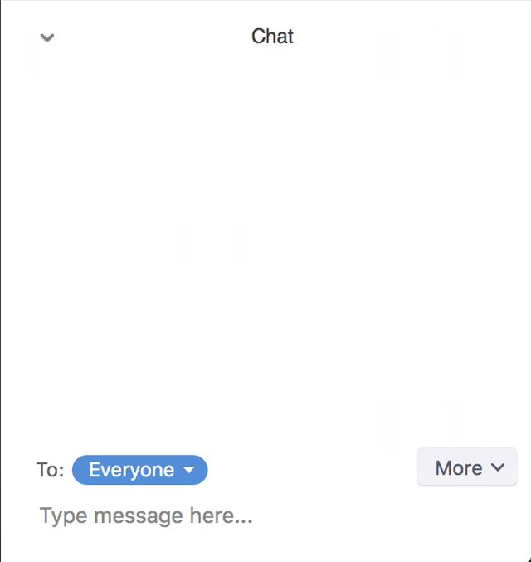
Presentation Logistics
This presentation is being recorded
Participants should access Zoom from a browser or app for full participation
Participants will be on mute throughout the presentation
To submit questions during the presentation, please type them in the “Chat”
  Questions will be addressed periodically during the presentation
  There will also be time for questions at the end of the session

Slide 3

Overview
Today we will discuss:
  The Transition
  The Advisor Factor
  Tips and Tricks
  Observations and Future Implications
  Resources and Q&A
Notes:
How the Academic Advisement Center at Santa Fe College transitioned to fully remote operations in response to COVID-19
What considerations should be made as it relates to staff during a transition to fully remote operations
Tips and tricks for a success transition
Observations during this fully remote period and discussion of what this might imply for the future of advising
Listing of helpful resources for advising during this time and the opportunity to participate in Q&A

Slide 4

The Transition Context
Santa Fe College Academic Advisement Center
11 Advising Specialists, 1 Coordinator, and 1 Advising Support Specialist, and 2 work-study students
Students assigned based on AA-advisement track
Advising offered via drop-in or appointment
Appointments were scheduled using GradesFirst (in-person, phone and Zoom options)
Registration for Summer/Fall and was scheduled to open within 2 weeks
Notice that all operations moving online: issued mid-day on 3/17
Notes:
Although Santa Fe College has advisors housed in the Academic Advisement Center (centralized advising for AA students) as well as program advisors housed in academic departments (decentralized, program-specific advising for AS, BAS/BS, and certificate students). This presentation is focused on the transition of the advisors in the Academic Advisement Center
Department staffing breakdown
Students are assigned an advisor based on their advisement track but can meet with any advisor for drop-in
Advisors rotated between offering advisement via drop-in or by appointment
Although in-person, phone, and Zoom options were available, Zoom was the least frequently selected format
The notice was issued by the College President. All operations were expected to have transitioned by 3/18

Slide 5

The Transition
Updated Messaging:
  Signs at the physical location
  Department website header
  Autoreply email template
  Voicemail message template
  Advisor messaging campaign
All advising was transitioned online to Zoom format
Scheduled appointments were updated in GradesFirst to reflect the format change
  In-person and phone appointment options were removed
  Appointments were held in advisors’ personal Zoom meeting rooms
Virtual advisement lobby was created in Zoom
  Meeting configurations so no video and muted on entry
  Waiting room with messaging and hours of operation
  Meeting room lobby included PowerPoint slide displaying instructions
  Breakout rooms were created for each advisor
  Students were admitted individually and notice was sent to advisors via Microsoft Teams chat
  Advisors responded to chat requesting to take student and student was subsequently assigned to a breakout room

Slide 6

The Advisor Factor
Advisor training and resources
Constant communication (group and individualized)
Individualized projects
Professional development
Virtual Team Building
Reporting and Assessment
Notes:
Because Zoom was already an advising format option, advisors had already been trained on Zoom technology
Prior to the transition to online operations, advisors had also tested out the breakout room feature
Advisors had also been polled to determine if they had technology available to offer advising from home
Communication via email, team meetings, and one-on-one meetings. The use of autoreply and messaging templates was already a department practice for student communications
Each advisor received an individualized project to work on during the slower moments for the betterment of their caseload, the department, or the College as a whole
Professional associations and internal College entities started sending out information about professional development opportunities which were shared with advisors. A Zoom advising session was also held with the larger College advising community to get an idea of how people were doing and any changes that had been implemented.
Because it is a centralized office, transitioning to remote operations removed the social aspect of the work environment in many ways. Because this was an important consideration in terms of team morale, some department meeting time was devoted to virtual team building (charades, important object, bucket list, virtual baby shower, etc.).
Students were provided with a Qualtrics survey link following each advising session to provide feedback on the technology and the content of their advising sessions. Advisors also submitted daily, and then weekly accounts of email advising interactions.

Slide 7

Tips and Tricks
Don’t plan for the crisis, plan for the future
Do more than just learn the technology, try to break it
Both standardization and personalization are necessary
Repetition and reassurance are your friend
Disruption breeds creativity – Capitalize on it
Dispel the idea of a “return to normal”
Notes:
Being proactive rather than reactive allows greater control and flexibility. Additionally, this crisis will pass but others will eventually arise with different features so tailoring to the crisis is often counter productive.
In order to effectively troubleshoot and employ technology it is important to not only know what it’s capable of, but to also know what the conceivable boundaries are. Knowing the shortcomings will allow you to effectively and proactively plan around them.
During times of crisis, people are looking for structure as well as consideration of their personal needs. Development and wide communication of standardized protocols establishes some sense of stability during the uncertainty. That said, leaving room for customization and accommodation is also necessary.
There will be a lot of information and communication during a crisis and in the field of advising specifically, it is essential to be up-to-date on any changes in order to effectively communicate that information to students. That said, information overload is a real possibility so be prepared to have to repeat key items, chunk information, and provide reassurance when concerns arise.
Disruptions and crisis are times which innovation and creativity abound out of necessity. Rather than limiting those creative thoughts to the crisis at hand, try to reframe the focus to improvements that can positively impact operations even after the crisis is over.
It’s common for individuals to desire a “return to normal” but the reality is that things will never return to exactly as they were. Nor would we want them to. Instead of focusing on what was “lost,” change the dialogue to highlight what has been found and where the changes could lead in the future.

Slide 8

Observations and Future Implications
  Humility, patience, and thoughtful consideration
  Increased self-sufficiency and self-advocacy
  Recognition of the “human” factor
  Increased efficiency and productivity
  Reimagined service delivery
  Resiliency
Notes:
Advisors have reported that student interactions have taken on a different tone. Students are more likely to be understanding and humble when making requests and also appear to be carefully considering the options they have available (i.e. – petitions, pass/fail grading, etc.). Similarly, staff appear to be more patient when awaiting updates or when encountering restrictions. These positive traits, if carried forward, will help strengthen connections and mutual respect for students and staff alike.
It’s often reported that students don’t read their email or other resources that may be available to them and they often do no reach out for help. During this crisis, a lot of students have changed their habits to make sure they are accessing the most up-to-date information and are also using their resources to advocate for themselves and communicate their needs. These behaviors will continue to benefit students in the future and advisors can build upon these skills to expand their students’ opportunities for growth.
Zoom sessions allow students and advisors to see each other in their natural elements. A pet barking in the background becomes a connection point as does home décor. There is also a feeling that the playing field is level as students feel that advisors “know what I’m going through” and are experiencing some of the same conditions in society. Likewise, as students are more readily advocating for themselves and reaching out for support, advisors are learning more about the circumstances their students are dealing with and are able to operate from a place of empathy and compassion. We’re all human after all.
The transition to online services, has forced many inefficient process which required direct human contact to be revised. It has also provided a new lens from which to view the student and higher education experience. Opportunities for increased productivity have also come to light along with the opportunity to continue that productivity into the future with the development of new processes and time saving techniques.
It has now been demonstrated that remote operations are possible and in some areas, even preferred. As such, when considering “returns to campus,” areas should carefully consider what that might look like and how the ability to operate remotely could also increase the ability to deliver services (i.e. – virtual night or weekend advising).
Resiliency has been demonstrated by students and staff alike. Both have proven that they can persevere under what were previously unthinkable circumstances. It is important to highlight this, not ignore it and to acknowledge that we are capable of more than we think.

Slide 9
Resources
Achieving the Dream COVID-19 Response Resources
NACADA Academic Advising Resources in Response to COVID-19
Frontier Set Resources for Colleges and Universities Confronting the COVID-19 Crisis
American Association of State College and Universities Resources for State Colleges and Universities on the Coronavirus
54 Fun Virtual Team Building Activities For Remote Teams
Notes:
Canvas module with numerous resources related to: Online Teaching & Learning Through Disruption, Delivering Support Service to Students during COVID-19, Institutional Support: Continuity of Operations, and Data Strategy During COVID-19
Recordings, slide decks, handouts and crowdsourced resources for advising
Crowdsourced Google doc database of resources for students, staff, and faculty
Government, International, Campus, Media, Policy, and State-specific resource listings
Ideas for ways to engage teams remotely

Slide 10

Q&A

Slide 11

andrea.lee@sfcollege.edu

