Slide 1

Recitation Hall:
Effective Peer-Facilitation of a Gateway Math Co-requisite Course
Dr. Roger Isaac Blanco
Miami Dade College

Slide 2
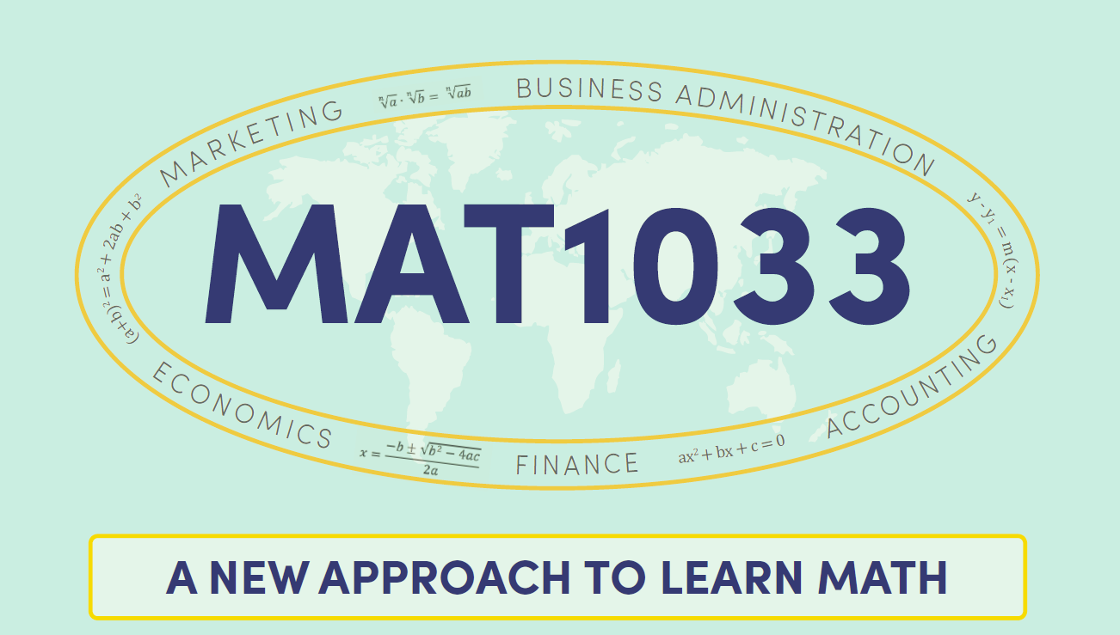

Slide 3
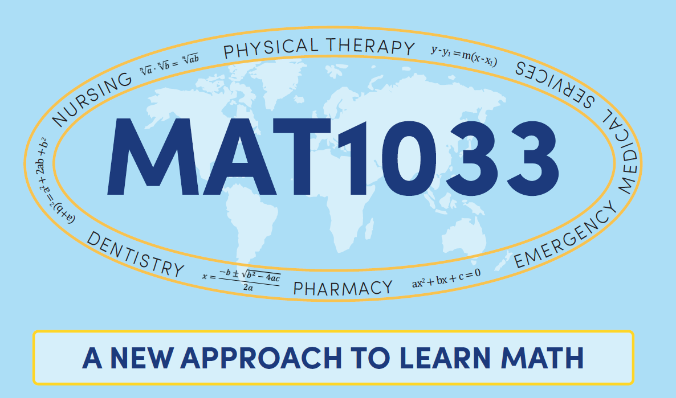

Slide 4
First Step: Create “Lab” Course
PERMISSION from Academic Council for Experimental Course (in Florida, coded 1990L)
Zero Credit, Two-hour Required Time for Recitation Hall; Must Be on Student’s Schedule
Submit Objectives under each Competency

Slide 5
Students will get individualized, small group or whole group instruction to deepen their conceptual understanding of _______________________. The students will reinforce and apply their content knowledge with effective problem-solving techniques and non-cognitive activities to make _________________ meaningful and relevant to their fields of study while strengthening the concepts needed to achieve the objectives of (Gateway course). (2 hr. lab)
Corequisite: (Gateway course)
Recitation Hall “Lab” Course Description

Slide 6
  Working in pairs or in small groups and focusing on comparing and interpreting each other’s ideas, instead of simply getting the answer to a given problem
  Revising, rewriting and/or creating scripted, conceptual questions about a given problem and/or problem situation
Recitation Hall “Lab” Objectives

Slide 7
  Creating models for real-life situations
  Using EXCEL spreadsheets to create and analyze “what if” scenarios for real-life scenarios and/or situations
  Completing computer-based assignments including proper representation and discussion of results to support their mastery of course content
Recitation Hall “Lab” Objectives

Slide 8
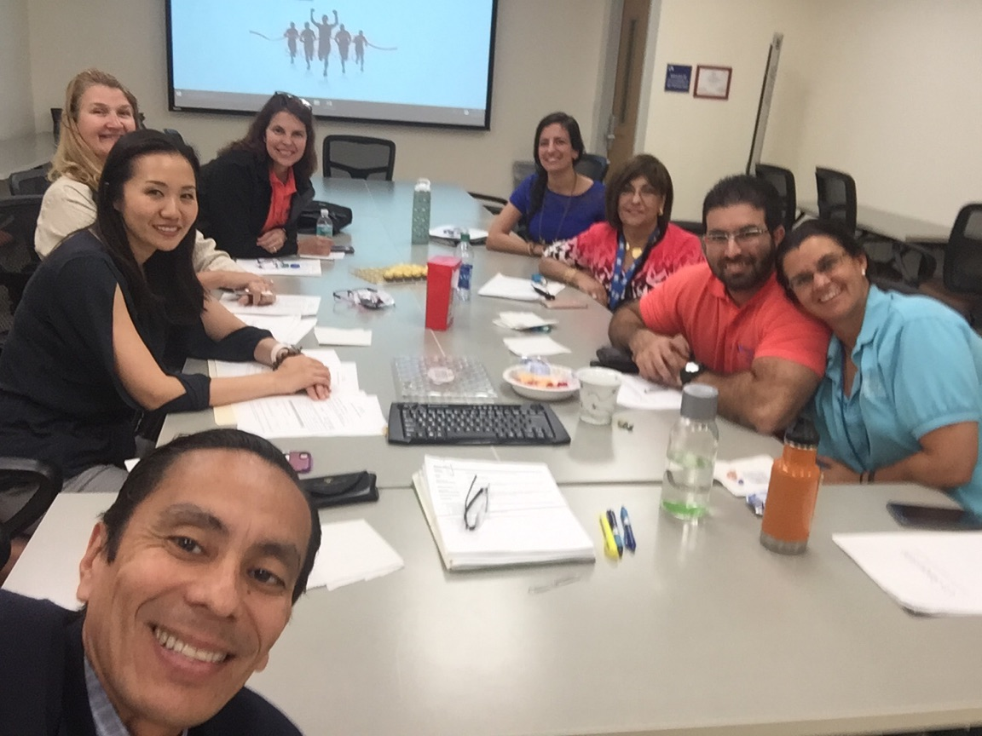
Second Step: Writing Curriculum
ILAs use CURRICULAR MATERIALS created by faculty.
Success in using Contextualizing Curriculum based on Perin (2011) and Chaplot, et al (2013).
Employ local names & industries as well as youth culture references to increase student interest: hoverboards, energy drinks, YouTube as a Career, pizza & sushi

Slide 9
Students use BUSINESS concepts as the context for learning mathematical _______ content.
Appreciation & Depreciation
Revenue, Fixed Costs, Variable Costs, Profit
Break-even Point
Comparison of Vendors
Meeting Production Deadlines
Investment & Borrowing
Expansion & Production Costs
Contextualizing for Targeted Majors with Large Enrollment

Slide 10
Students use HEALTH SCIENCES concepts as the context for learning ___mathematical_____ content.
Blood Pressure
Fitness, Nutrition, Exercise & Wellness
Physical Therapy
Burn Unit & Body Surface Area
Alzheimer’s & Dementia
Hospital Administration & Staffing
Treating Disease & Drug Dosages
Contextualizing for Targeted Majors with Large Enrollment

Slide 11
Co-Requisite Is the Name of the Curriculum for Recitation Hall with ILA
PART A: Activate Prior Knowledge & Worked Out Examples
PART B: Contextualized Real Life Scenarios & Problem Situations building on material taught by professor
PART C: Easy Problems from Harder Next Course (for use after a Unit Test)

Slide 12
Third Step: Hiring Employees (ILAs)
Advertise
Interview
Ability to work well in a multi-ethnic and multi-cultural environment with students, faculty and staff
Possess excellent interpersonal skills including oral and written communication
Take pride in improving as an instructor through gaining & employing research-based knowledge
Combats stereotype threat
Good at Teaching? Good at Math?
Part-Time Employee, 7-20 hours per week
3.0 or higher in the assigned course (or a more advanced course in the same sequence).
Ability to work flexible schedule including evening

Slide 13
Division of Labor
Faculty
ILA
Distribute Syllabus & Plan Pacing
Teach from STUDENT TEXT
Assign Home Learning, including PERFORMANCE TASKS
Administer Quizzes (retrieval practice) and Tests
Grade & Inform Students of Their Progress
Weekly Meeting with Professor to Discuss Progress
Assist Professor During MAT1033 Class
Conduct RECITATION HALL, teaching from CO-REQUISITE TEXT & COLLEGE ALGEBRA READY
Contact Students about Absences
Attend PEDAGOGY Class or Seminars

Slide 14
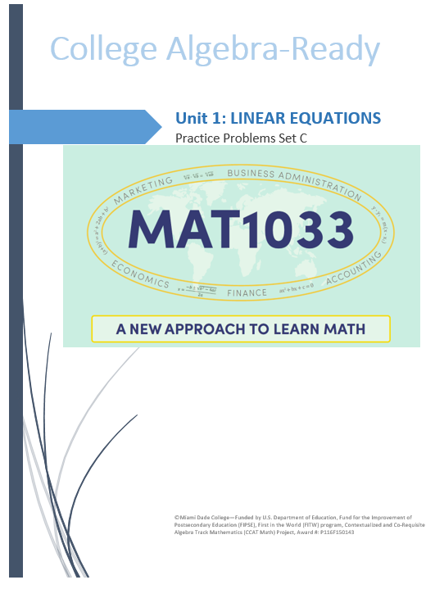

Slide 16
3 Ways of Mastering ___________________
Professor
Whole Class
ILA in Recitation
Group Work
Open Lab
Tutoring

Slide 17
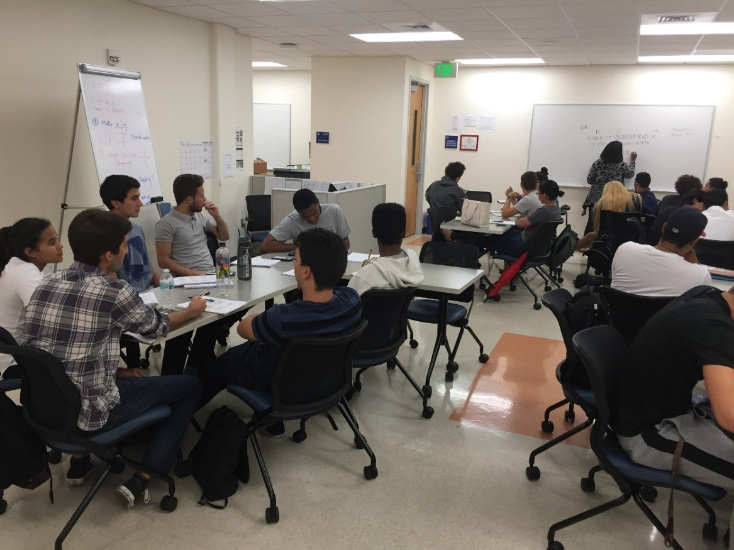
Required Recitation Hall Led by ILA
Each student benefits from the required two hours of Recitation Hall per week, during which time the Co-Requisite packet is completed with a peer or small group. The ILA directs this work, and elicits student explanations for solutions.

Slide 18
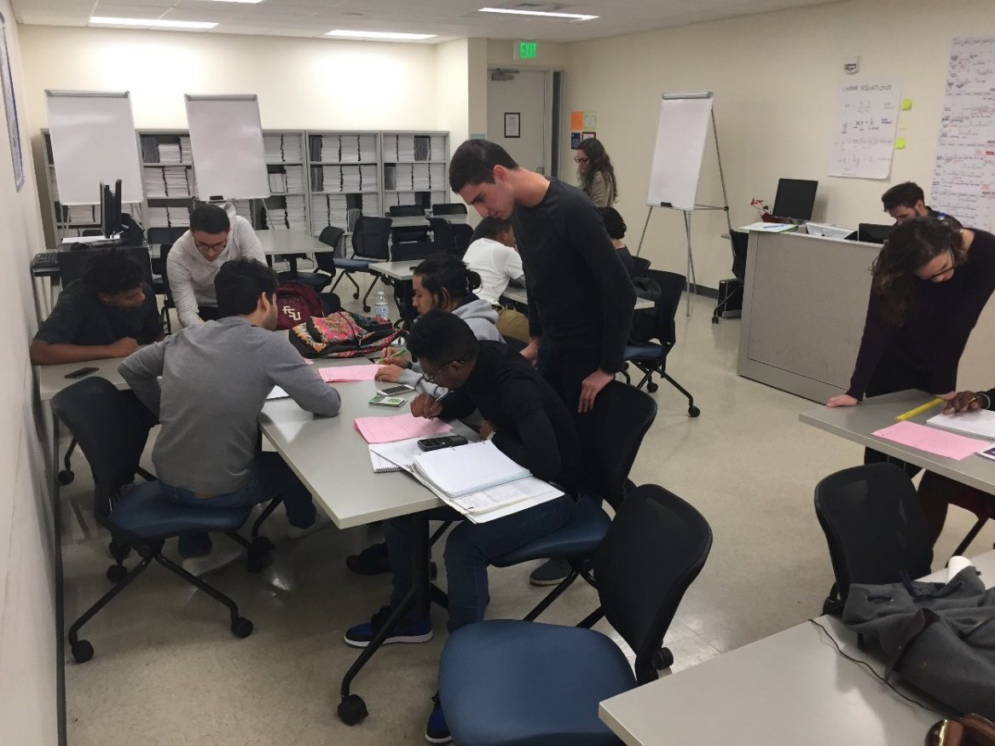
Deeper Understanding in Recitation Hall
The purpose of the ILA is not to teach the material nor to solve the problems for the student but to facilitate the student’s small group interaction and discourse as the students work through the Co-Requisite material.

Slide 19
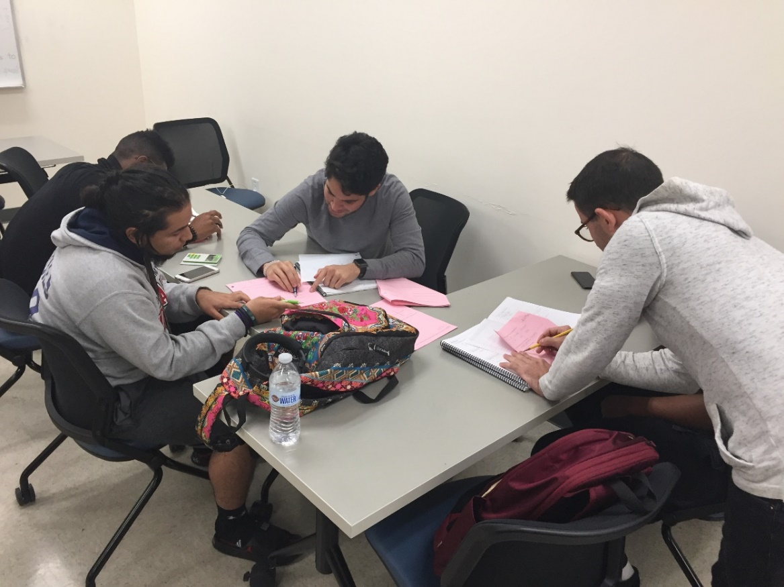
Recitation Hall: Comfort & Accountability
Attendance in Recitation Hall is mandatory and is part of a student’s grade. The students will be quizzed on the material in the Co-Requisite packet each week.
The work in Recitation Hall allows the formation of friendships, study buddies and informal co-horts to move onto the next course together.

Slide 20
ILA’s Offer UNIT TEST PREPARATION:
  The Recitation Hall Lab offers individual review sessions during Open Lab time to students for four days before the scheduled Unit Test.
    The ILA will interview and assess the student’s academic needs:
      Text for that Unit—which problems were not completed
      Booklet 6 homework practice problems
      Quizzes
      Booklet 6 Practice Test—understanding his or her mistakes or process errors

Slide 21
ILA’s Offer Specific Feedback:
After taking the Unit Test Review Session, the student’s incorrect solutions will be reviewed with the student by the ILA.
Students will be offered a Unit Test Review Session after a minimum of one-hour of reviewing the unit during Open Lab hours.

Slide 22
REMIND (non-numbered TEXT), Phone Call
Email
Blackboard Retention Center
Early Alerts & Interventions

Slide 23
Key Areas of Strategic Redesign
MAT1033 Redesign
MAT1033
Mastery Worksheets
Embedded Learning Assistants (LAs)
EAI strategies
Standardized syllabi and assessments
Scaling of non-algebra pathway
MGF1106/MGF1107
Active CL
MAT1033 Contextualized
MAT1033/MAT1990L
Active Classroom Learning (CL) and Recitation Hall (RH)
Contextualized Curriculum for Business and Health Sciences Meta-Majors
Co-requisite Materials
Embedded Instructional Learning Assistants (ILAs)
Early Alerts and Intervention (EAI) Strategies & Progress Monitoring
Standardized syllabi, assignments, assessments & grading
Blackboard (BBL) Gradebook and Retention Centers
Students with programs of study that do not require College Algebra for degree, transfer or baccalaureate
Non-Algebra = MGF (Mathematics, General & Finite)
Alternative Path: MAT0029/MGF1106

Slide 24
Meeting Objectives
Obj 1. MAT1033 Pass Rate | Obj 2. MAC1105 Registration Rate | Obj 2. MAC1105 Pass Rate | Obj 3. 30 Credits Completion in One Year | Obj 4. Fall-to-Fall Retention
+13.4% | +5.6% | +4.8% | +7.5% | TBA%
Program Overview
Summary | Intervention | Control
Total # of Terms: | 8 | 6
Total # of Sessions: | 72 | 68
Total # of Faculty: | 44 | 51
# of Full time Faculty: | 13 | 15
# of Adjunct Faculty: | 31 | 36
Total # of Enrolled Students: | 1,760 | 1,687
Total # of ILAs: | 68
Student-Advisor Ratio | 200:1

Slide 25
https://www.mdc.edu/math/ccat/

Slide 26


Slide 27
To continue the conversation . .
Dr. Roger Isaac Blanco
Grant Director, Pedagogy
Miami Dade College
rblanco7@mdc.edu
305-237-2754

