Slide 1
Soft Skills Are Hard Skills!
Research & Remedy
Association of Florida Colleges
Annual Meeting and Conference | November 2018
Colleen Englert
Executive Director | Florida Ready to Work

Slide 2
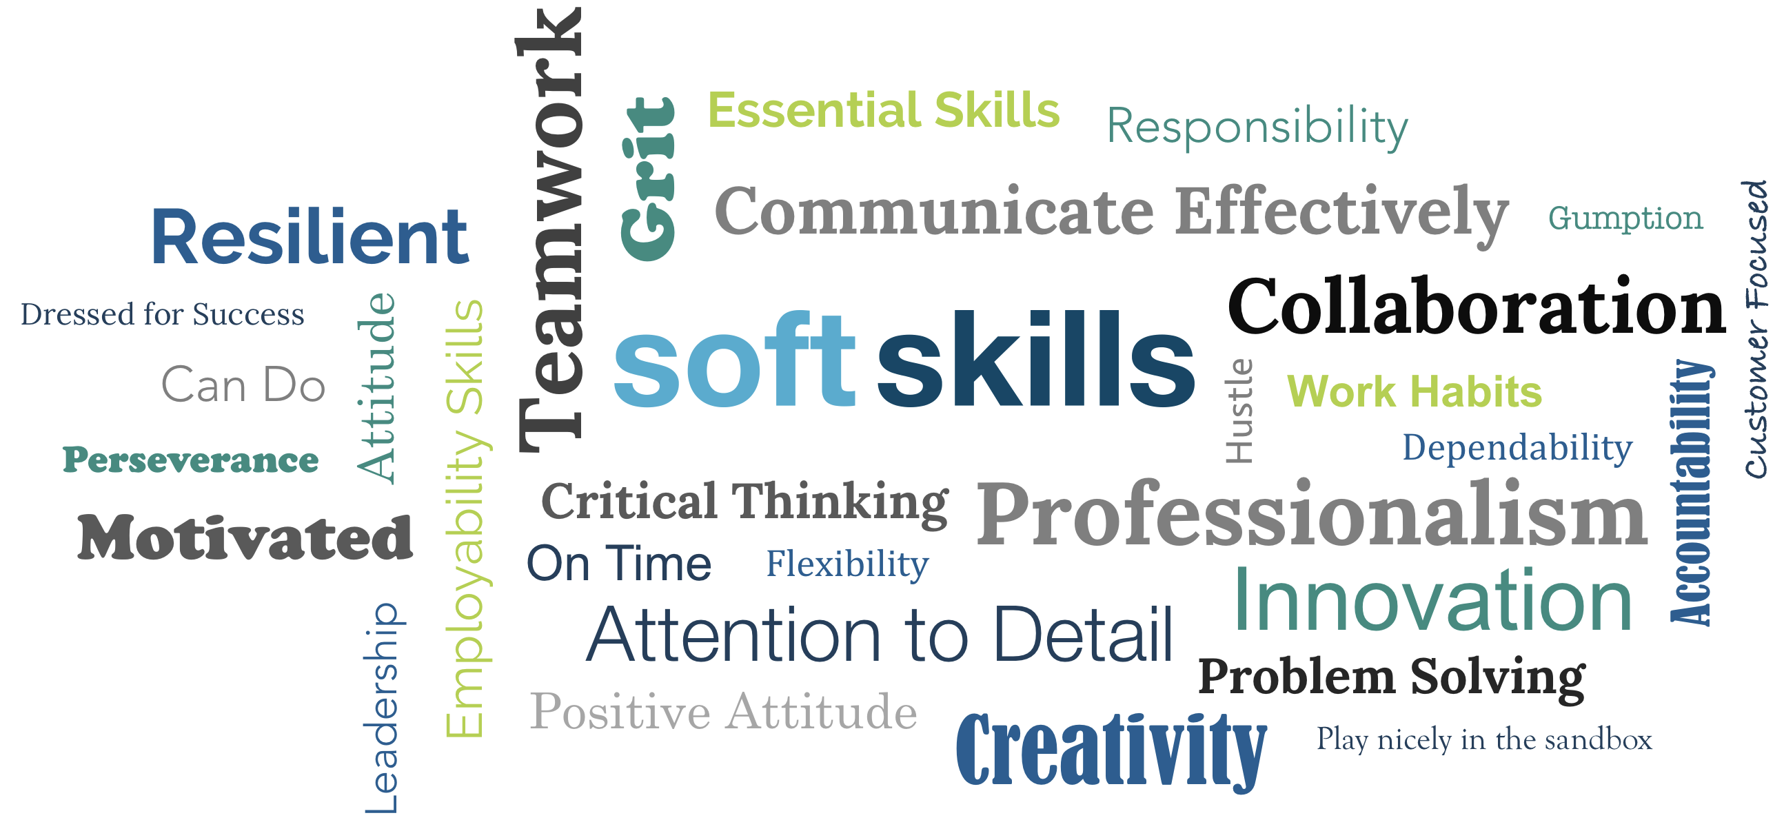
Defining soft skills ?

Slide 3
Research Consensus
Soft skills are ‘hard’ to define, teach and measure
Soft skills are the essential foundation for most all jobs across industries
Soft skills are lacking / in-demand for most all jobs across industries
Employers most often hire for ‘hard skills’ (technical / experience) and fire for ‘soft skills’
Disconnect between employers and graduates / educators in the understanding and importance of soft skills

Slide 4
63 percent of graduates believe
they are ‘very’ prepared.
Employers disagree.
Only 14 percent of employers believe
recent graduates are ‘very’ prepared.
US Chamber of Commerce Foundation, / Allegheny Conference, 2015
Soft Skills

Slide 5
Most significant disconnects in perceived preparedness between employers and graduates:
commitment / accountability
communication
time management
professionalism
critical thinking / problem solving
US Chamber of Commerce Foundation, / Allegheny Conference, 2015
Soft Skills

Slide 6
Biggest divide is professionalism and work ethic. Nearly 90 percent of students think they are prepared; only 43 percent of employers agree.
Close to 80 percent of students believe they have essential communication and critical thinking
skills; only 42 percent and 56 percent of employers agree.
National Association of Colleges and Employers, 2018
Soft Skills

Slide 7
More than 70 percent of employers believe recent college graduates are not well-prepared to
apply knowledge and skills in real-world settings or do not have essential critical thinking and communication skills — non-technical ‘soft’ skills.
Association of American Colleges and Universities, 2015
Soft Skills

Slide 8
Employer-education mismatch –
96 percent of college academic officers are confident in preparation of students.
Only 11 percent of business leaders agree.
Lumina Foundation, Gallup for Inside Higher Education Poll, 2014
Soft Skills

Slide 9
Florida employers report gaps in foundational ‘soft skills’ twice as often as technical skills:
communication
reliability and time management
leadership
problem solving
CareerSource Florida, Florida Skills Gap and Job Vacancy Study, 2018
Soft Skills

Slide 10
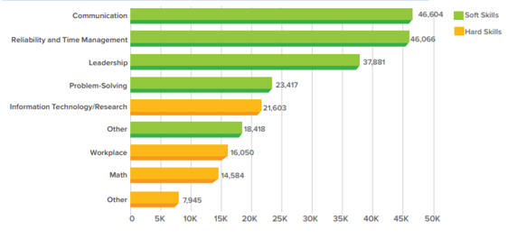
Soft Skills Out Rank Hard Skills
CareerSource Florida, Skills Gap and Job Vacancy Study, 2018

Slide 11
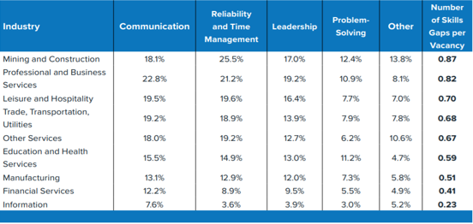
Soft Skills Gaps by Industry Super Sector
CareerSource Florida, Skills Gap and Job Vacancy Study, 2018

Slide 12
The Remedy
Review the research
Apply ‘technical skill’ innovation lessons learned
Prioritize and integrate ‘soft skills’ as an essential and measurable learning objective for every student, every classroom, all faculty
Proactively and continuously engage employers in further defining, teaching and evaluating soft skills
Leverage own career services, CareerSource partner and community-based resources
Don’t wait! Take the first step with Florida Ready to Work

Slide 13

myfloridareadytowork.com

Slide 14

Overview
A first-step, scalable foundational career readiness and soft skills solution
Sponsored by Florida Department of Economic Opportunity
Managed by WIN Learning, a national career readiness company
State funded, no direct cost to implementation partners or students
Eligible partners include all state colleges, technical colleges, high schools, adult education, CareerSource regions, and others
Performance bonus funding: $15 per credential

Slide 15
Curriculum
NEW Soft Skills Courseware – A Blended Solution
Conveying Professionalism – Dependability, courtesy, attitude, motivation, personal accountability, and time management
Communicating Effectively – Verbal and nonverbal communication and listening; use of communication tools including email etiquette, cell phone, and social networking; resolving conflict; and acknowledging criticism.
Promoting Teamwork and Collaboration – Teamwork skills and interactions, benefits of diversity and sensitivity to differences, accepting responsibility, and leadership.
Thinking Critically and Solving Problems – Innovation, creativity, flexibility, overcoming adversity, goal setting, and critical thinking strategies.

Slide 16
Proctored Assessment
NEW Soft Skills Assessment
Research based, criterion referenced
Academic and employer subject matter expert developed and validated
Situational judgement, career contextualized, application of skills from employer point of view
Multiple choice ‘BEST’ and ‘WORST’ response to situation
Proctored, 60 Minutes, Scored Passed or Not Passed
Aligned to curriculum

Slide 17
Credential
NEW Florida Soft Skills Credential
State sponsored, signed by Governor
Competencies summarized on back of credential
Employer recognized

Slide 18
More Information
  Colleen Englert | Executive Director
  cenglert@floridareadytowork.com
  850.228.9558

