Slide 1
Leadership Lessons from a Burning Building:
What was More Important Than my Stuff was on Fire?!
Nikki Duslak
Director of Educational Opportunity Programs Lake-Sumter State College
BFA in Theater M.Ed. in Secondary Education M.Ed. in Educational Leadership and Policy Studies

Slide 2
What is most important to those we serve?
Survey examined two different groups: "workers" and "CFOs"
"Which of these are the most important attributes in a corporate leader?"
Eight leadership attributes were listed: Accessibility, Collaborative Mindset, Competitiveness, Decisiveness, Fairness, Integrity, Strategic Mindset, and Transparency
Both groups placed Integrity at the top of the list
75% of workers
46% of CFOs

Slide 3
So what is this doing to our organizations?
Global survey indicates 25% of employees don’t trust their leadership
70% of employees cannot picture themselves at their current companies next year
Over 9,000 employees
More than 20 industries

Slide 4
What does this data mean? (TL;DR)
We all value integrity more than any other trait
Workers feel leaders don’t have it
Workers are unhappy in their organizations and intend to leave

Slide 5
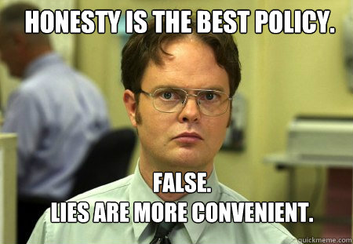
What is integrity?
The quality of being honest and having strong moral principles; moral uprightness.

Slide 6
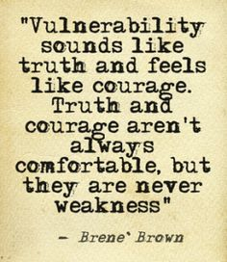
What does integrity mean in leadership?
Integrity in leadership means building trust
Most leaders work to build rapport
Research tells us the difference between rapport and trust is a level of vulnerability
Vulnerability can’t be reached if our ego is in the way

Slide 7
What is the current trend in leadership?
We are not authentic in our interactions, and instead be who we think we should be instead of who we are
We work from fear, a desire for power, and habit
We assume that our problems are “real” and theirs are less significant

Slide 8
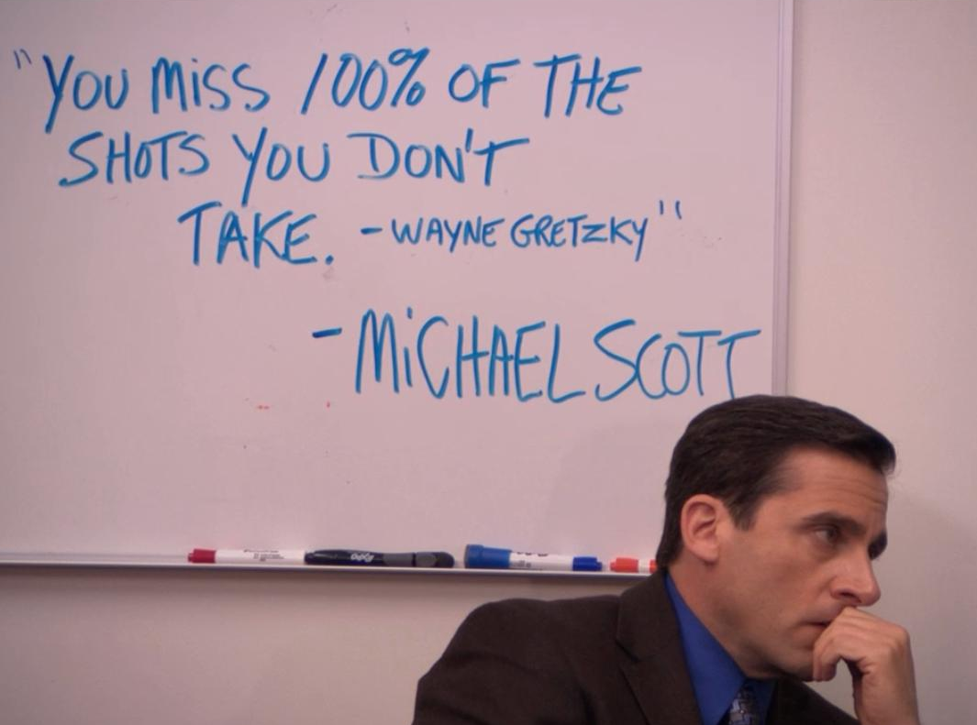
What is ego?
A person's sense of self-esteem or self-importance.

Slide 9
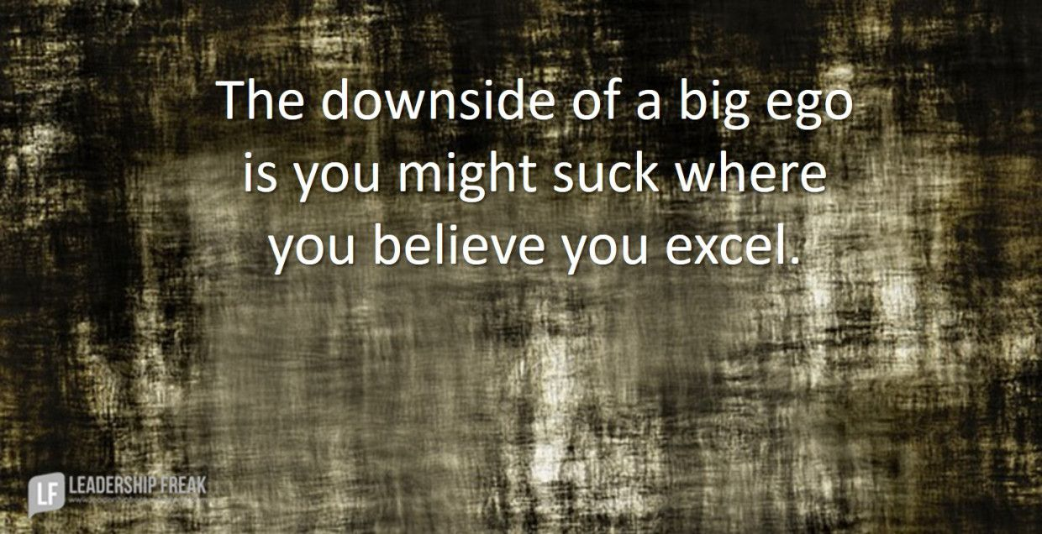
What happens when leaders have too much ego? (Misuse of Systematic Neglect)
They believe their opinion matters more than others
Stop listening
Stop learning
They don’t improve

Slide 10
No one wants to work for these people…
Qualities from afar are different than qualities up close
Ambition becomes entitlement
Vision becomes micromanagement
Analytical becomes cynical
Charismatic becomes manipulative
We don’t apologize or admit when we are wrong

Slide 11
So what can we do as leaders?
Balance your self interest with the group interest
Recognize your own strengths and limitations
Admit when you make a mistake
Help to cultivate other leaders
Stop referring to the team as “your staff” or “your teachers”

Slide 12
So what can we do as leaders?
Put out their fires as you put out yours
Be respectful of their emergencies
Never tell faculty or staff you don’t have time
“I have time if you can walk with me”
“This is so important. Can we follow up later today?”
Ensure you know and understand their priorities and their lives

Slide 13
Here’s a great example!
High school English teacher
Overhead caught fire
18 minutes to respond
No one came for us
I never forgot that feeling
What was more important than my stuff was on fire?

Slide 14
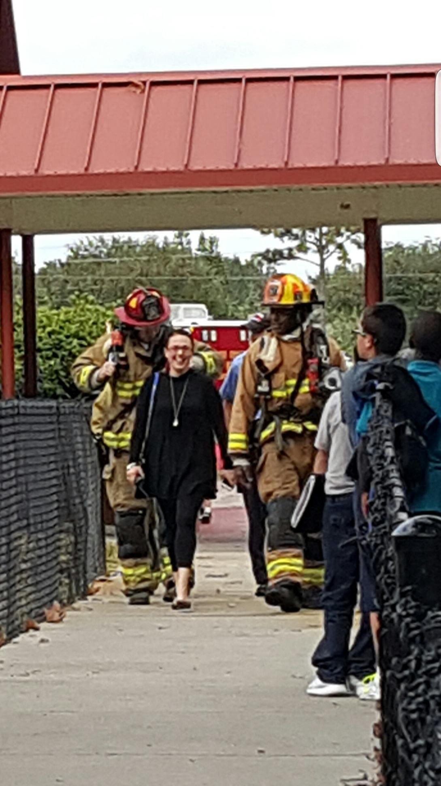
Here’s what I did with this…
Art Teacher- well intentioned gnat
Each morning she was in my office 3 minutes after I was
Campus fire
All are evacuating (k-8, 520 students)
She asked me if I had a minute
I went back to my feeling of unimportance
This was HER fire
My actual fire didn’t matter to her
She doesn’t have that perspective
She was fighting for what she needed when she had time

Slide 15
Your fire isn’t theirs, but their fire is yours
Leaders have 50,000 foot level view
Employees don’t see that view
Happy people who feel appreciated do more work than unhappy people who feel unvalued
Workers who feel valued become intrinsically engaged with their work communities

Slide 16
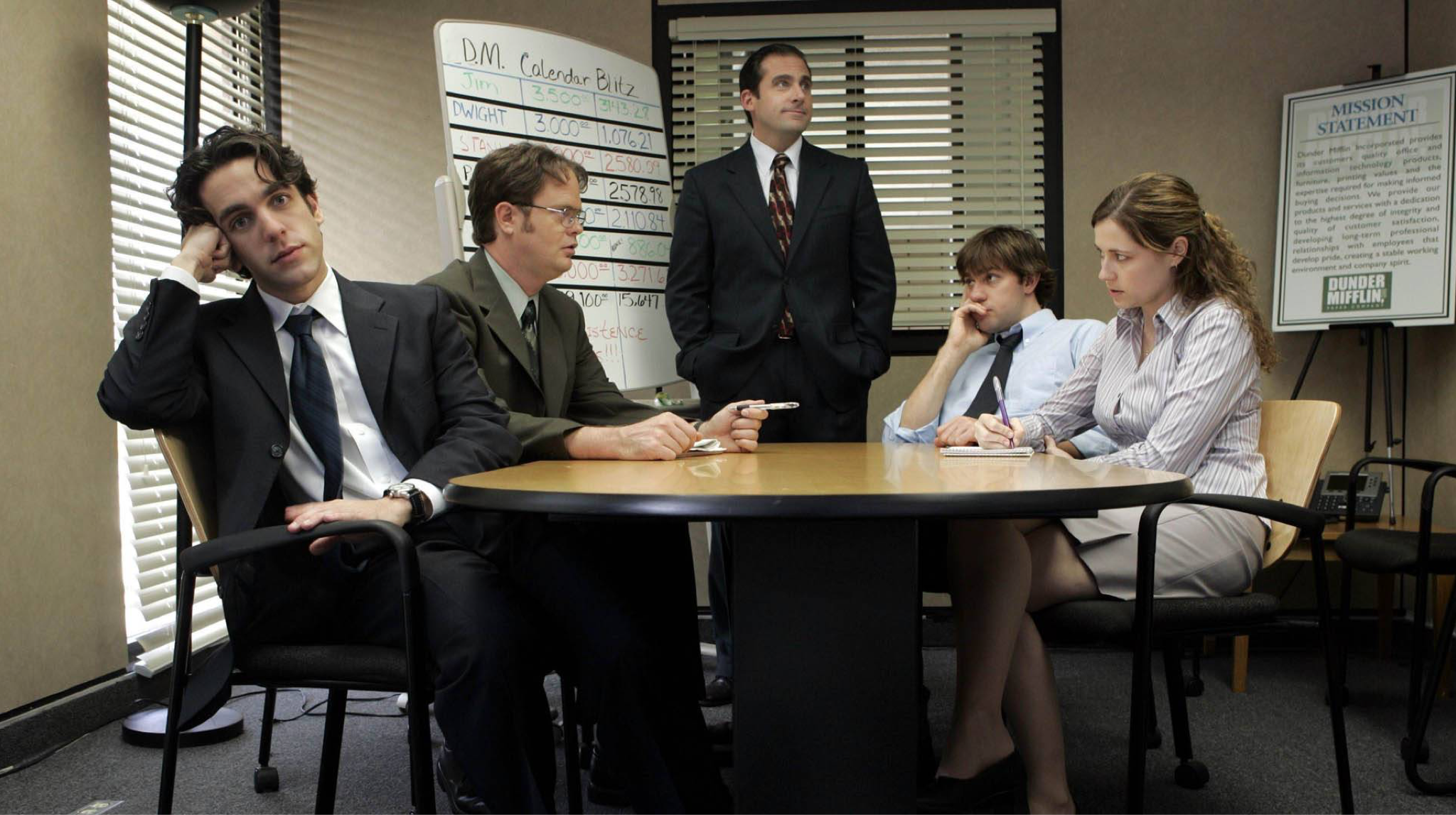
When have you played with fire?
Think of a time when a boss or leader left you feeling unheard, unanswered, or unimportant
Think of a time when you may have done that as a boss or a leader

Slide 17
Questions?

Slide 18
Resources
https://www.forbes.com/sites/victorlipman/2016/10/25/the-most-important-leadership-attribute-new-study-has-clear-answer/#6334f3304df2
https://www.forbes.com/sites/forbescoachescouncil/2018/02/26/is-a-lack-of-follow-through-costing-you-credibility-four-steps-to-protect-the-perception-of-your-leadership/#3064574462ba
https://files.eric.ed.gov/fulltext/ED407024.pdf
https://dc.etsu.edu/cgi/viewcontent.cgi?referer=https://www.google.com/&httpsredir=1&article=2468&context=etd
https://www.psychotherapynetworker.org/blog/details/1004/bren%C3%A9-brown-on-vulnerability-as-a-crucial-strength

