Slide 1
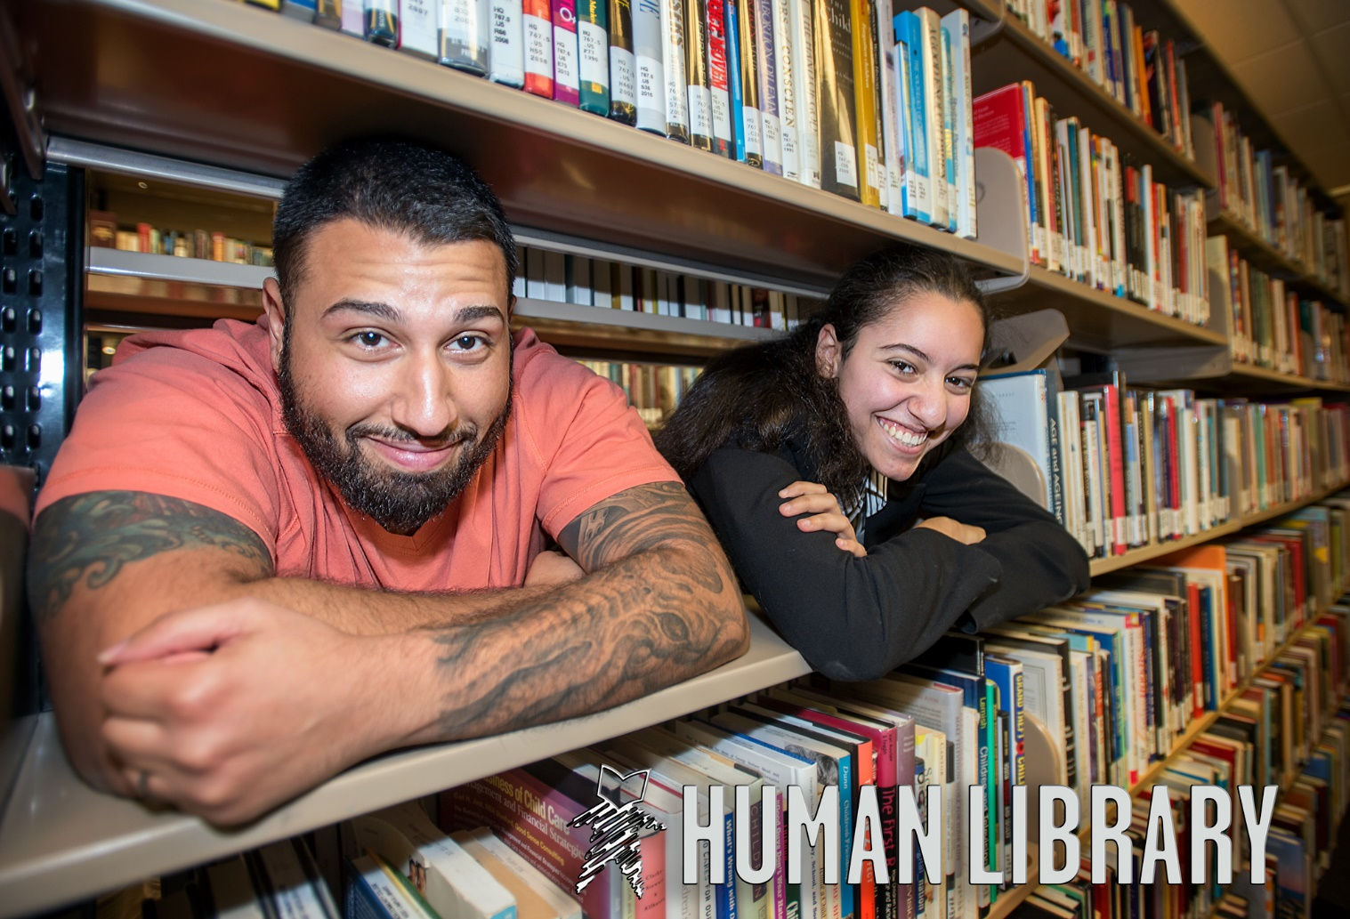
The Human Library™ at Valencia College- West Campus Library
November 8, 2018
Jeannie Rodriguez
Regina Seguin
Nardia Cumberbatch

Slide 2
What is the Human Library™?
Created by Ronni Abergel, Dany Abergel, Christoffer Erichsen and Asma Mouna of the Danish youth organization Stop The Violence in 2000
Operational on five continents
Library of human beings (versus a print book) that represent a group in the community that are somehow exposed to stigma, prejudice and/or discrimination
“Aims to establish a safe conversational space where difficult questions are expected”
Must apply to become an event host
  You agree to maintain the integrity and methodology of the HL
  Permission granted to use HL materials
Notes:
Jeannie

Slide 3

What is the Human Library™?
Notes:
Jeannie

Slide 4
What is the Human Library™?
“It was developed to challenge societal prejudices wherever and for whatever reasons they occur, and to help people form a better understanding of those with whom they share their communities.”
Notes:
Jeannie

Slide 5
Question 1
What interests you about The Human Library™?
Notes:
Jeannie
CANCELLED DUE TO WIFI Reminder log in --- Mentimeter.com login ncumberbatch@

Slide 6
Anatomy of the Human Library
Terminology, Roles, Titles/Topics, Pillars as defined by The Human Library™
Notes:
Jeannie

Slide 7

The Human Library Book Depot
Virtual book depot
Recruit new books and prepare them for publication
Notes:
Jeannie

Slide 8
8 Pillars of Prejudice
Religious beliefs
Sexuality
Ethnicity
Occupation
Lifestyle
Social status
Political conviction
Health & disability
“Topics from at least five pillars should be represented in order for
the Human Library to be true to its methodology and mission.”
Notes:
Jeannie
Do not allow thematic events. The pillars consists of groups that are exposed to stereotypes, stigma or discrimination due to:

Slide 9
Examples of titles/topics from the pillars:
Sexuality : Lesbian, gay, bisexual, transgender,
Religion : Catholic, Christian, Jewish, Muslim, Buddhist, Convert, Atheist,
Lifestyle : Skater, Street artist, Tantric, Nudist/Naturist, Swinger, Poly Amorous, Body Modified,
Health : Schizophrenic, Bipolar, Alcoholic, HIV+, different disabilities such as handicap,
blindness, deaf and more.
Occupation : Police Officer, Journalist, Soldier and other occupations that may be relevant.
Ethnicity : Caucasian (where relevant), African, Asian, Native, etc.
Social status : Homeless, Refugee, Immigrant, Unemployed, Young Mother,
Political conviction : left wing, right wing, moderate, climate activist, antifur, vegan
Notes:
Jeannie

Slide 10
Question 2
Which pillars of prejudice would be most relevant to your community? Why?
Notes:
Jeannie
Serial testimony.
1 minute to reflect
30 secs to 1 minute each talking time
30 secs to 1 minute cross talk time

Slide 11
Roles in the Book Depot
Books
Book Depot Manager
Head Librarian
Librarians
Dictionaries
Additional Roles we added to our library:
Auxiliary All-star
Blurb Cataloger
Book Lounge Bouncer
Notes:
Jeannie

Slide 12
Books
The people that have been courageous enough to agree to this and have met the requirements to be published.
  Not everyone can be a book!
They should not be “over published.”
“It is wise to have more than one copy of each title.”
Cannot be paid! No “speaker fees”, etc.
Must be interviewed and screened!
30 mins. max.-can be terminated earlier by either the Book or the Patron.
Notes:
Jeannie
so to speak as you risk them becoming professionals and the meetings with readers can tip from an open talk to more of a “oneway” communication because the books build a routine.

Slide 13
Book Depot Manager
“Takes care of the books and coordinates their availability for events.
During events this person is present in the room (book lounge) where books are kept until their next reader requests them.
A caretaker. Each time books return from a loan the manager makes sure they are okay and has a chat with them about the session. It is not supervision but still in a small way it is. Books need breaks and the manager in cooperation with the librarians needs to make sure that books are not overly exposed and remember to take breaks.
Has the overview of who is available on the bookshelf.”
Notes:
Jeannie

Slide 14
Head Librarian
“Coordinating role to ensure that all parties are working as they should.
Overall responsibility for running the event on the day.
This is the person that everyone else can go to if they have questions, need help in resolving an issue or for guidance on how to work with this methodology.”
Notes:
Jeannie

Slide 15
Librarians
“Work at the counter meeting and greeting readers.
Explain the concept and facilitate the loans.
It is imperative that the librarians are able to communicate well and guide the readers to their choice of literature.
Explain the rules of the HL to readers and to make sure that readers are truly motivated to meet the person they are requesting.”
Notes:
Jeannie
Typically we ask a few questions to readers, such as: What do you think you want to ask your book? And why do you want to talk to this person specifically? This is done to ensure the sincerity of the readers and to protect our books from unwanted contact with people who have ill intentions (never seen, but we need to be careful and ensure that the readers are prepared to comply with the rules and respect the books).

Slide 16
Librarians As Protectors
“To ensure the sincerity of the readers and to protect our books from unwanted contact with people who have ill intentions there are questions the librarians will ask:
  What do you think you want to ask your book?
  And why do you want to talk to this person specifically?”

Slide 17
Warning Signs
Threatening statements
Intimidating, belligerent, angry
Confrontational
Hate Speech/Gesture/Conduct
Odor of alcohol or drugs
There have been no reported problems at a HL event.

Slide 18
Dictionaries
“Chaperone/Guide”
“Their role is to ensure social comfort of both books and readers and if need be to support the reading.”
Examples: language barriers or books that do not feel comfortable going on loan by themselves
Notes:
Jeannie

Slide 19
The “Blurb”
“Book presentation page for the catalogue/list of literature.
Short text that invites the reader to reflect on the stereotypes and prejudices that are out there on each topic.
Book will provide most of the content for this page so that the stigmas on the page are based on actual experiences.”
Notes:
Jeannie

Slide 20
Question 3
Reflecting on your own community, what considerations would be important to ensure an inclusive and safe environment for your patrons? Your staff? Your “Books”?
Notes:
Jeannie

Slide 21

Valencia’s Human Library Events

Slide 22
Titles/Topics We Have Chosen
Sexuality: Lesbian
Gender Expression: Transgender
Religion: Muslim
Occupation: Police officer, Veteran, Professor
Race/Ethnicity: Black, Hispanic
Social Status: Homeless
Human Trafficking
Notes:
Have to meet with them over the next two weeks.

Slide 23
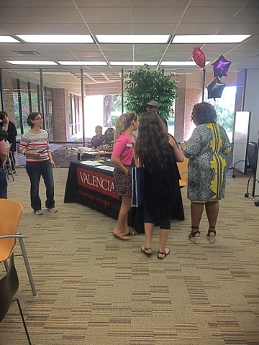
How Many Titles?
The HL suggests that 10-15 titles can be managed easily with 3-5 staff.
  We needed more staff for less titles.

Slide 24
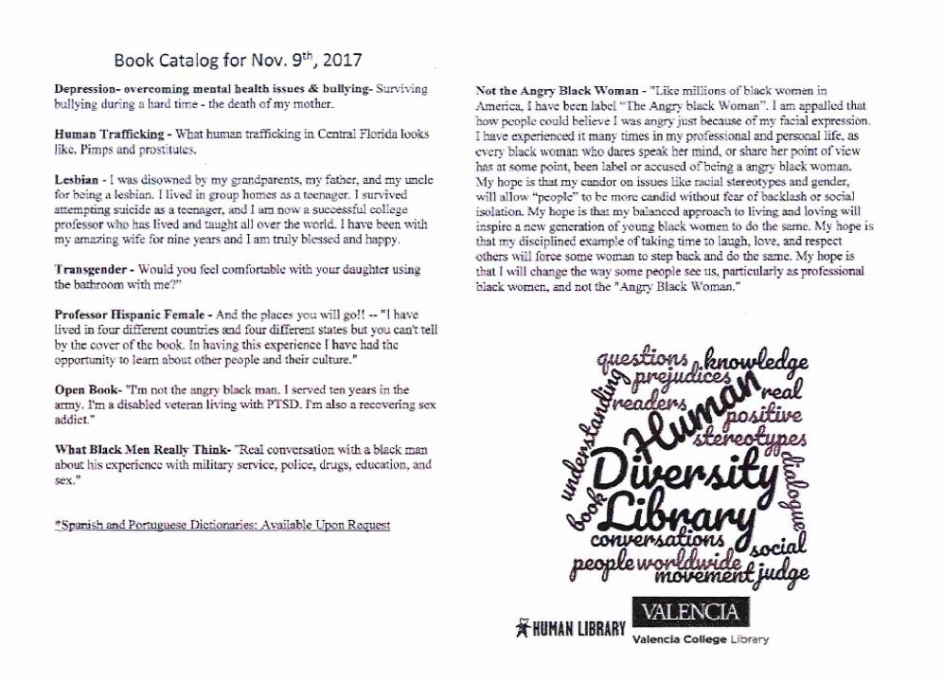
Titles/Blurbs
Notes:
Nardia

Slide 25
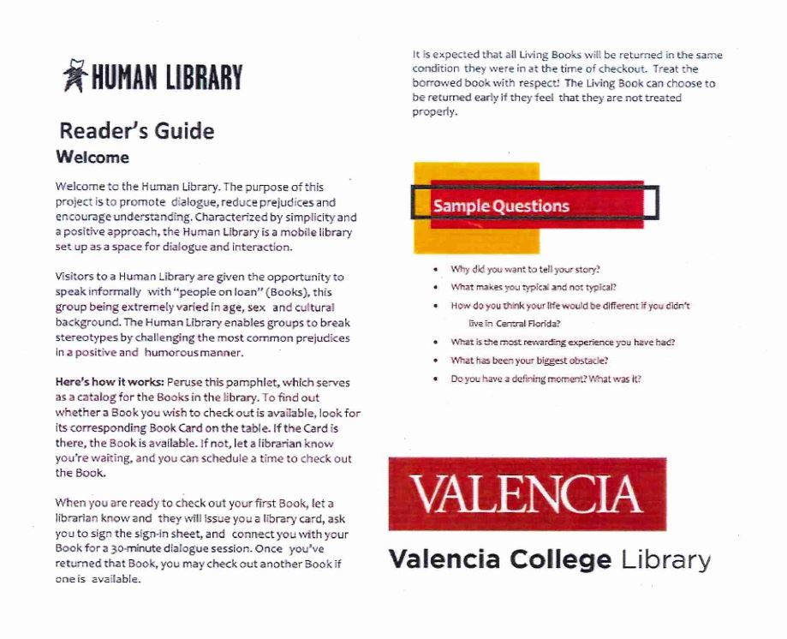
Reader’s Guide
Notes:
Nardia

Slide 26
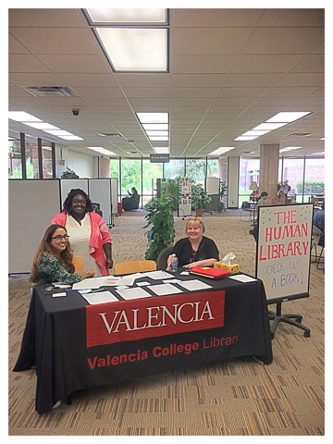
Event Details
  1st event
    Date: May 23, 2017
    Location: Valencia College West Campus Library
    Duration: 4 hours, 12:00PM-4:00PM
    Staff: 10
    Books: 6
    Readers: 27
  2nd event
    Date: November 9, 2017
    Location: Valencia College West Campus Library
    Duration: 4 hours, 12:00PM-4:00PM
    Staff: 10
    Books: 8
    Readers: 21
Notes:
Nardia

Slide 27
Roles
BD Manager | Head Librarian | Librarian | Dictionary | Auxiliary All-star | Blurb Cataloger | Book Lounge Bouncer
Jeannie | Regina | Kaleema | Ana | Kaleema | Marcy | Jeannie
 | Judy | Devika | Pedro | Ruth |  | Ana
 |  | Beth |  | Alicia |  | Miranda
 |  | Daryl |  | Judy
 |  | Kendyl |  | Nardia
Notes:
Nardia

Slide 28
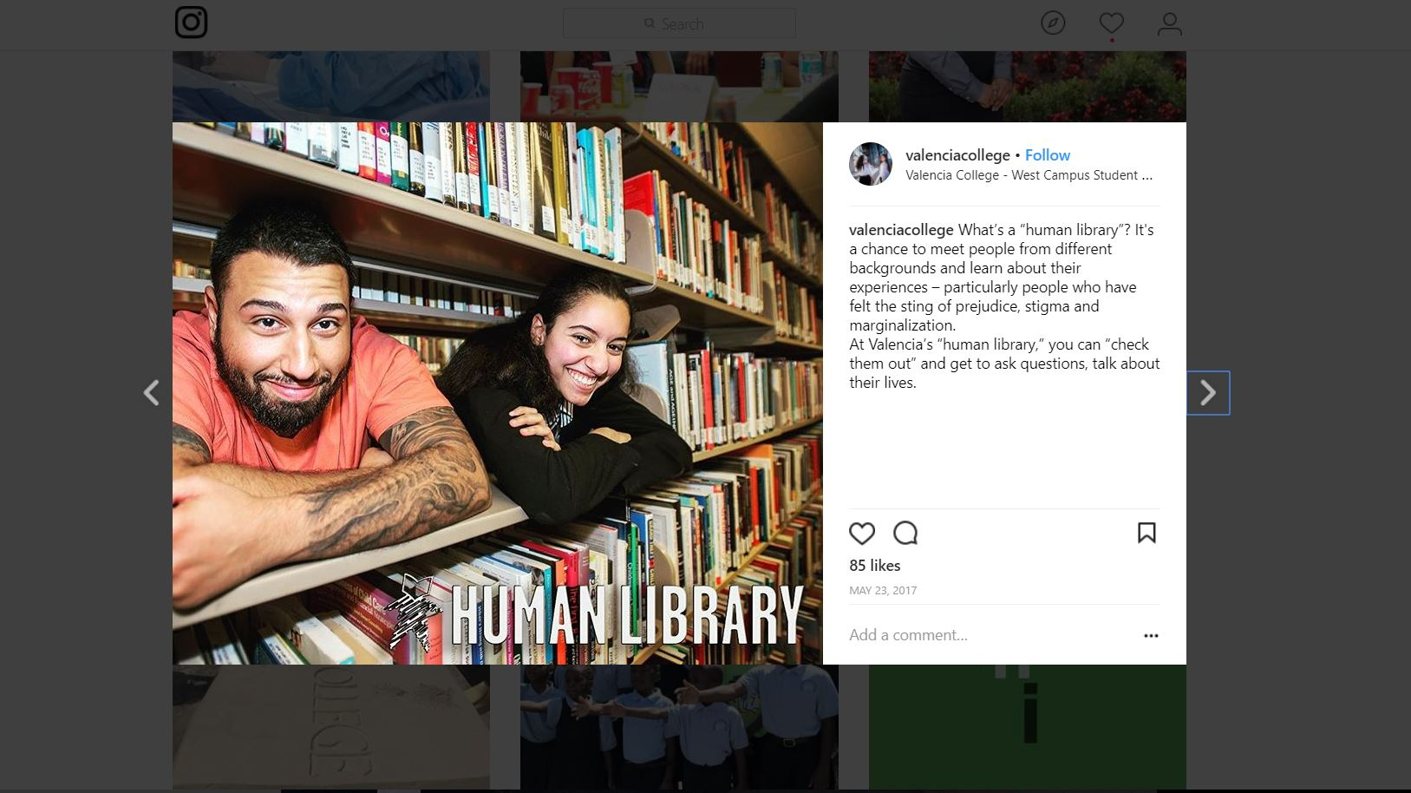
Marketing
Created Signage using HL images
Shared via:
  VISIX
  Social Media
  Email
  Newsletter
Notes:
Nardia

Slide 29
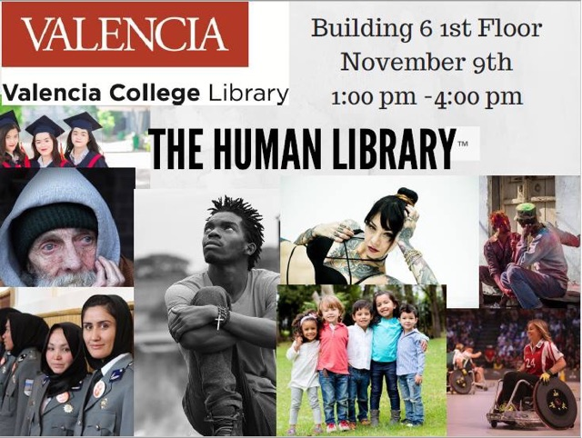
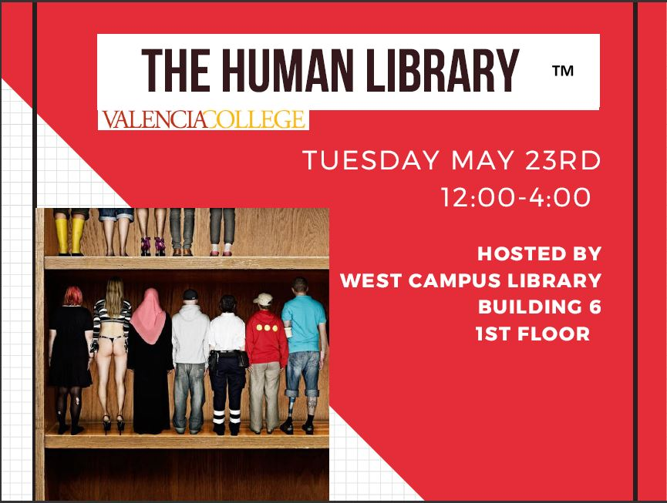
Marketing- Flyers
Notes:
Nardia

Slide 30
Food & Refreshments
Provided refreshment for the Books
Light meal
  Sandwiches, fruits, finger foods
Drinks
  Water, Tea, coffee, soda
Utensils, napkins, decorations
*We funded this by donations from our own staff. Going forward we are partnering with different areas in our college for funding.*
Notes:
Nardia

Slide 31
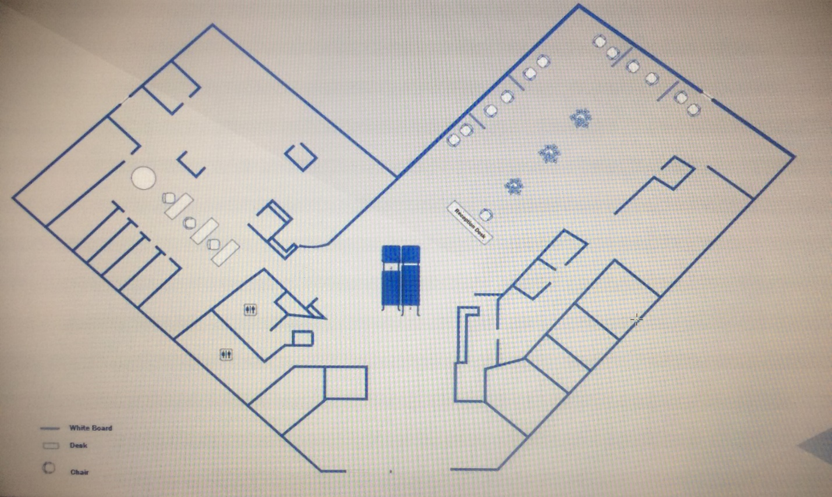
Layout
Semi-private spaces for Readings
  Two chairs
  *Tissues*
Circulation/Checkout Desk
Book Lounge
  Refreshments
  Wi-fi
  Laptops, computers, chargers
Notes:
Nardia

Slide 32
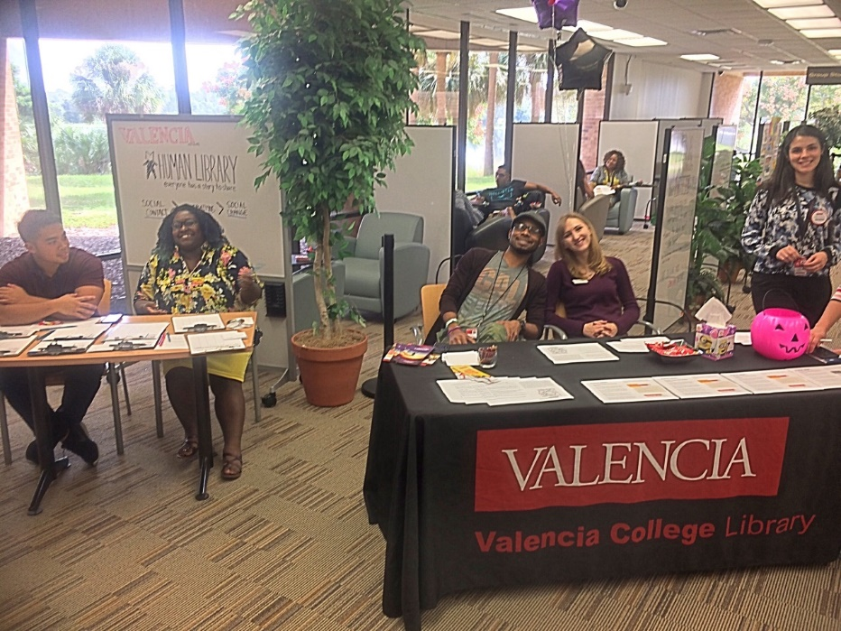
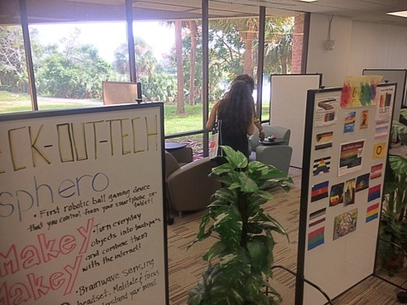
Layout
Notes:
Nardia

Slide 33
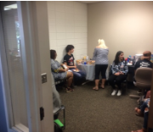
Challenges
Finding Books!
  Not everyone can be a book
  Scheduling/availability
  Time consuming-phone and in-person interviews
Layout
  Proximity of Book Lounge and Reading area
Checkout Procedures
  Simple is best- this is low-tech! Sign-in sheets and pens!
Classes showing up
  Long waitlists
Notes:
Nardia

Slide 34
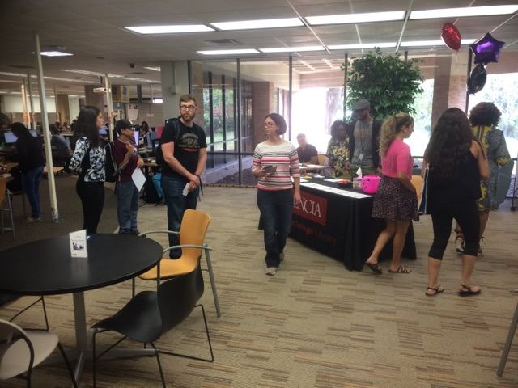
Event Feedback
Surveys
  Books
  Readers
Student papers
Emails, Phone calls
  Feedback about the event
  Inquiries about future events
Notes:
Regina

Slide 35
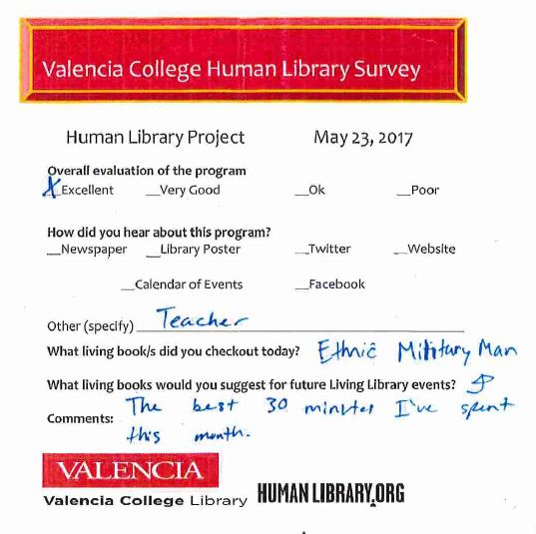
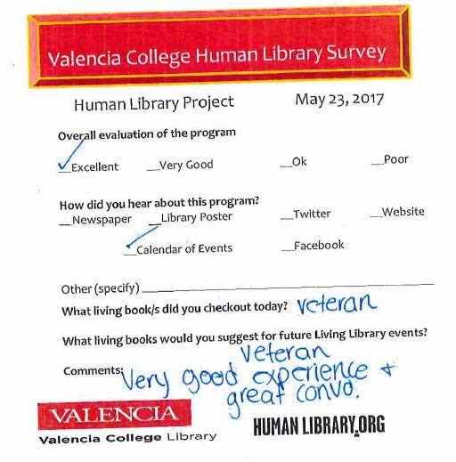
Event Feedback- Reader Surveys
Notes:
Regina

Slide 36
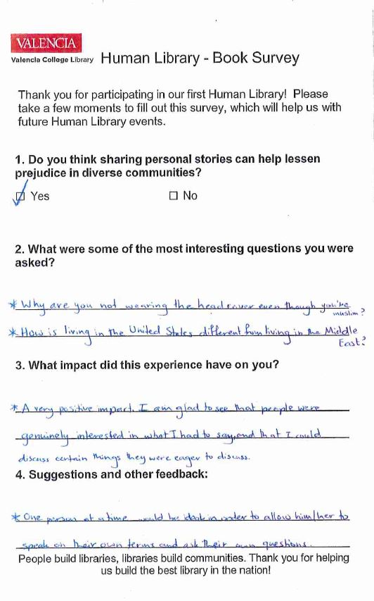
Event Feedback- Book Survey
Along with speaking with the books after each checkout, we asked for them to fill out a survey at the end of each event.
Notes:
Regina

Slide 37
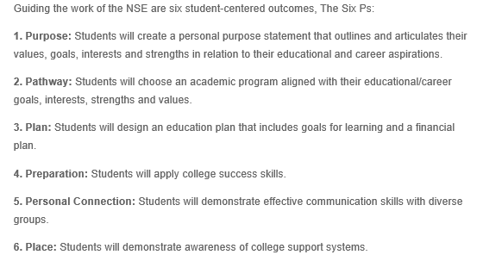
Learning Outcomes
New Student Experience (NSE) Learning Outcomes
6 P’s of student success
Personal connection
Notes:
Regina

Slide 38
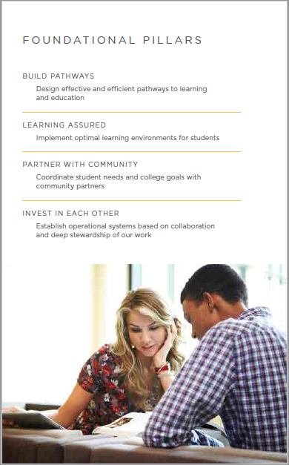
Strategic Outcomes
Foundational Pillars
Invest in Each Other
Partner with the Community
Goal: Explore and develop partnerships with the community to enhance programming
Goal: Establish personal connections for all new students across the college
Notes:
Regina

Slide 39
Looking Ahead
Partnering with other areas
  Funding
  Growth-helping start events at other campuses
Constantly on the lookout for new titles!
Notes:
Regina

Slide 40

Notes:
Regina

Slide 41
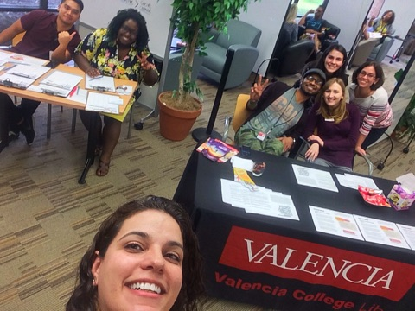
Questions?
Jeannie Rodriguez
jrodriguez237@valenciacollege.edu
Regina Seguin
rseguin@valenciacollege.edu
Nardia Cumberbatch
ncumberbatch@valenciacollege.edu
Notes:
Regina

