Slide 1
Creating a Culture of CARE at Valencia
69th AFC Annual Meeting & Conference
November 8, 2018
Presenters:
Leonard C. Bass, Dean of Learning Support
Chris Teumer, Assistant Director, Learning Support & Advising

Slide 2
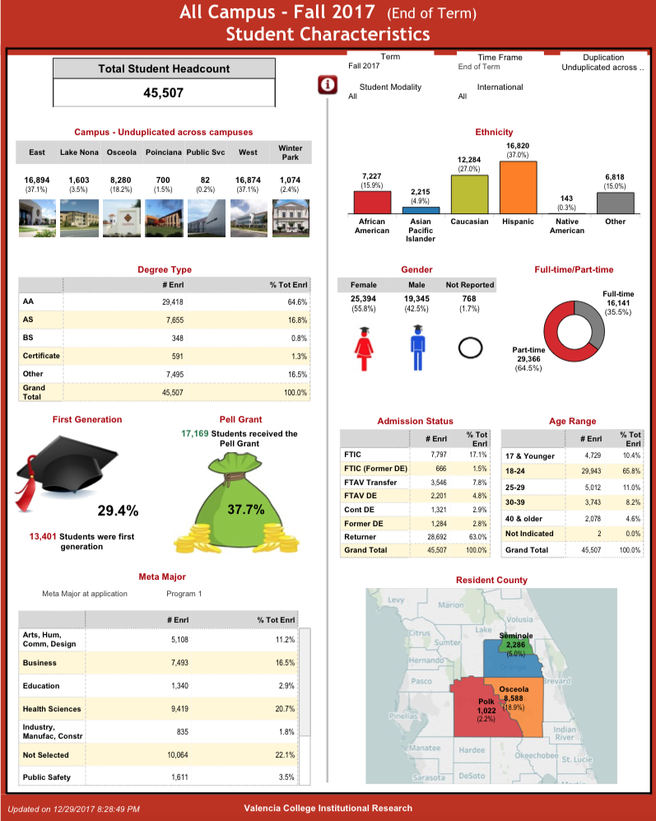
Valencia named “best community college in the nation in 2011”
Honored as a Vanguard Learning College in 2001 by the League for Innovation in the Community College and Joined board of directors in 2016.
2009, Valencia was named an ATD Leader College and earned the first Leah Meyer Austin Award for Excellence in Student Success
Valencia received the 2017 Great Colleges to Work For designation awarded by The Chronicle of Higher Education
Named a winner of the inaugural Siemens-Aspen Community College STEM Award by the Aspen Institute College Excellence Program. (2018)

Slide 3
Continuous Assessment
& Responsive Engagement
Early Alert at Valencia College

Slide 4
What is CARE?

Slide 5
Phases of CARE

Slide 6
Typical “Academic/Early Alert” Short-comings
Greenhouse Study (2008) indicates:
Low faculty & student participation rates
Transactional
Lack of inter-departmental information sharing
Open loop, disconnected interventions
eTool dependence, not user-friendly
Assessment not continuous
Faculty-Student engagement non-existent
Gardner Study (2012)
Only 40% of users report increased persistence/retention
Less than half of institutions realized cost and educational benefit

Slide 8
Impact of CARE at Valencia
Faculty
140+ completers of LFMP 3348 to-date
Micro-Interventions (CARE Plans)
New assessment strategies (e.g. early diagnostics)
Faculty focus on key touchpoints throughout the semester along with just-in-time interventions
Title V Fellows (Summer 2017) & Pacific Research (Summer 2018)
Faculty reported an increase in student participation & engagement in class
Improved (faculty) understanding of how to support struggling students
Faculty gained an in-depth understanding of resources, increased their interaction with campus support services, and developed a stronger connection to the College.
Institution
Elimination of departmental silos
Title V Grant (2015-2020) to support scaling the work

Slide 9
Columbus State Community College Site Visit September 20th, 2017

Slide 10
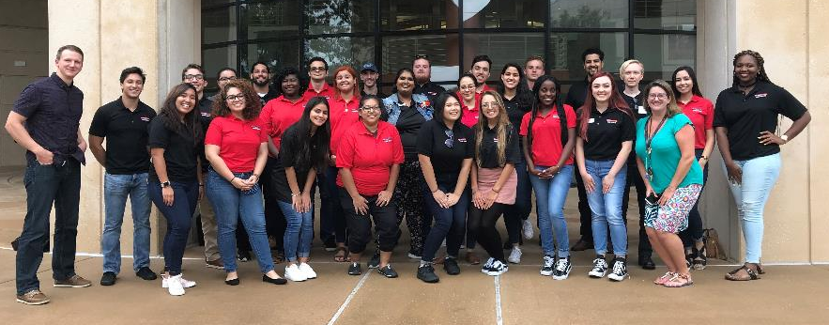
Merging SL & CARE: CARE+

Slide 11
Overcoming the challenges of SL
Referrals…
Reach students who don’t self-identify as needing help.
Encourage students to take advantage of the resources available to them.
Increased Training for Coaches
Identify and address underlying student issues, rather than just the symptoms.
Connect students with the appropriate non-academic resources.
Increased Training for Faculty
Must complete LFMP 3348 - LifeMap Early Alert & Intervention as prerequisite to working with a CARE Coach.
Addendum to LFMP 3348, Infusing Your CARE Coach, will be piloted in Summer 2019.

Slide 12
CARE+ Structure
Leadership
Chris Teumer – CARE+ Manager
NSE, English, & Education Liaison
Jen Adams – CARE+ Coordinator
Math & Science Liaison
CARE Coaches - Math, Science,, & New Student Experience
Branding
Beginning Fall 2018, CARE+ (faculty initiated) merged with tutoring (student initiated) and support services provided by the Learning Support Center, formerly known as the Academic Success Center.
CARE+ acquired a dedicated coaching suite

Slide 13
CARE Coach Roles & Responsibilities
Model and teach successful learning behaviors to students
Assist the faculty member with:
Planning & supporting classroom activities
Facilitating classroom discussions
Providing information to students
Respond to all student referrals generated by the faculty member.
Hold group study sessions and one-on-one peer coaching sessions.
And more…

Slide 14
CARE Coach Training & Preparation
Foundational Training: NASPA Certified Peer Educator
Understanding the Power of Peer Education
Create Change in High-Risk Behaviors
Effective Listening
Manage Crises, Respond, & Refer
Act as an Empowered Bystander
Reflecting on Identities
Programming & Presentation Skills
Group Development & Success

Slide 15
Weekly Training Topics
Growth mindset
Specific student populations (e.g. homeless, Veterans, etc.)
Strengths Coaching
Peace and Justice (Principles, Conflict, etc.)
Health & wellness
Mindfulness
Recognizing & supporting students in emotional distress
Campus & community resources
And more…

Slide 16
The Faculty Referral Process
Faculty
After consulting with the student, faculty create a referral to coaches.
CARE Coach
Receives alert from faculty (could originate from another coach).
Reaches out to student for triage, resource referral, and support (continuous).
Follows up with their faculty member.
Identifies at-risk student
Documents important details related to the student’s situation.
Student
Attends all scheduled meetings with the coach.
Completes agreed upon action items between sessions.
Contacts the coach for help, referrals, and/or assistance whenever needed.
Engages in dialogue with student to asses the student’s needs.

Slide 17
By the Numbers…
Spring 2018 (Pilot)
7 faculty
25 classroom sections
480 students enrolled
20 CARE Coaches
38 faculty referrals generated
Summer 2018
16 faculty
32 sections
696 students enrolled
25 CARE Coaches
46 faculty referrals generated
Fall 2018
21 faculty
74 Sections
1884 students enrolled
28 CARE Coaches
40 Referrals to-date

Slide 18
Summer 2018 Survey Results
NSE (Online)
78% response rate (n=47)
80% of students reported an increased awareness of resources at Valencia.
66% reported that having a coach has increased their sense of belonging at Valencia
69% believe their confidence to overcome challenges has improved after working with a CARE Coach.
Math, Science, & English
8% response rate (n=50)
84% of students reported an increased awareness of resources at Valencia.
85% reported that having a coach has increased their sense of belonging at Valencia
75% believe their confidence to overcome challenges has improved after working with a CARE Coach.

Slide 19
Student Quotes
“I believe this is the best college I have ever attended and please keep these programs in place to help all the students it only takes 1 person to believe in you and these coaches and your school show you want students to grow and make a life not just collect there money.” – NSE Student
“The care program has had a significant impact on my academic success through encouragement and providing resources I was unaware of. The environment provided with care is safe and reassuring it is motivating to work with students who have gone through the class and understand often where it is the students struggle..” – Math Student

Slide 20
The Future of CARE

Slide 21
Phase 2 – Support Services
CARE Academy
Strategic Partnerships
Student Services
Faculty Development
Organizational Development (HR)
Site Visit to Colorado Schools
Colorado State University
Arapahoe Community College
Front Range Community College
EAB Deployment
Strengthen Communication
Creating and closing communication loops

Slide 22
Questions & Contacts
Leonard C. Bass – lbass11@valenciacollege.edu
Chris Teumer – cteumer@valenciacollege.educollege.edu

