Slide 1
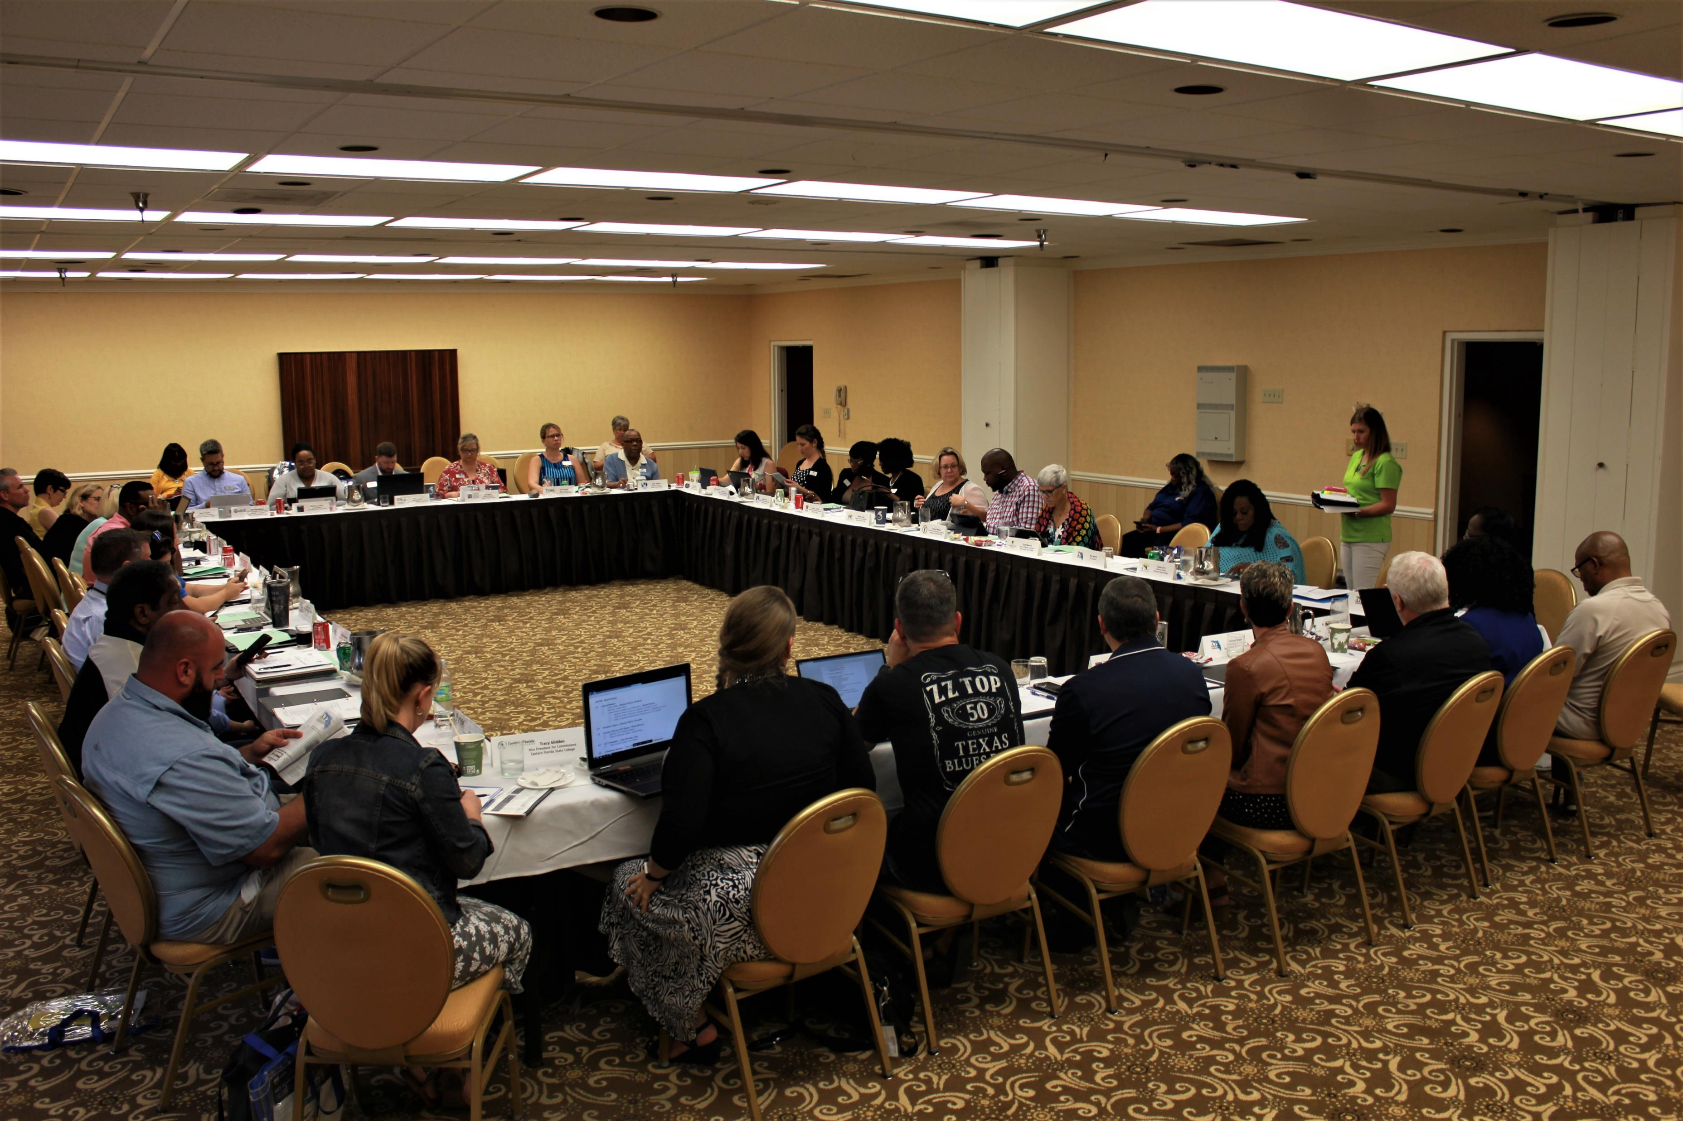
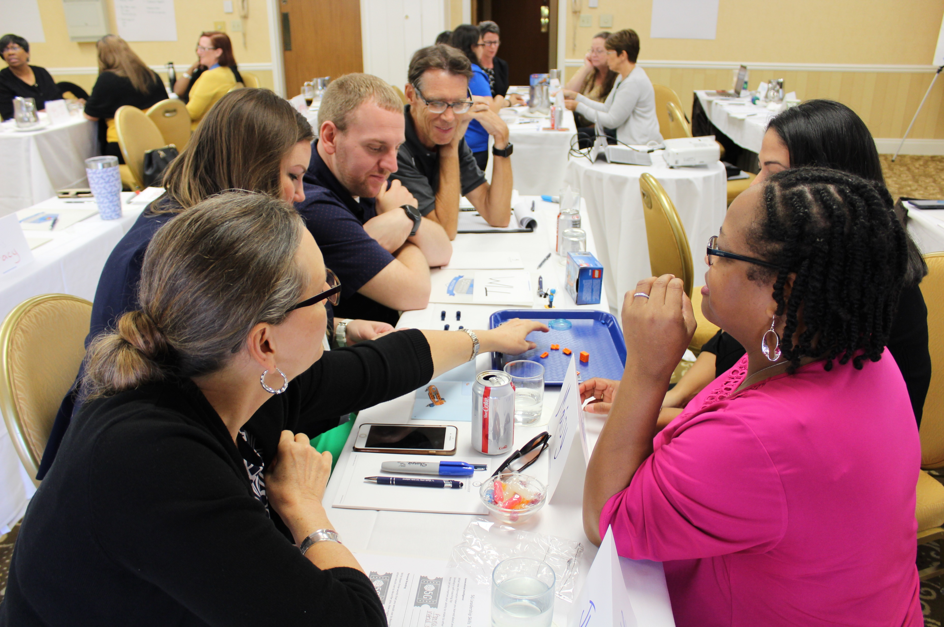
Let’s Give Them Something To Talk About:
AFC Membership 101

Slide 2

WHO WE ARE:
Founded in 1949
28 institutional members
Approx. 7000 individual members
29 Chapters and 14 Commissions
6 fulltime professional staff
3 professional publications – Current, Capitol Perceptions & Annual Report

Slide 3
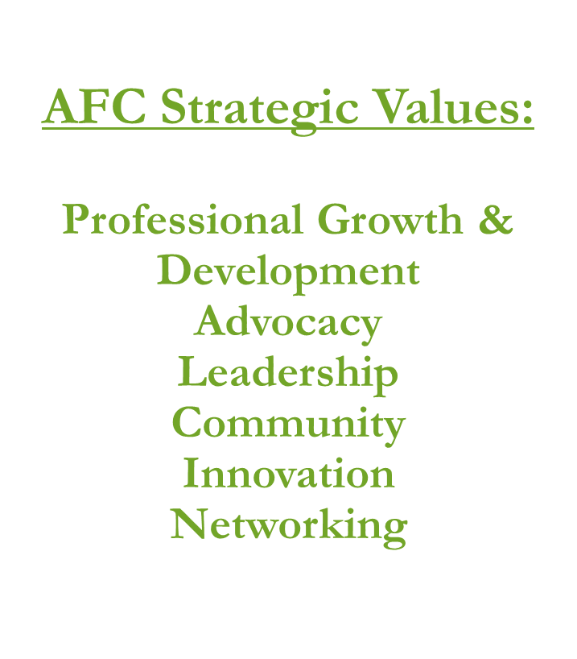
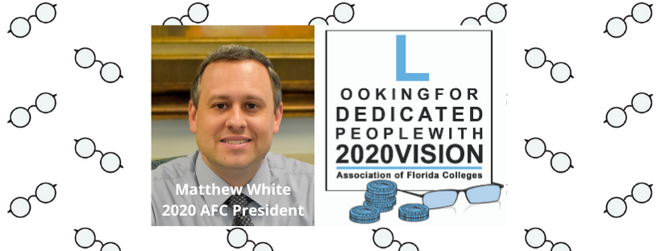

Slide 4
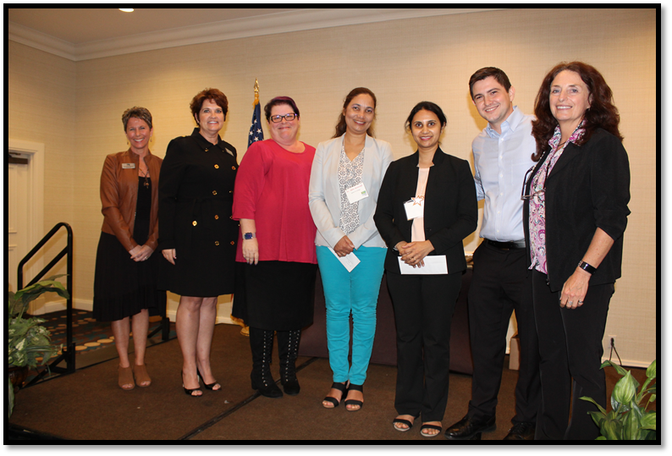
Let’s Talk About Professional Development:
Commissions
Provide the Professional Development of the Association
Currently - there are 14 Commissions
Based on employment classifications and interests
Each member can belong to at least 3 Commissions
Provide Recognitions & Awards
2019 Professor of the Year
Amee Mehta, Professor of Biology
Seminole State College
2019 Finalists:
Asha Brunings, Phd., Associate Professor of Microbiology
Santa Fe College
Jacklyn Pierce, Assistant Professor of English
Lake-Sumter State College

Slide 5
Professional Development:AFC Commissions
Administration | Facilities | Student Development
Campus Safety | Faculty | Technology
Career & Professional Employees | Healthcare Education | Trustees
Communications & Marketing | Institutional Effectiveness, Planning, & Professional Development | Workforce, Adult & Continuing Education
Equity, Diversity, & Inclusion | Learning Resources | ** Retirees Committee**

Slide 6
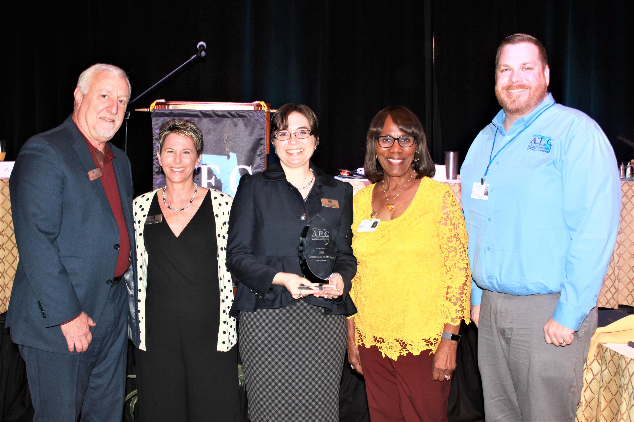
Professional Development
Host Spring Conference
Sponsor Educational Session at Annual Conference
Exemplary Practices
Present Awards at Annual Conference
Monetary Awards/Stipends
2019 Commission of the Year:
Learning Resources

Slide 7
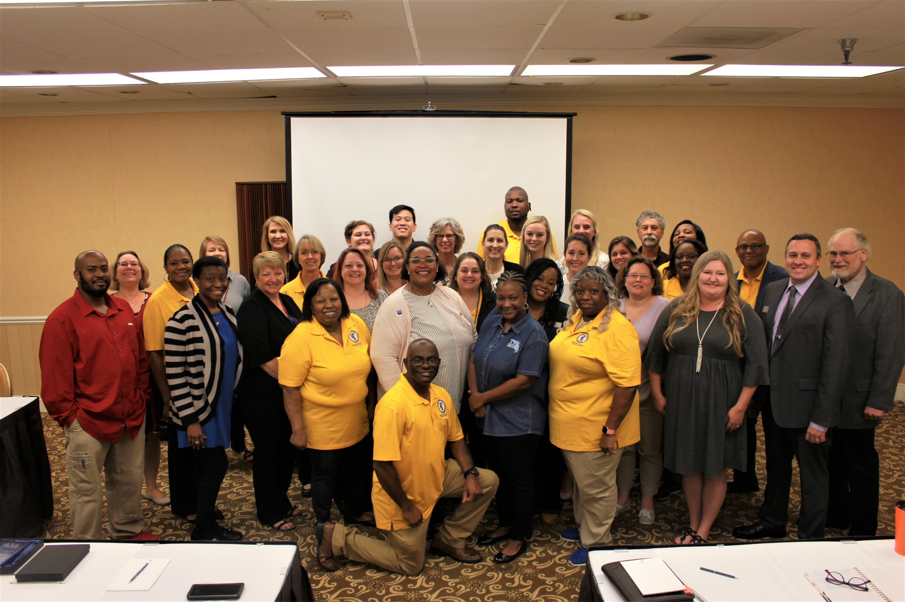
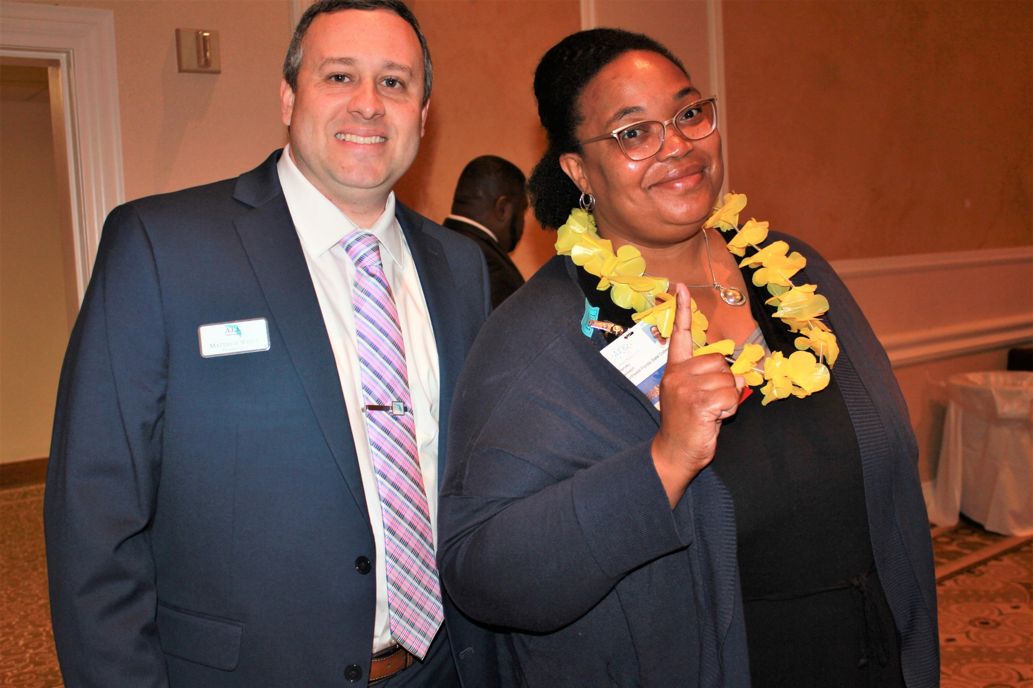
Professional Development:
Chapters & Regions
Region 1 – Chipola, Gulf Coast, Northwest Florida, Pensacola, Tallahassee
Region 2 – Florida Gateway, Florida State at Jacksonville, North Florida, St. Johns River, Santa Fe
Region 3 – College of Central Florida, Daytona State, Eastern Florida, Lake-Sumter, Seminole, Valencia
Region 4 – Florida SouthWestern, Hillsborough, Pasco-Hernando, Polk State, St. Petersburg, South Florida, State College of Florida
Region 5 – Broward, Florida Keys, Indian River, Miami Dade, Palm Beach
Region 1
AFC President Matt White &
Region 1 Director Wanjiku Jackson

Slide 8
Let’s Talk About
AFC Annual Events & Activities
Leadership Conference
Legislative Days
Commission and Region Conferences
Board Meetings
Trustees Legislative Conference
Campus Safety Symposium
Annual Meeting and Conference - November

Slide 9
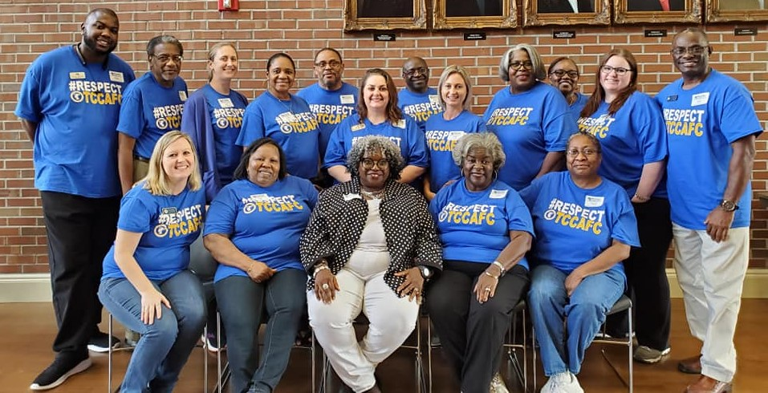
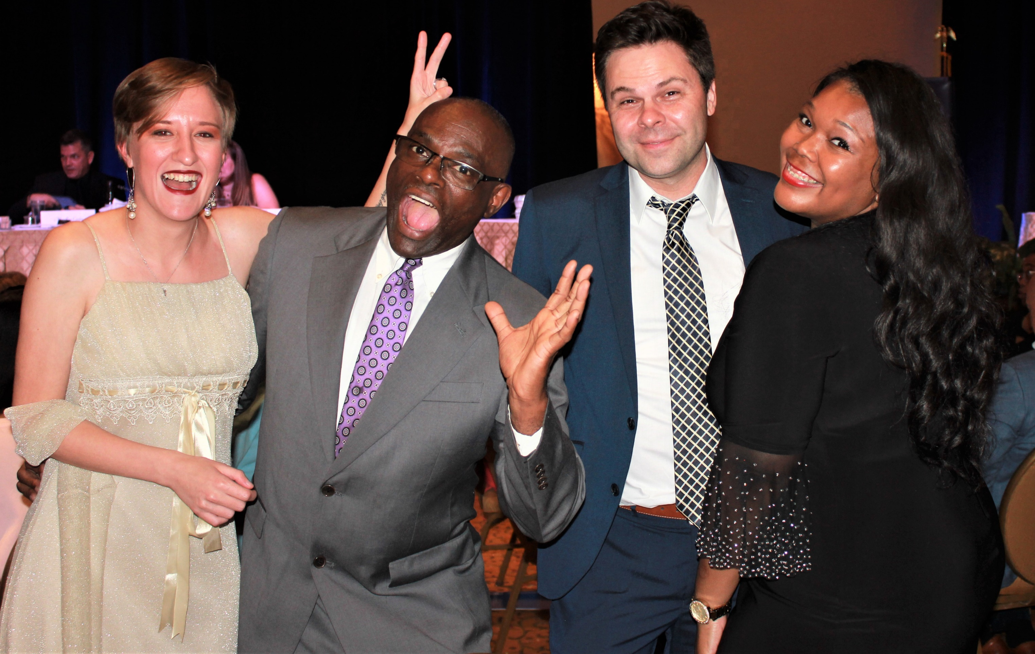
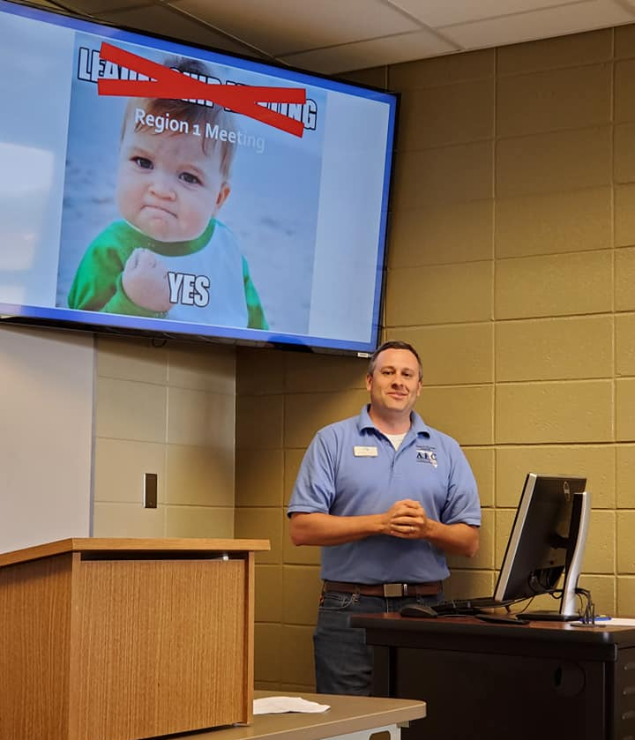
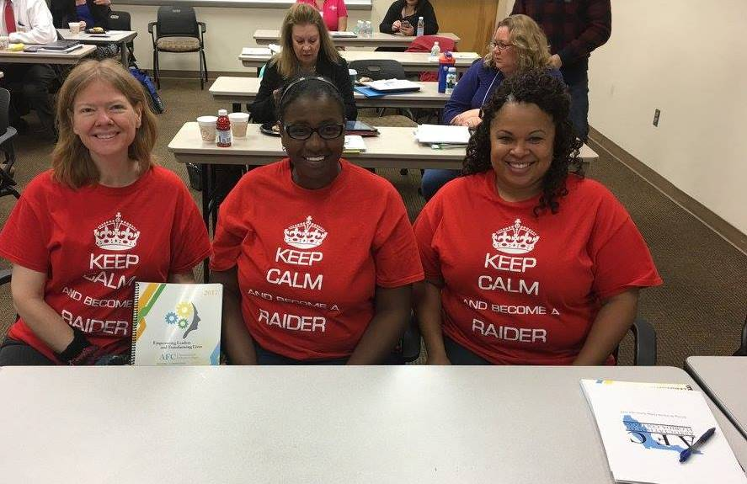
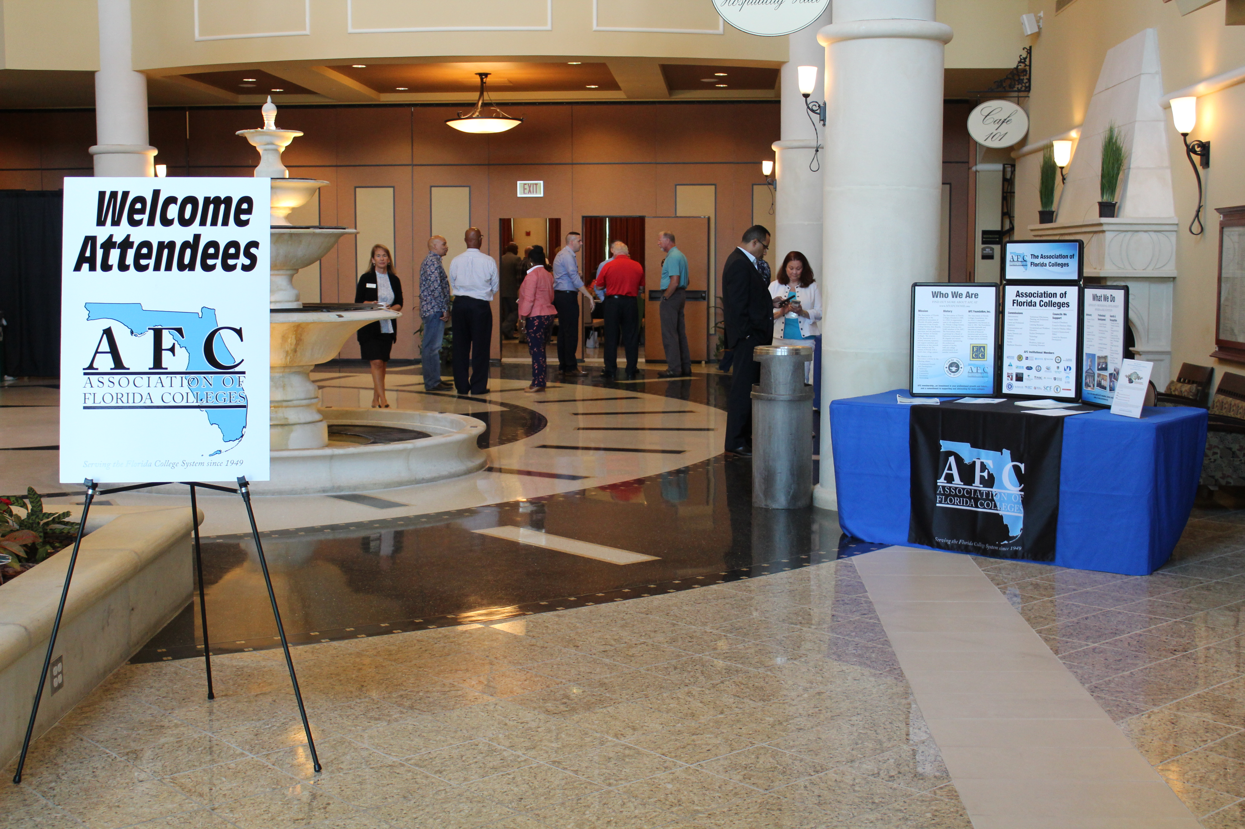

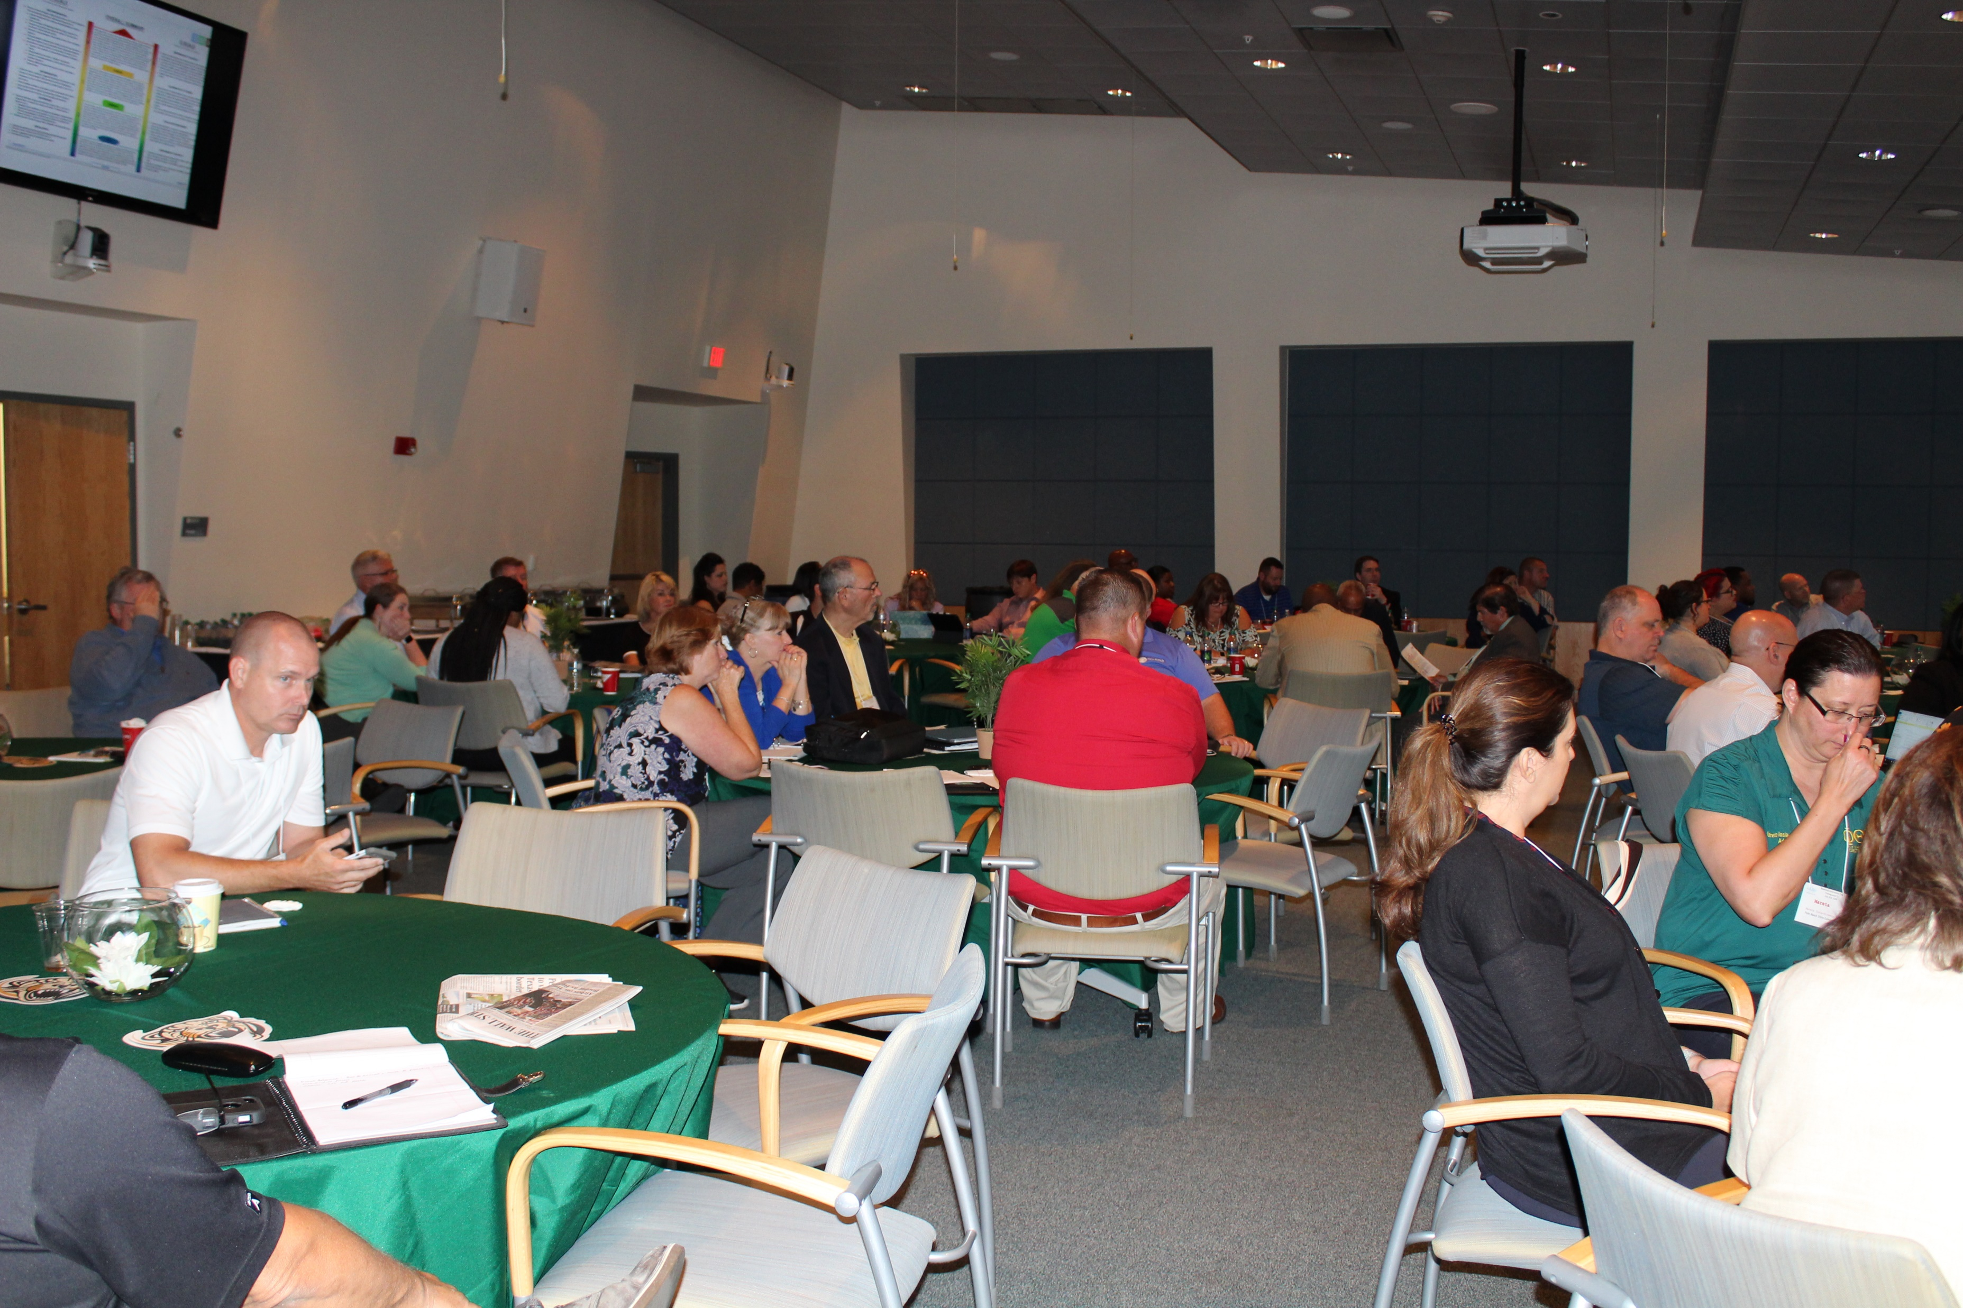
Upcoming in 2020
Campus Safety Symposium
Spring Conferences
Regions & Commissions

Slide 10
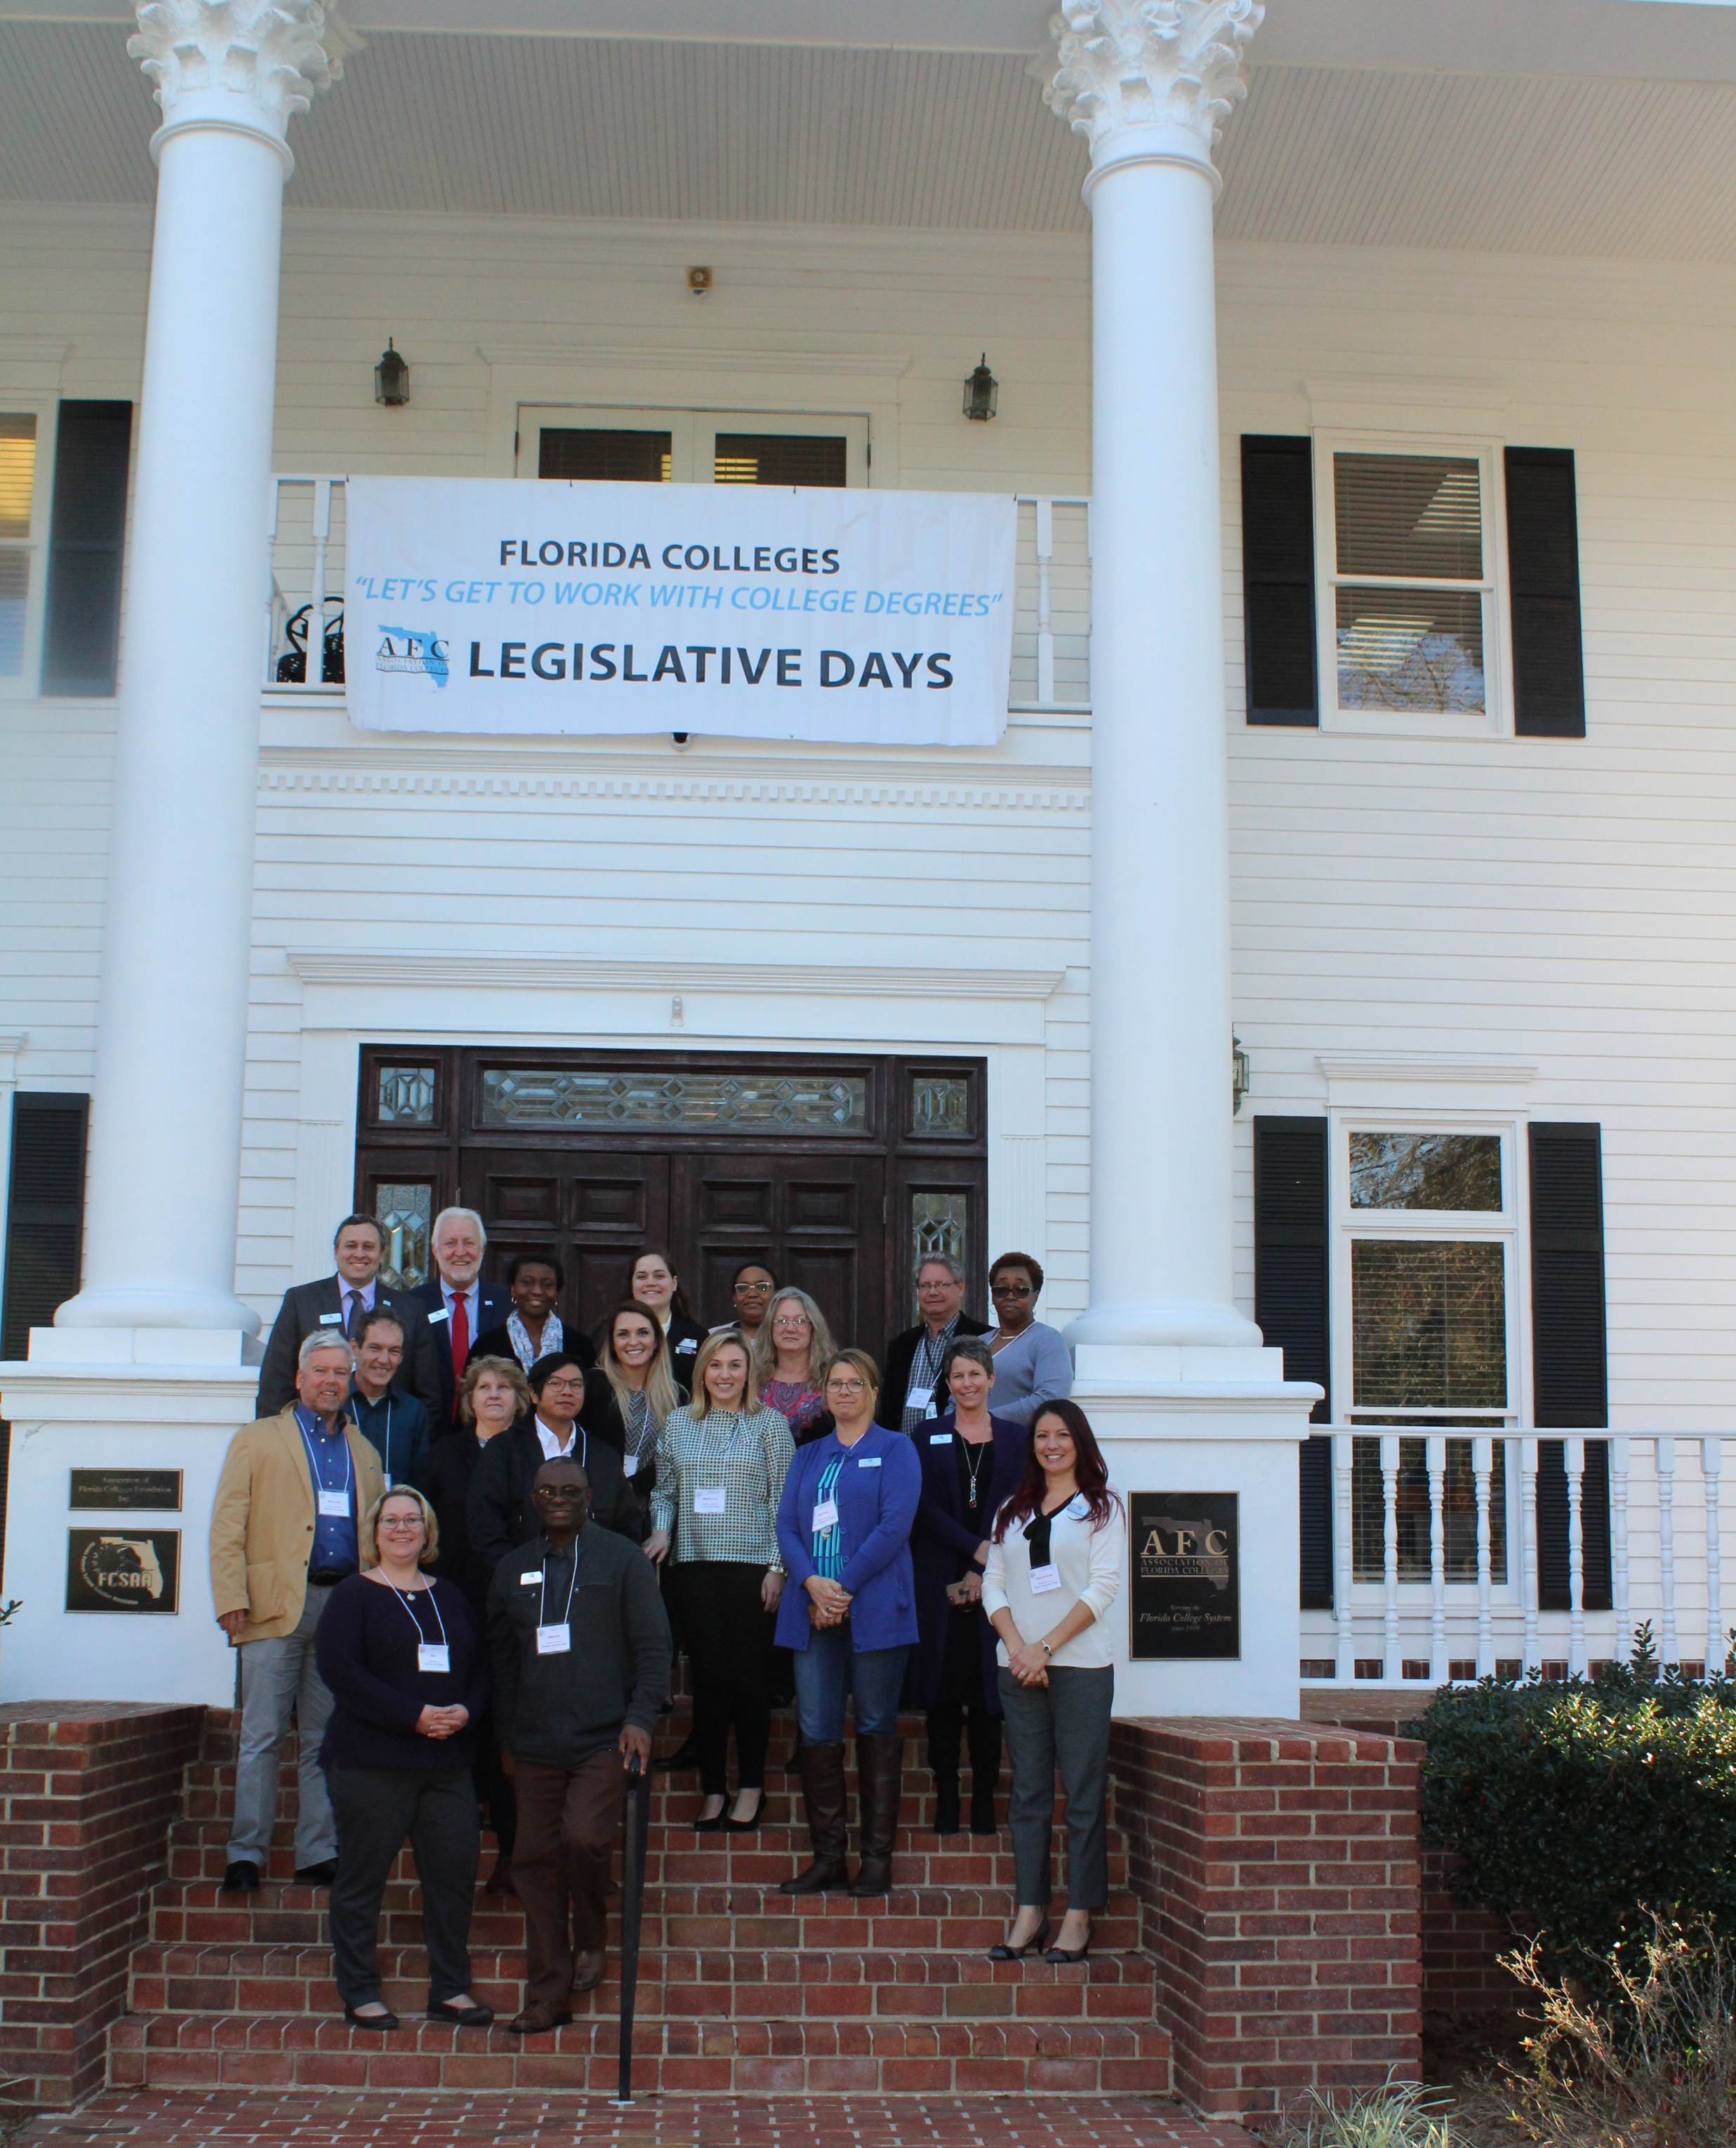
Let’s Talk About Advocacy
Support Florida College System (FCS) Legislative Priorities
AFC Legislative Committee (College Lobbyists and Presidents)
Communicate Issues to Members
Represent the 28 Institutions and almost 7,000 Members
Capital Perceptions ~ Published each week of the Legislative Session
2020 Legislative Days

Slide 11
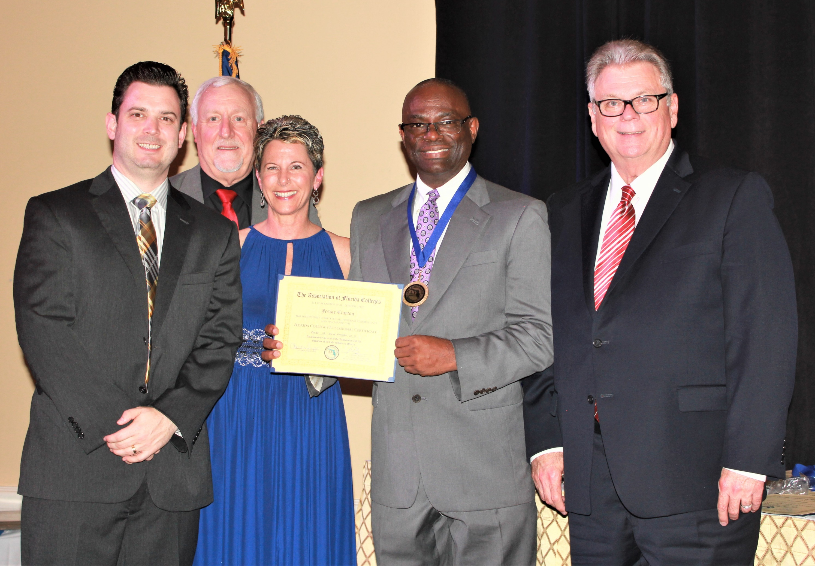
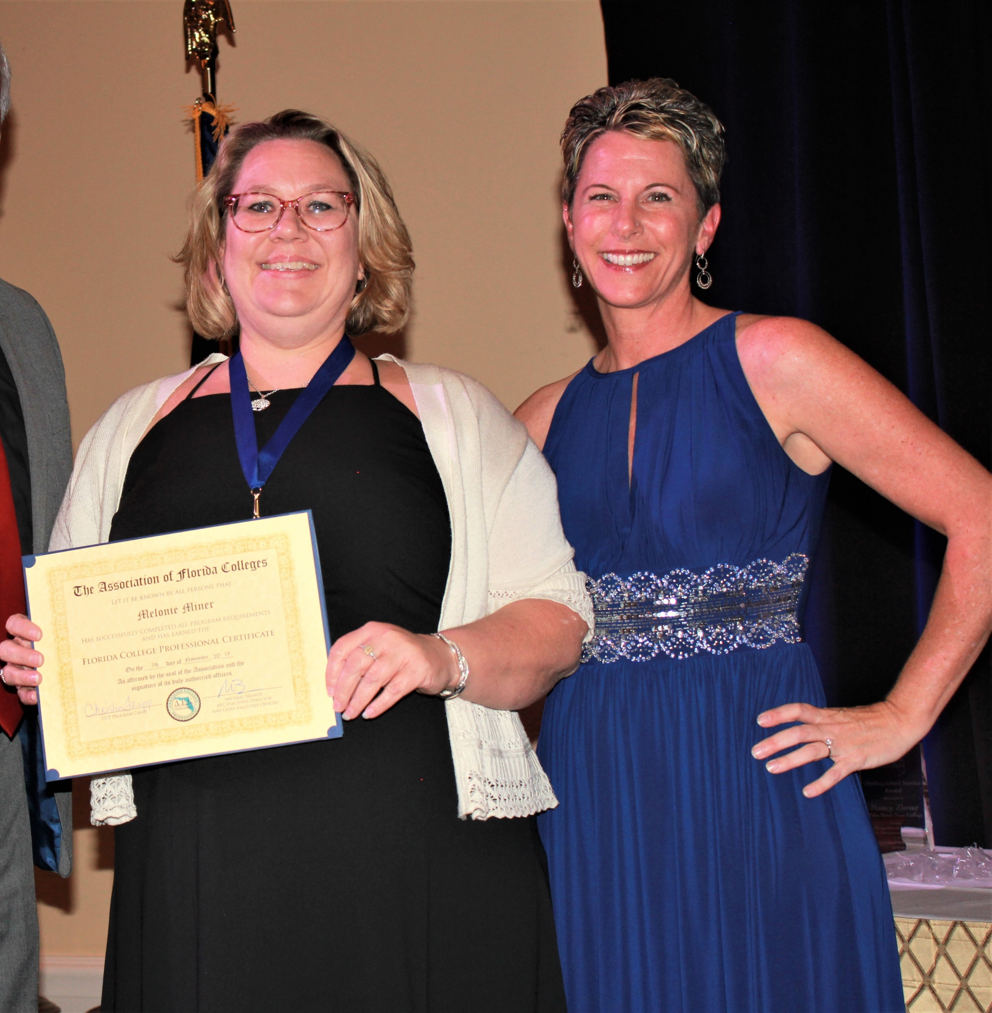
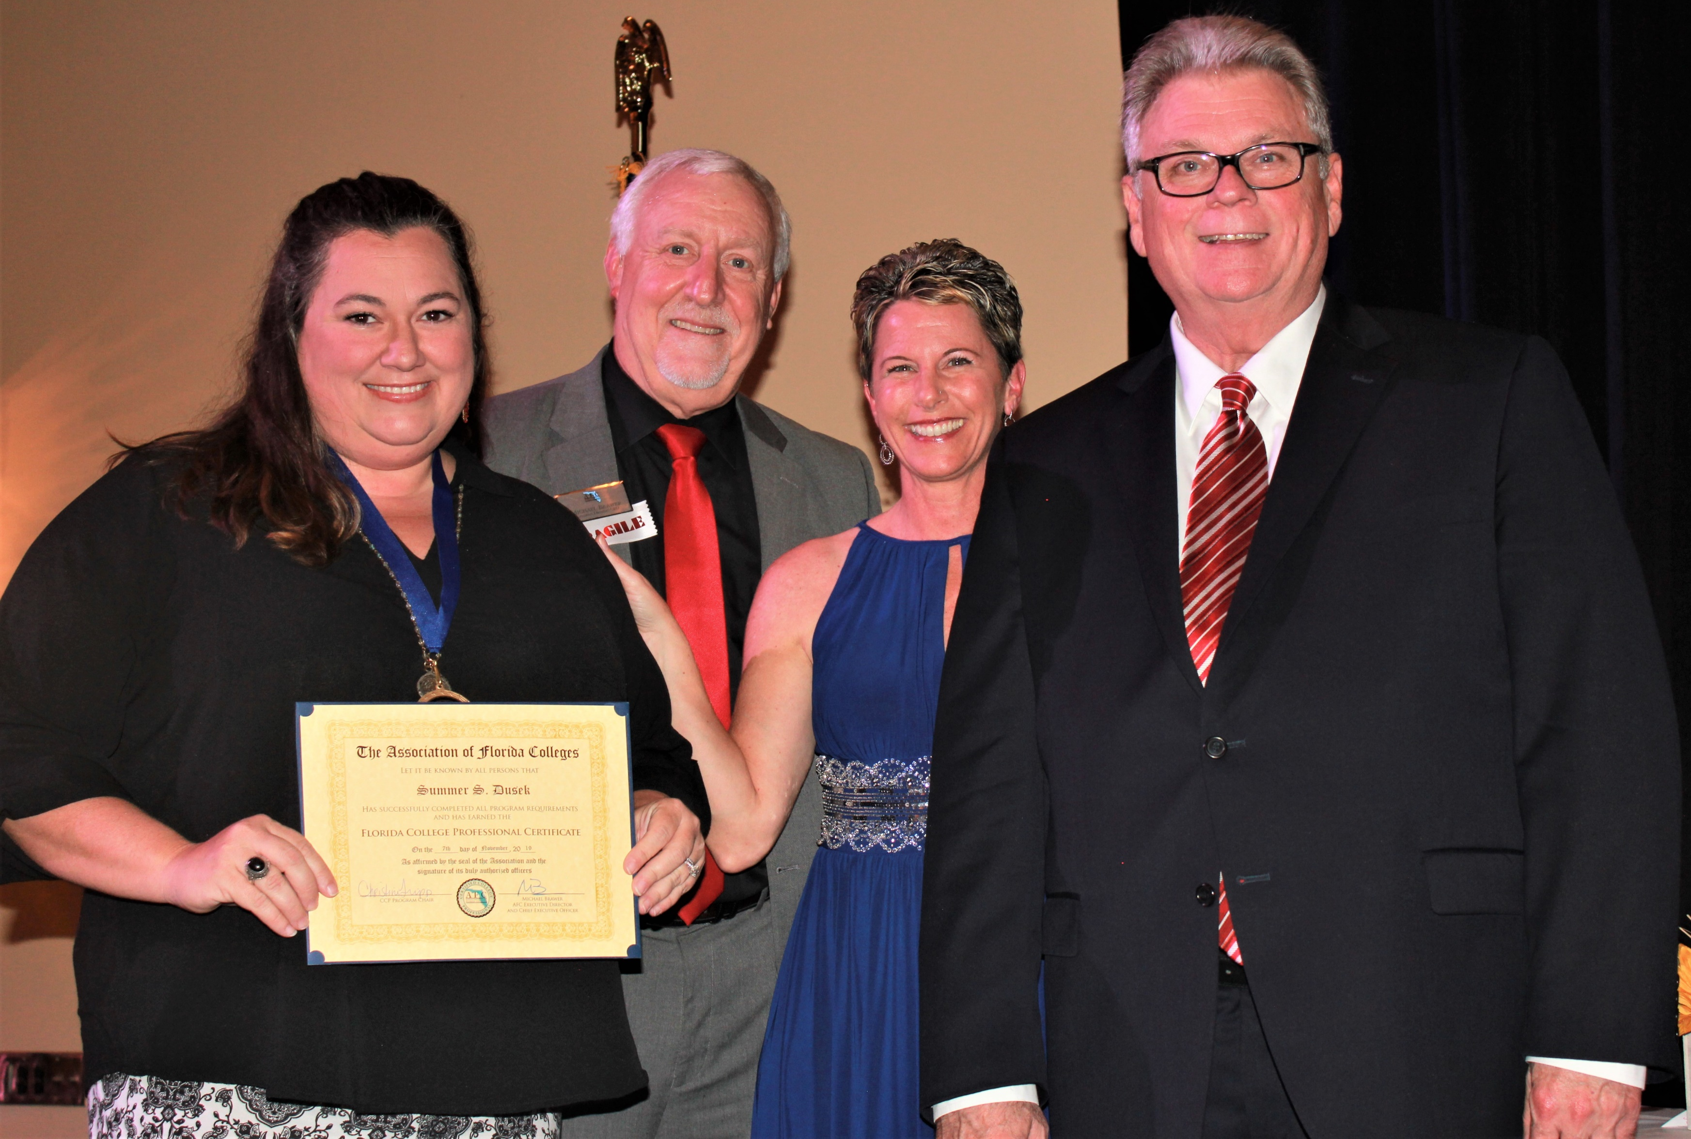
Let’s Talk About Leadership:
Certified College Professional Program
2019 CCP Graduates
Region 1
Core Courses:
  Leadership
  Legislative Process & Advocacy
  The Florida College System
  Building Community & Customer Service
    Application Fee: $200
Jessie Clayton ~ TCC
Melonie Minor ~ PSC
Summer S. Dusek ~ TCC

Slide 12
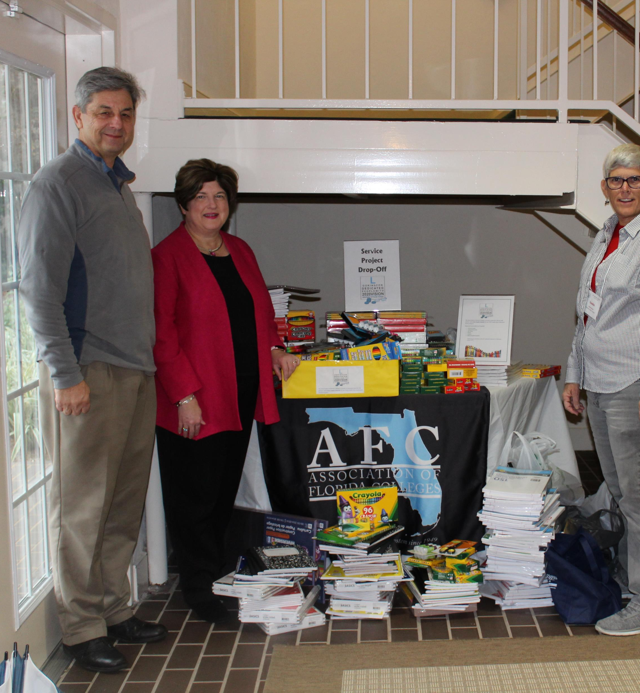
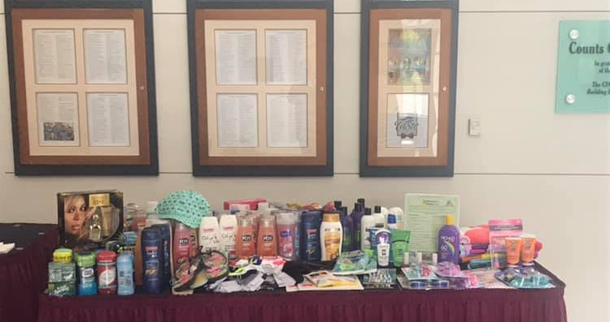
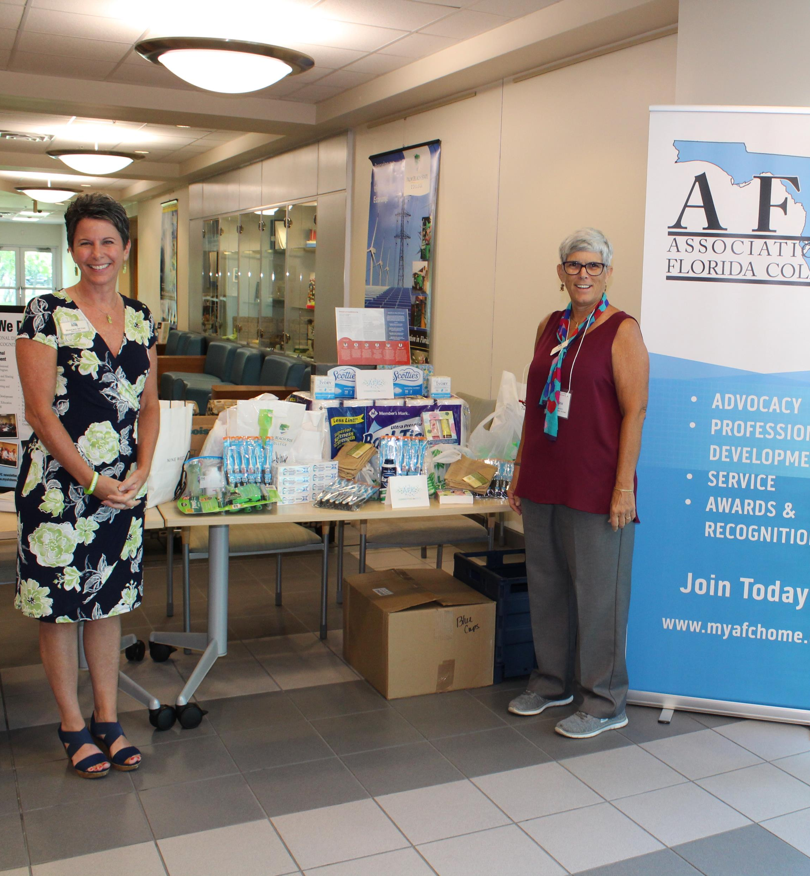
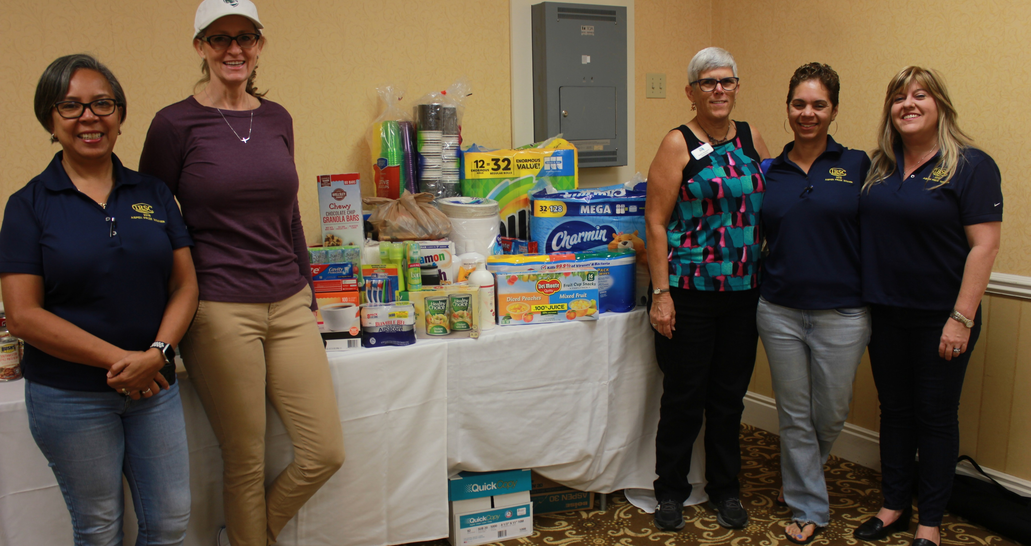
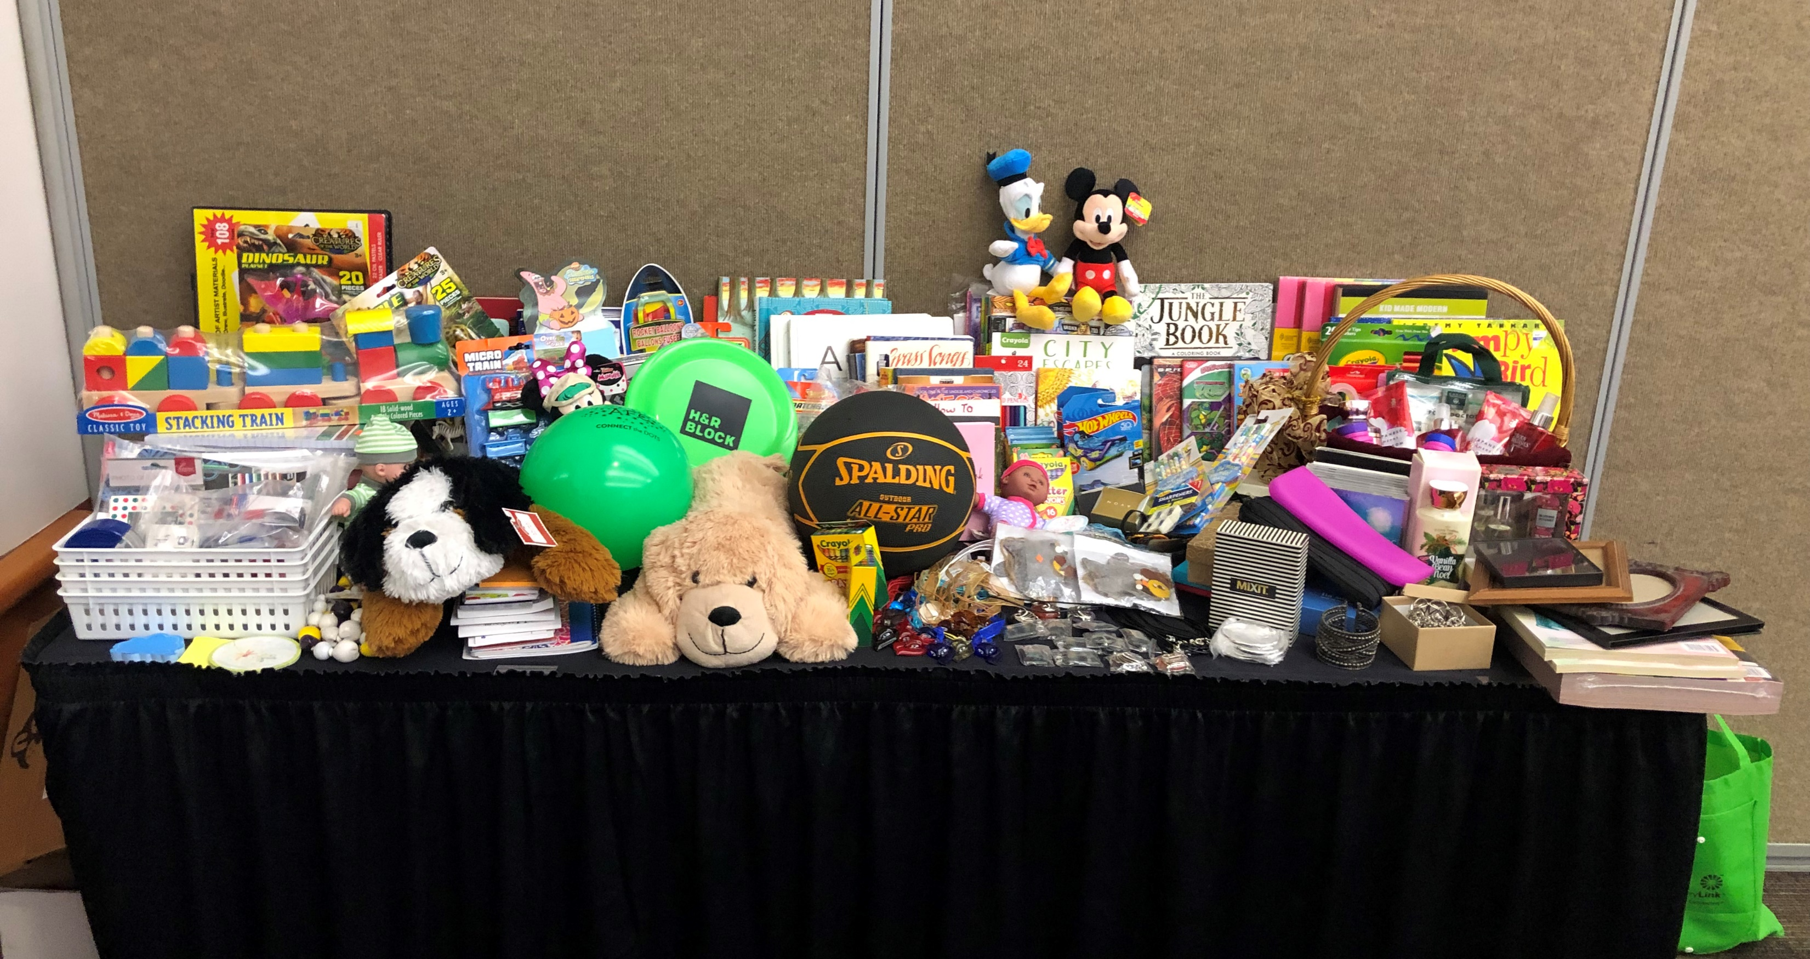
Let’s Talk About AFC Community Service:
We Make A Difference!
Chapters, Regions & Commissions Give Back Throughout the Year!

Slide 13
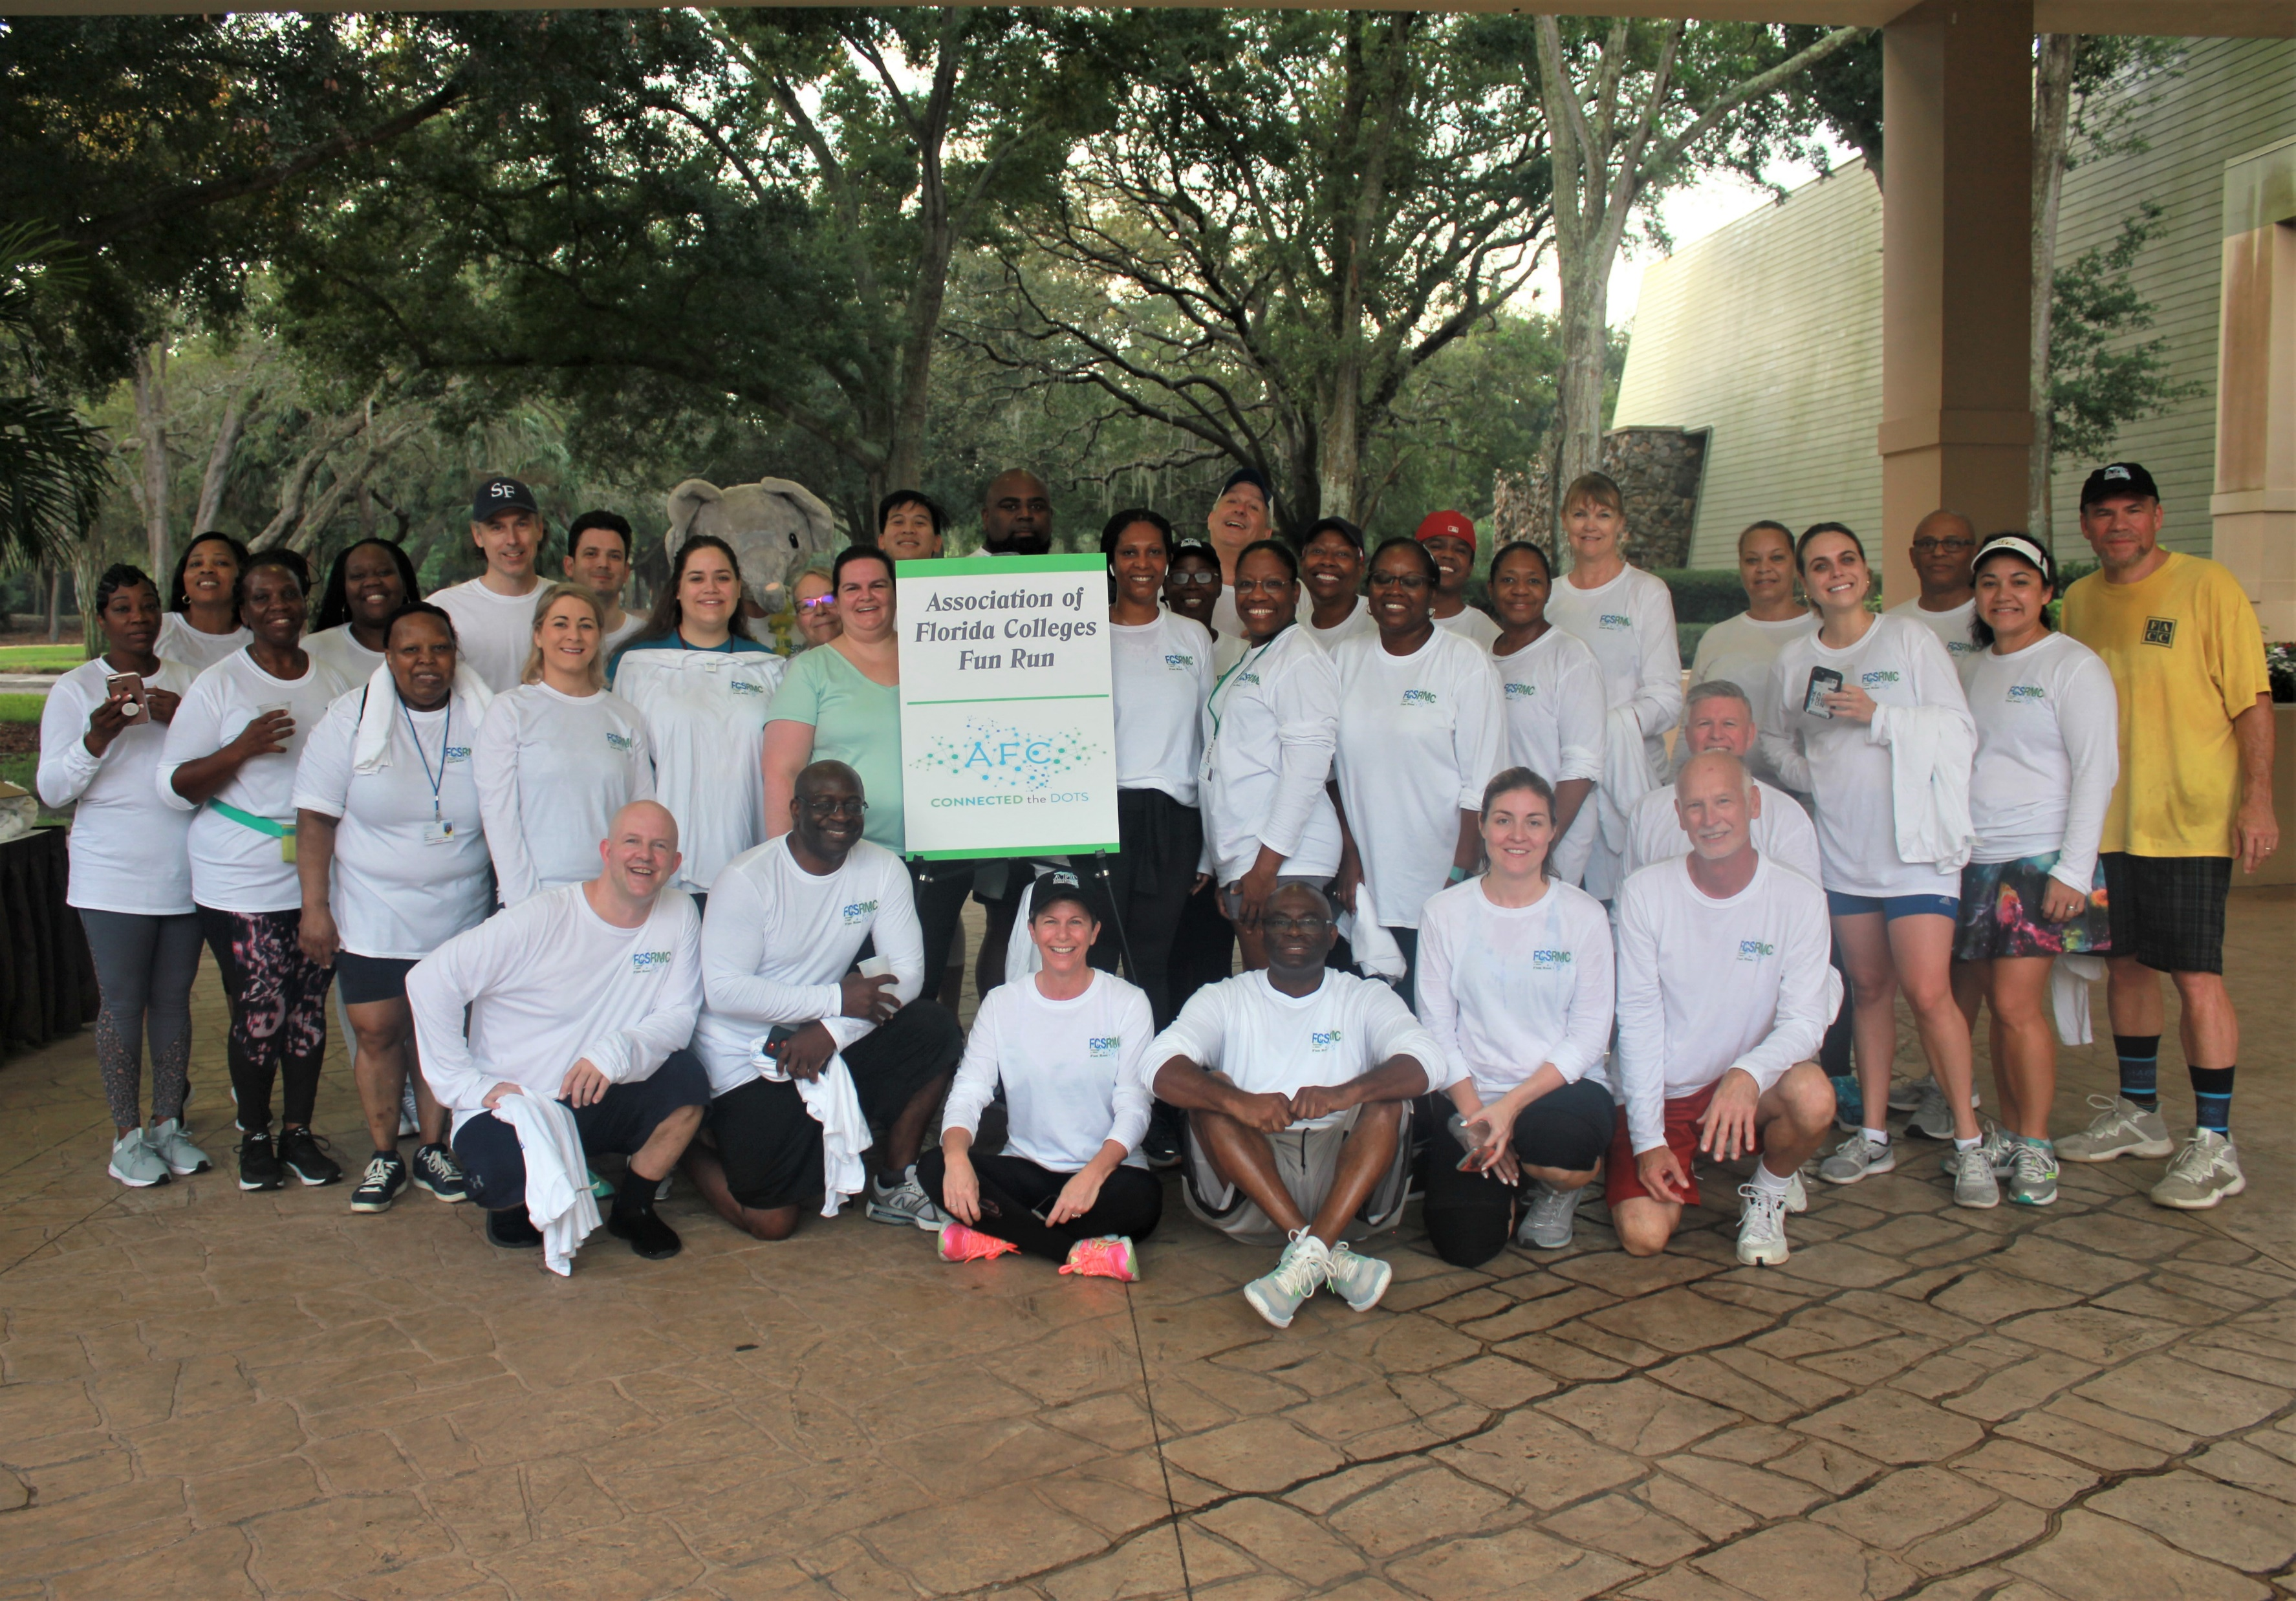
Let’s Talk About the Network: What’s In It For You?
Benefits of Belonging
Share best practices with colleagues from around the state
Opportunities to network and form relationships with people who hold your job or the job you aspire to at other institutions
Receive recognition for innovative programs and projects
Friends made for a lifetime

Slide 14
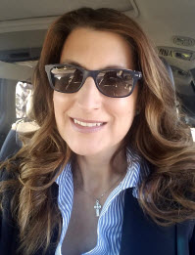
My AFC Story:
Lori Cannon ~ Gulf Coast State College
I am a first generation college student. My mother graduated high school, my father did not. Throughout my childhood, education was never thought of as a vehicle for success but more as a box to check for getting a job to contribute as our financial circumstances were less than desirable. I was fortunate enough to find my spouse early in life. After marrying at 19 and working a couple of years, at 22 I became a stay-at-home mom.
My husband was stationed at Tyndall AFB so I visited Gulf Coast State College. After conquering all my doubts and fears of being out of school for more than 15 years, I found a place that was welcoming and encouraging. While finishing my associates degree, I also found a job on campus in the Student Activities department. It was through this incredible opportunity I found the drive and purpose to continue on at FSU-PC and receive my bachelors degree 3 years later. My institution was so supportive in not only my educational goals but also in what I could give back to the institution that I pushed on and 3 years later received my Masters in Political Science, all of this with 3 children and a military spouse.
I can confidently say that GCSC helped me not only achieve my educational goals, that I am proud to say serve as an example to my children, but provided the environment that has allowed me to grow as a student, professional and future leader within the Florida College System. I can not imagine being anywhere else.

Slide 15





Let’s Talk About:
AFC Benefits ~ Discounts

Slide 16
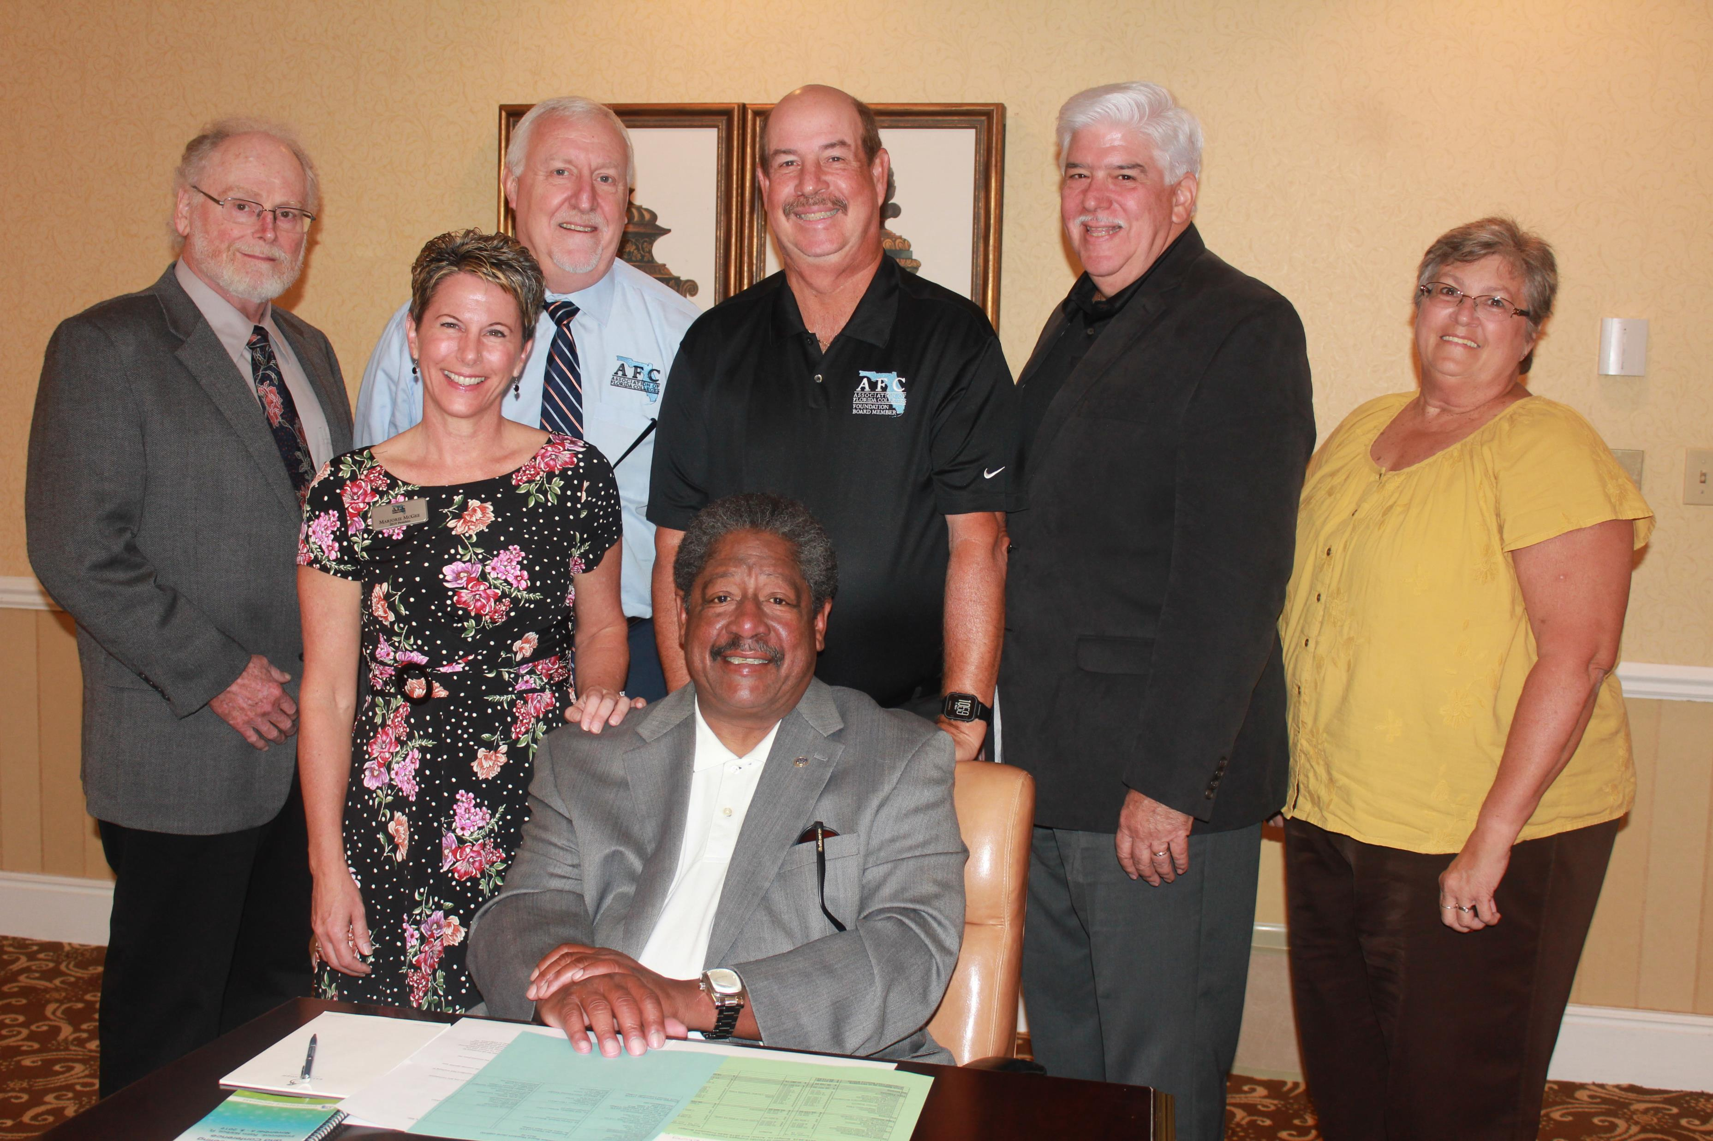
AFC Foundation Scholarships
Offered to members who can demonstrate an effective professional development plan to advance their knowledge and skills as a college professional.
Funds may be used for:
  AFC Leadership Conference, Legislative Days, or Campus Safety Symposium
  AFC Annual Conference
  AFC Certified College Professional Program
  AFC Commissions Conference
  AFC Regional Conference
    Up to 10 scholarships will be awarded annually. Award amounts will range from $100-$300 each. Funds may be used to cover costs of registration or enrollment, travel, and materials to any of the events listed above.
2019 AFC Foundation Board

Slide 17
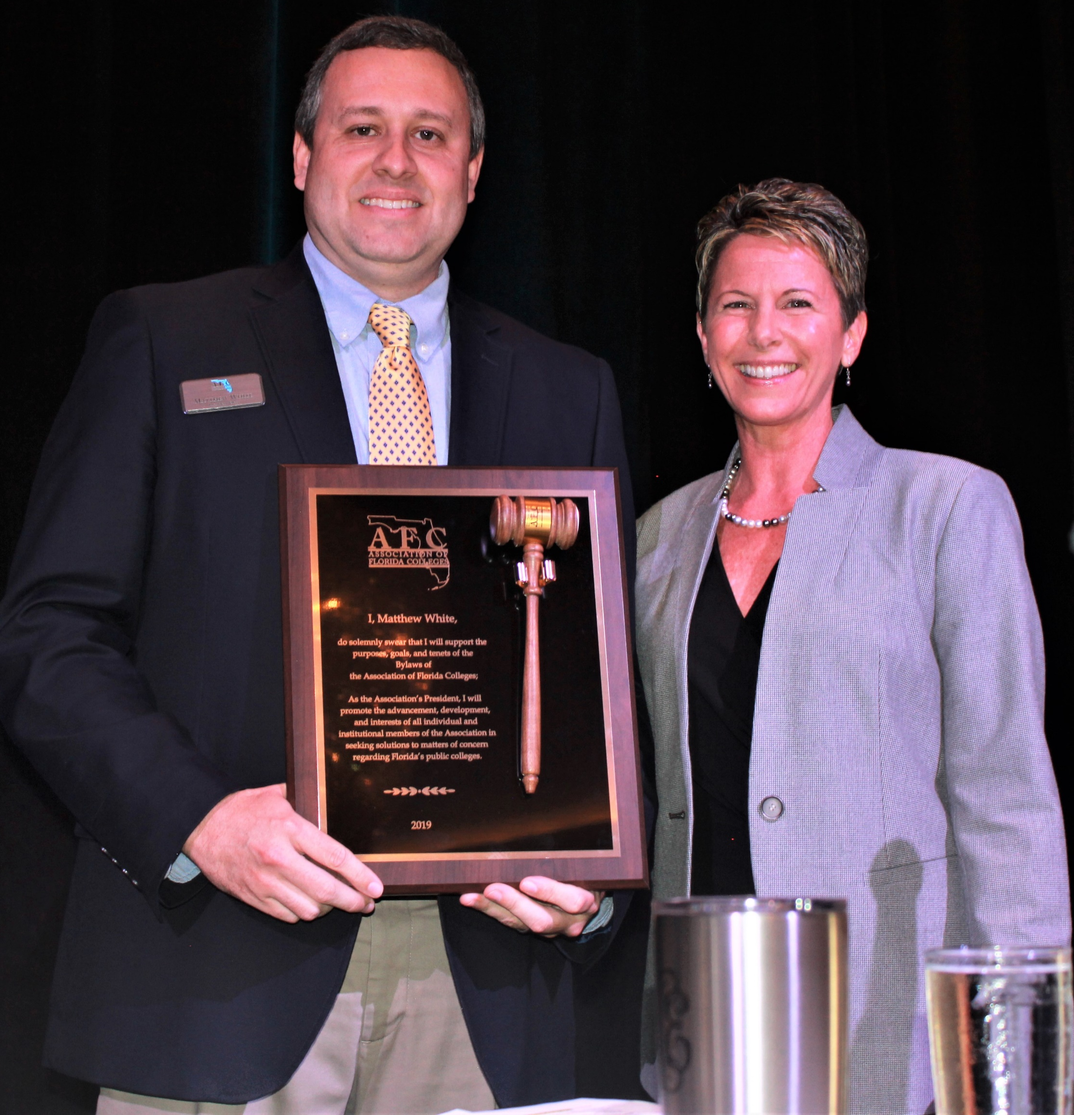

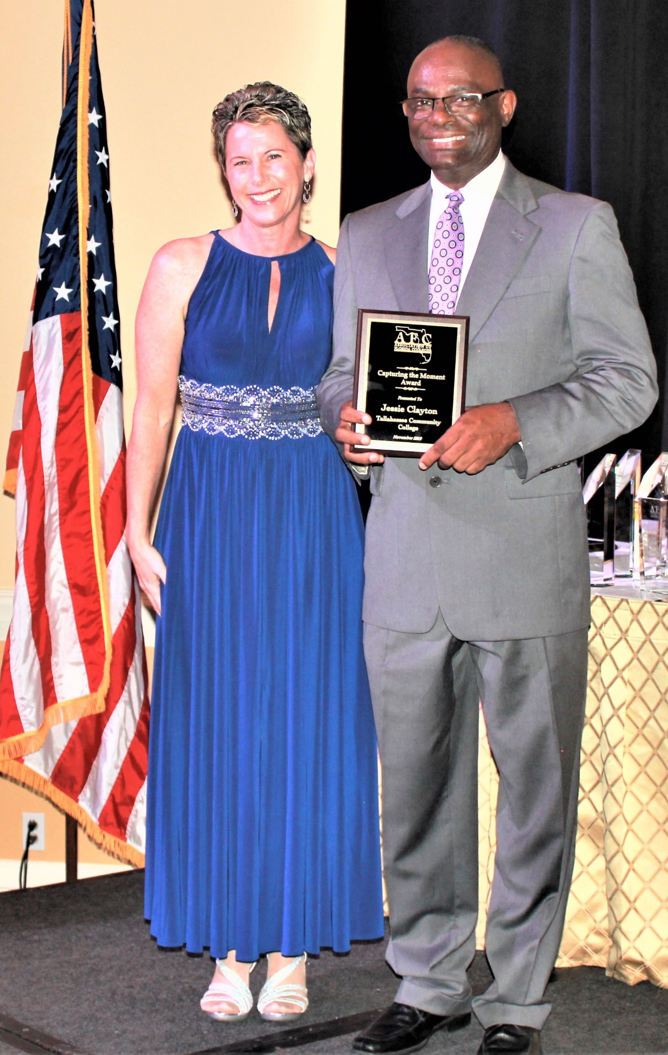
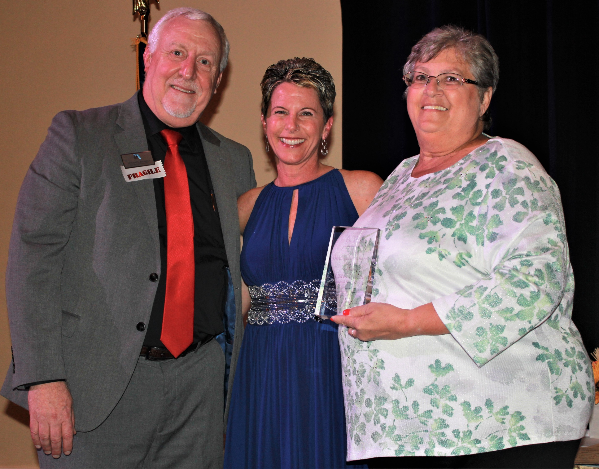
AFC Awards & Recognition
2020 President ~ Matthew White
Chipola College
2019 Presidential Award ~ Jessie Clayton Tallahassee Community College
2019 Board Member of the Year Award
Carol Quinn, Pensacola State College

Slide 18
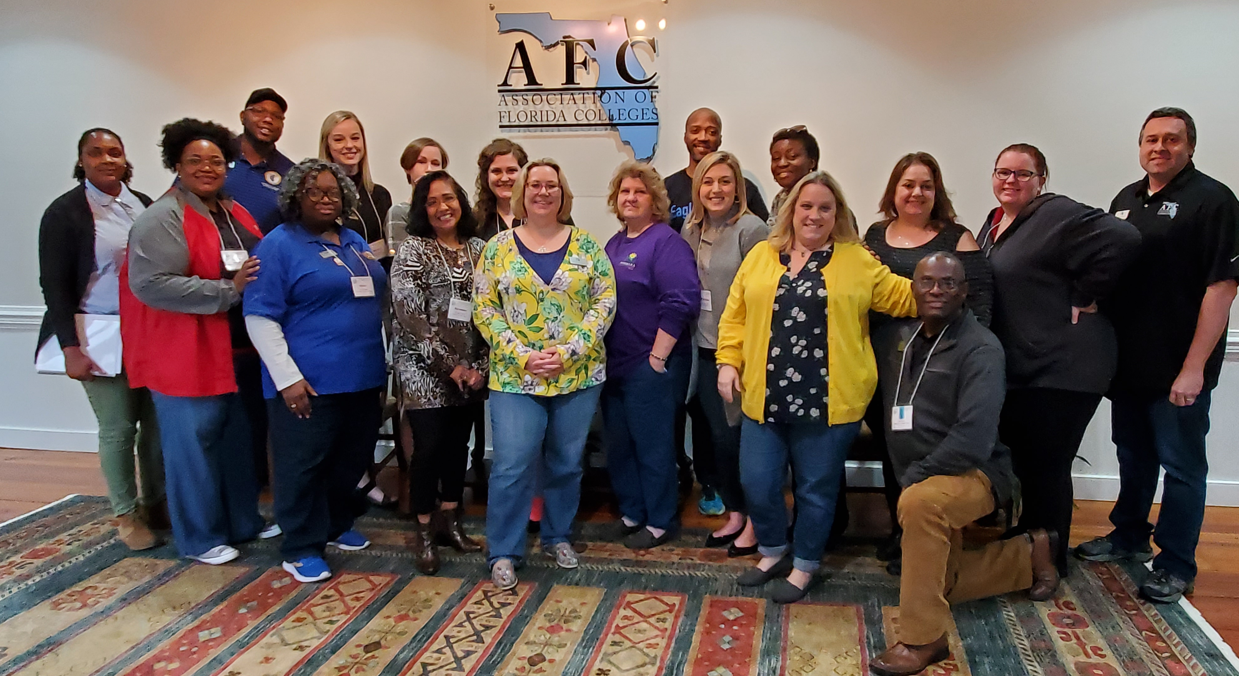
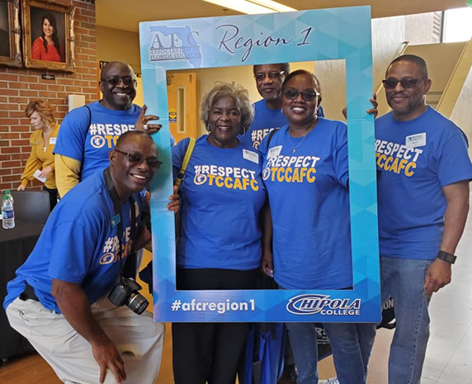
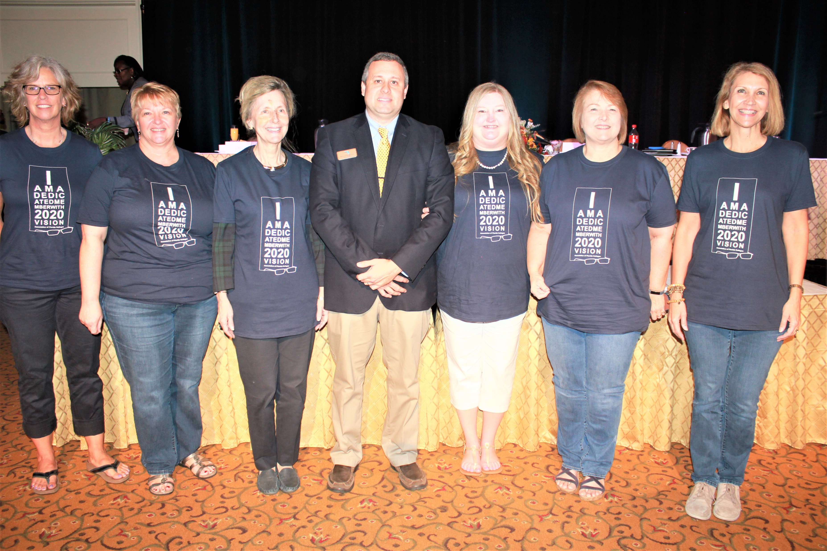
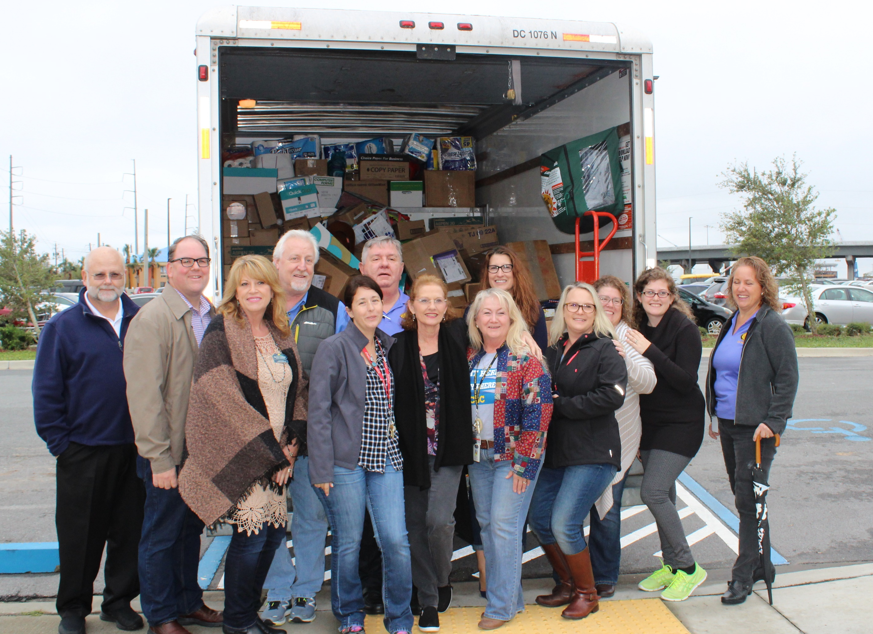
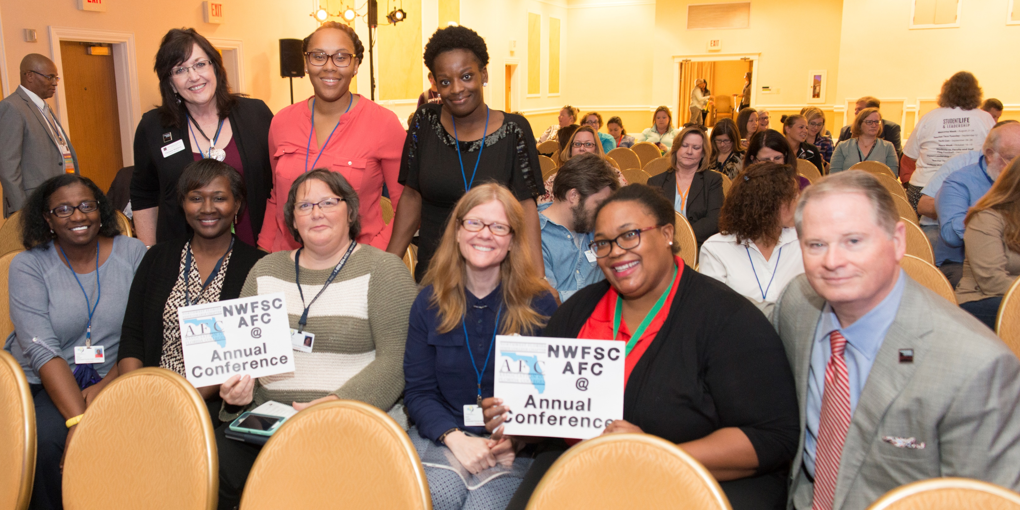

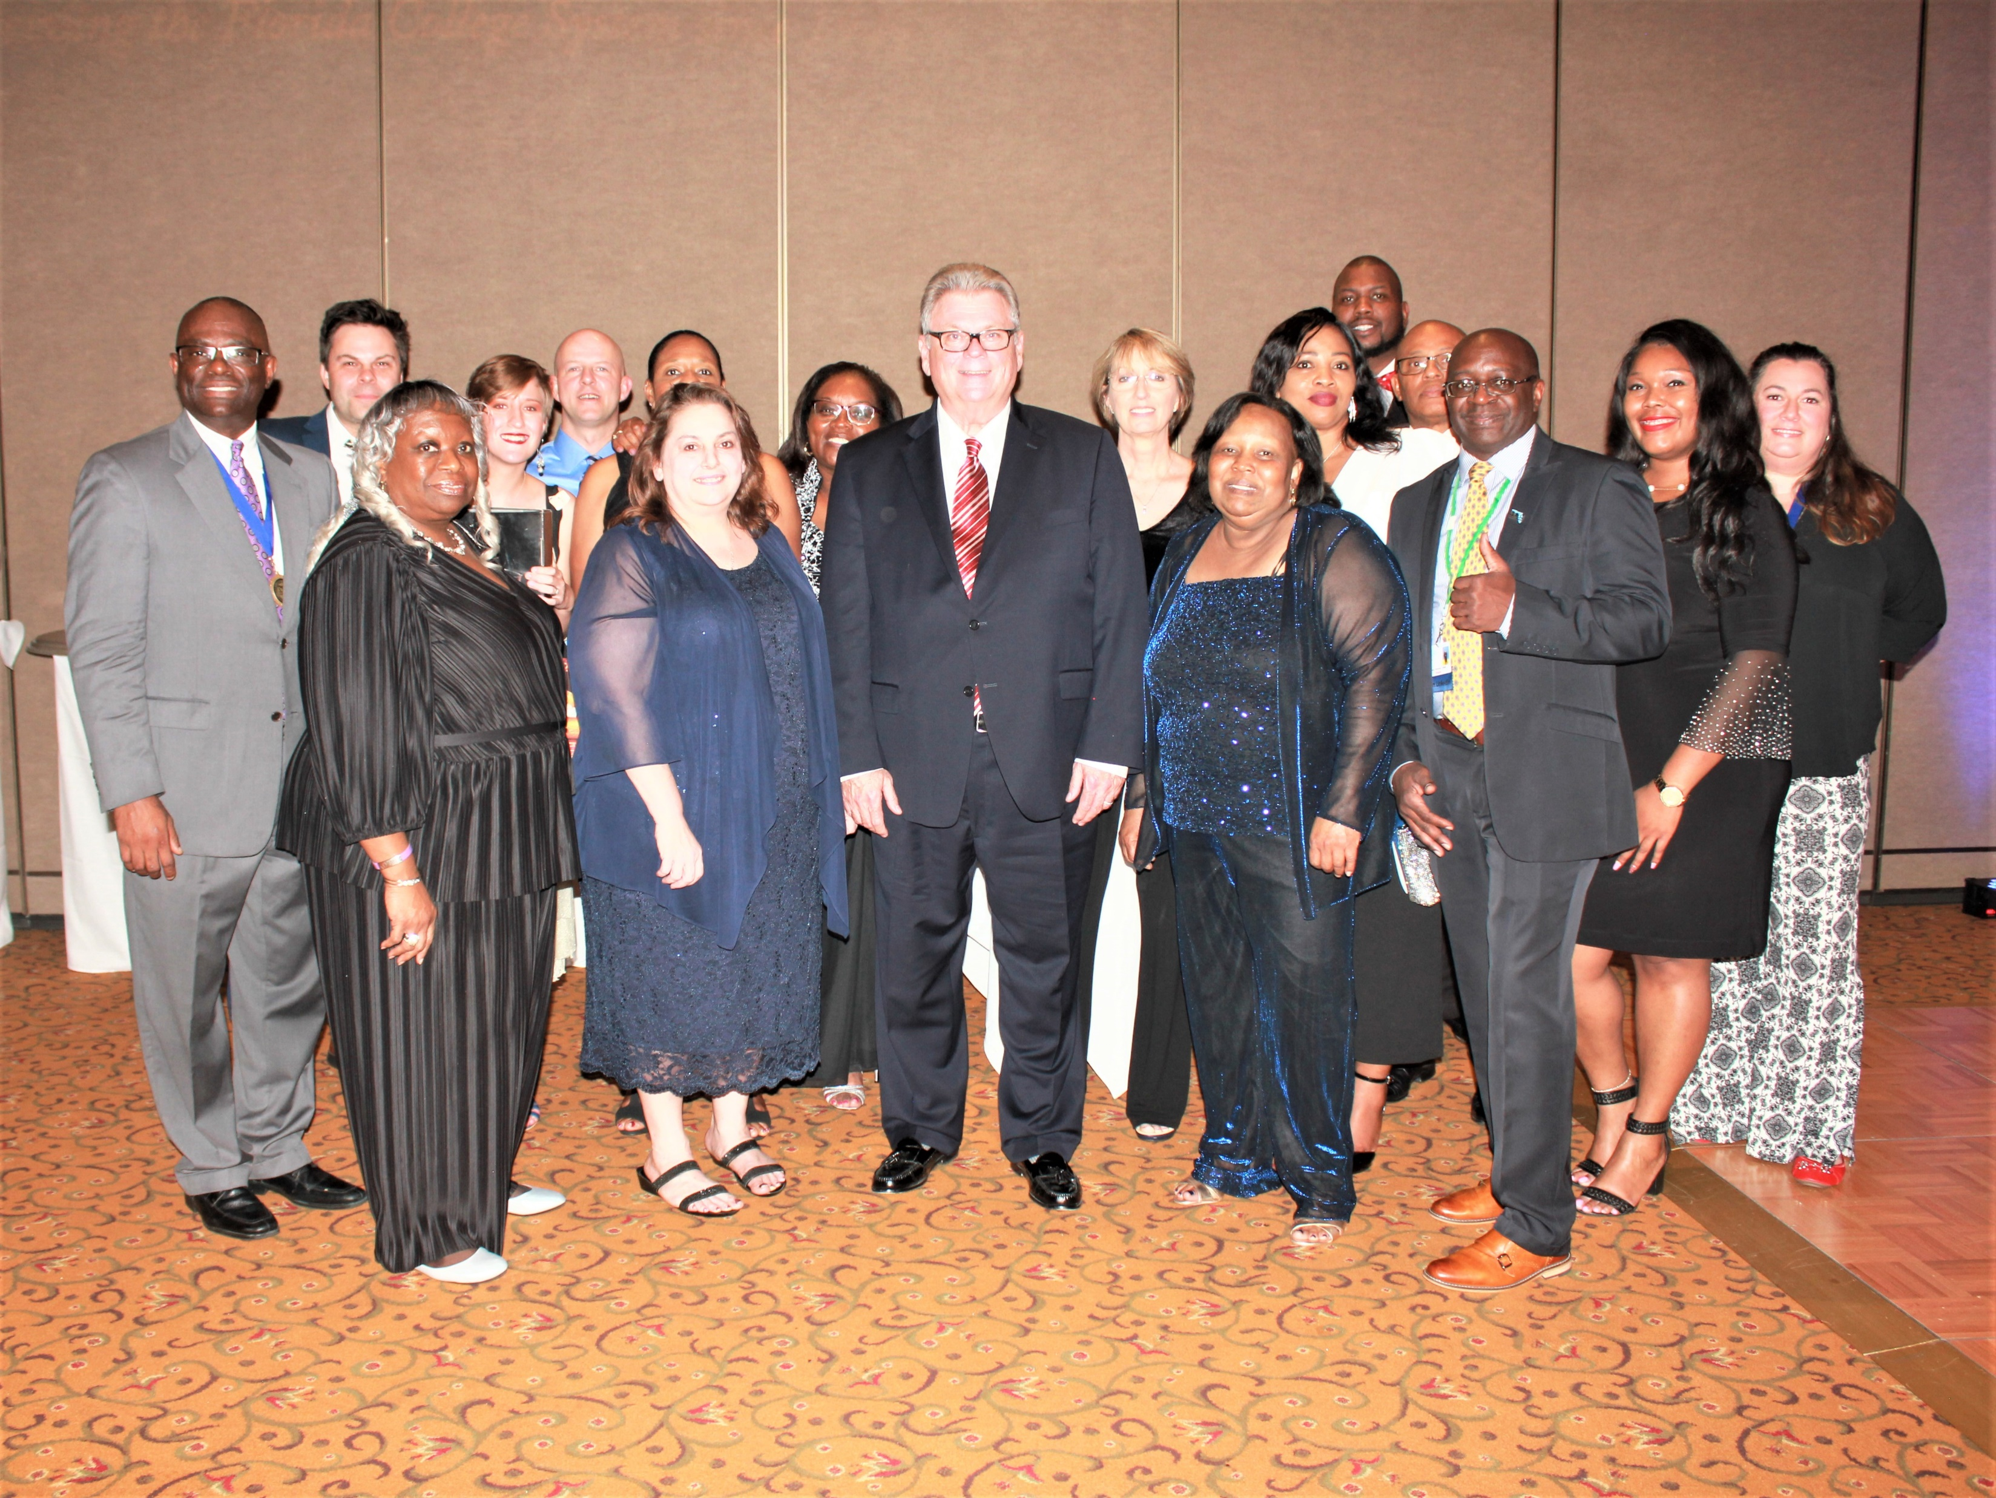
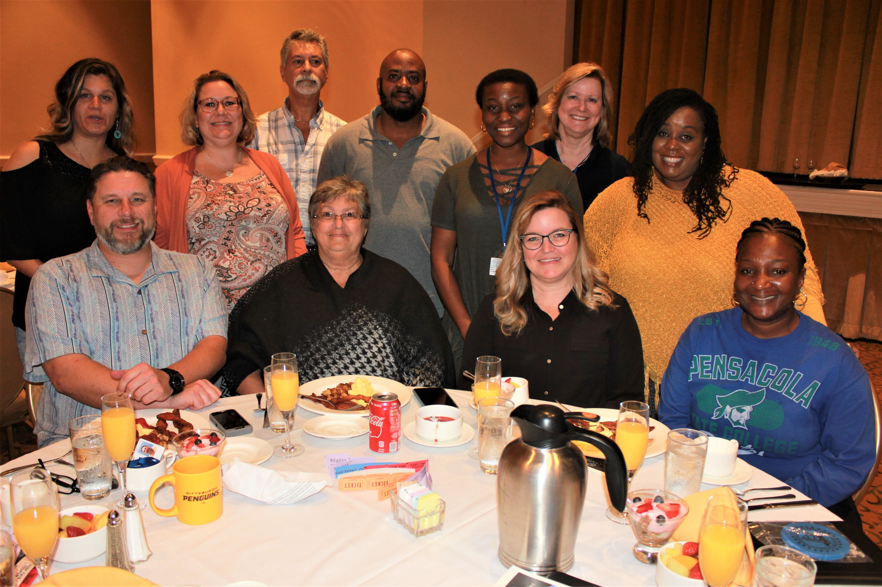
Region 1

Slide 19
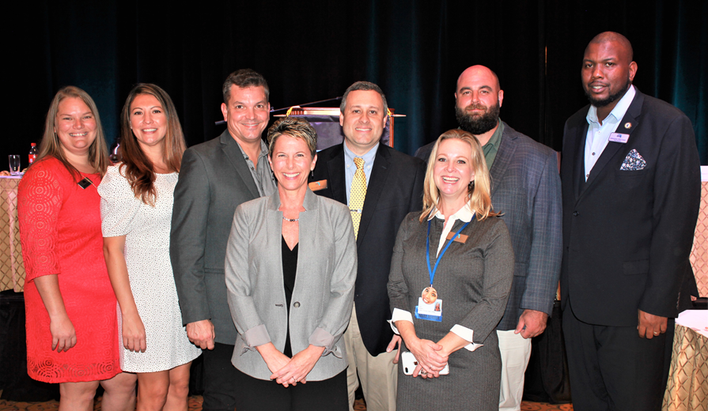

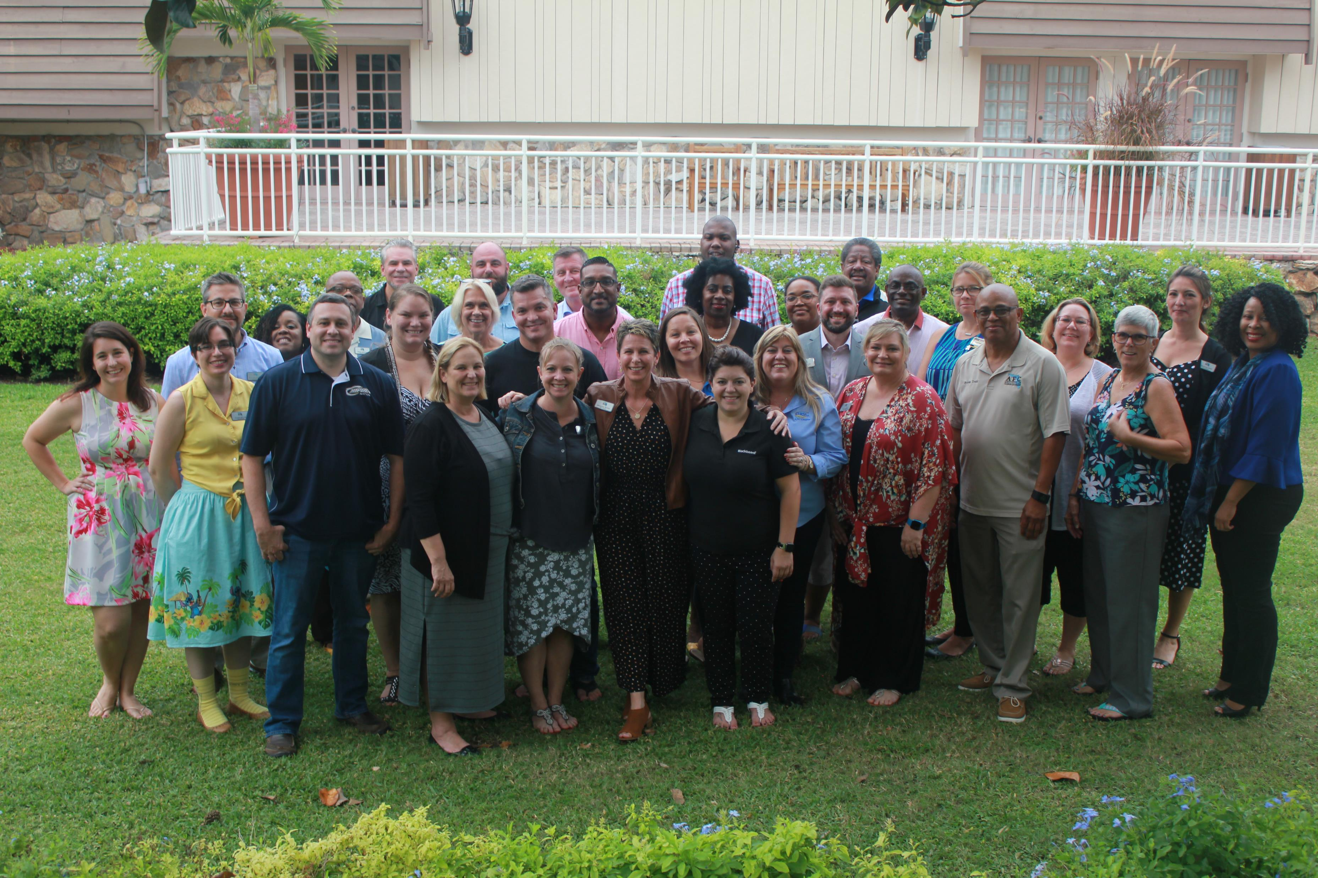
Who’s Next????

