Slide 1
Active Communication: How, What, Why, & When
2020 AFC Leadership & Planning Conference
Marjorie McGee, College of Central Florida
Tracy Glidden, Eastern Florida State College

Slide 2
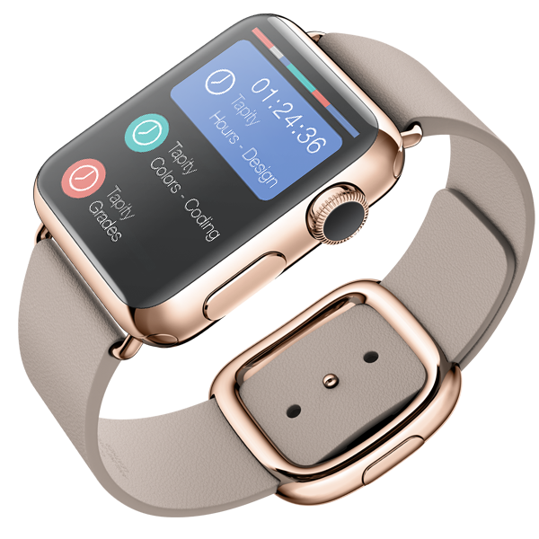
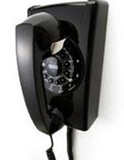
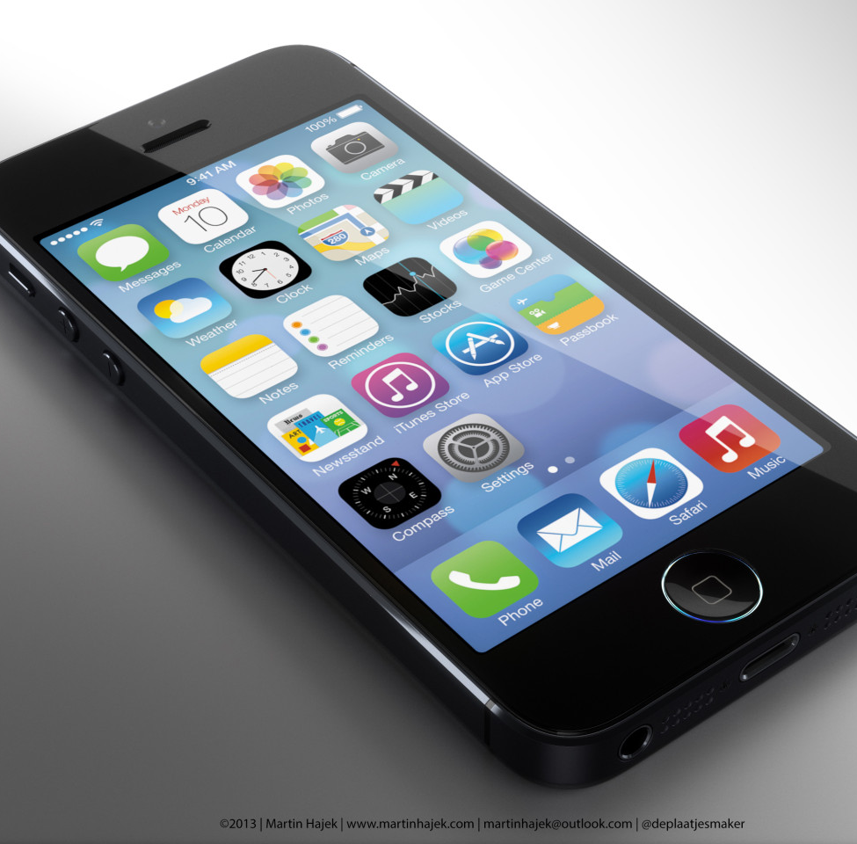
Which one are you?

Slide 3
How
Email
Facebook
Instagram
Text Messages
Conference Calls
Face-to-face

Slide 4
What
Relevant information
Always have an agenda

Slide 5
Why
Your why
Their why
Coaching
Important information
Upcoming events

Slide 6
When
Determine how often you want to communicate
Coordinate with state-wide meetings or events
Be consistent
Be predictable

Slide 7
Tips for success
Be open to changing methods
Make sure you aren’t overwhelming during work hours
Include your support team by delegating
Seek out and share best practices

Slide 8
Questions?

