Slide 1
Let’s Give Them Something To Talk About
Membership Development:
Retention, Recruitment & Reengagement

Slide 2
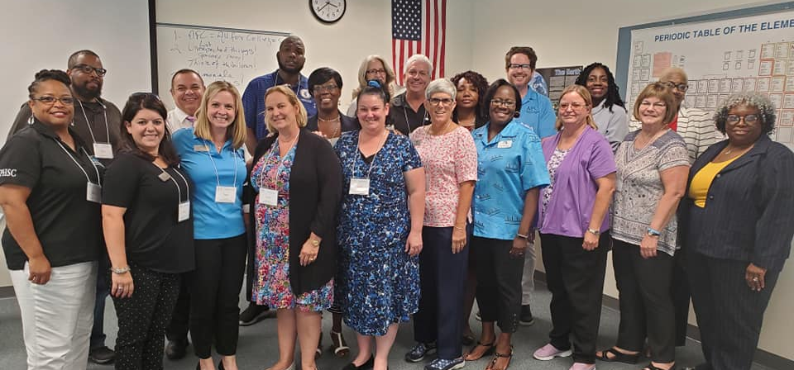
Step 1
Membership Team

Slide 3
Recruit A Strong Membership Committee
Skills of Team Members
Comfortable talking to other people
Knowledgeable about AFC, Chapters, & Commissions
Encouraging and inviting
Tenacious ~ WON’T take No for an answer

Slide 4
Build Your Campaign
Create incentives for current members to bring in new members
Create a targeted campaign of potential members from data you receive from HR
Create a plan to attend each departmental meeting to recruit new members
Create a member mentor program
Create a schedule for information sessions on each campus and in each building (department)
Create a competition between departments, divisions, campuses (who can recruit the most new members)

Slide 5
Designing A Campaign
Follow up with potential members with email, brochures, flyers, and personal contact
Develop a quarterly chapter/commission newsletter and forward it to new members
Utilize the AFC website &social media to list your meeting schedules and activities

Slide 6
NEWS FLASH: AFC DUES CHANGE!!!!!
Beginning July 1, 2020
All New regular members will pay $50 annually to join the AFC
All adjunct faculty and part-time employees will pay $25 annually
All regular members paying above $50 may elect to lower their rate

Slide 7
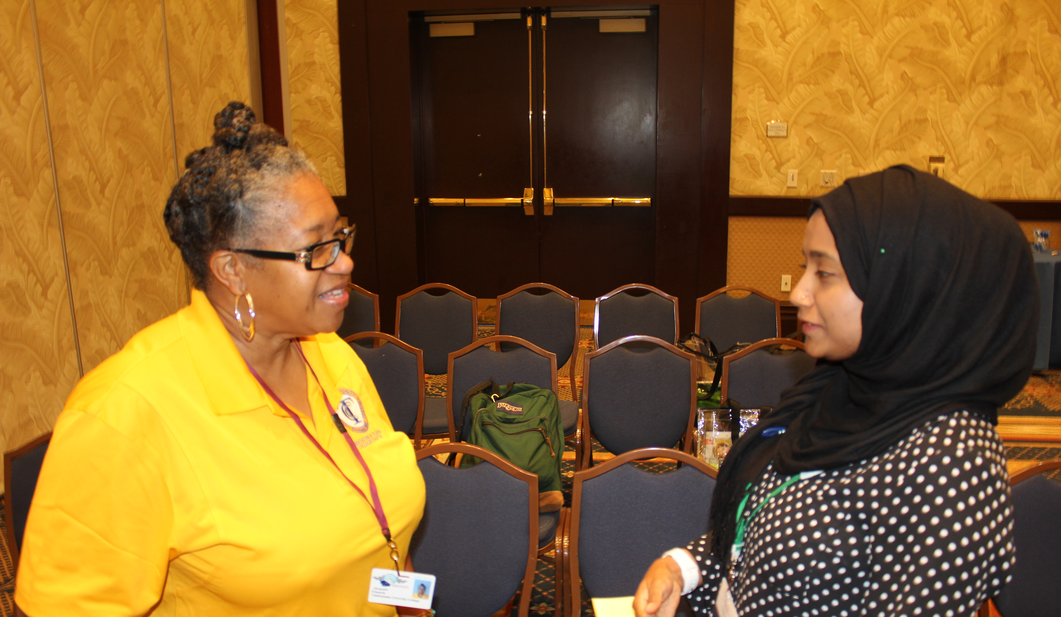
Retention: Who Are Your Members?

Slide 8
Actively Engaged Members
Who Do You Know?
What Do You Say?
Tell them what’s new
Acknowledge that we want them active
Find out why they haven’t been active
Share Your AFC Story
Find someone in AFC they know
Recognize them when they DO Engage

Slide 9
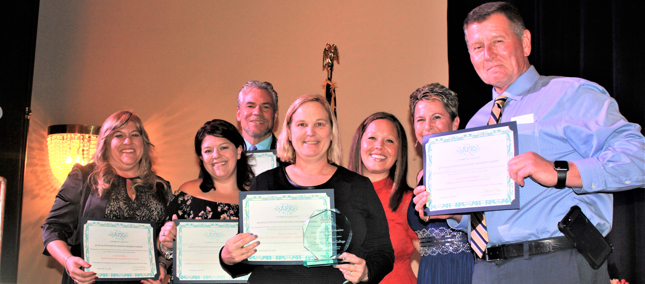
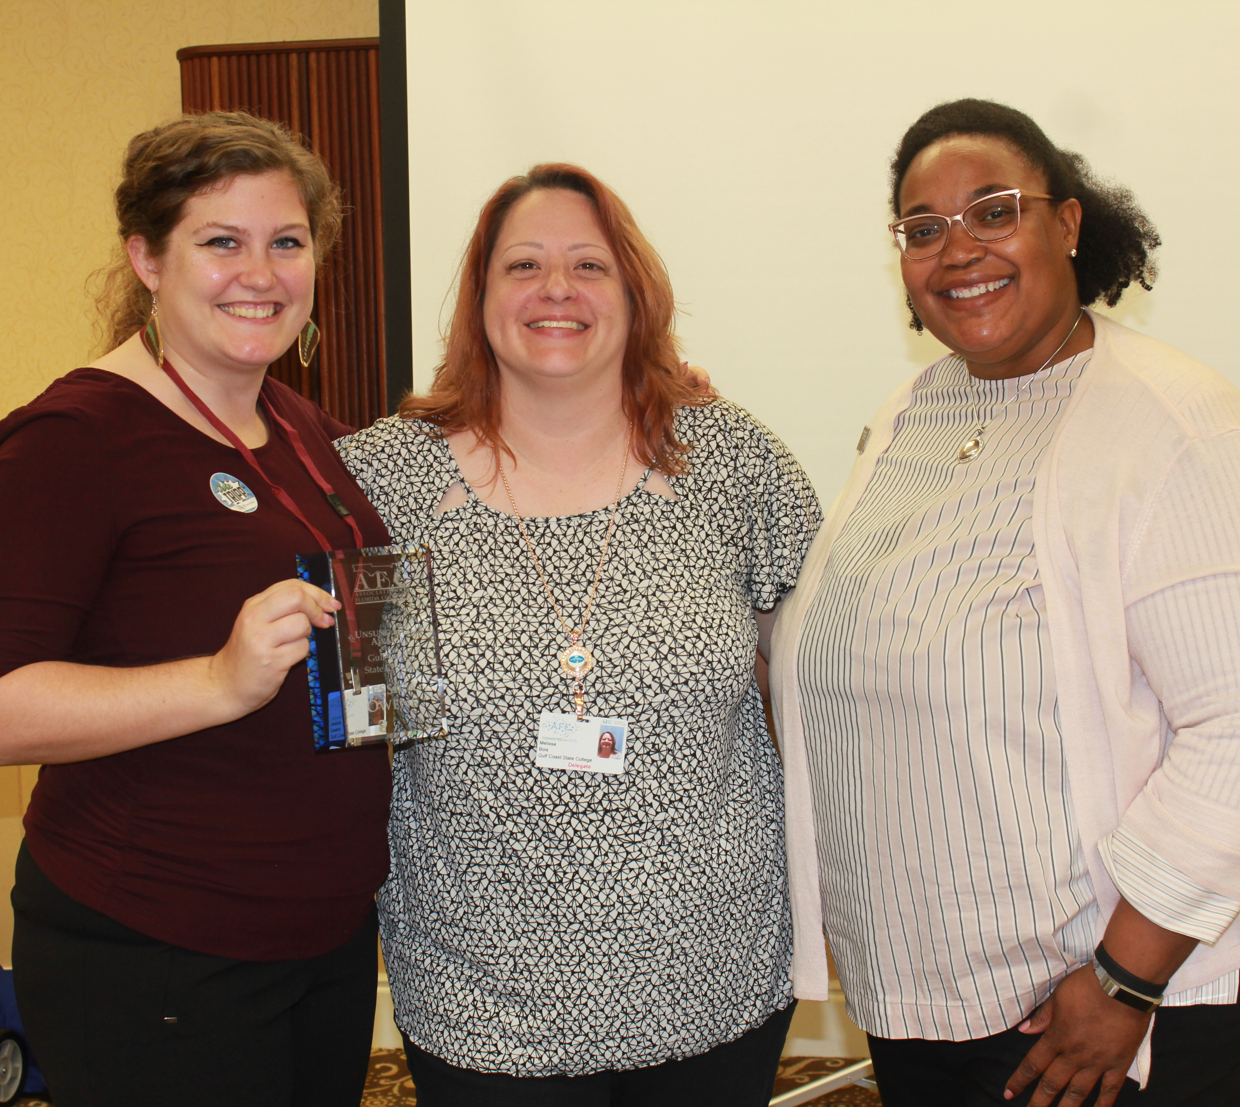
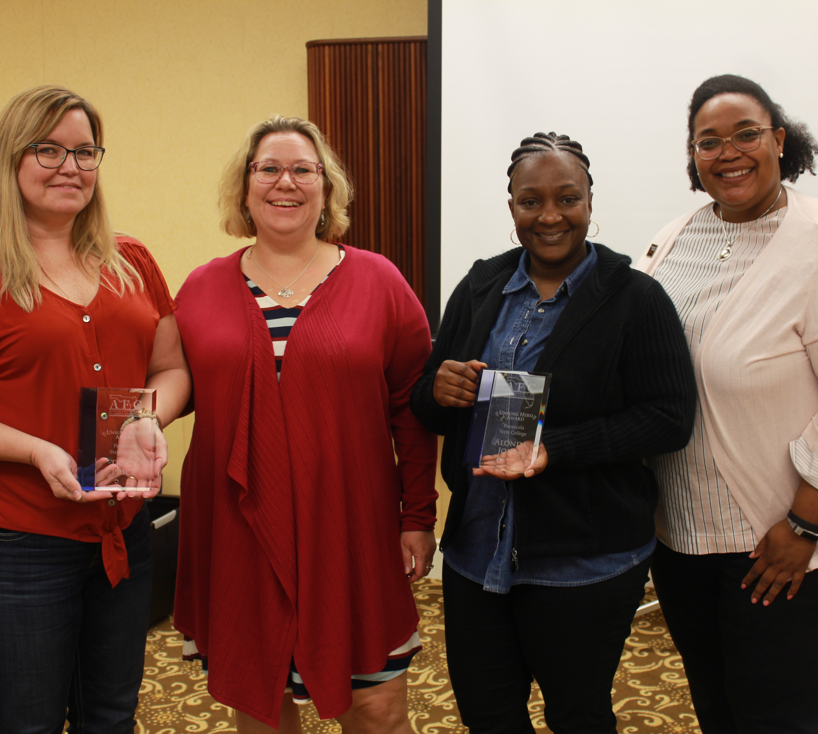
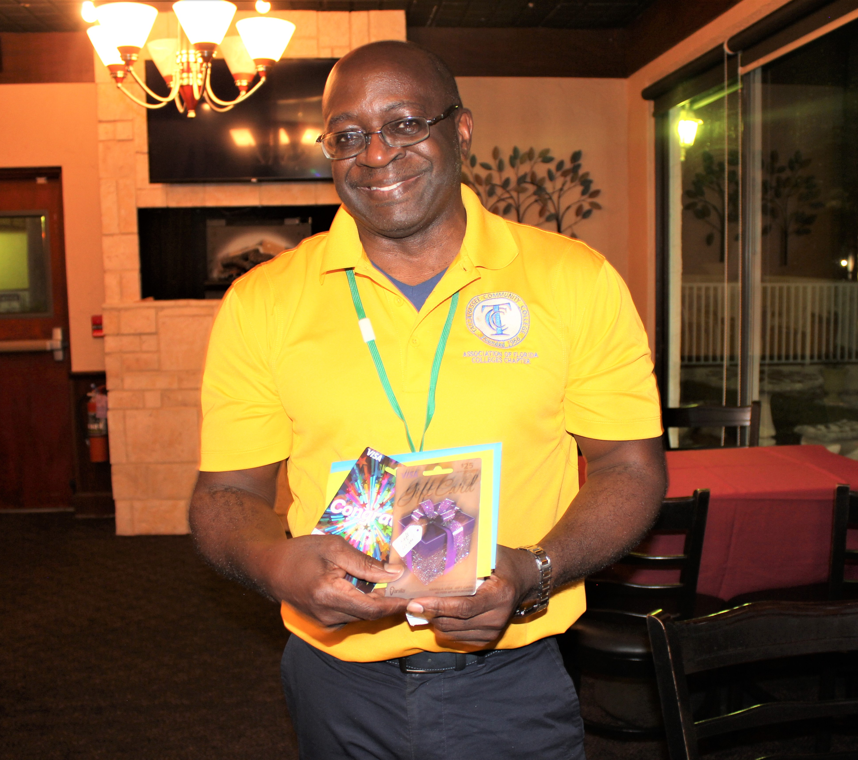
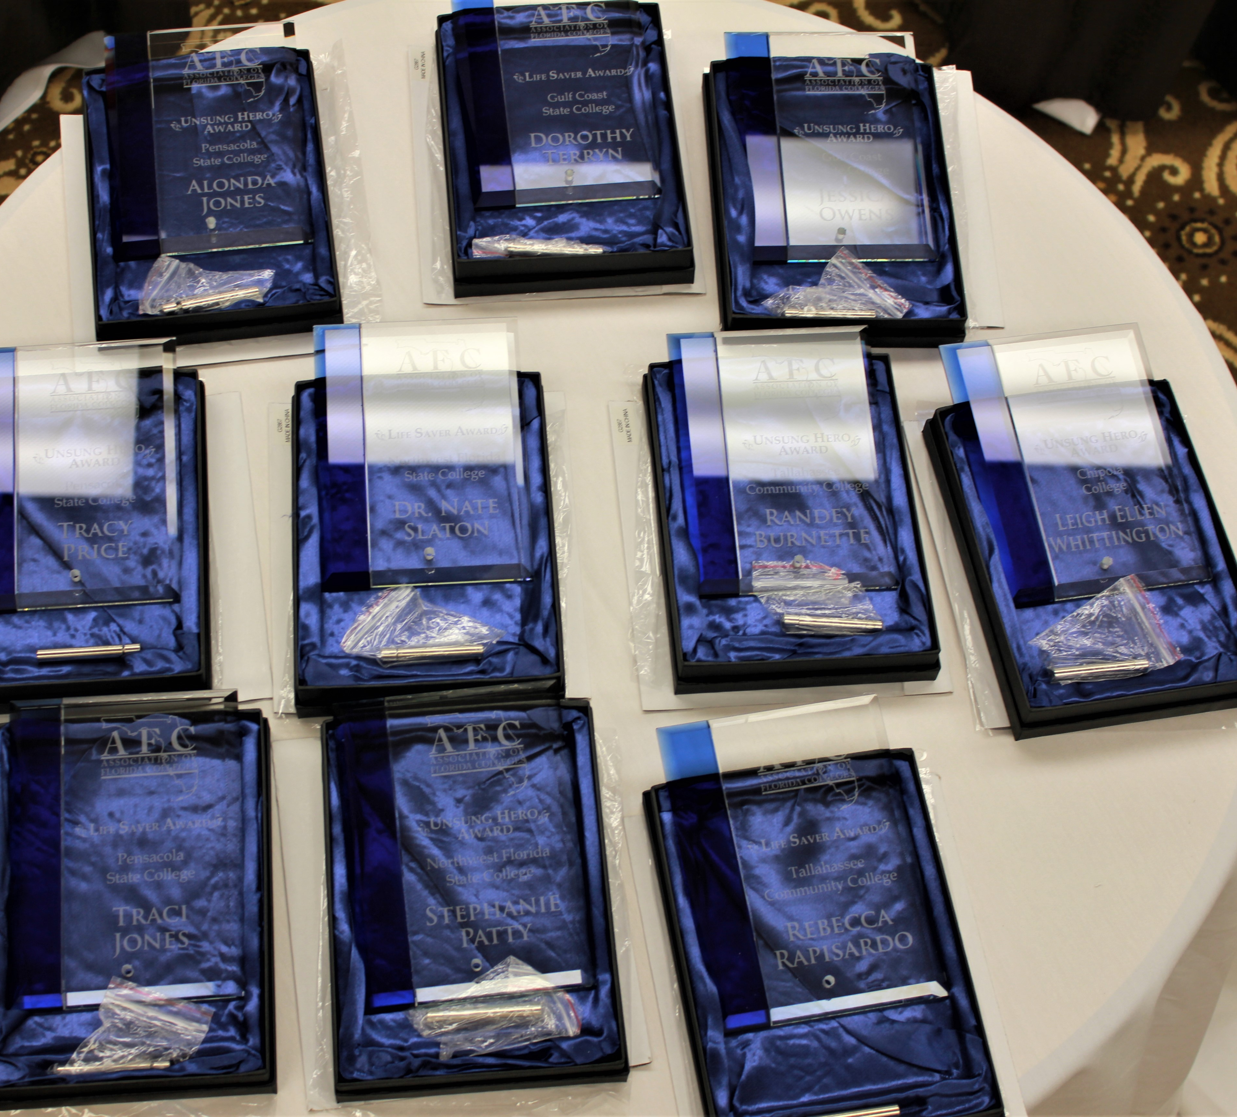
RECOGNITION
Give Some Form of Recognition to those Who Do Get Involved
Every time someone gets involved on all levels, including programs and meetings, someone needs to say “thank you”

Slide 10
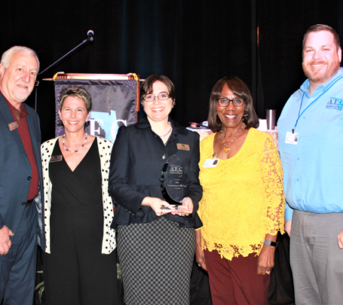
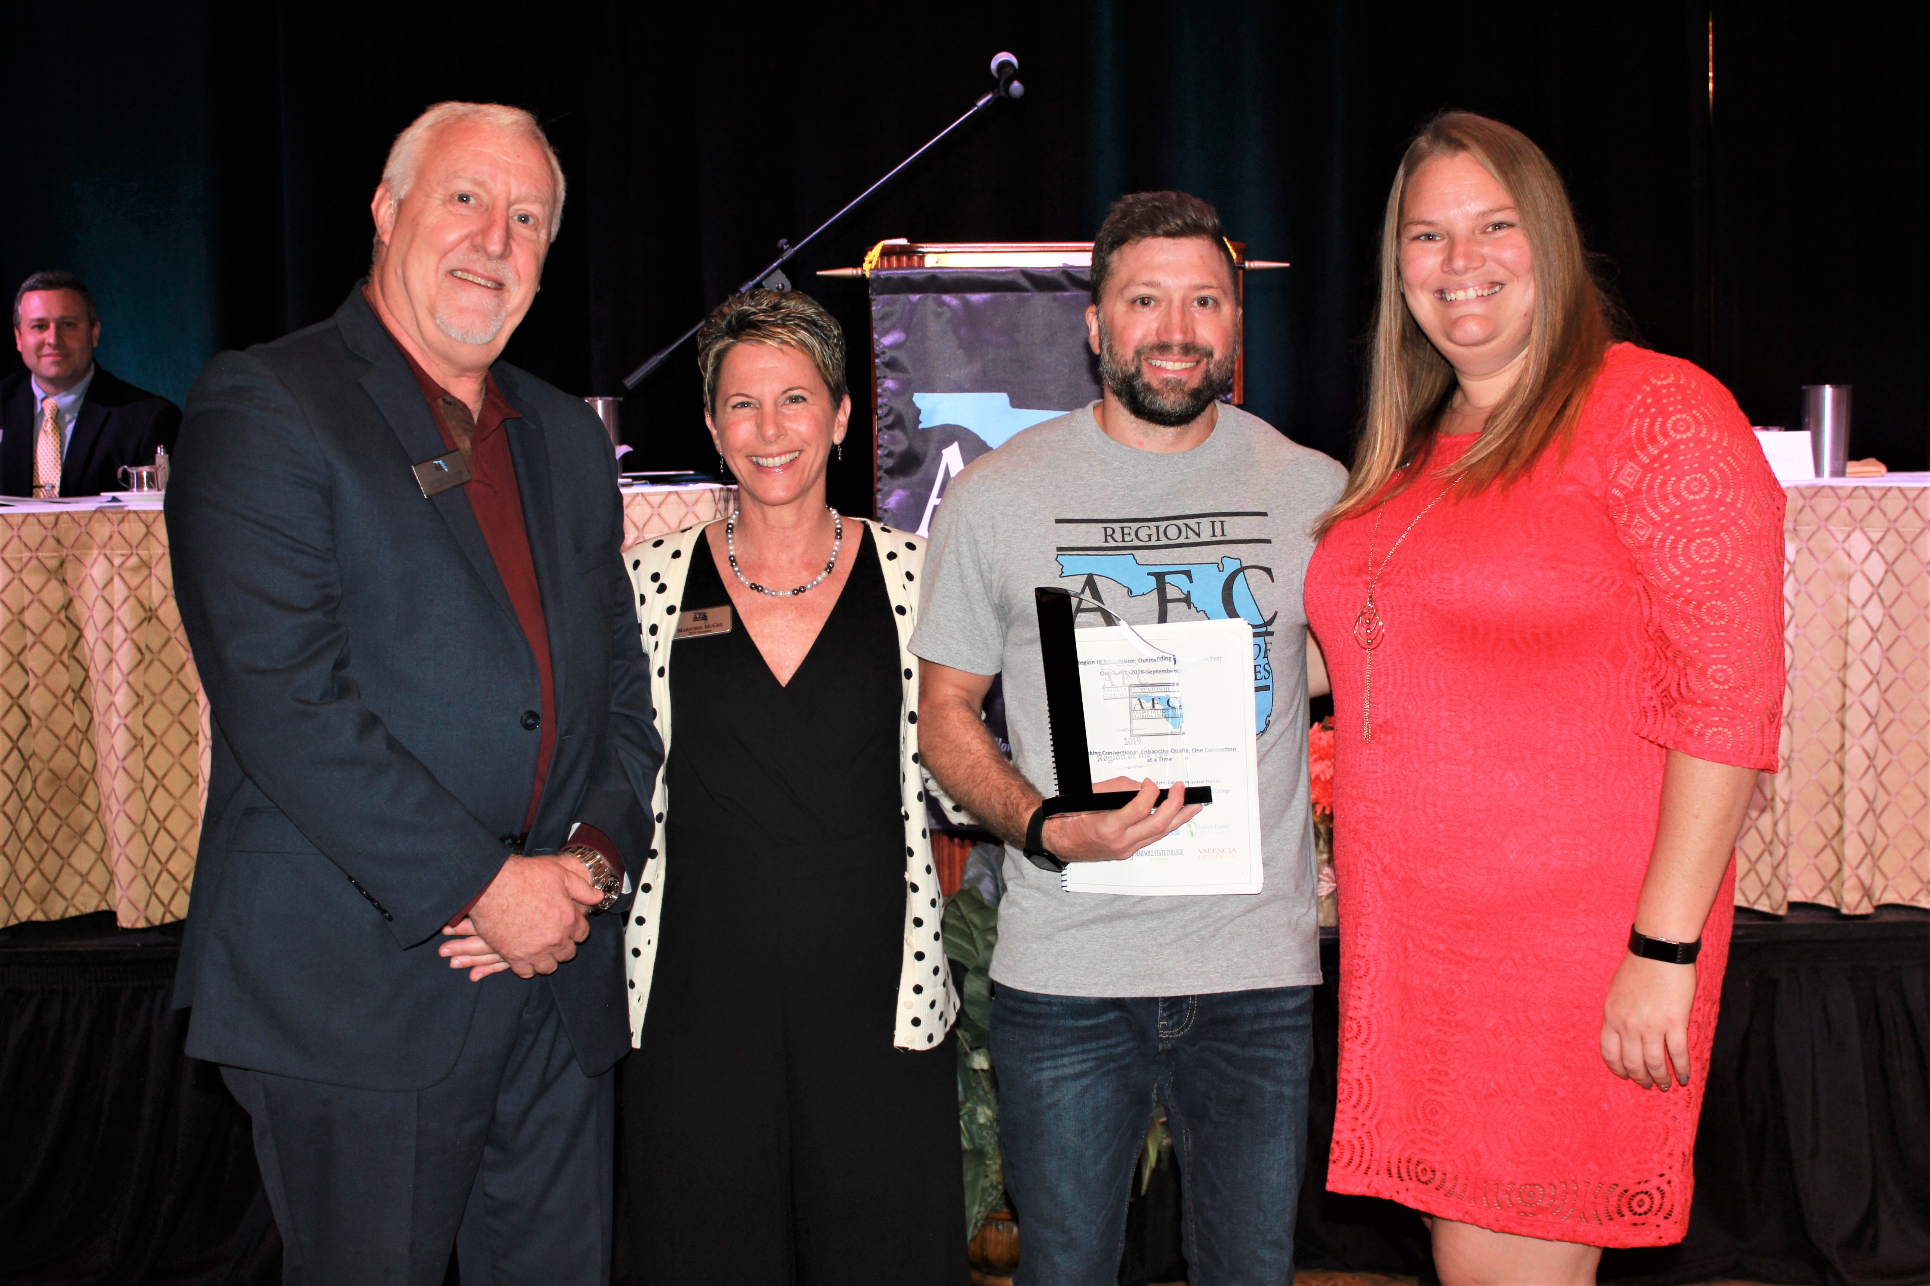
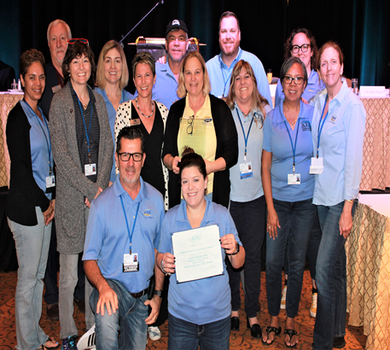
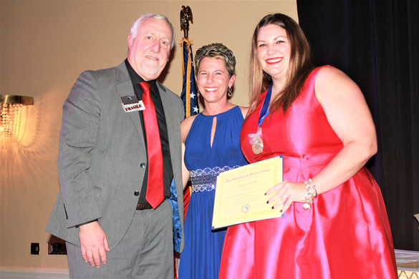
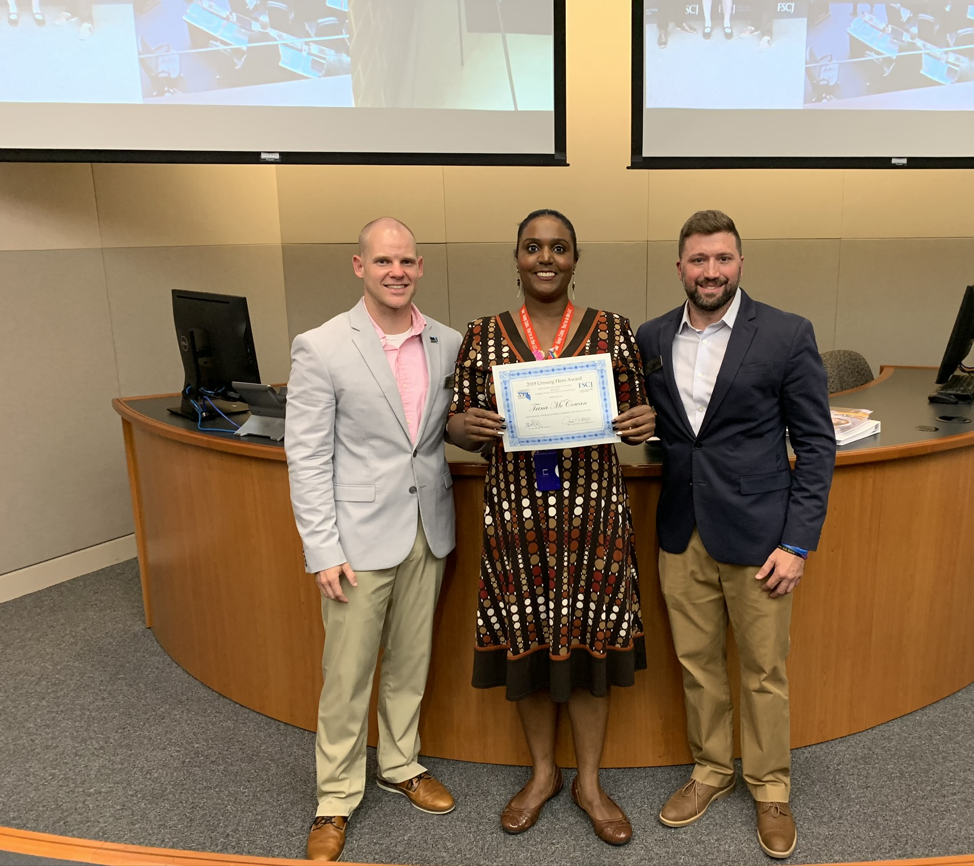
Let’s Talk About It & Let’s Share It!
#AFC2020Vision

Slide 11
Overcoming Objections
How do you respond when a potential member does not understand the value of AFC?
“It cost too much and I can’t afford it.”
I don’t have time.
AFC doesn’t really do anything? It’s for the career staff and not for faculty or administrators. It’s just not for me.

Slide 12
The 3F’s: FEEL, FELT, FOUND
I know how you feel.
I may have felt the same way initially.
However, I found that My AFC Membership really was a great investment.

Slide 13
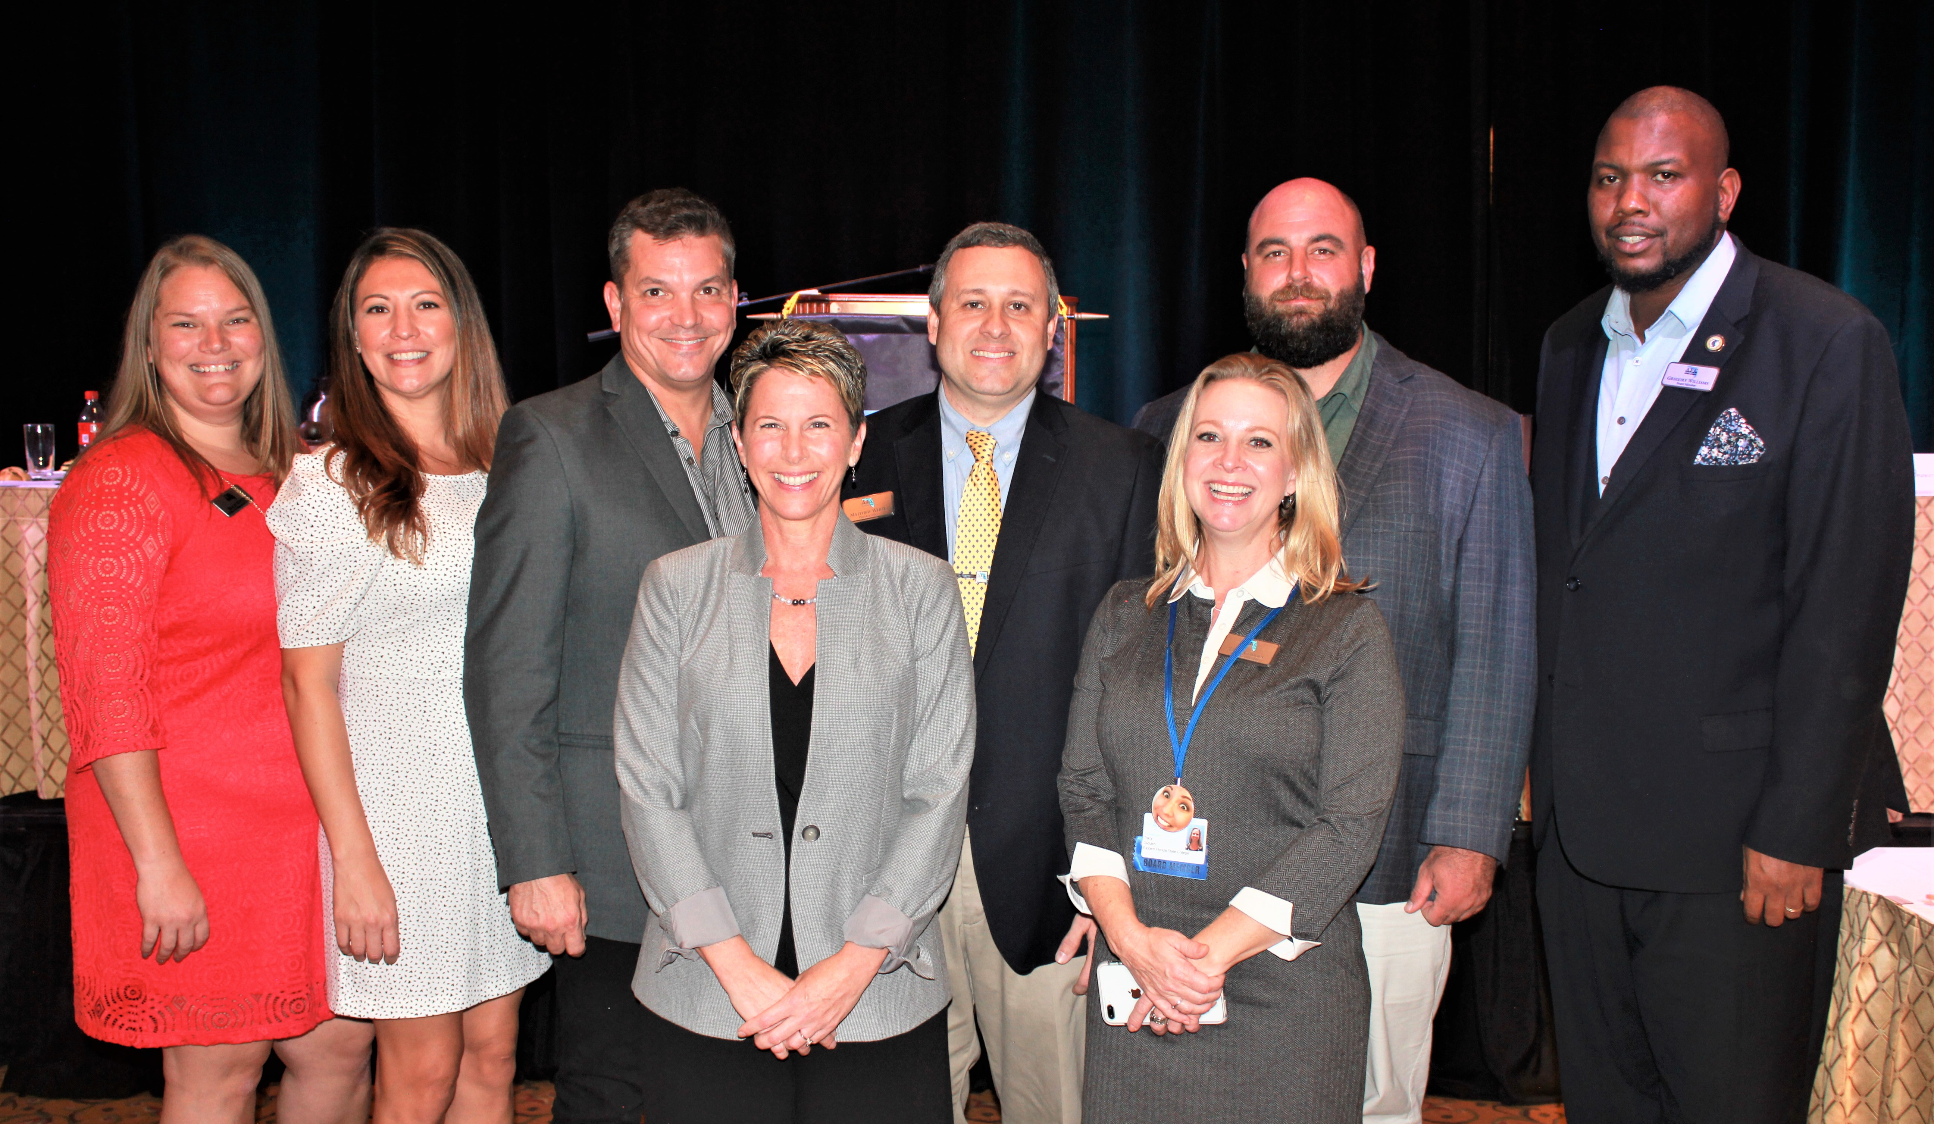
UTLIZE YOUR RESOURCES~ WE CAN HELP YOU!

Slide 14
Membership Development

