Slide 1
Budgets & Conference Planning

Slide 2
Conference Planning 101
Theme & Agenda
Registration
Budget
Catering
Speakers/
Educational Sessions
Service Project
Evaluation
Sponsors/Exhibitors

Slide 3
Joint Conferences ~ Recommendations
Regions
Financial Split
50% to Host Chapter
Region Director/Chapter President = Agreement
Options
50/50 Split
100% of Sponsorship by Region or any agreed %
Equal Split of All Funds
Commissions
Financial Split
50% to Host Chapter
Region Director/Chapter President/Commission Chair = Agreement
Options
50/50 – Region/Commission
100 % of Sponsorship Funds by Region or Commission
Equal Split of All Funds

Slide 4
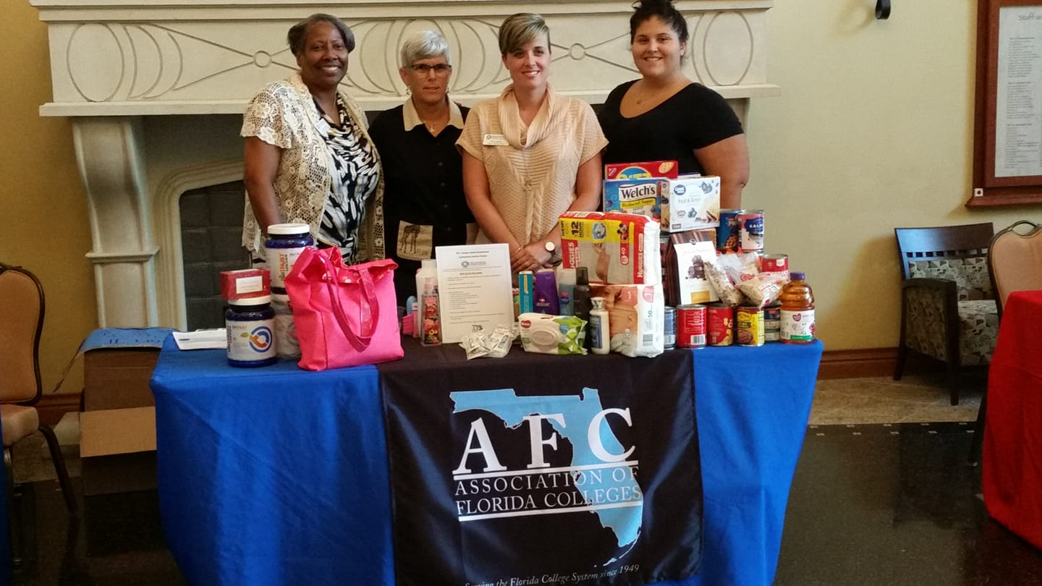
Plan A Community Service Project

Slide 5
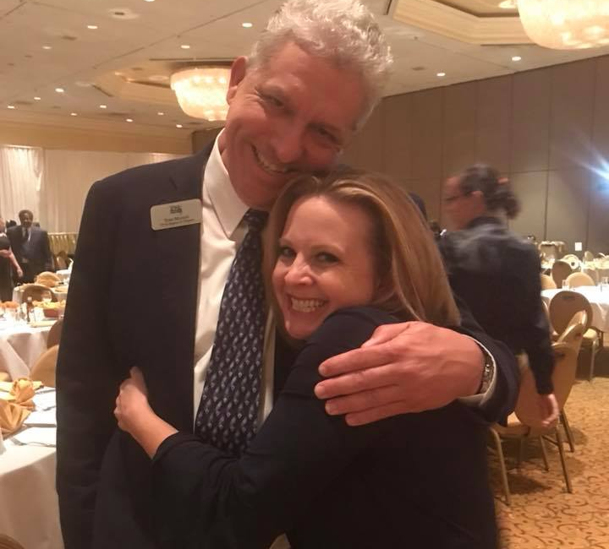
“Make connecting with others a daily priority.”
John Maxwell

