Slide 1
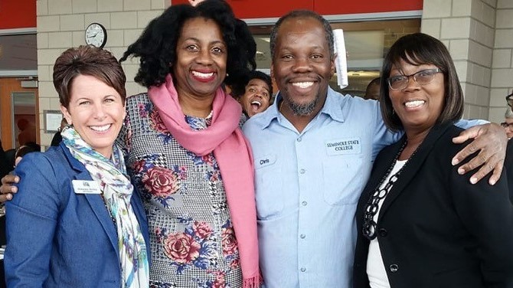
Association of florida colleges Membership Development Committee Leadership Conference January 31, 2019 – Seminole State College
Breakout Session Brainstorming Ideas

Slide 2
Group 1 Ideas
Target new employees with personalized contacts and/or orientations
Social events
Sell Networking as a benefit
College Welcome Back Events (Give-aways, Social Stuff)
Faculty Ambassador

Slide 3
Group 2 Ideas - RECRUIT
Personal Office Visits; informing people of AFC benefits (Professional Development, Discounts, Resume Building)
Wear the AFC Polo
Don’t take no for an answer(and “not right now” or “I’ll think about it”)
Follow Up (Quickly and within one week)
Get the application form to them, and get it back
Namedropping (of influential colleagues involved in AFC)
Don’t assume others are recruiting

Slide 4
Group 2 Ideas (Continued) RETAIN
Be visible- show members you care. Send information frequently.
Activities are professional development opportunities that the college doesn’t have to pay for.
Avoid conflict of interest by sending emails during lunch breaks of evenings/weekends.
Name-drop of influential college personnel involved with AFC.
Encourage participation at conferences.

Slide 5
Group 3 Ideas RECRUIT
Letter sent with application campus-wide – one goes into new employee orientation which includes values and highlight of what the chapter contributes
Host Social event – What is AFC Chapter meetings (raffle, food)
Retractable banners that can be displayed at events with values and benefits. Table cover with logo.
Highlight commissions and how to get involved beyond local chapter with professional development presentations and awards.

Slide 6
Group 3 Ideas (Continued) RETAIN
Work with HR to get information on retirees during exit interview
Encourage payroll deduction vs. credit card or check
Stay on radar, continue to offer socials, fundraisers, conferences and functions.

Slide 7
Group 4 Ideas
Meet and Greet
Partner with HR/New Employee Orientation
Exhibit Table at Faculty Meetings
Open Membership Development Week
Member Appreciation – Holidays/Special Events
AFC Luncheons
Focus on New AFC Members (Make a list)
Happy Hour with Chapter Officers

Slide 8
Group 4 Ideas (Continued)
Chick-Fil-A (Breakfast)
Convocation/Faculty Senate
Raffle to Local Sports Team
Open Enrollment/Health Fair

Slide 9
Group 5 Ideas
Wine and Dine them with Receptions prior to events (like Convocation)
AFC Appreciation Events/Pair with Holidays.
Identify a strong member of faculty and use them to recruit by Using the Teaching and Learning Conference as a tool.
New Employee Orientation
Hold AFC 101 Sessions
Hold a Button Day event where a surprise prize is given randomly to employees showing their AFC pride.

Slide 10
Group 6 Ideas RECRUIT, RETAIN AND EXCITE MEMBERS
High Touch
Speak to every new member (attend all college events).
Provide AFC/Chapter Materials to share (Incentive form/flyers- get chapter members to print copies).
Set-up a booth/table at all events.
Point out AFC members for non-members to connect with on campus.
Attach prizes (Get President/Chapter to pay) Example: $20 to recruit member.
Recognition to those who recruit other (shout out at meetings)

Slide 11
Group 6 Ideas ( continued)
Create a video (members can see how cool it is to be a member)
Make someone (or a few people) to be the “face” at your chapter
Membership Pride – members wear a pin, bumper stickers
Raffle off good prizes (more tickets based on # of people you recruit)
Office to Office Visits
Visit all new employees
Social events for members
Polo Shirts

Slide 12
Group 7 Ideas
New employee engagement
Tabling
Membership Picture board/display case
Regular Chapter Meetings
Add campus liaisons to your chapter officers
Service Projects

Slide 13
Group 8 Ideas
HR Orientation
Share your AFC story
Communicate the benefits
Keep Current members informed (including those who do not go to conference)
Activities – Involve all members
ROI – Membership Cost/What you get
Incentives – Recruit the Recruiter
AFC Day – “Buttons”
Partner with Professional Development
Engage Executive Leadership

