Slide 1
Leadership & Technology
Matthew White
Notes:
Are your classroom colors different than what you see in this template? That’s OK! Click on Design -> Variants (the down arrow) -> Pick the color scheme that works for you!
Feel free to change any “You will…” and “I will…” statements to ensure they align with your classroom procedures and rules!

Slide 2
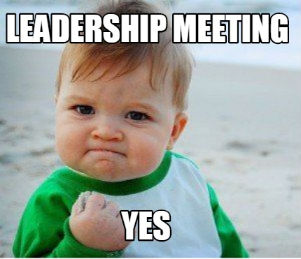

Slide 3

Technology

Slide 4

Technology & Leadership

Slide 5


Slide 6

Binge Watchers Anonymous

Slide 7
“The art of communication is the language of leadership.”
James Humes (Speechwriter for five Presidents)

Slide 8

How Do You Communicate?
Commission
  Board
  Members
Chapter
  Board
  Members
Region
  Chapter Presidents
  Members

Slide 9
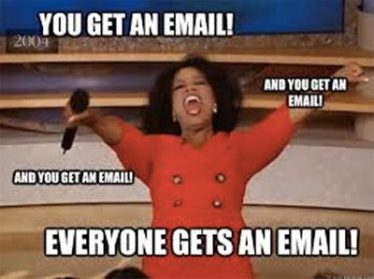
Member Communication (One Way)
Email (maybe opt-in or opt-out)
AFC Blast (opt-out)
Remind.com (opt-in)
Facebook Page (opt-in)

Slide 10
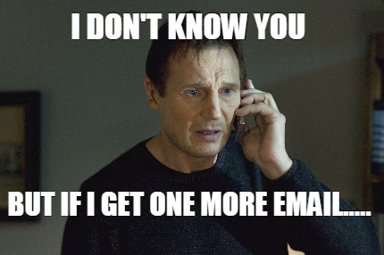

Slide 11

E-Blast

Slide 12


Slide 13
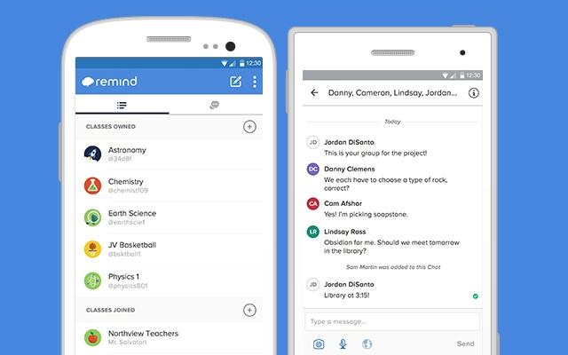

Slide 14
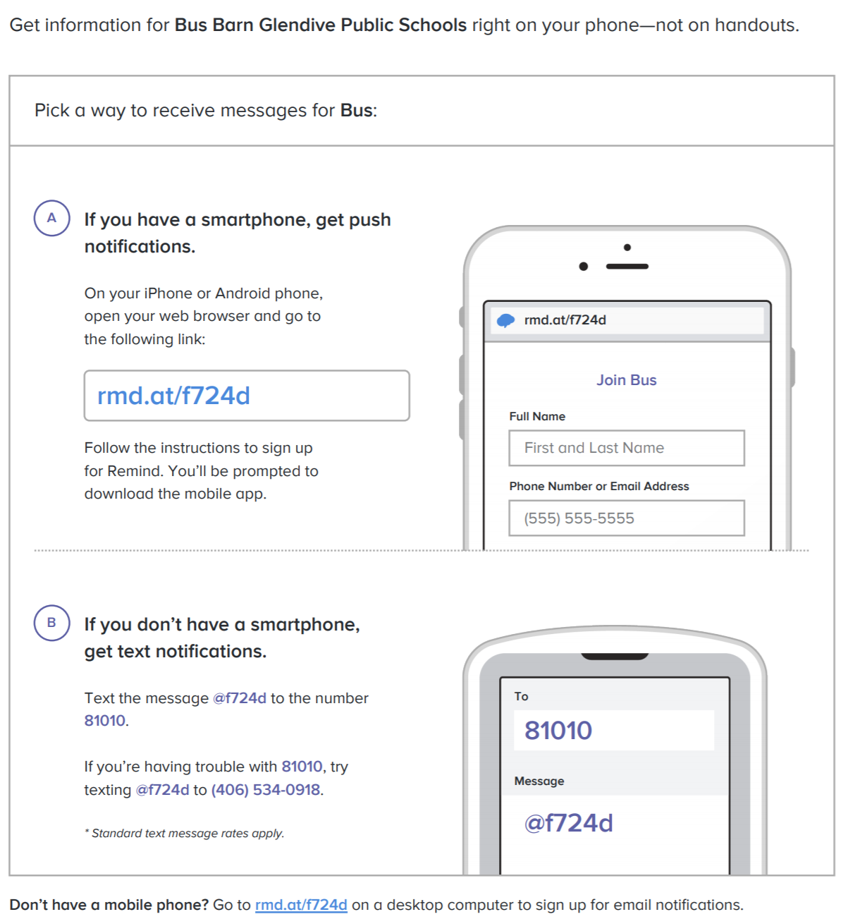

Slide 15


Slide 16
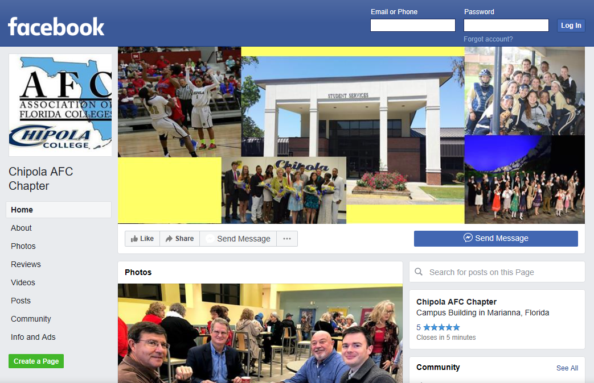

Slide 17
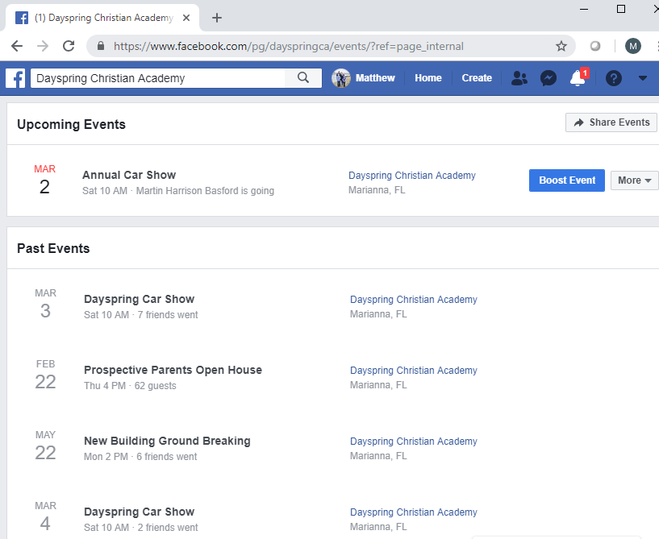

Slide 18
Combine Methods
E-Blast/Email/FB Page +

Slide 19
Board Communication (Two Way)
Email
Group Text
Facebook Group
GroupMe.com

Slide 20
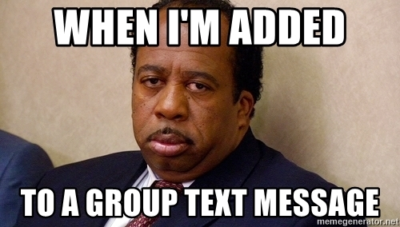

Slide 21


Slide 22


Slide 23
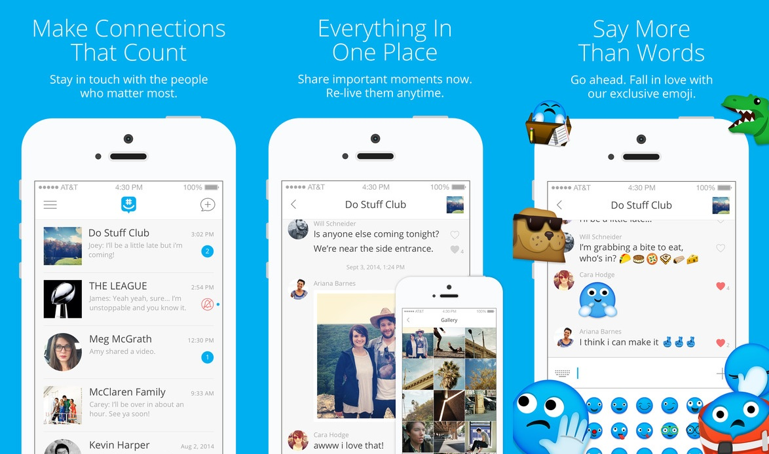

Slide 24
What have you found that works best for communication?
Commission
  Board
  Members
Chapter
  Board
  Members
Region
  Chapter Presidents
  Members

Slide 25


Slide 26
Technology with a Purpose
Technology should make people’s lives easier (although this is often far from the norm), as well as more productive and more fulfilling.

Slide 27
Questions?

