Slide 1

Earn Your Florida College Professional Certificate!
Christine Tripp
Chair, Certified College Professional Program

Slide 2

What is CCP?
The Certified College Professional (CCP) Program provides the Florida College Professional Certificate (FCPC).
The content provides AFC members with the opportunity to earn a leadership designation related to their work as a college professional, and experience they may not be able to obtain elsewhere. Earn a Florida College Professional Certificate.

Slide 3

Program Format
Online Coursework (40 Credits)
Professional Development and Activities (35 Credits “Job-Related” and 25 Credits “Other”)
3. Practicum
100 credits required to graduate.

Slide 4
1. Online Coursework
Leadership (10 Credits)
  Practical Application of Leadership Skills
  Ethics
  Effective Communication – Interpersonal Skills
  Self-Awareness
Legislative Process And Advocacy (10 Credits)
  General knowledge of the legislative process and how it impacts the colleges within the Florida College System
  Keys to advocacy
  The Florida College System legislative budget process
The Florida College System (10 Credits)
  The Florida College System
  The History of the Florida College System
  The state and the local budget process
  Local governance - the District Board of Trustees
Building Community And Customer Service (10 Credits)
  The role of a college employee in the college community
  Internal and external customers

Slide 5
Job-related Professional Development
35 credits minimum must be earned via professional development activities; activity must be specifically related to skills required to carry out day-to-day job tasks.
Job-related, college credit hour, successfully completed=Two credits
AFC, non-AFC, or college offered, professional development (6hrs max per)=One credit per hour
Two credits for each job-related, college credit hour (as part of non-degree seeking program), successfully completed (up to ten credits maximum); As part of a degree seeking program, you will earn two CCP credits for each college credit-hour up to a maximum of 25 credits.
One credit for each hour of AFC, non-AFC or college offered, professional development (not to exceed six hours per day).
One credit for each AFC Chapter or Commission meeting/event/function participation (not including social events), up to ten credits maximum.
One credit for serving as a Chapter or Commission committee chair.

Slide 6
Other Job-related Professional Development
Providers outside your college or the AFC is acceptable toward the CCP credit requirement:
Conferences, workshops, seminars, or classes (including face-to-face, audio/videoconference, and online delivery) that relate to and enhance your work at the college or your participation in the AFC. Such programs may be offered by or other professional societies or associations to which you may belong.
All courses, including on-line, must be facilitated by an instructor
Self-study courses must be accredited by a viable state or national entity to qualify for credit.
General software training courses are NOT acceptable.
College or university courses taken for a degree at an accredited postsecondary institution qualify for two (2) CCP credits per earned college credit hour. (Not more than 25% of all CCP credits may be earned via postsecondary education classes.)

Slide 7
Other Professional Activities
AFC Chapter of Commission meeting/event/function (not social events) = 1 Credit
Becoming an elected AFC Officer at the state, region, chapter or commission level, or by serving as a standing committee or special committee chair appointed by the AFC President = 3 Credits
Serving as a Chapter of Commission Chair = 1 Credit

Slide 8
Credit Tracking at a Glance
Event/Activity | Date | Credits | Document
Job-Related (35 credits needed)
2019 AFC Student Development Conference | 5/14/19 – 5/16/19 | 6 | Registration Form or Invoice
NACADA webinar | 1/31/19 | 1 | Registration, Email
Bachelor’s Degree classes (one each term) | 1/1/19 – 12/31/19 | 18 | Registration, Class Schedule, Transcript, Grades, etc.
Campus Safety Training at work | 5/15/19 | 3 | Attendance Sheet or Email
Other (25 credits needed)
2019 Chapter Vice President | 2019 | 3 | Website Screenshot
Chapter Campus membership meeting (attendee) | 2/2019 | 1 | Minutes or Email Confirmation
Student Development Conference Meeting (attendee) | 5/2019 | 1 | Minutes or Email Confirmation
Region III Meeting at Annual Conference (attendee) | 11/2019 | 1 | Minutes or Email Confirmation

Slide 9
Practicum
Deliver a one-hour presentation on a topic of your choice that is viable for CCP credit.
This may be done at the AFC state, region, chapter or commission level, or as part of a college-based professional development program.
A copy of agenda and materials used to lead instruction is required and the topic must be approved by the CCP Chair before completed.

Slide 10
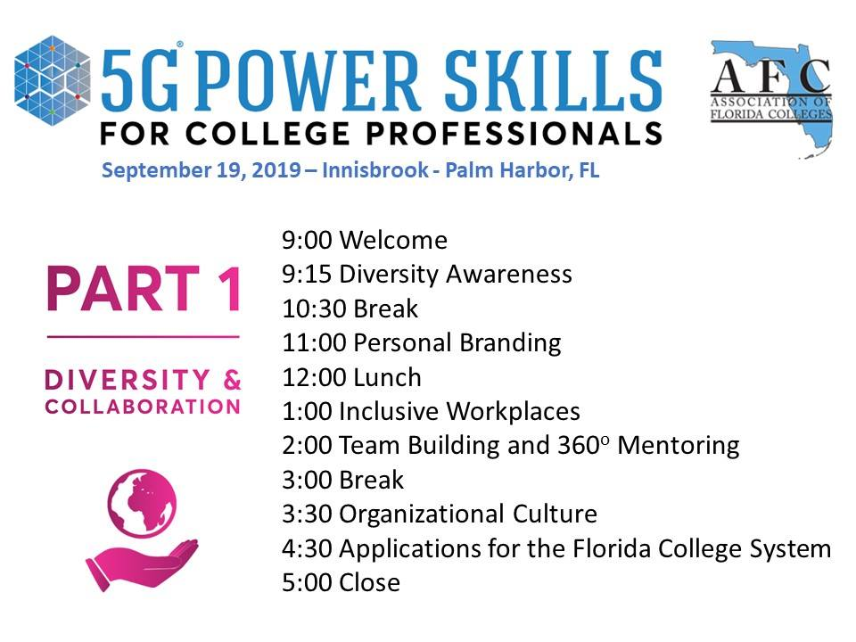
Other CCP opportunities
CCP CORE+
You don't have to already be in the CCP Program to participate!
First up in the series - 5G Power Skills for College Professionals,
A one day workshop offered Sept. 19, 2019.

Slide 11
COST AND HOW To APPLY
$200.00 for AFC members and $425.00 for non-members
Verification of program criteria:
  You are employed full-time, part-time, or as adjunct faculty employee by an institution within the Florida College System or related organization for at least one year.
  If you are a member of the AFC, you are a member in good standing.
  You are committed to upholding the AFC Certified College Professional "Standards of Conduct".
  Your college president will support your effort to earn the FCPC, if your tuition payment will be paid by your institution.
If your college is paying your application fee, you will be required to upload a letter of support from your college president at the time of application.
Welcome letter sent and effective date provided

