Slide 1
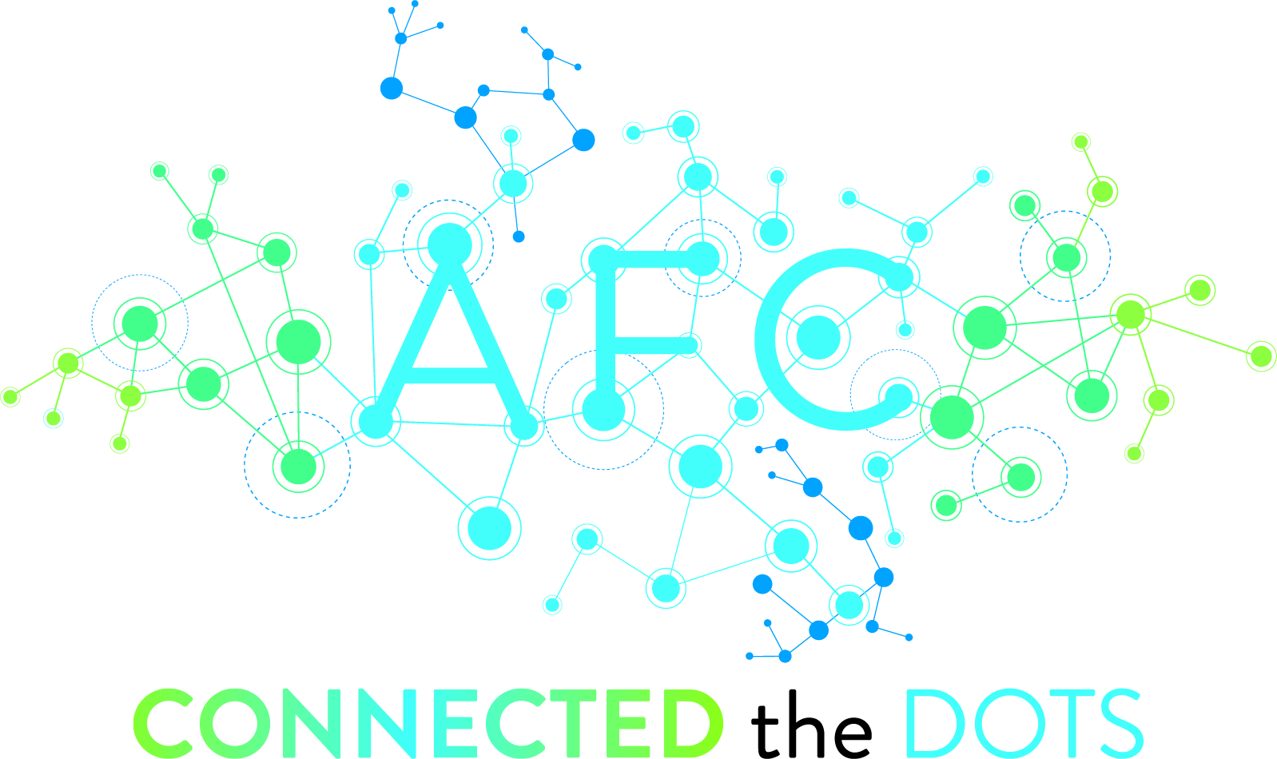
Connecting the Disciplines Beyond the Classroom
Carrie Thompson, Professor I, English, Palm Beach State College
Kate Montero, Associate Professor, Speech Communication, Palm Beach State College
Shauna Ramos, Associate Professor, Speech Communication, Palm Beach State College
Belle Glade, Loxahatchee Groves, and Palm Beach Gardens Campuses

Slide 2
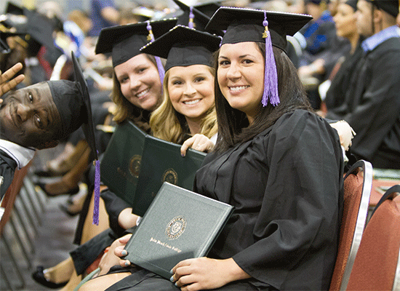
On average a mere 45% of students obtain a degree or certificate at the first institution they attend within six years of starting college, according to the National Student Clearinghouse Research Center. The completion rate was only about 39% for those who started at two-year public institutions.
What can we do to engage our students, promote retention and ensure their success?
Encourage participation in campus activities and extracurricular programming
We can tackle this issue with an interdisciplinary approach
Prioritize faculty & student relationships through interpersonal exchanges outside of the classroom
Connect learned concepts with life lessons

Slide 3
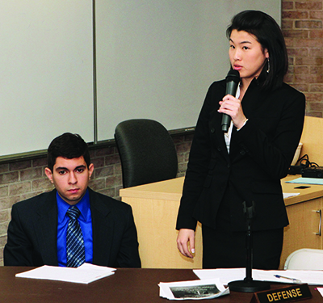
More than 50 years of research proves that campus activities play an integral role in creating a sense of campus community which in turn increases students’ persistence rates and grade point averages.
Queensborough Community College’s Mock Trial Competition Participation
    Participant Benefits:
    increase in retention
    degree completion
    scholarship awards
Most notably, every participant went on to a four-year college or university
The employment connection

Slide 4








CONNECTING THE…

Slide 5
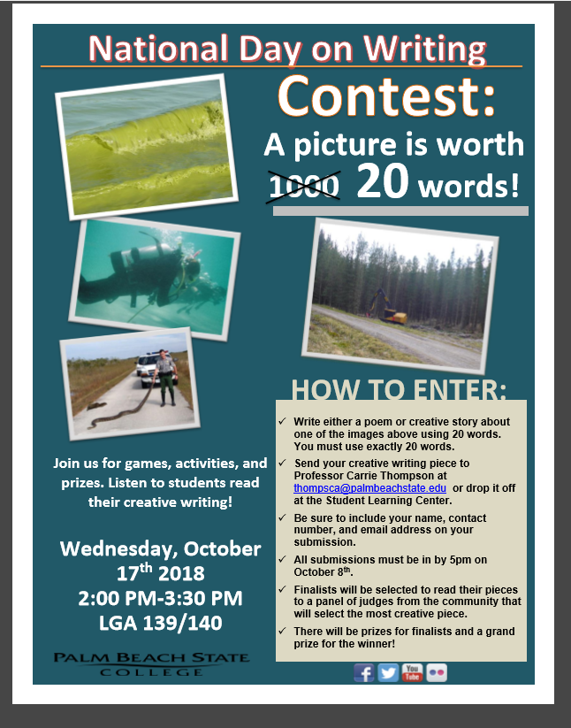
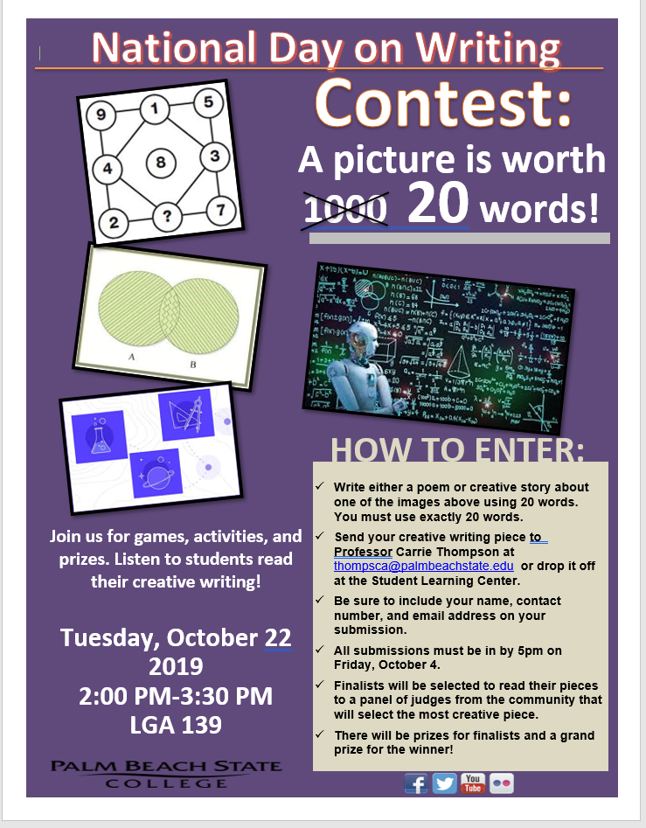

Slide 6
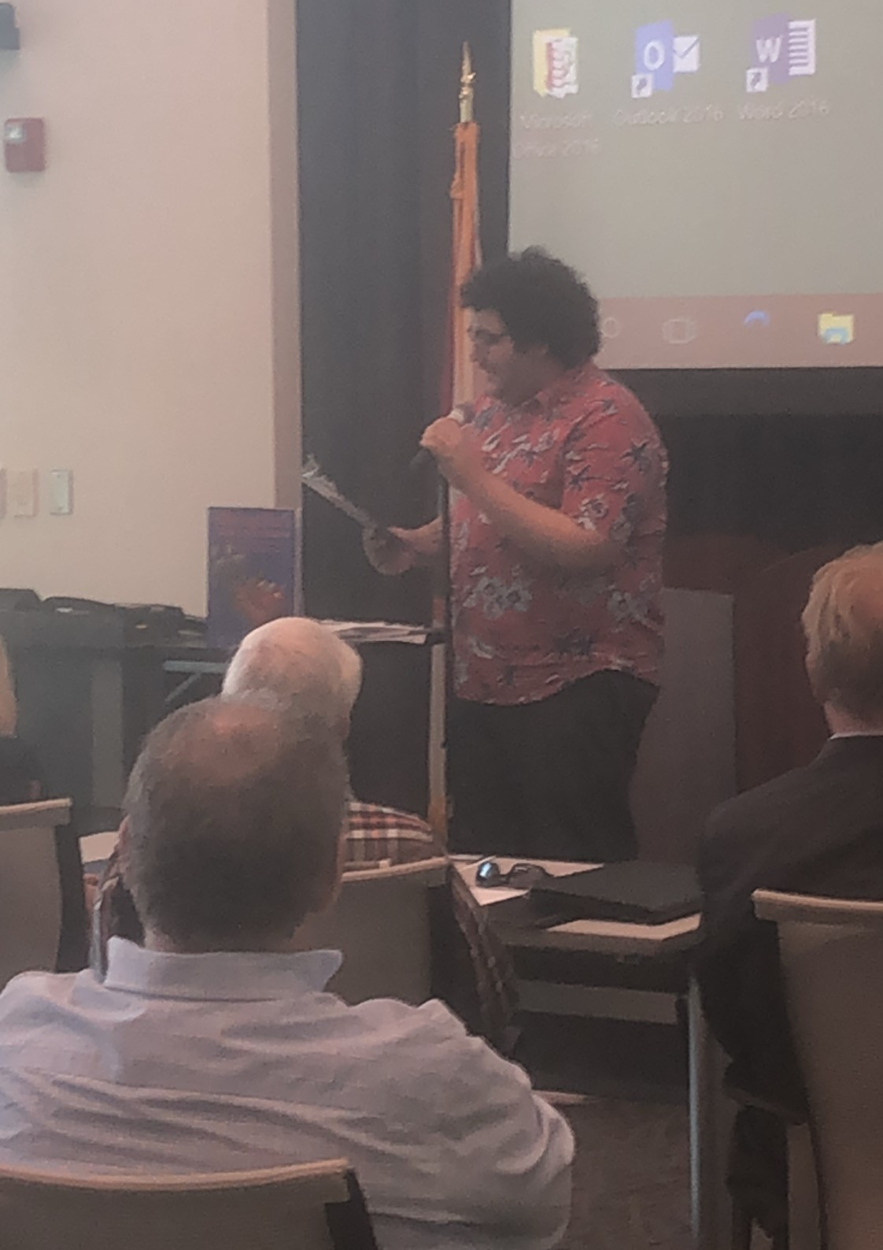
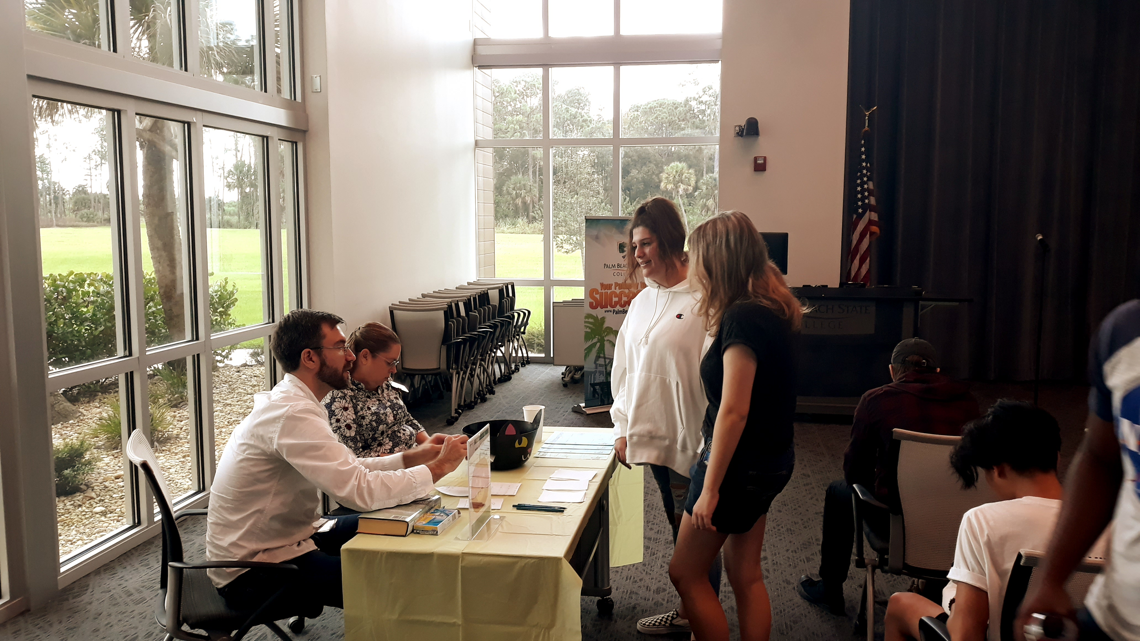
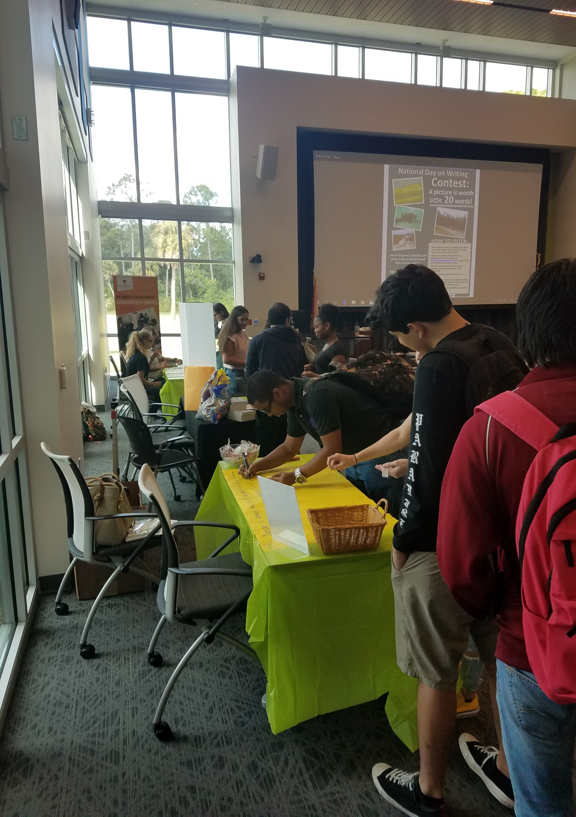
Researches at the University of Southern Mississippi conducted a study about constructs that factor into seven student retention. They discovered seven major factors. Three of the seven are the following: social connectedness, involvement and engagement, faculty and staff approachability are three of the seven. (qtd. in Hanover Research).

Slide 7
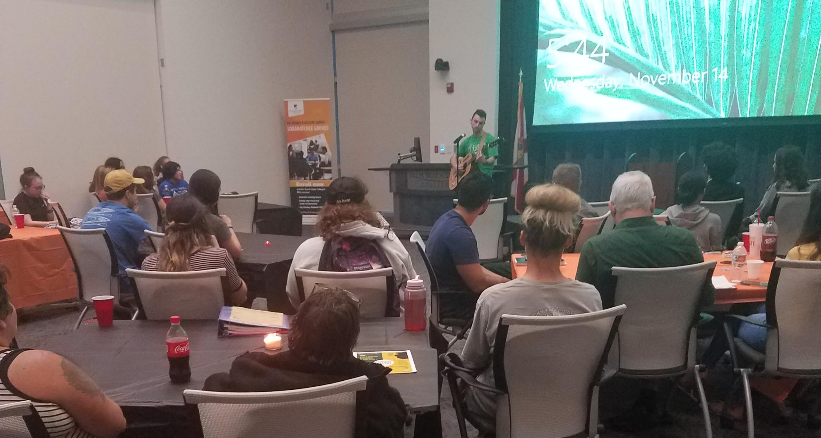
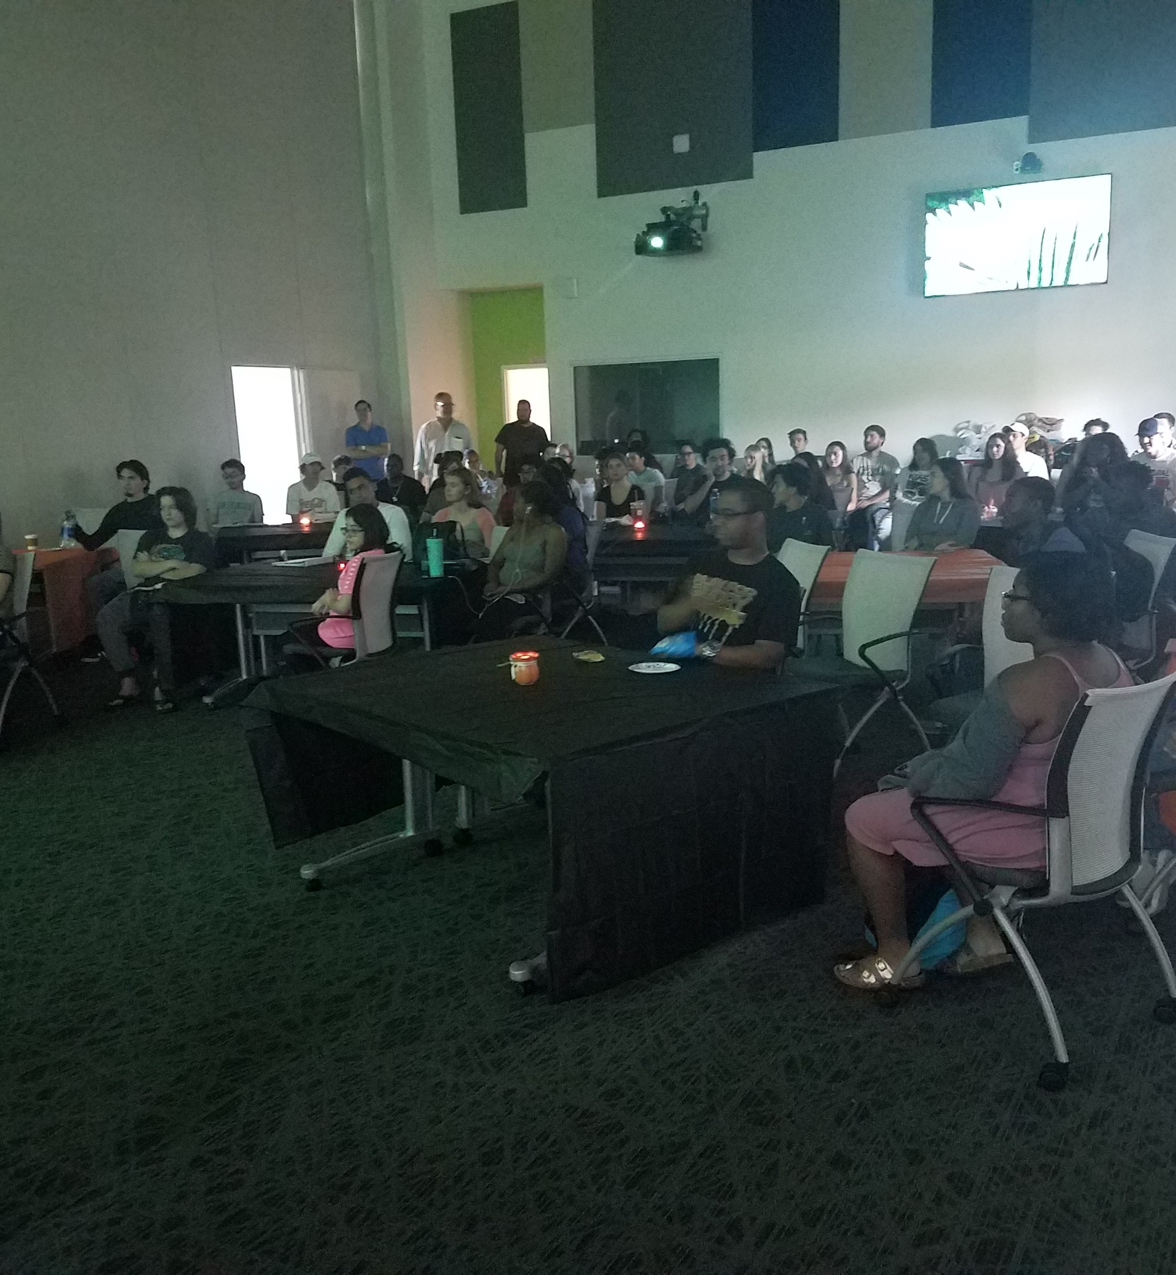
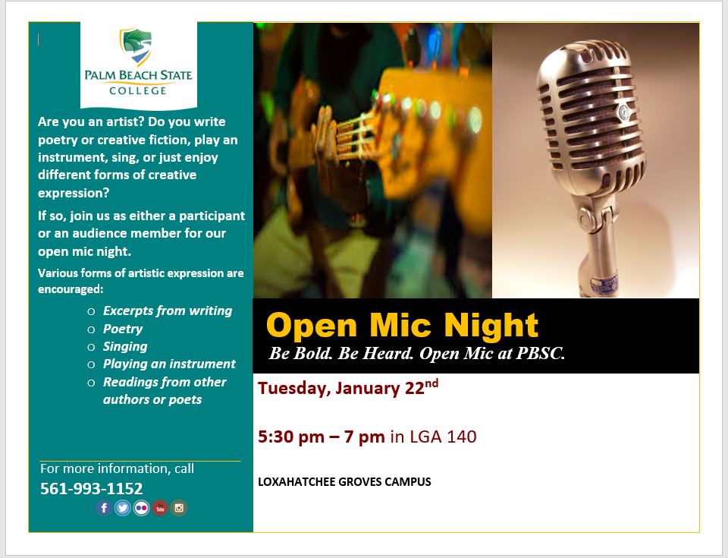
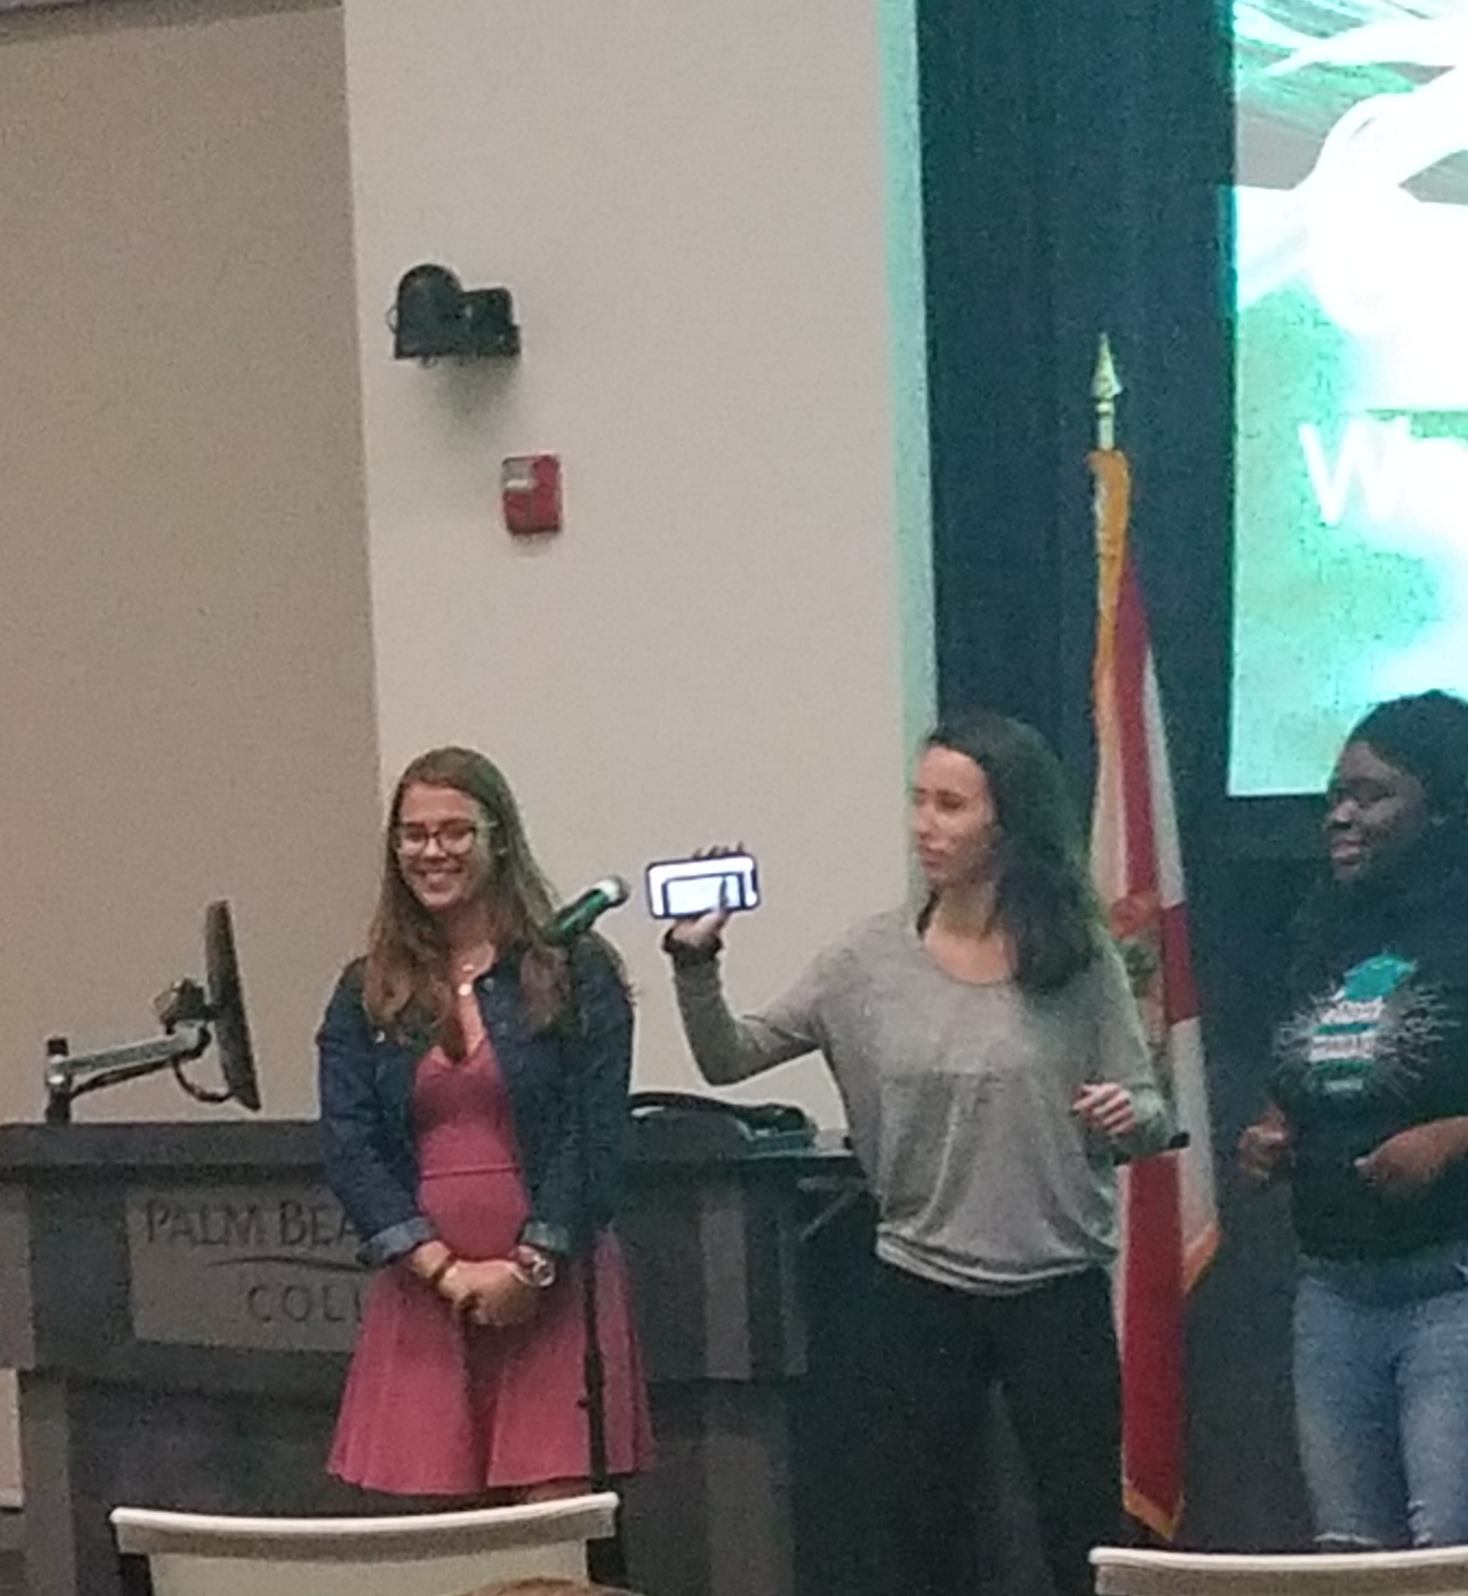

Slide 8







CONNECTING THE…
with

Slide 9

Plato regarded student-teacher relationships as essential to student learning.
Benefits of student-faculty interaction beyond the classroom:
Increased student effort
Increased retention rates
More success in grasping learned concepts and mastering course learning outcomes
Higher completion rates
Informal interactions matter
Survey says…

Slide 10
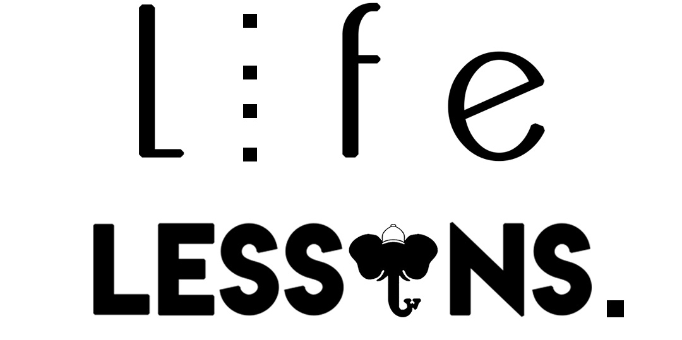
CONNECTING THE…
with

Slide 11

CONNECTING THE…

