Slide 1
ACUE and You: Evidence-Based Teaching Practices to Revitalize Your Classroom
Christine Neubert, MS, RHIA Instructor – Health Information Technology Indian River State College

Slide 2
Back to School
A.S. Degree HIT
Passed RHIT
First job in the field
B.S. HIM
Promoted to director
Passed RHIA
Change in Scenery
M.S. HIM
ACUE
AFC Conference
?????
Survived first year!
Notes:
Currently work as an instructor in the Health Information Technology Department at Indian River State College. I teach a variety of health information management and healthcare courses, specializing in online courses. I recently participated in a year-long course by the Association of College and University Educators (ACUE), and earned a Certificate in Effective College Instruction..

Slide 3
ACUE – Effective College Instruction
Credentialing organization – best teaching practices
Toolkit of instructional skills in five core competencies
Designing and Effective Course & Class
Establishing a Productive Learning Environment
Using Active Learning Techniques
Promoting Higher Order Thinking
Assessing to Inform Instruction & Promote Learning
5 -7 modules per competency
Each module, implement a new technique and reflect on results
Notes:
Implementing simple, yet effective teaching practices engages students, promotes high order learning, and supports student success. The Association of College and University Educators (ACUE) provides a course for educators to develop and hone these techniques, and last year, I was given the opportunity to participate. In this presentation, I will be sharing some of the knowledge I gained. We will be discussing several teaching practices and active learning strategies that I think are particularly useful in healthcare education. I will be sharing tips for implementation, as well as some classroom results from these teaching practices in action.

Slide 4
The Active Learning Cycle
Explore the Concept
Introduce the Concept
Apply the Concept
Notes:
Active learning consists of teaching strategies which make the students active participants in their own learning. This can involve individual or group reflection/work. How much activity is necessary? They are considered to be actively learning when they are cognitively engaged – what am I doing, how is this helping me learn?
Explore – activity that makes students think about concept, raise questions, identify misconceptions – establish the “need to know”
Introduce – provide answers to student exploratory questions
Apply – apply what they learned to real-life problems, answer questions, predict

Slide 5
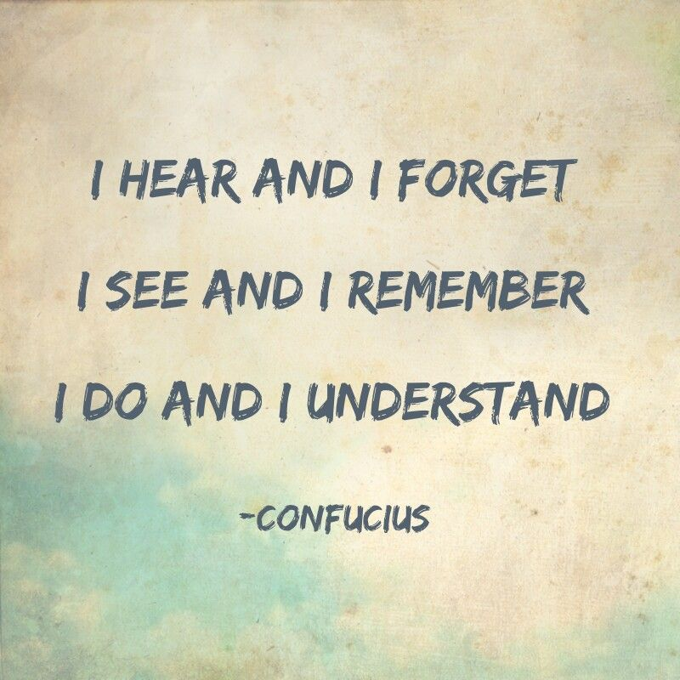
The Active Learning Cycle
“Not having heard something is not as good as having heard it. Having heard it is not as good as having seen it. Having seen it is not as good as knowing it. Knowing it is not as good as putting it into practice.”
-Xunzi

Slide 6
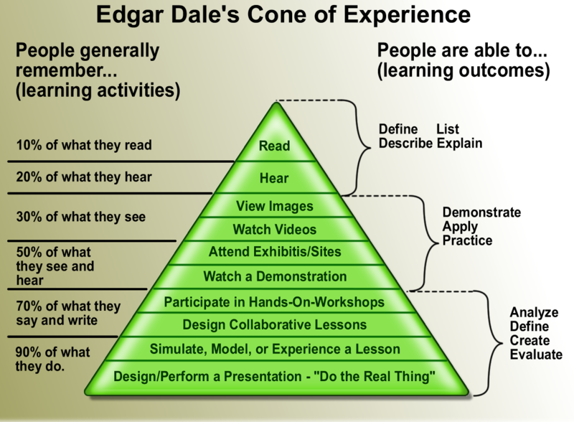
The Cone of Experience
Wikipedia

Slide 7
The Syllabus - Reconnaissance
Have students read the syllabus (5-10 minutes)
Go back and highlight five most important things
Call on students to share findings
Wait them out!!
After discussion, cover the points you find most important
This Photo by Unknown Author is licensed under CC BY-SA
Notes:
What is a reconnaissance?
No second chance to make a first impression – introducing them to the course, to yourself, to your style
My students generally note the following:
Due dates
Class meeting dates
Classroom policies
Grading scale
Writing format (APA vs. MLA)
What most don’t note:
Learning objectives – problem!!
This helps identify what your students are focused on – a tip-off of potential future emails.

Slide 8
The Syllabus – Scavenger Hunt
Develop handout with questions they need the syllabus to answer
Identify your most important items
Write your questions with these in mind!
More “personal” questions
Which learning outcome are you most excited about?
Which module/content/chapter interests you most?
Individual or group work
Discussion debrief after!
Notes:
Purpose: make sure student is reading syllabus and knows how to navigate
Results: less emails!!!

Slide 9
Engagement Trigger
Most learning happens at the beginning and end of class
“Primacy-Recency”
I Do, We Do, You Do
Start with the most important concept or skill
Statistic, image, quote, short video (< 5 minutes), graph
Build the foundation for that class
Move the administrative stuff to the middle while students are working
Exit tickets for attendance
Notes:
Start the class to maximize learning. Beginning and end of class are best times to learn, so grab their attention right from the start. - “Primacy-Recency effect”
I Do, We Do, You Do – this model gradually puts the responsibility more on the learner. [Demonstration, prompt, practice]
Build the foundation for that class – make sure it relates! Examples: Med Terminology course : Youtube video either about specific body system or memory tips. Module on HIPAA: start with statistics on breaches and financial impacts/fines
Move the administrative stuff to the middle while students are working and reflecting on the new material
Benefits: less students coming in late. Easier to start class, more engaged throughout. Grab attention right at beginning

Slide 10
Skeletal Outlines
Provides an outline of your class
Student fills in the pertinent information
Learning objectives - what is the point of this class meeting?
What are some things I already know about this topic?
Key ideas of each class segment
One thing I really want to remember/most important thing…
This Photo by Unknown Author is licensed under CC BY
Notes:
Susan Grover and Anne Hendricks “Accommodating Specific Learning Disorders in the Classroom: Minor Effort, Major Benefits.” – an accommodation for input disorders – inputting “ability to understand and receive information.” due tp poor auditory discrimination, can’t follow organizational patterns of lecture, cannot differentiate what’s most important vs. least important
Kinesthetic activity – keeps student focused, helps identify areas they missed, shows the relationship amongst all information covered – connections!!
Benefits: easier to fill in gaps or areas missed, less questions, peer-peer support, teaches students how to follow lecture patterns.

Slide 11
Lecture Techniques: Pair, Compare, Ask
Segment lectures (10 minutes)
After segment, students pair off
Compare notes
Fill in any gaps
Write down questions
Student-led Q&A session
You field any unanswered questions
Notes:
Dr. Steven Brookfield, University of St. Thomas and a John Ireland endowed chair – lecture gets a bad rap because it’s been misused. ACUE suggests divide your lectures into 10-15 minute segments as research suggests this is how long they pay attention on average. After 10-12 minutes, attention starts to fade, basic blocks and connections, cannot differentiate between what is most important vs. not as important. Lectures become not as effective.
Breaks allow them to refocus, shake it off, check in with each other, compare notes, ask/formulate questions.

Slide 12
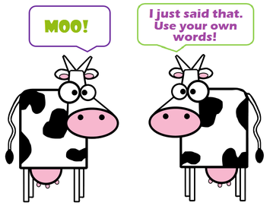
Lecture Techniques: Paraphrase
Occurs after “big idea” or concept, or natural break in lecture
Students write a summary in their own words
Different targets for audience
Practitioner vs. patient
Peer vs. supervisor
Basic knowledge vs. no knowledge vs. high level knowledge
This Photo by Unknown Author is licensed under CC BY-SA-NC

Slide 13
Lecture Techniques: Short Case Studies
Segment lectures (10 minutes), or after “big idea/concept”
Apply portion of lecture to a realistic scenario
Ask specific questions
Teach class how to develop their own questions
What is the problem?
What can we do about it?
What do we need to do next?
What? So what? Now What?
This Photo by Unknown Author is licensed under CC BY
This Photo by Unknown Author is licensed under CC BY-NC
Notes:
What, so what, now what is a reflective model developed by Gary Rolfe, Dawn Freshwater, Melanie Jasper in 2001.
What- describe the situation
So What- What have you learned, what are the results, analysis, etc.
Now What – identify future steps/needs/connections, how will you apply new knowledge

Slide 14
Lecture Activities: Pass a Problem
Each group writes question/problem from lecture/reading material
Exchange card with another group
Students work together to answer peers’ question
Groups meet for short debriefing
Cards collected after to identify misconceptions, common ideas, etc.
Notes:
Source of test questions!

Slide 15
Lecture Activities: Team Quiz
Divide lecture into sections
Form groups based on number of sections
3 sections, groups of 3
After first segment, first group member writes 2-3 question quiz on content
Other members read through notes
First group member quizzes remainder of group and corrects as needed
Lecture continues, pausing for each section’s quiz
This Photo by Unknown Author is licensed under CC BY-NC-ND

Slide 16
Muddiest Point
Occurs end of lecture
Students write down what is “muddiest” point
Collect and identify common trends, questions
Address via LMS or at next class
Alternatives:
Ask student what they think could help them understand?
Students also identify the day’s concept they completely understand
Notes:
Monitoring technique to check for understanding
Very important to address what you’re doing with this information

Slide 17
One-Minute Paper/One-Minute Thread
Students take one minute to write a paper/discussion post
What was most meaningful? What concepts are still unclear? What additional questions/comments do you have?
Clear: Now I understand the steps needed to perform procedure
Unclear: I don’t get why this doesn’t happen
Comment: Can you go over this process in more detail and maybe include an image to help me visualize
This Photo by Unknown Author is licensed under CC BY-SA-NC
Notes:
The students must reflect on everything they learned that day, and summarize into useful feedback for the instructor. Provides rapid feedback because the professor and the student’s idea of what is important and meaningful may not be the same!
Helps them organize their thinking

Slide 18
Analytic Teams
Form groups and assign each student a role
Proponent – points of agreement
“Clozapine is the best medication for schizophrenia.”
Critic – points of disagreement
“The health risks outweigh the benefits and is not the best choice medication”
Illustrator – identifies relevant examples
Evidence of successful treatment
Data on risks
Skeptic – challenges the idea
“How many other medications should be tried first?”
“At what point, is it too dangerous to continue treatment?”
Summarizer – recaps keys points and writes a conclusion
Notes:
Can be done online or in-class. May work particularly well for long-term group project, with a more complex scenario.

Slide 19
Student Persistence
Motivation
What motivates the student?
How can we enhance motivation?
Self-efficacy
Sense of belonging
Own perception of value
Markers
Precollege behaviors
Academic behavior and social experience
Life experience
Momentum
Momentum points that begin in K-12
Notes:
Students don’t want to be retained, they want to persist. Related but different perspectives. Vincent Tinto asks what can the college do so more students want to persist?
Article by Michelle Berkeley, The Three Keys to College Persistence states there are three things that indicate a likelihood to persists. Readiness for college is the toolkit, college persistence is the application of these tools.
Motivation what motivates the student, how can we enhance that motivation?
self-efficacy (they must be confident in their own abilities) – belief in their own abilities to succeed
a sense of belonging – this increases motivation, how do they perceive their own sense of belonging?
perception of value – matched with the right track and career, instructors cab help make meaningful connections, inclusive material
Markers are indicators (precollege, college, and life experience) that affect persistence
precollege – college readiness
academic behavior and social experience (participation in activities, faculty-student interaction, GPA, remedial courses, full vs. part time, withdrawals, etc.)
life experience financial aid, FTE, single parents – all can effect engagement and focus
Momentum builds momentum through momentum points (college pre experience) ex. Rigourous hs curriculum, AP or IB, earn a high GPA, attain credits during hs, attendance, exposure to college norms, complete college application, complete fafsa. These momentum points creates a path in which the student moved with increasing forward motion. K-12 and college must work together for these momentum points = shared responsibility

Slide 20
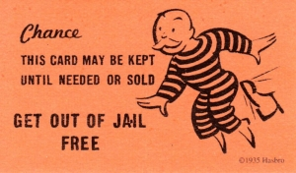
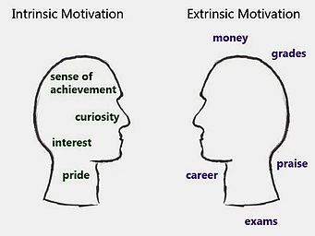
Student Persistence
Intrinsic motivation
Amnesty coupons
Foster sense of belonging (especially online)
Introductions
Pair students up early to discuss study activities
Rubrics/checklists
This Photo by Unknown Author is licensed under CC BY-SA
This Photo by Unknown Author is licensed under CC BY-SA
Notes:
Students may not have intrinsic motivation, so we need to help them find it.
Amnesty coupons – late assignment passes, quiz retakes

Slide 21
Student Persistence
Increased effort = improved performance
Send reminders
Send messages of support
This Photo by Unknown Author is licensed under CC BY
This Photo by Unknown Author is licensed under CC BY

Slide 22
References
Association of College and University Educators. (2018). Effective teaching practices.
Berkeley, M. (2017, February 14). The three keys to college persistence. Retrieved from https://www.gettingsmart.com/2017/02/three-keys-college-persistence/
Borton, T. (1970). Reach, touch, and teach: Student concerns and process education. New York, NY: McGraw-Hill.
Grover, S. & Hendricks, A. (n.d.). Accommodating specific learning disorders in the classroom: minor efforts, major benefits. Retrieved from http://kairos.technorhetoric.net/7.1/coverweb/grover_hendricks/accomodating.htm#Skeletal
Nilson, L. B. (2010). Teaching at its best: A research-based resource for college instructors (3rd ed, pp. 118–120.). San Francisco, CA: Jossey-Bass.
Rolfe, G., Freshwater, D., & Jasper, M. (2001). Critical reflection in nursing and the helping professions: a user’s guide. Basingstoke: Palgrave Macmillan.
Sousa, D. A. (2011). How the brain learns (4th ed.). Thousand Oaks, CA: Corwin.
Tinto, V. (2016, September 26). From retention to persistence. Retrieved from https://www.insidehighered.com/views/2016/09/26/how-improve-student-persistence-and-completion-essay
Top Hat. (2018, November 26). Active learning: How professors should teach. [Video file]. Retrieved from https://www.youtube.com/watch?v=IOcgBCVbHNg

