Slide 1

Service Projects Committee-
Making Florida a Better
Place Together!
By: Obi Kalu-Service Projects Committee Chair

Slide 2
What is Community Service?
Community Service is a not for pay activity/project done by an individual or group for the benefit of the public or an institution.
How do you or your college give back to the community?

Slide 3
AFC and Community Service
Community Service is one of AFC's Strategic Values
AFC engages with the community at the state and local level. We also engage at the chapters, regions and commission levels.
Service is important to AFC. AFC dedicates a service/community project at each event they host. Each Region, Commission, and Chapter generally participate in a service project.

Slide 4
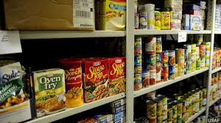
This year’s Service Project…
First Service Project of the Year…YOUR College's Food Pantry!
Everyone registered for this conference is encouraged to donate to your college's food pantry. If we all donate just ONE item, we can make a difference!
Let’s keep this one going all year! Food insecurity is real for so many and our students. AFC can do its part to give back.

Slide 5
Join the AFC Service Project Committee!
Thank you for giving your time to serve as a Region Rep! We need a few more! Working together makes light work ☺
If you need ideas for a service project or have one to share, contact me or one of these dedicated Reps!
Region 1: Alonda Jones-Pensacola State College
Region 2: Myisha De Nose-Florida State College of Jacksonville
Region 3: Charlene Latimer-Daytona State College
Region 4: Mildred Diaz Santiago-Pasco Hernando State College
Region 5: Open

