Slide 1
Association Update

Slide 2
WHO WE ARE:
Founded in 1949
28 institutional members
29 Chapters and 14 Commissions
4 fulltime professional staff
3 professional publications – Current, Capitol Perceptions & Annual Report

Slide 3
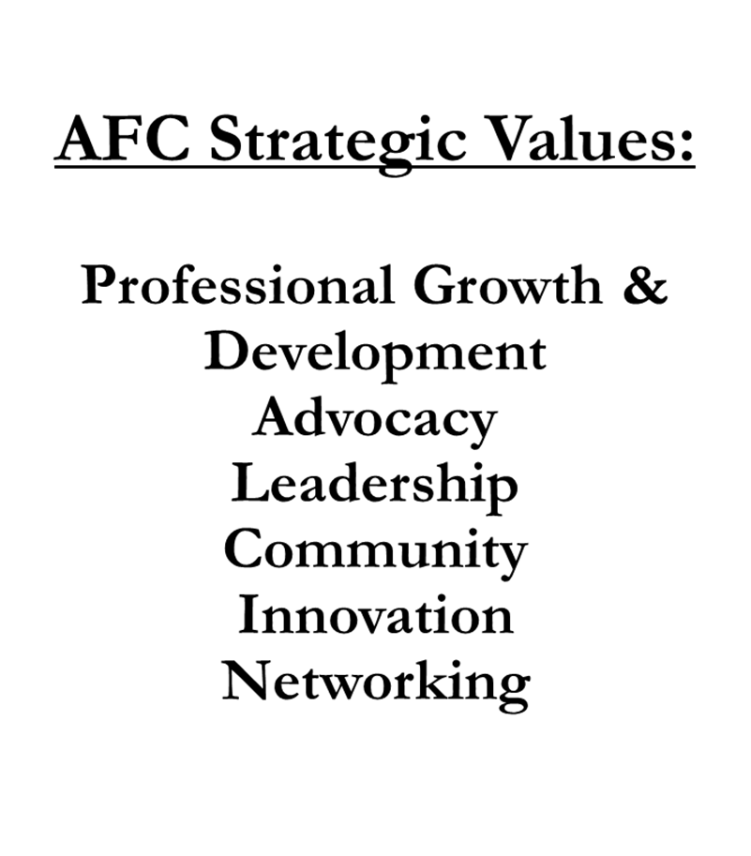
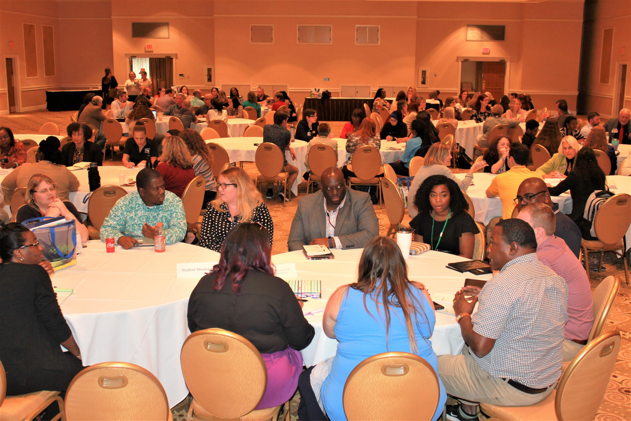

Slide 4
WHAT’S NEW: INCREASED AFC VISIBILITY

Slide 5
Virtual Activity
Since April of 2020, we’ve held over 100 virtual webinars, workshops, and conferences.
Held our first virtual Annual Meeting & Conference
More than 3,600 people (members and non-members) have participated in an AFC activity/event
https://afc.memberclicks.net/assets/Publications/Annual_Report/AFC%20Annual%20Report%202020_FINAL.pdf
2021 ~ We will do more

Slide 6
ACCESS AFC
AFC partnered with Alpha UMi Inc. to create professional development webinars/workshops. Alpha UMi specializes in innovative training programs to elevate professionalism and leadership through interpersonal skills, leadership skills and soft skills development.
Topics will include:
Winning Mindset
Resiliency
Emotional Intelligence
Ethics
Communication
Time Management

Slide 7
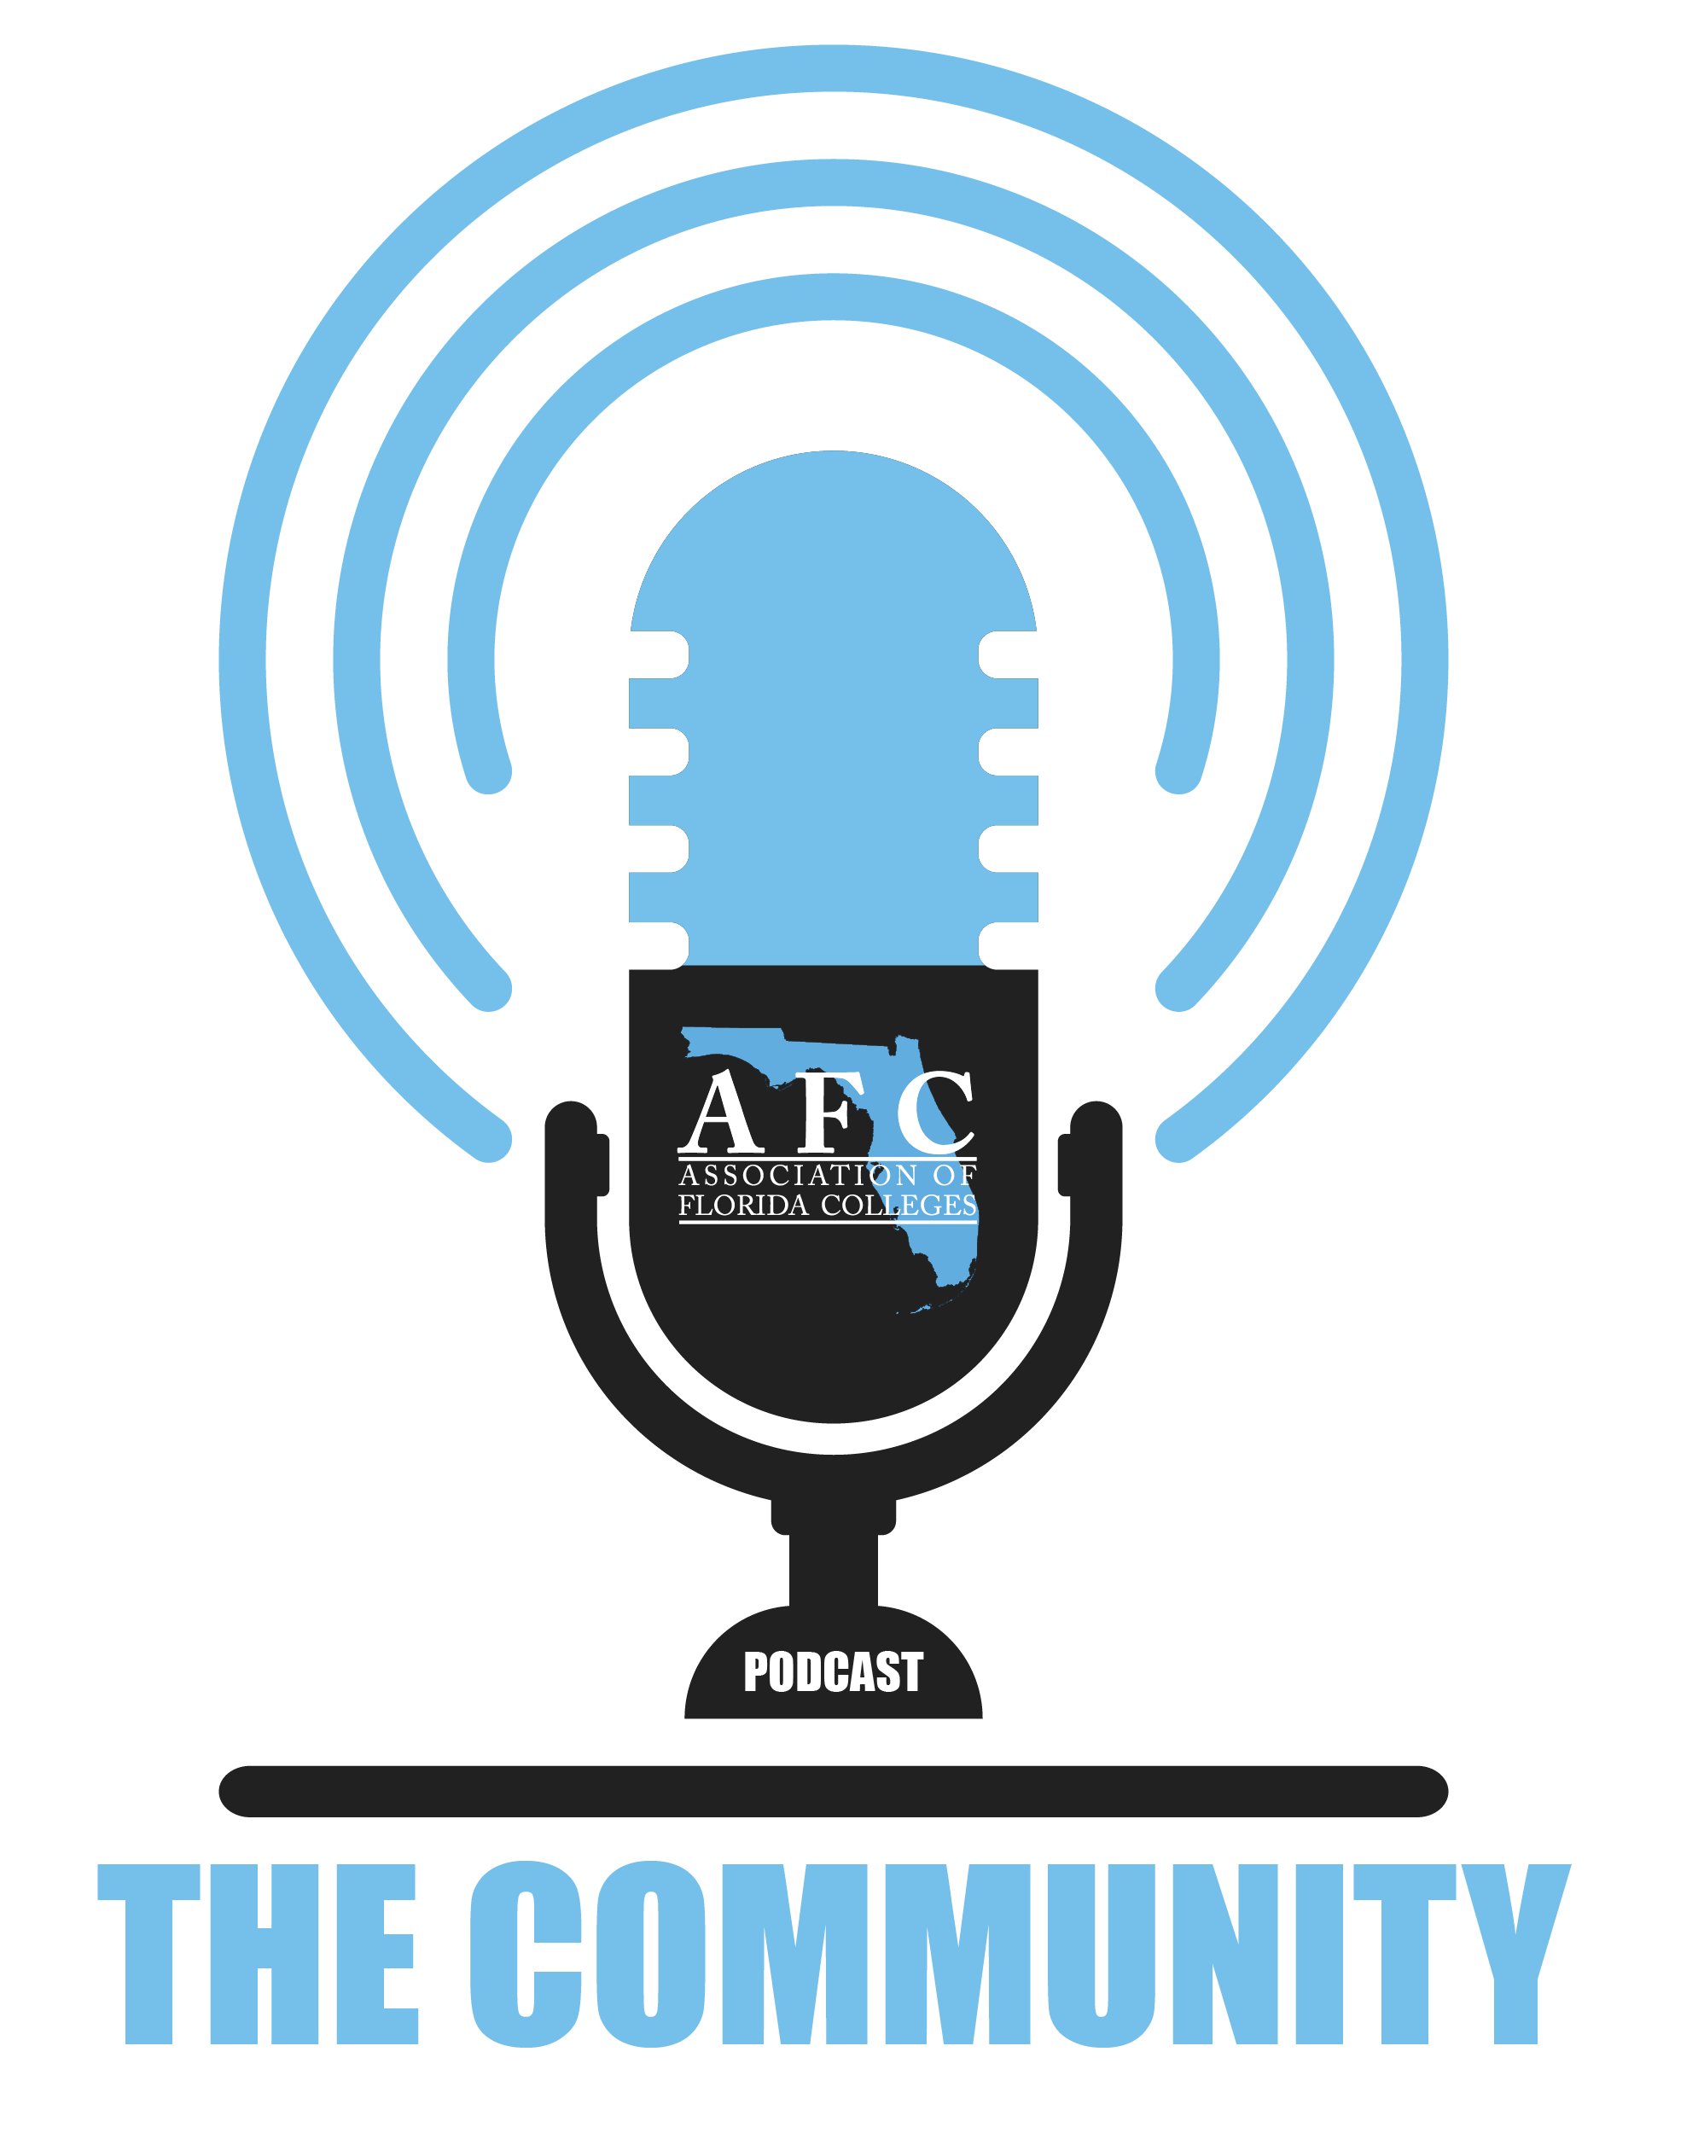
What’s New?
The Podcast is a new avenue for the AFC to tell its story. We will be highlighting member colleges, Florida College System programs, and of course, AFC members. The AFC Podcast is our way of recognizing the good works of the AFC and our collective higher ed Community.
Hosted by Christine Tripp, Director, Student Recruitment & Enrollment Marketing Services at Eastern Florida State College & Doug Ryan, Doug Ryan Consulting

Slide 8
When: Every Third Thursday Next: Feb 18, 2021~ 1:00 PM Eastern

Slide 9
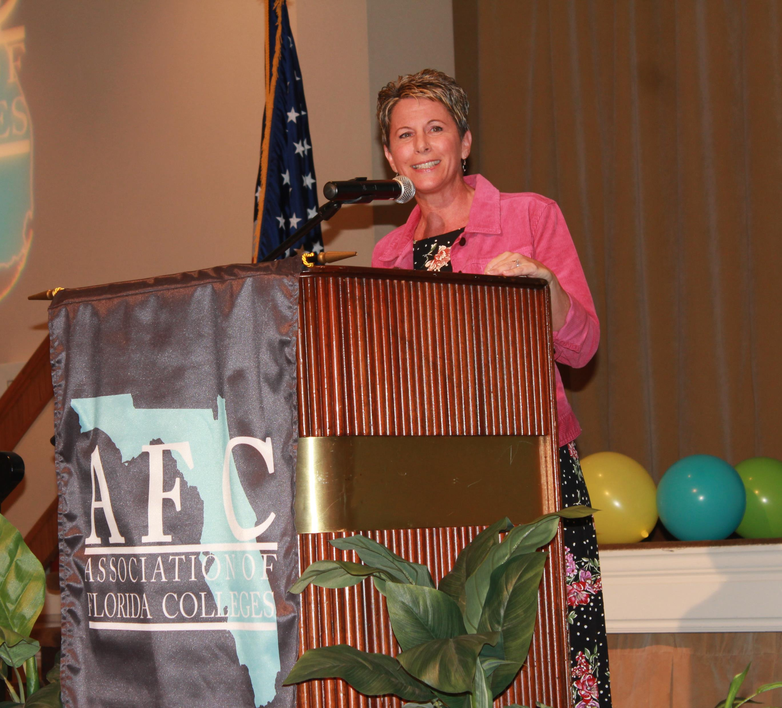
The life of a higher education professional is unique. Everyone has a story to tell.
No matter your job title - faculty, advisor, police officer, coordinator, administrative specialist, facilities manager, or librarian - you make a difference. Every college employee is important to a student’s journey. We want to collect and share your personal stories.
Video (2 minutes)
Written

Slide 10
