Slide 1
Jessica Kummerle, Legislative Committee Chair
2021 Legislative Update

Slide 2
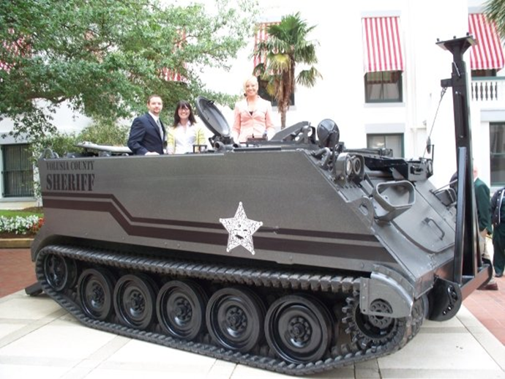
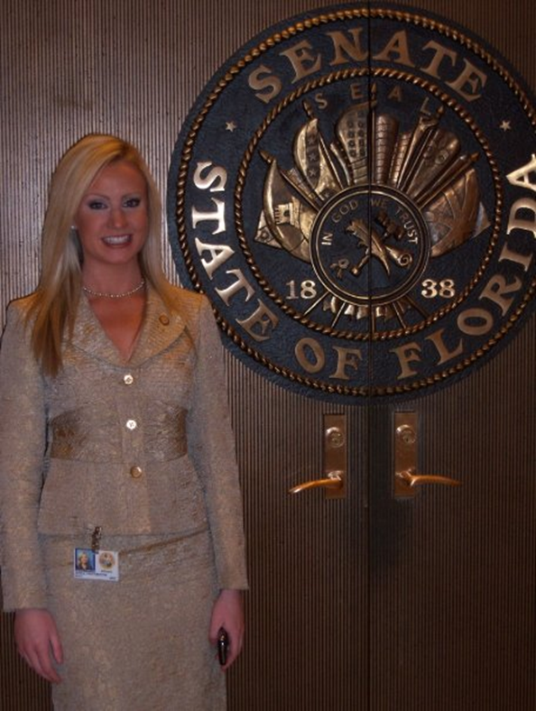
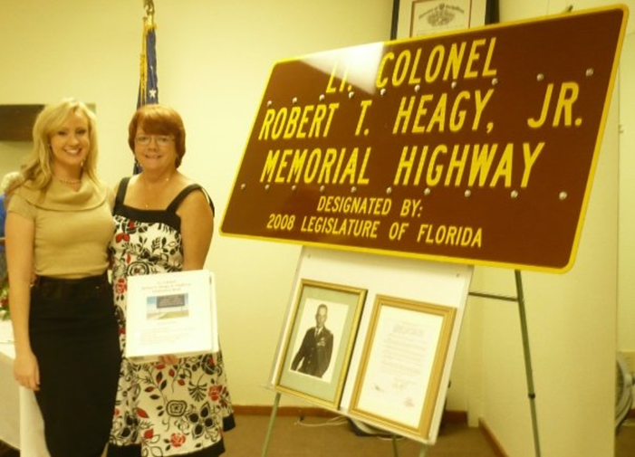

Slide 3
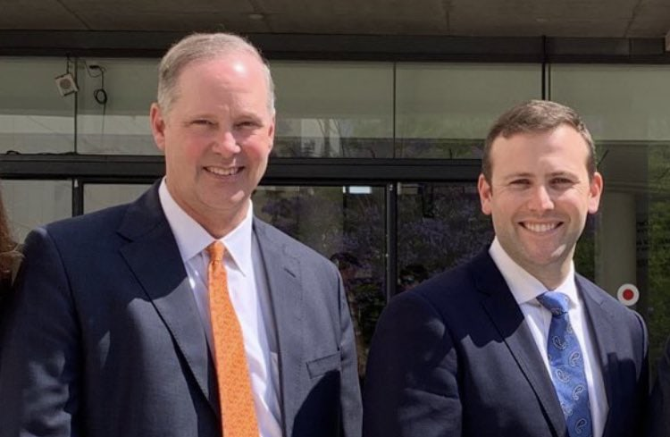
State Leadership

Slide 4
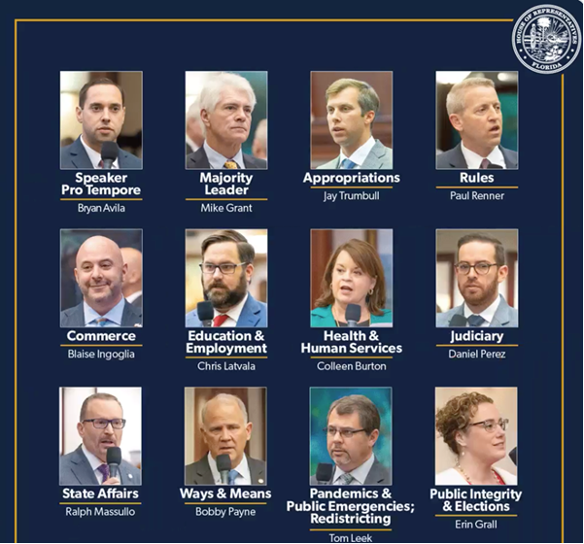

Slide 5
Florida House of Representatives
Republicans: 78
Democrats: 42
Florida Senate
Republicans: 24
Democrats: 16

Slide 6
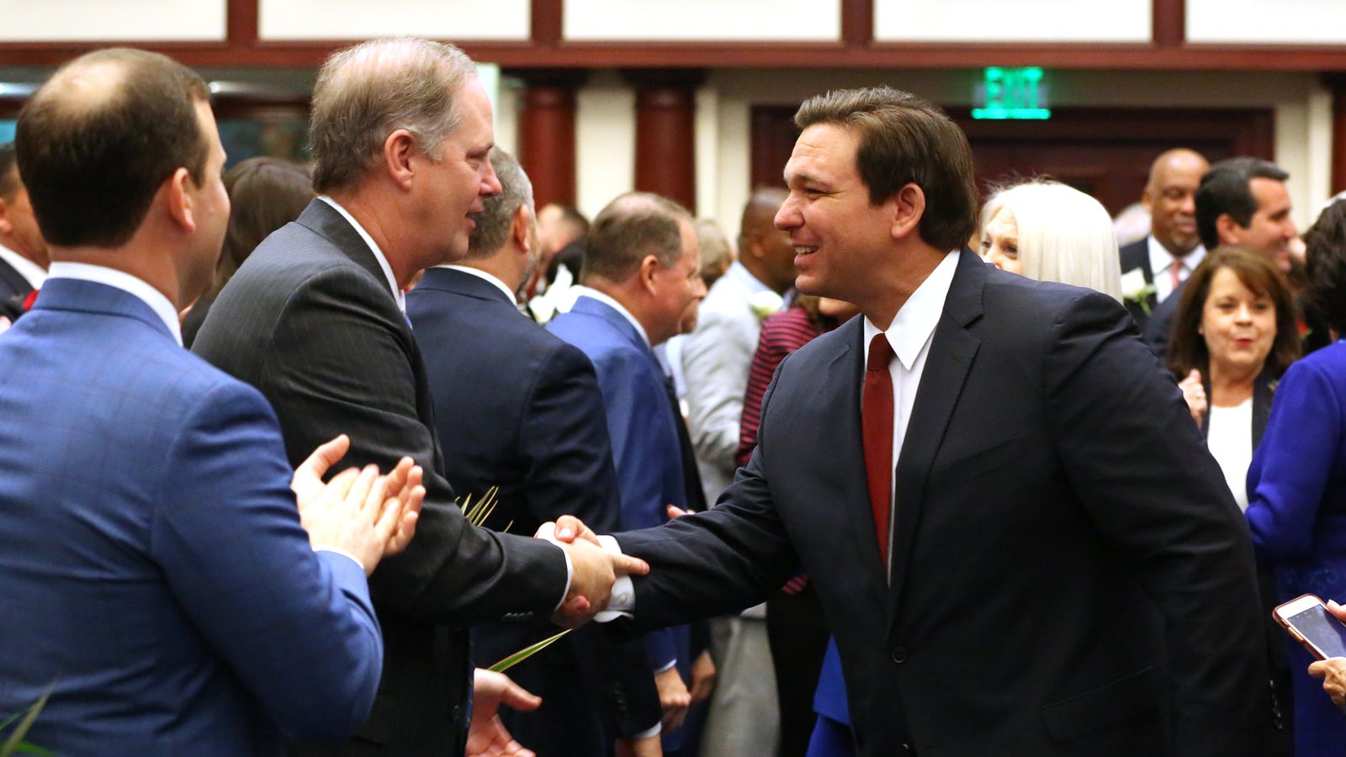
Session Dates
Committee Weeks
January 11
January 25
February 1
February 8
February 15
Session Convenes: March 2
Last Day of Session: April 30

Slide 7
Council of Presidents
2021 Priorities
Conserve our Program Fund
Invest in FCS Infrastructure
Maintain Funding for the Complete Florida Plus Program

Slide 8
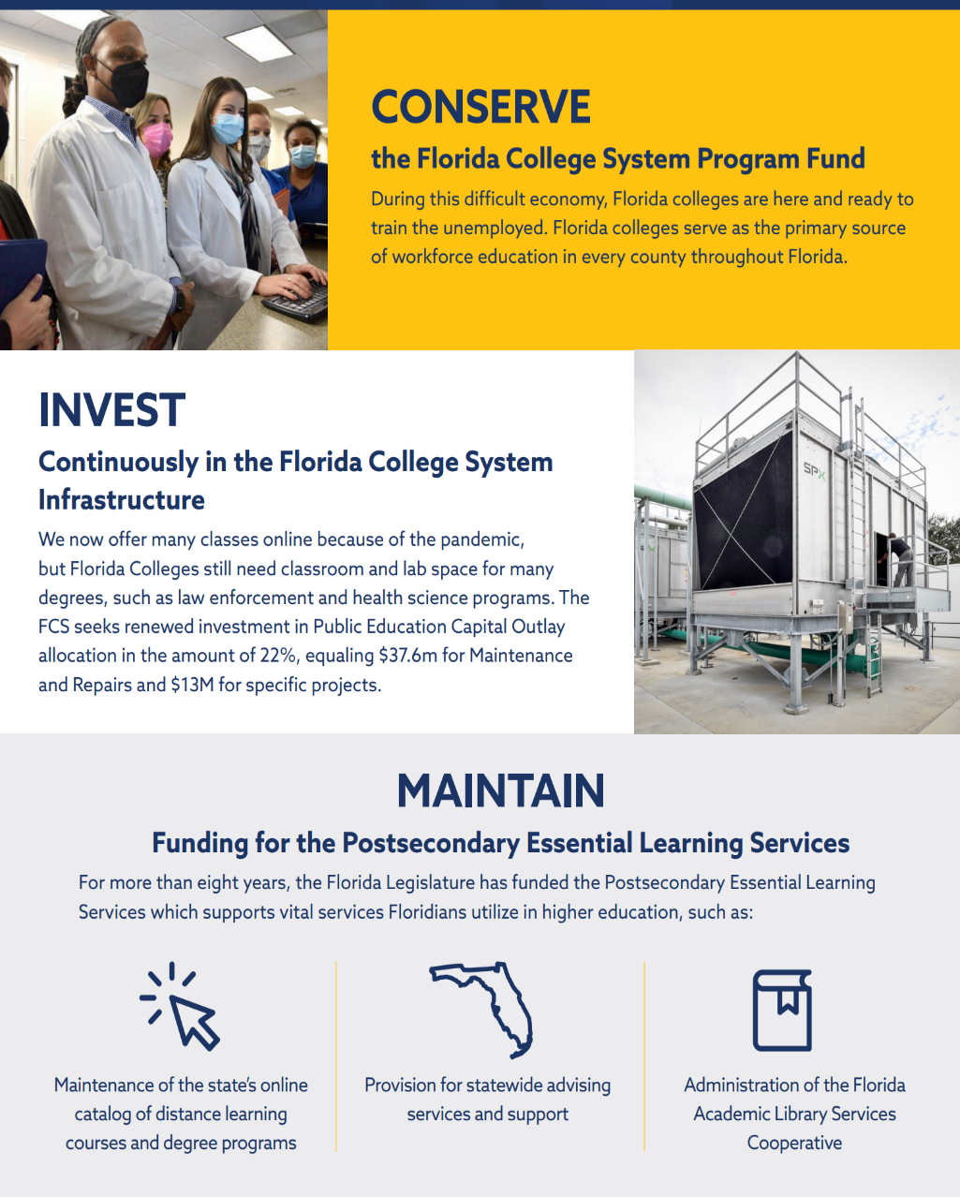
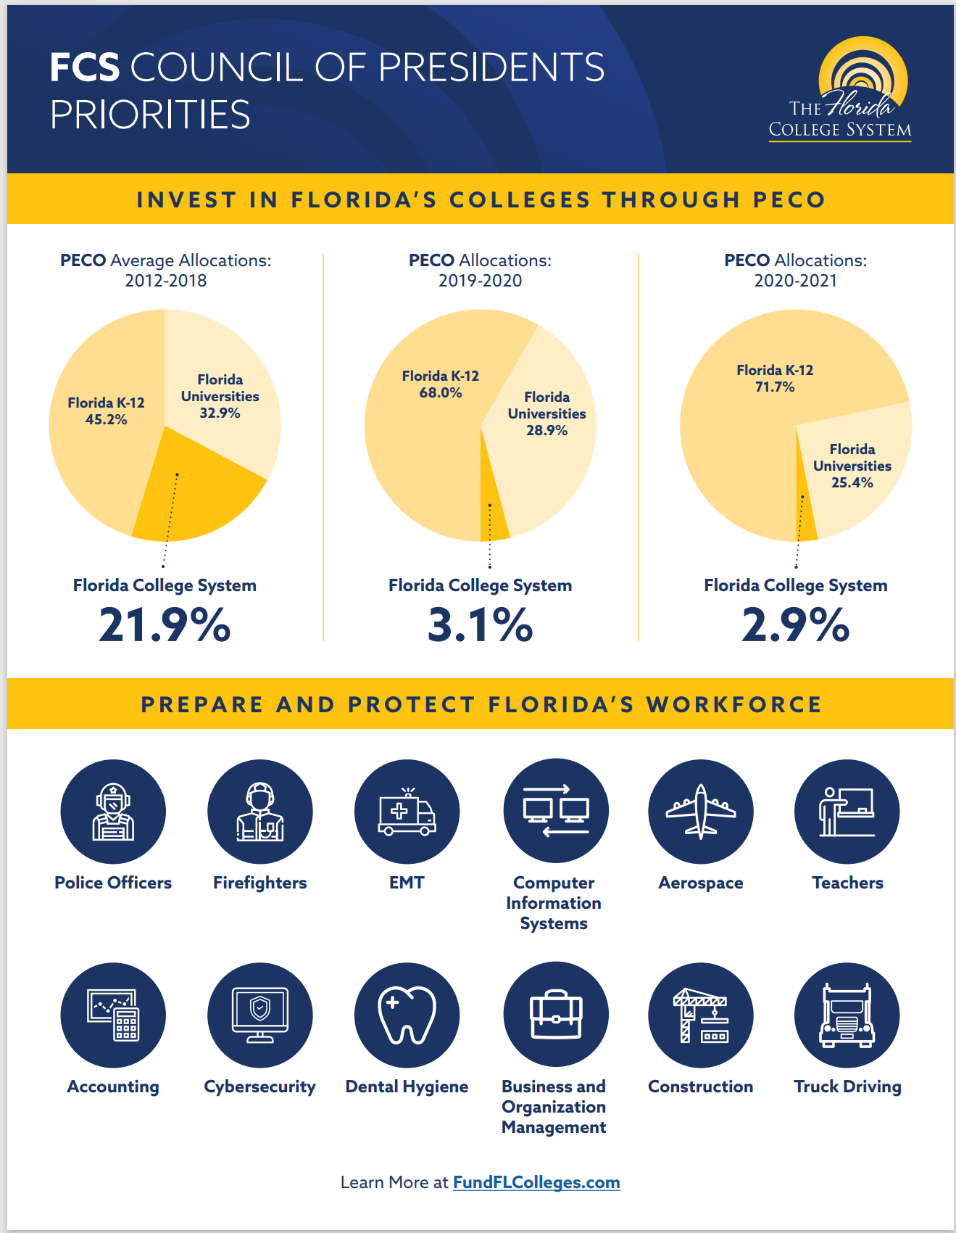
One Page Document Review

Slide 9
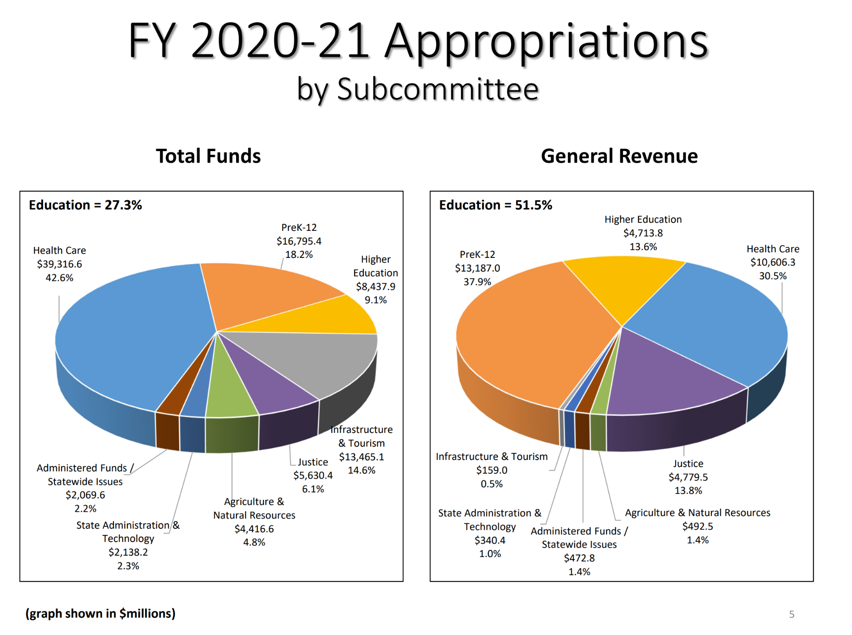
Budget

Slide 10
Budget

Slide 11
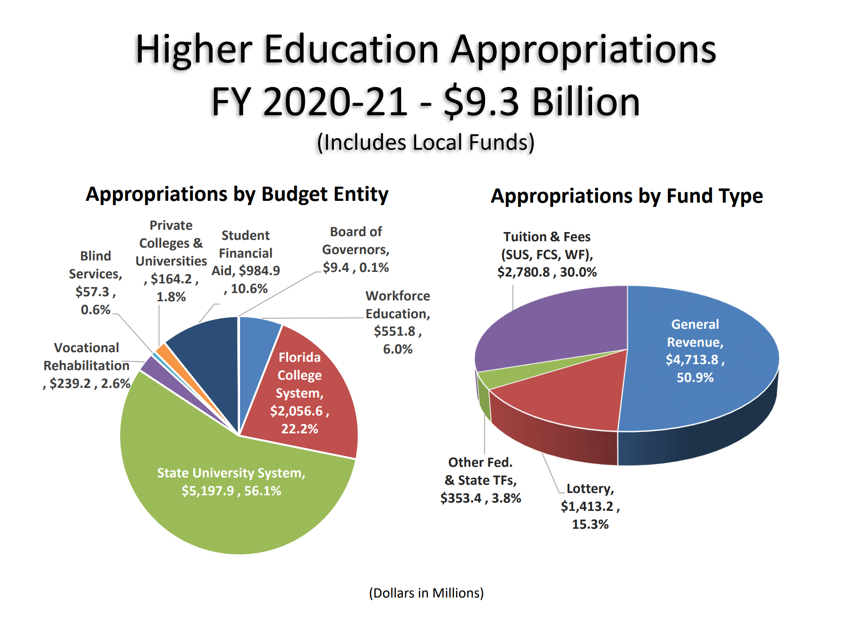
Budget

Slide 12
Policy Discussions and Bills Review
HB 7/SB 72- Civil Liability for Damages to COVID-19 (McClure/Brandes)
Provides requirements for civil action based on COVID-19-related claim; provides that plaintiff has burden of proof in such action; provides statute of limitations; provides retroactive applicability.
HB 51- Charter Schools (McClain)
Authorizes state universities & Florida College System institutions to sponsor charter schools without approval from the local school board.
SB 52- Postsecondary Education (Rodrigues)
Creates the Dual Enrollment Scholarship Program- Reimbursing institutions for courses taken by private or home-schooled students.
HB 99/SB 538- Use of Epinephrine Auto-injectors on Public K-20 Campuses (Gottlieb/Polsky)
Authorizes state universities & Florida College System institutions as entities for specified purposes relating to the emergency use of epinephrine auto-injectors.

Slide 13
Policy Discussions and Bills Review
SB 128- Florida Talent Development Council (Bradley)
Creates the Council that will address the feasibility of establishing and implementing the Pathways in Technology Early College High School program (P-Tech). P-Tech is a program that incorporates secondary & postsecondary education with workforce education and work experience using a flexible 6-year model.
HB 175/SB 508- Apprenticeship and Preapprenticship Programs (Shoaf/Brandes)
Revises requirements of DOE's annual report on apprenticeship & preapprenticeship programs; provides DOE's duties relating to apprenticeship programs; revises membership of State Apprenticeship Advisory Council; provides that parents of public school students be informed of workforce education opportunities.
SB 220- Public Records and Public Meetings (Brandes)
Any personal identifying information of an applicant for president is confidential until included in the final group of applicants. Any portion of a meeting identifying a president will remain confidential but must be recorded.
HB 6037- Postsecondary Out-of-State Fee Waivers (Fine)
Deletes provisions relating to waiver of out-of-state fees for certain students.

Slide 14
Policy Discussions and Bills Review
HB 233/SB 264 Intellectual Freedom in Postsecondary Education (Roach/Rodrigues)
The SBOE will require each FCS institution to conduct an annual assessment of the intellectual freedom & viewpoint diversity at that institution. SBOE may not shield students from free speech protected under the first amendment.
SB 258- Internship Tax Credit Program (Jones)
Providing a corporate income tax credit for qualified businesses employing degree-seeking student interns if certain criteria are met.
SB 300- Student Eligibility Requirements for State Financial Aid Awards and Tuition Assistance Grants (Taddeo)
Providing that, for purposes of receiving state financial aid awards, a student may not be denied classification as a resident based on his or her immigration status if certain criteria are met.
SB 84- Retirement (Rodrigues)
Providing for compulsory membership in the Florida Retirement System Investment Plan for employees initially enrolled on or after a specified date Effective Date: 7/1/2021

Slide 15
Stay Informed
Follow your delegation and state leadership on social media.
Remember you are still representing your college on social media.
Read the AFC Current that provides legislative updates.
Work with your college governmental relations director. Provide them insight and stories. Ask them how you can help.
Invite me to speak at your regional or chapter meetings.
Watch the Florida Channel for updated, non-partisan information.

Slide 16
Tips
Talk to your President and/or Governmental Relations Director prior to reaching out to anyone.
Research the legislator and legislation.
Always use their proper title.
Send handwritten notes.
Thank them for what they have done in the past.
Thank the staff and be polite to the staff.
Listen.
Be respectful.
Share your personal story.

Slide 17
Contact me
Jessica Kummerle
Email: kummerlj@cf.edu
Text: 352.318.2940
jetflorida Jet Kummerle

