Slide 1
2021
Strategic Planning
ASSOCIATION OF FLORIDA COLLEGES
MARJORIE MCGEE, COLLEGE OF CENTRAL FLORIDA
TRACY GLIDDEN, EASTERN FLORIDA STATE COLLEGE
Notes:
Welcome, introduce ourselves and the purpose of our committee.

Slide 2
Our AFC Presidential Goals:
Strengthen Partnerships
Re-engage Chapters
Support Campus Safety
Restructure Executive Board
Notes:
Each year, the AFC President develops a focus for the year with the executive committee. These goals provide direction to our Chapters, Regions, and Commissions to follow as we are planning out our year's activities.

Slide 3
Growth and Development
Advocacy
Leadership
Community
Innovation
Networking
Our AFC Values
Notes:
The president's goals always tie back to our AFC values, as should our goals within each of our Chapters, Regions, and Commissions.

Slide 4
"Leadership is Action, not Position"
-Unknown
Notes:
Here is where we share the poll and leave time for discussion.
Before we go any further, we want to know more about where you're coming from.

Slide 5
Chapters - Regions - Commissions
What are YOUR goals for 2021?
Notes:
Second poll question
Type in chat or open discussion of goals

Slide 6
SMART Goals
Specific
Measurable
Achievable
Relevant
Time-Bound

Slide 7
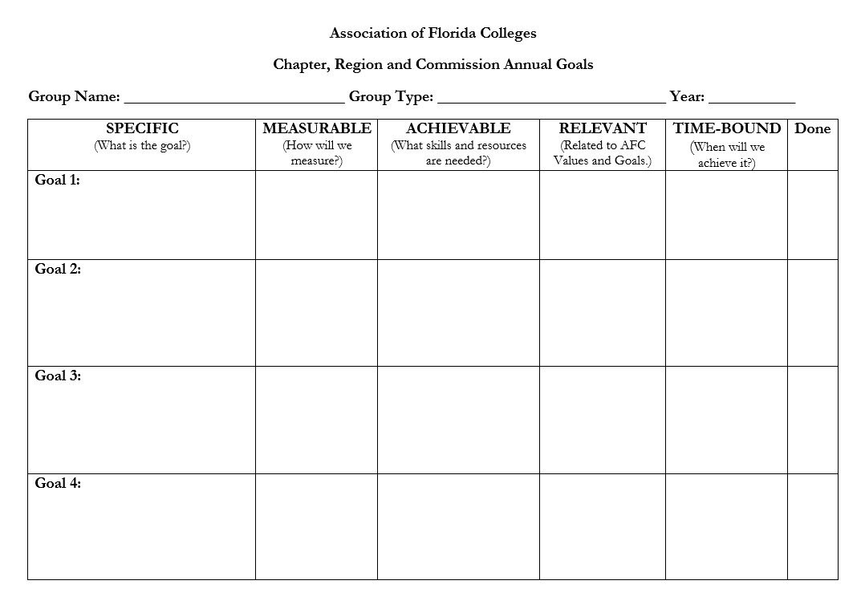

Slide 8
Plan it Out
Annual Goals Submitted
Board Reports
Board Meetings
Events
End of Year Books
ACTIVITY
DATE
March 1
Prior to each meeting
Quarterly (4/21 & 7/28)
Monthly/Bi-Monthly
June/October
Notes:
Poll question 3

Slide 9
Don't be an army of one - build your team!
Notes:
Poll question 4
You have a full committee but are you going to use them? DELEGATE
Need a team? Ask individuals specifically - everyone loves to be invited.

Slide 10
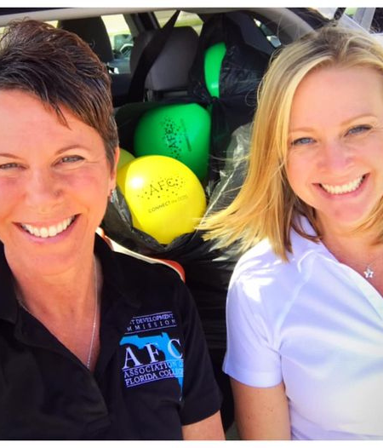
How can we help?
Notes:
Poll question 5

