Slide 1
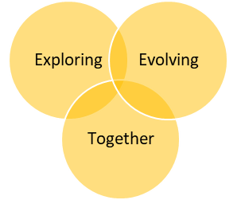

Holistic Support for New Faculty:
Creating a Customized Year-Long, Immersive New Faculty Cohort
Fred Ford
Matt Klauza
Phillip C. Mancusi
Helena Zacharis
AFC Teaching and Learning Conference

Slide 2

Where We Are Going
Overview:
PBSC
New Faculty Experience
Steps in Creating Your Own
(with pauses for brainstorming)
Faculty Testimony
Questions and Answers

Slide 3

What is the NFE?
The New Faculty Experience (NFE) is a year-long, bi-weekly series of dialogues and seminars that provides information, activities, and interactions to integrate new faculty into the life of the college and to enhance their teaching skills.

Slide 4
How Did We Get Here?
Faculty feedback gave us several indicators:
Lack of sense of community
Needed more awareness of our students
Desired more/new teaching approaches
Unaware of available support
Needed better awareness of the college
Wanted more engaging development opportunities

Slide 5
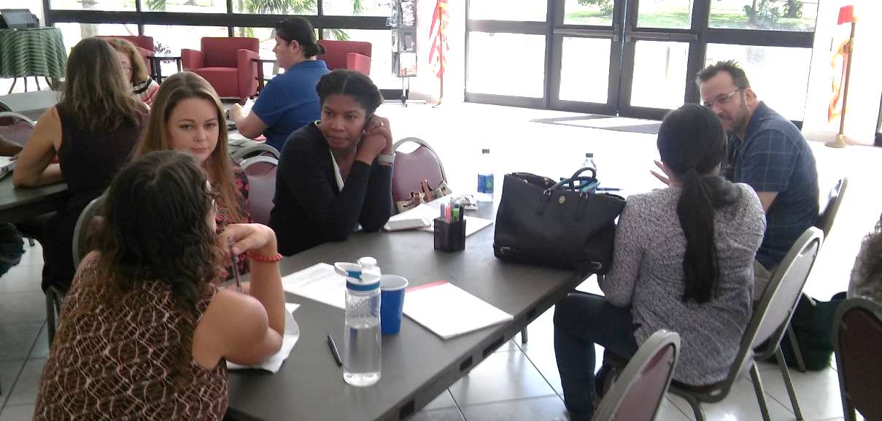
What We Wanted
We wanted something that…
Goes beyond onboarding
Is valuable and engaging for faculty
Produces a stronger faculty community
Results in increased student success

Slide 6
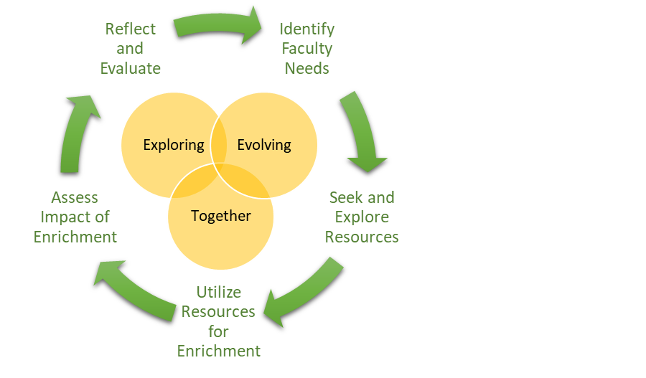
Mission Creation
Background, mission, vision, and more are in your packet.

Slide 7
Goals
The New Faculty Experience (NFE) will…
1. Build a community
2. Help faculty better understand PBSC students
3. Enhance teaching skills and approaches
4. Raise awareness of available support personnel and services
5. Further orient faculty to the college
6. Develop a habit of active, conscious reflection
7. Accomplish the above through analysis, creation, dialogue, reflection, and/or play

Slide 8
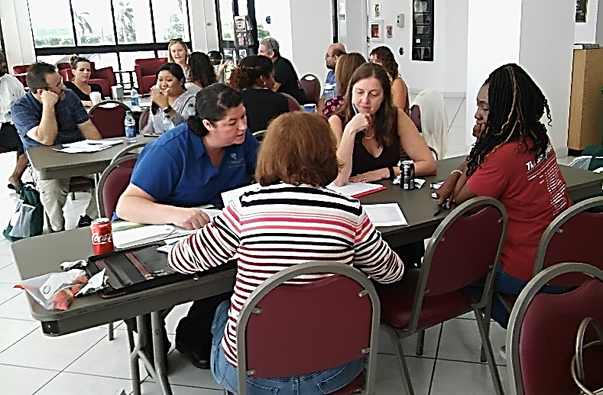
Important to Recognize
We recognize that…
Most faculty are not “new”
All faculty have strengths
These strengths vary between faculty members

Slide 9
Step 1: Identify Needs
Time to Brainstorm
What do new faculty need?
Administrative assistants
  What do new faculty need to know?
Students
  What should professors do more often? Less often?
Faculty
  What should your colleagues be able to do?
H.R.
  What support do faculty need?
Administrators
  What qualities should faculty possess?

Slide 10

Step 2: Outline a Curricular Structure
Time to Brainstorm
How does timing play a role?
How often will they meet?
  Every month? Bi-monthly? Every week?
Over how many months?
  1 semester or 2?
How long will they meet each day?
  # of hours?
Will each day have a different theme? Or will you have a variety of things for each day?
What will be included in each day?
Tip:
Use our sample topics for ideas!

Slide 11
Step 3:
Identify Personnel Resources
What personnel resources can you connect to faculty needs?
Internal experts
Student/campus services
Senior faculty
2nd-year faculty
Other faculty
Administrative expertise
Ongoing initiatives
External resources
Student focus groups
Time to Brainstorm

Slide 12

Step 4: I.D. Financial Resources
Time to Brainstorm
What financial resources do you need (and who has the $)?
Supplies
Facilitator(s) compensation
  Stipend?
  Release time?
  Other forms of compensation?
Participant compensation
  Stipend?
  Release time?
  Other forms of compensation?
Hospitality challenges in Florida
Tip:
Draw on your stakeholders!

Slide 13
Step 5: I.D. PD Resources
Time to Brainstorm
What professional development resources and/or readings do you need?
Readings
  Chronicle of Higher Education
  The Teaching Professor
  Other readings
Online resources
  Magna Publications
  Other colleges’ faculty development
  Youtube
Podcasts
  Teaching in Higher Ed
  The Cult of Pedagogy
Other resources

Slide 14
Step 6: Outline a Plan for Meetings
Time to Brainstorm
How will you organize your individual days?
What are the outcomes for each session?
Who will be involved?
  Will administrators be involved or is this a faculty-only space?
How should you start each session?
How should you end each session?
How will you ensure you cover each of your program goals and session outcomes?
Tip:
Checkout our sample curriculum in your packet!

Slide 15
Step 7: Execution
How will you ensure you create the best experience possible?
How will you inform them of this requirement ahead of time?
How will you let them know that this experience is valuable?
How will you recognize that they are not “new”?
How will you foster the experience they bring?
How will you provide opportunities for them to share their knowledge?
Time to Brainstorm

Slide 16
Step 8: Program Assessment
& Revision
How will you assess the effectiveness of the program?
Will you survey the participants?
  If so, when and how often?
Who else can provide evidence that the program is working?
What data points can you use?
To whom should you report your findings? And in what form?
How will you use your findings to refine the program?
Time to Brainstorm

Slide 17
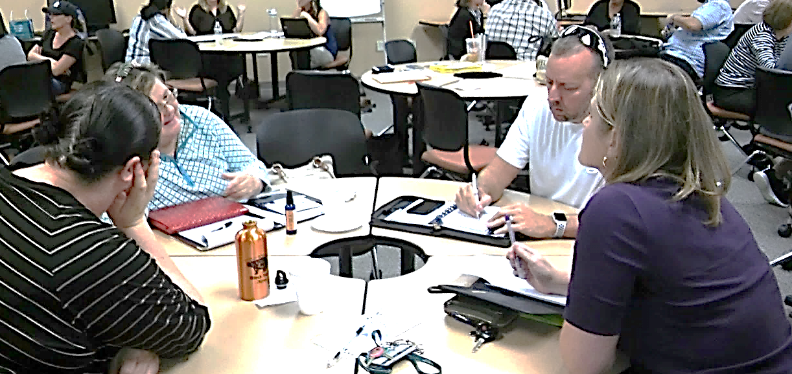
Faculty Testimony
Phillip C. Mancusi
Associate Professor
Political Science
and
American Government

Slide 18
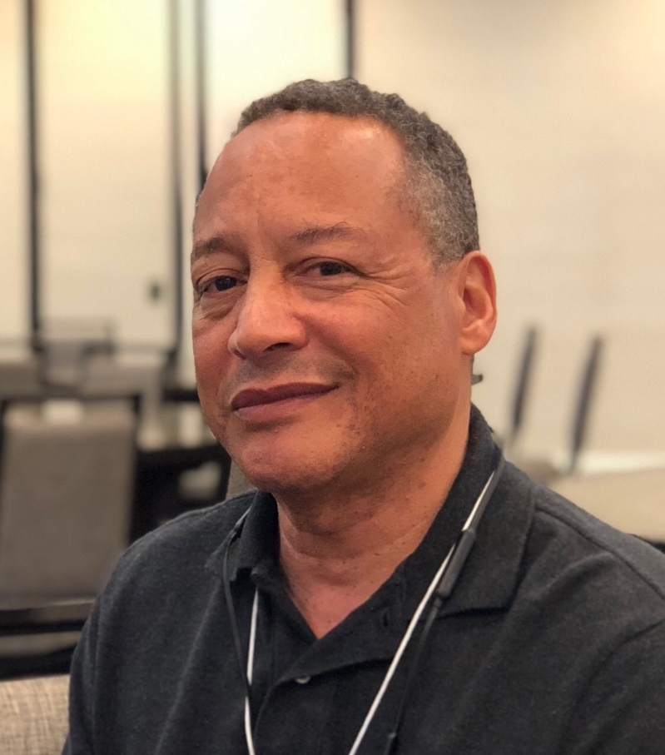
Faculty Testimony
Fred Ford
Associate Professor
Economics

Slide 19
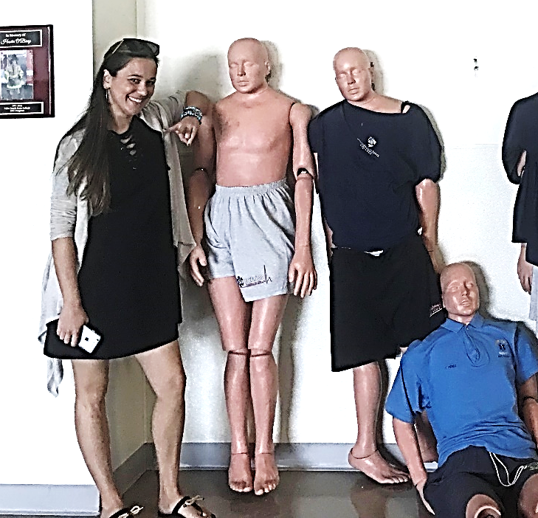
Faculty Testimony
Helena Zacharis
Professor I
College Reading and Writing
(Developmental Education)

Slide 20
Cross-Curriculum Collaboration
Professors to Mediators
Multiple Questions
  Prep students’ perspective
    Real-life
    Holistic approach
  Econ students’ perspective
    Class background
    Government structure
Peer-instruction
  Students were required to utilize what they had researched/learned and figure out adequate solutions
Lively discussion

Slide 21
Materials Available
What is in the Packet
Steering Document
List of topics
Readings and Resources
Sample Day’s Curriculum

Slide 22
Time for Questions
CONTACT INFORMATION
Fred Ford
fordf@palmbeachstate.edu
Matt Klauza
klauzam@palmbeachstate.edu
Phillip C. Mancusi
mancusip@palmbeachstate.edu
Helena Zacharis
zacharih@palmbeachstate.edu

Slide 23
Holistic Support for New Faculty:
Creating a Customized Year-Long, Immersive New Faculty Cohort
Fred Ford
Matt Klauza
Phillip C. Mancusi
Helena Zacharis
AFC Teaching and Learning Conference

