Slide 1
Success in Mathematics Pathways Re-Design: Lessons from the Florida College System
AFC Teaching and Learning Conference
April 5, 2019

Slide 2
Florida Student Success Center

Slide 3
Florida Student Success Center’s Role and Vision
The role of the Florida Student Success Center is to support institutional initiatives that improve college completion rates and promote student success.
The vision of the Florida Student Success Center is to serve as a resource of evidence-based, innovative practices and timely information for colleges.

Slide 4
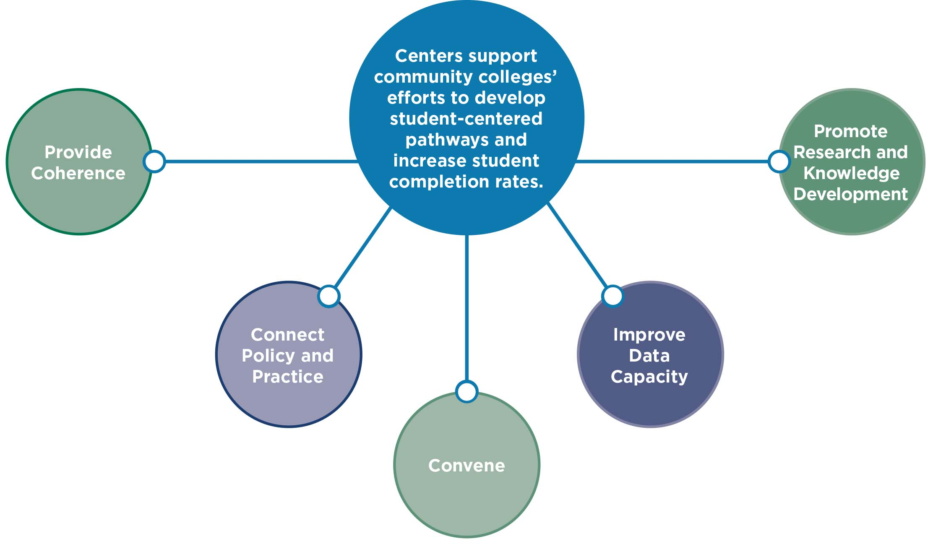
Pillars of Statewide Student Success Centers

Slide 5
Florida Mathematics Re-Design

Slide 6
Mathematics Re-Design
Nationally, hundreds of thousands of students fail higher education math courses each year.
Math is the most significant academic barrier to postsecondary attainment—particularly for students of color.
To ensure that all students achieve momentum to earn a college degree, we must work together to redesign pathways and courses, modernize content and instruction and eliminate barriers.
To that end, Florida high school, college and university faculty are collaborating on a statewide initiative to close achievement gaps and improve student success in mathematics.
Source: Dana Center Mathematics Pathways

Slide 7
Florida Mathematics Re-Design
Charge
Explore complex issues surrounding mathematics pathways to prepare: high school students for transition into postsecondary; Florida College System students for success in gateway courses aligned to their programs; and Florida College System students for transition into four-year universities.
Guiding Values
Transparency, collaboration, respect, diversity, evidence-based inquiry
Deliverables
1) Cataloging evidence-based practices designed for scale
2) Developing recommendations for state policy and institutional policy and practice around mathematics re-design

Slide 8
Mathematics Workgroups
High School to Postsecondary Alignment
FCS Mathematics Sequences
FCS to University Alignment
Explore how high school curriculum in mathematics aligns with postsecondary expectations
Examine multiple pathways for students to enter based on programs of study as well as the re-design of course structures to maximize support for students
Examine how FCS curriculum in mathematics aligns with university expectations, particularly for students in transfer programs
~30 faculty and administrators per workgroup representing K-12, Florida College System and State University System
~40 members at-large who will engage through newsletters and webinars and submit feedback in the collection of evidence-based practices and policy recommendations
Notes:
Naomi

Slide 9
Milestones
Milestone Progress
Defining the Challenges
Prioritizing the Challenges
Gathering Information
Linking Challenges & Solutions
Prioritizing Solutions
Policy Recommendations & Evidence-Based Practices
Administer survey on key challenges & synthesize findings
Milestone 2
Complete
Milestone 3
Complete
Milestone 4
Complete
Milestone 5
Complete
Milestone 6
May 2019
Milestone 1
Complete
Prioritize the challenges and assign members to huddles—smaller working groups
Identify factors contributing to challenges, evidence & drivers or root causes
Brainstorm & evaluate potential solutions to the challenges previously identified
Propose and prioritize formal recommendations
Identify policy recommen-dations and evidence-based practices
Notes:
Naomi

Slide 10
Huddles – Defining the Challenges
High School to Postsecondary Alignment
FCS Mathematics Sequences
FCS to University Alignment
Content alignment from elementary to college
Professional development for math teachers
Advising students into math sequences & career paths
Improving fundamental math skills & concepts
Assessment of students
Foundation preparedness
Multiple sequences/pathways
Ambiguity of math sequencing resulting in content overlap
Placement, advising misplacement & single measure of college readiness
Revisit prerequisites for commonality
Communication about desired math outcomes for degree programs
Alignment of course content
Advising of math pathways
Aligning prerequisites for courses between institutions
Highlighted = overlap

Slide 11
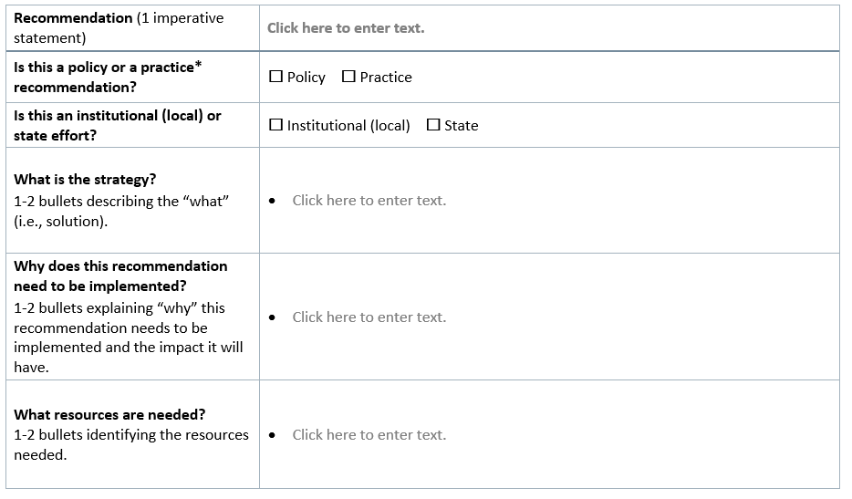
Recommendations

Slide 12
FCS Math Sequences – (Draft) Samples
Challenge | Solution
Limited resources in academic advising | Strengthen advising across institutions through: Informal math faculty advising with prof. development or college service Greater awareness for the Florida Virtual campus common pre-req manual Increased funds for more advisors
Content of gateway mathematics courses may not be aligned to the needs of today’s college students, in terms of both their fields of study and workforce aspirations | Change the state policy to discourage over-reliance on College Algebra as a default gateway course Develop and administer a statewide survey to academic disciplines in order to identify the mathematical skills and topics most relevant to students majoring in specific programs of study Once empirically-based information about mathematical needs is gathered, recommendations about common math course requirements for each program can be made

Slide 13
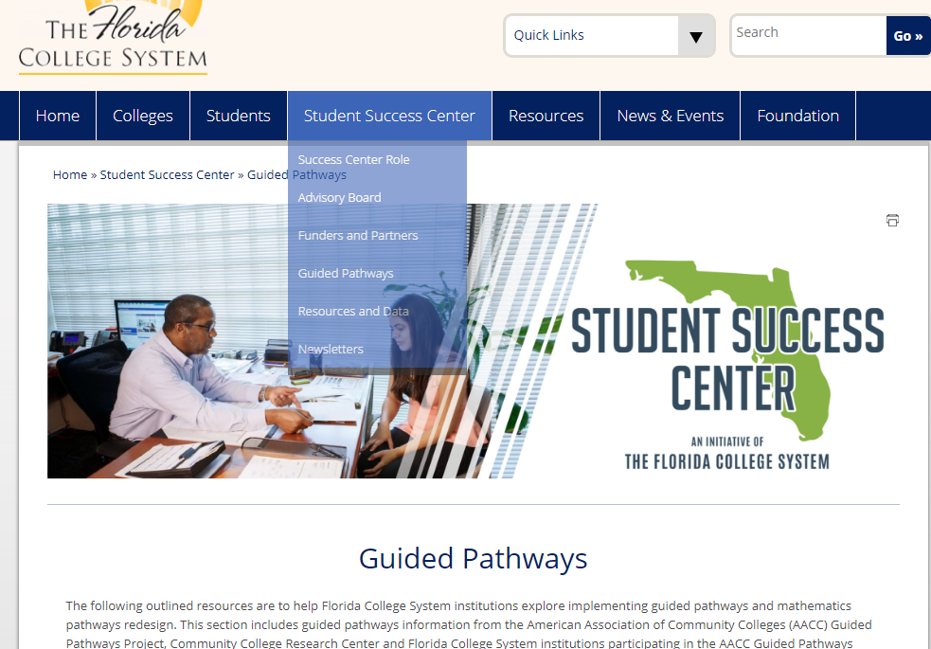
Student Success Center Website
www.floridacollegesystem.com

Slide 14
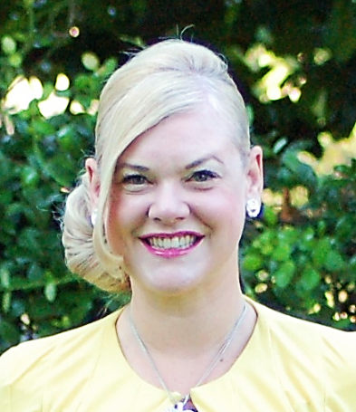
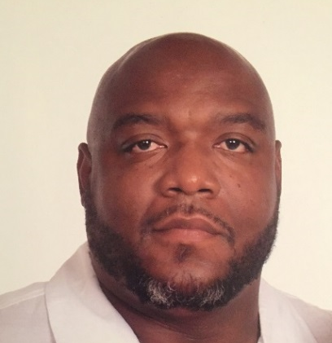
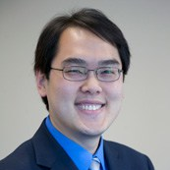
Panel Discussion
Moderator:
Dr. Angela Long
Deputy Director, Florida Student Success Center
Marc Campbell
Chairperson, School of Mathematics, Daytona State College
Jimmy Chang
Dean of Mathematics, St. Petersburg College,
Gibbs Campus
Megan Cavanah
Mathematics Department Coordinator and Professor,
Polk State College

Slide 15
Success in Mathematics Pathways Re-Design: Lessons from the Florida College System
Daytona State College
Marc Campbell, Chairperson, School of Mathematics

Slide 16
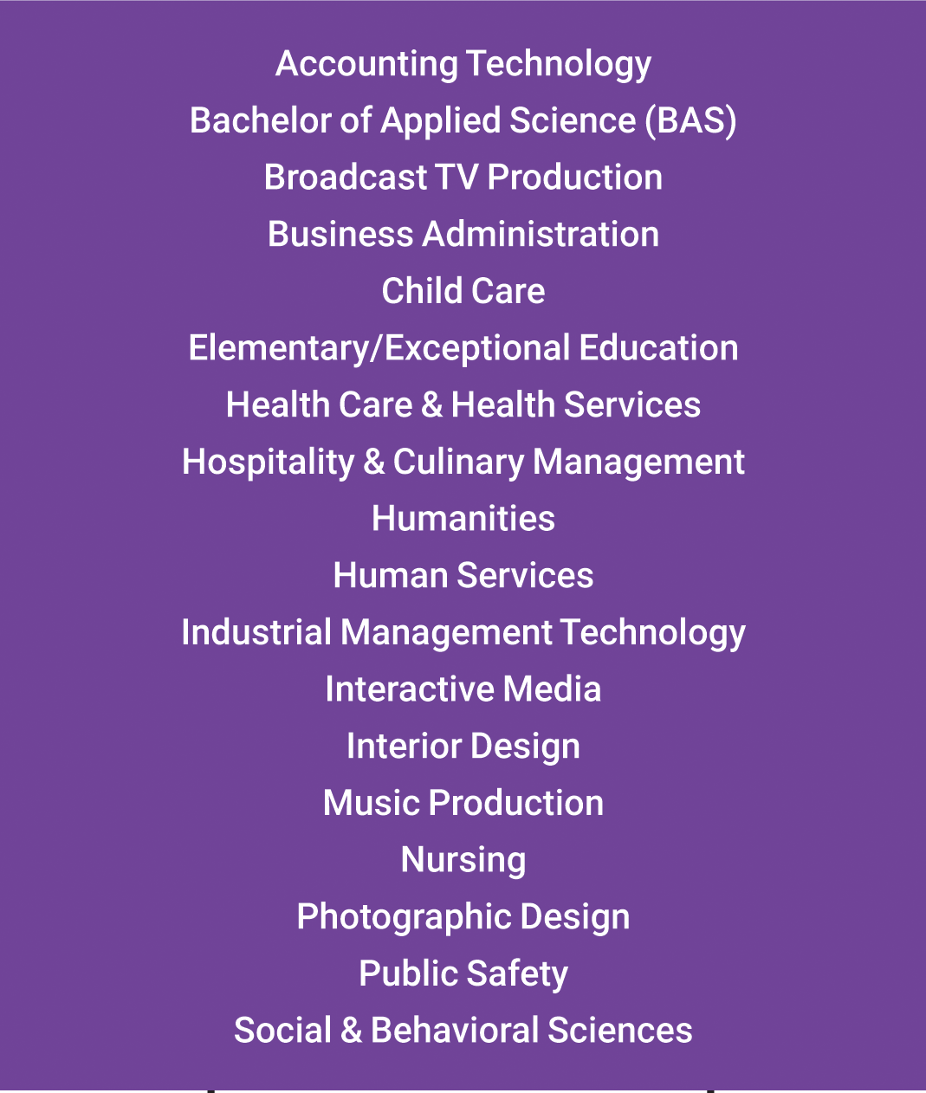
Non-STEM Pathway
STEM Pathway
(Required for some majors)
*MGF2106 & MGF2107 can be taken in any order
*MAC1140 & MAC1114 can be taken in any order or simultaneously

Slide 17
Non-STEM Pathway Results

Slide 18
STEM Pathway Results

Slide 19
STEM Pathway Results

Slide 20
What’s The Next Step?
Marc D. Campbell
Chairperson, School of Mathematics
1200 W. Int'l Speedway Blvd.
Daytona Beach, FL 32114
p: 386.506.3520 or 386.506.3695
f: 386.506.3036
e: marc.campbell@daytonastate.edu

Slide 21
Success in Mathematics Pathways Re-Design: Lessons from the Florida College System
St. Petersburg College/Gibbs Campus
Jimmy Chang, Dean of Mathematics

Slide 22
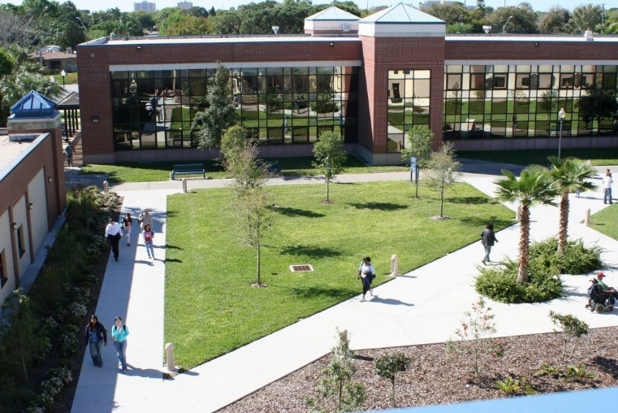
St. Petersburg College Expanded Math Pathways
Spring 2014 – Piloted MAT 1100 – Exploration of Math & Quantitative Reasoning
Scaled in Fall 2014
Allows successful students to enroll in MGF 1106, MGF 1107 and STA 2023
MAT 1100 Enrollment in 2017-18: 1,265 students
MAT 1100 Success Rates: 68% - 81%

Slide 23
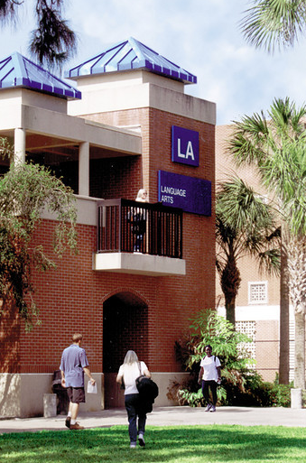
Streamlined, Accelerated Dev. Math
Fall 2014 – Piloted MAT 0022 – Developmental Mathematics. Scaled in Fall 2016.
One-semester course combining MAT 0018 and MAT 0028
Completion of Dev. Math requirements in one semester - MAT 0022, MAT 0028 or MAT 0056
Success rates overall higher than pre-SB 1720

Slide 24
The Road Ahead: Revised Math Pathways
Liberal Arts Math & Statistics Pathway
MAT 1100 will be phased out in Fall 2019
Students who are MAT 1033/1100 eligible may self-enroll in MGF 1106/1107
MGF 1106 will be a prerequisite option to STA 2023
College Algebra Pathway
Fall 2019: Pilot 1-credit co-requisite MAT 1033L with MAC 1105 for students who are MAT 1033/1100 eligible
Fall 2020: Scale co-requisite model; MAT 1033 will be phased out
MAC 1105 will be a prerequisite option to STA 2023

Slide 25
Success in Mathematics Pathways Re-Design: Lessons from the Florida College System
Polk State College
Megan Cavanah, Mathematics Faculty and Department Coordinator

Slide 26
Pathways Initiatives at Polk State College
Megan Cavanah

Slide 27
Implementation of Math Pathways
In 2016, the mathematics department implemented two math pathways.

Slide 28
For students who do not need College Algebra or Calculus courses.
For students who need College Algebra or Calculus courses.
MAT 0057-1, -2, -T
Essential Math
or
MAT 0018/0028
Developmental Math I and II
MAT 0057-1, -2, -T
Essential Math
or
MAT 0018/0028
Developmental Math I and II
Exempt Students may enter here
MAT 1100
Intro. to College Mathematics
MAT 1033 Intermediate Algebra
MGF 1107
Explorations in Mathematics
MGF 1106
Topics
in Mathematics
MAC 1105
College Algebra
STA 2023
Intro. to Probability and Statistics
MAC 114*
Precalculus &
Trigonometry Courses
MAC 2233
Applied Calculus
MAC 23** and MAP 23**
Calculus Courses

Slide 29
Implementation of Math Pathways
Fall 2016 - the mathematics faculty implemented two math pathways.
Through the use of common messaging by faculty and Student Services staff, we were able to advise students into the correct pathway.
Fall 2016 - it became a requirement that all FTIC students take a first-year seminar course, SLS 1122.
In the course we added a Success in Mathematics lesson.
What are some of the similarities/differences in taking math courses?
What are the math pathways?
Fall 2017 - we used a video to explain the math pathways.

Slide 30
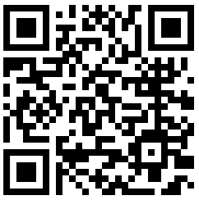
Implementation of Guided Pathways
Spring 2018 - we began our Guided Pathways Initiative.
Two-part Student Success Summit to map programs to pathways and begin sequencing courses.
Summer 2018 - The Pathways Team developed an action plan, established workgroups and guiding principles.
Some guiding principles: avoid “toxic” course combinations, early and continued engagement in subject-matter courses, MAT 1033 only for programs that require MAC 1105 or other calculus-based courses
Fall 2018, Spring 2019 – Pathways Workgroups
began developing program maps.
To date, approximately 65 maps
have been created and published.
Notes:
The goal of the Student Success Summit was to begin Guided Pathways work at Polk State by Clarifying the Paths as described in the AACC’s adapted model
Part 1, held in March, focused on mapping programs to pathways
Part 2, held in April, focused on sequencing courses for programs and transfer intents
Part 1 focused on mapping programs to pathways and completing the Programs to Pathways grid
Began by reviewing data regarding transfer intents declared by AA-degree-seeking students and selected which ones to include considering popularity and number of prerequisites
Categorized each AA transfer intent and Polk State program into a primary pathway
Part 2 focused on sequencing the courses for the AA transfer intents in each Pathway
Included all state-mandated common pre-requisite courses
Considered a variety of factors when sequencing courses including toxic course combinations, complementary course combinations, and early and continued engagement in subject-matter courses
Summer
Pathways Team developed a Short-Term Action Plan to guide the next phase of work
Established a workgroup for each Pathway
Workgroups met over the summer and finalized the sequence for the top AA transfer intent in their Pathway
Pathways Team developed guiding principles and decided on a format for Program Maps, which will include the sequence of courses by term for both full- and part-time students
Developed a visual identify for Pathways materials
Workgroups have been meeting regularly to develop Program Maps for remaining AA transfer intents and AS/Bachelor’s/Certificate programs
To date, 63 Program Maps have been completed
Program Maps page was established on polk.edu https://www.polk.edu/academics/program-maps/
Work groups are working to complete and publish Program Maps for remaining AA transfer intents and AS/Bachelor’s/Certificate programs
Pathways Team attended the AACC Pathways Workshop in January in New Orleans and is currently developing an action plan to begin the work of Help Students Get on a Path

Slide 31
Next Steps
Guided Pathways – continue mapping AS, Certificate and Bachelor’s Programs
Math Pathways – continue revising math sequencing, curriculum and offerings
Engaging in discussions around current math pathways
Currently deciding on next steps in math re-design using
Antidotal evidence and data
Recommendations from our sister colleges and the Student Success Center Mathematics Re-Design Workgroups

Slide 32
Panel Discussion
Moderator:
Dr. Angela Long
Deputy Director, Florida Student Success Center
Marc Campbell
Chairperson, School of Mathematics, Daytona State College
Jimmy Chang
Dean of Mathematics, St. Petersburg College,
Gibbs Campus
Megan Cavanah
Mathematics Department Coordinator and Professor,
Polk State College

Slide 33
Questions?

Slide 35
Thank you!

