Slide 1
Best Practice Programs in Developmental and Gateway Writing Courses
AFC Teaching and Learning Conference
April 5, 2019

Slide 2
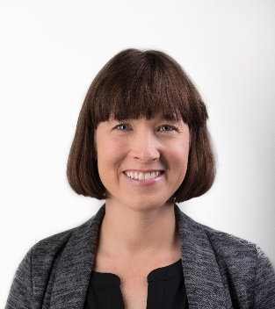
Presenters
Professor Liz Barnes
School of Humanities and Communication
Daytona State College
Dr. Scott Hopkins
Dean of Arts and Letters, Lake-Sumter State College

Slide 3
The English Studio
Daytona State College
Professor Elizabeth Barnes, School of Humanities and Communication

Slide 4
Best Practice Programs in Developmental and Gateway Writing Courses
The English Studio
Liz Barnes, Professor in the School of Humanities and Communication and Chair of Academic Support

Slide 5
Daytona State College
Campus | Headcount | FTE
Advanced Technology College | 2,649 | 460.3
Daytona Beach | 23,118 | 8,700.7
DeLand | 3,094 | 851.8
Deltona | 2,216 | 535.2
Flagler/Palm Coast | 1,902 | 622.3
New Smyrna Beach/Edgewater | 1,262 | 235.3
Total | 26,045 | 11,405.6

Slide 6
ENC0055L: The English Studio Co-Requisite (Contextualized) Support for ENC1101
The English Studio (ENC0055L) is a one-credit, weekly, guided lab made up of a facilitator and a group of 12 student peers, who are also enrolled in various sections of ENC1101: Introduction to Composition.
This group workshop is designed to help students navigate course requirements, build critical thinking skills, and complete complex writing and reading assignments.
Well established, nationally recognized pedagogical model in composition studies designed to help underprepared writers.
Studios are facilitated by Academic Support Center (ASC) Learning Specialists, Writing Center Specialists and faculty volunteers (who satisfy a service requirement or teach a one-hour overload).
It is designed for students who qualify for placement in developmental education courses in reading and/or writing.

Slide 7
ENC0055L: The English Studio Student Learning Outcomes
Upon completion of this course, the student will be able to:
Identify critical thinking, reading, and writing skills.
Recognize the elements of writing processes and various genres.
Explain strategies for composing in different rhetorical situations
One-Hour developmental education credit.
Pass or Not Pass based on attendance.

Slide 8
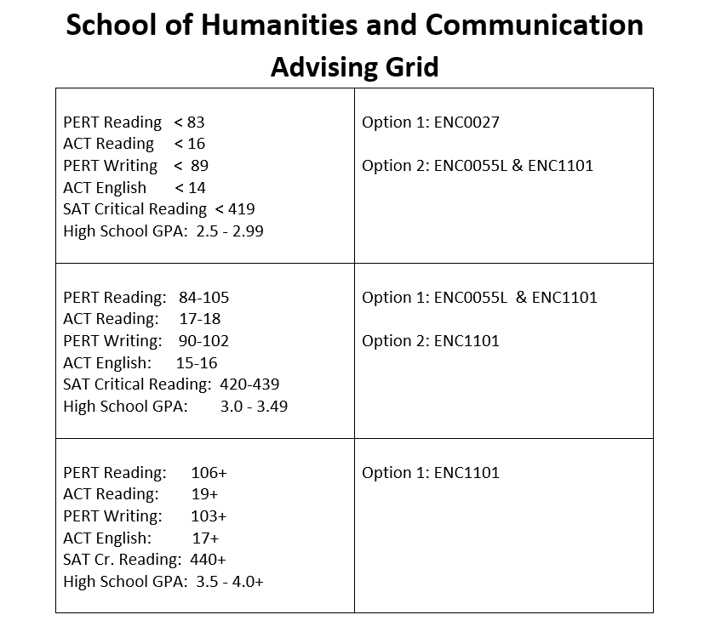

Slide 9
What is the Studio Concept?
“A Studio program organizes small groups of students to meet frequently and regularly to bring to the table the assignments they are working on for a writing course.”
“A studio learning environment is one where others are working and discussing their work simultaneously, where teachers provide, along with other students, guidance, suggestions, input.”
“The Studio is a configuration of relationships that can emerge from different contexts.”
Grego, Rhonda, and Nancy Thompson. Teaching/Writing in Third Spaces: The Studio Model. Studies in Writing and Rhetoric. Carbondale: Southern Illinois University Press, 2008. Print.

Slide 10
Local Context
DSC has academic support and writing centers on five regional campuses (Daytona Beach, New Smyrna, Deltona, DeLand, Flagler/Palm Coast).
SH&C offers gateway composition sequence in a variety of course delivery modalities: face-to-face, online, hybrid, accelerated and 16-week.
New Writing Center (founded in 2010) staffed with professional writing specialists.
Academic Support Center created to support pre-gateway developmental coursework in math, reading and writing.
Learning specialists in the ASC and writing specialists in Writing Center are credentialed to teach developmental reading and/or writing.

Slide 11
Why the Studio Model Works
For Students:
Encourages academic support usage
Builds confidence
Improves critical thinking skills
Supports process-oriented and genre based pedagogy
Fosters relationships and community
For Daytona State:
Encourages institutional collaboration
Academic Support Center
Writing Center
School of Humanities and Communication
Advising

Slide 12
Revised Two-Semester Composition Sequence Student Learning Outcomes
ENC1101: Introduction to Composition
Upon completion of this course, the student will be able to:
Demonstrate critical thinking and reading skills.
Apply an understanding of the elements of writing processes to various genres.
Use strategies for composing in different rhetorical situations.
ENC1102: Writing with Research
Upon completion of this course, the student will be able to:
Synthesize ideas from a variety of sources.
Integrate inquiry-based research into writing processes.
Produce analytic texts that effectively address different rhetorical situations.

Slide 13
Success Data
Success in: | ENC1101 | ENC1101&Studio | Studio
Fall 2013 | 69% 1779/2570
Fall 2014 | 70% 1940/2771 | 62% 221/354 | 71% 254/356
Fall 2015 | 74% 1962/2657 | 67% 273/409 | 79% 322/410
Fall 2016 | 75% 1983/2652 | 68% 267/390 | 74% 293/394
Fall 2017 | 75% 2002/2667 | 67% 171/256 | 75% 192/257
Fall 2018 | 77% 1840/2394 | 76% 162/214 | 84% 179/214

Slide 14
Post DevEd Reform: Encouraging Results
Students are getting into gateway classes more quickly, spending less money to get there, and succeeding at higher rates than they did pre-reform.
Students who were taking 4-8 hours of DevEd Reading and Writing can now take the one-hour English Studio (ENC0055L) while they are enrolled in Introduction to College Composition (ENC1101).
It took the majority of DevEd students 2 or more semesters to complete ENC1101 pre-reform. Now they’re doing it in one semester.

Slide 15
Student Voices
“The studio really helped me. It made me feel as though I had a safe place to go and get positive yet constructive criticism on my writing.”​
“I think the best thing about my studio is that it was small and intimate. I would suggest that all classes be that way because it forces students to contribute to conversation, socialize, and connect.”​
“The English Studio for me was great. I would recommend it to first time college students. My instructor was very helpful and I learned a lot not only about reading and writing but I also learned some things that you wouldn’t learn in a normal classroom.”​
“After being out of school for more than thirty years, I was nervous about getting good grades and being able to flow into my classwork. I do have to work as well, and this class and instructor were very helpful in my transition.”​

Slide 16
Assessment & Program Management Challenges
Identifying correlations and causes for ENC1101 student success trends.
Tending to the collaboration among partners (advising, faculty, ASC, and Writing Center).
Assessing the opt-in (choice) element of the developmental education reform on student success and retention.

Slide 17
The Writing Emporium
Lake-Sumter State College
Dr. Scott Hopkins, Dean of Arts and Letters

Slide 18
Best-Practice Programs in Developmental and Gateway Writing Courses: Radically Redesigning the ENC 1101 Curriculum
An Evidence-based Approach

Slide 19
Disclaimer* The contents of this presentation were developed in partnership with a grant from the Department of Education. However, the content does not necessarily represent the policy of the Department of Education, and you should not assume endorsement by the Federal Government.
* Not a real disclaimer

Slide 20
Four Key Problems in ENC1101
Information literacy
College-level writing
Unprepared
Motivation
Source: Marla Cummins

Slide 21
Evidence-Based Solutions:
1: Librarian Interventions
ACLR standards
Personalized librarians
2: Tools for Processes
3: Mastery Paths / UDL
4: Choice, Interventions, and Agency
Source: Powerful Learning Practice

Slide 22
Data
 |  | # Students (N) | Pass Rate % | DF Rate % | Withdraw Rate %
Emporium (Fall 2018) | Fully-Seated | 951 | 77.9 | 17.0 | 5.1
 | Online | 91 | 70.3 | 22.0 | 7.7
Historical (Fall 2012 – 2017) | Fully-Seated |  | 81.3 | 13.97 | 4.73
 | Hybrid |  | 69.72 | 38.44 | 7.22
 | Online |  | 67.51 | 20.87 | 11.63

Slide 23
Works Consulted
Brunk-Chavez, Beth, and Elaine Fredericksen. “Predicting Success: Increasing Retention and Pass Rates in College Composition.” WPA: Writing Program Administration - Journal of the Council of Writing Program Administrators, vol. 32, no. 1/2, 2008, pp. 76–96. Education Source, db14.linccweb.org/login?url=http://search.ebscohost.com/ login.aspx?direct=true&db=eue&AN=41978206&site=ehost-live. Accessed 4 Apr. 2017.
Bunn, Michael. “Motivation and Connection: Teaching Reading (and Writing) in the Composition Classroom.” College Composition and Communication, vol. 64, no. 3, 1 Feb. 2013, pp. 496–516. ERIC, db14.linccweb.org/login?url=http://search.ebscohost.com/ login.aspx?direct=true&db=eric&AN=EJ1008559&site=ehost-live. Accessed 4 Apr. 2017.
Cho, Kwangsu, and Charles Macarthur. “Learning by Reviewing.” Journal of Educational Psychology, vol. 103, no. 1, Feb. 2011, pp. 73–84. Education Source, db14.linccweb.org/login?url=http://search.ebscohost.com/login.aspx?direct=true&db=eue&AN=508183339&site=ehost-live. Accessed 4 Apr. 2017.

Slide 24
Works Consulted Continued
Combs, Stephen M. “In Search of a Proper Role for First-Year Composition in the Two-Year Open-Enrollment College.” Academic Leadership Journal in Student Research, vol. 4, 1 Jan. 2016. ERIC, db14.linccweb.org/login?url=http://search.ebscohost.com/ login.aspx?direct=true&db=eric&AN=EJ1100740&site=ehost-live. Accessed 4 Apr. 2017.
Conway, Brittney, et al. “An Alternative Path for Academic Success: Evaluating the Role of Mental Skills in an English Composition Course.” Journal of College Student Development, vol. 57, no. 3, Apr. 2016, pp. 321–325. Proquest Social Science Premium Collection, db14.linccweb.org/login?url=http:// search.ebscohost.com/login.aspx? direct=true&db=eric&AN=EJ1101575&site=ehost-live. Accessed 4 Apr. 2017.

Slide 25
Works Consulted Continued
Corbett, Patrick. “What about the 'Google Effect'? Improving the Library Research Habits of First-Year Composition Students.” Teaching English in the Two-Year College, vol. 37, no. 3, Mar. 2010, pp. 265–277. Proquest Social Science Premium Collection, Accessed 7 Apr. 2017.
Dahlman, Jill. “Student Self-Efficacy and the Composition Classroom: Affecting Success through Self-Regulated Strategy Development (SRSD), Assessment, Assignments, and Teacher Practice.” ProQuest LLC, ProQuest LLC, 1 Jan. 2010. ERIC, db14.linccweb.org/login?url=http://search.ebscohost.com/login.aspx? direct=true&db=eric&AN=ED523666&site=ehost-live. Accessed 4 Apr. 2017.
Hart, Mary, et al. Interactive Freshman Composition: Using Toolbook to Write It Right. 1996, Interactive Freshman Composition: Using Toolbook to Write It Right., db14.linccweb.org/login?url=http://search.ebscohost.com/login.aspx? direct=true&db=eric&AN=ED404662&site=ehost-live. Accessed 4 Apr. 2017.

Slide 26
Works Consulted Continued
Hyland, Theresa. “Reflections on Teaching Referencing: What Four Case Studies Can Tell Us About Developing Effective Teaching Strategies.” TESL Canada Journal, vol. 27, no. 2, 2010, pp. 51–67. Education Source, db14.linccweb.org/login?url= http://search.ebscohost.com/login.aspx? direct=true&db=eue&AN=508158709&site=ehost-live. Accessed 4 Apr. 2017.
Janssens-Bevernage, Anouk. “Are You a ‘Guide on the Side’ or ‘Sage on Stage’ e-Learning Designer?” The e-Learning Nomad, 13 Nov. 2014, dynamind- elearning.com/2014/11/are-you-a-guide-on-the-side-or-a-sage-on-stage-e- learning-designer/. Accessed 1 Feb. 2018.
---. “Can We Develop e-Learning that Respects Adult Learning Principles?” The e-Learning Nomad, 22 Nov. 2013, dynamind-elearning.com/2014/11/are- you-a-guide- on-the-side-or-a-sage-on-stage-e-learning-designer/. Accessed 1 Feb. 2018.

Slide 27
Works Consulted Continued
Kellogg, Ronald T., et al. “Does Automated Feedback Help Students Learn to Write?” Journal of Educational Computing Research, vol. 42, no. 2, Mar. 2010, pp. 173– 196. Education Source, db14.linccweb.org/login?url=http://search.ebscohost.com/ login.aspx?direct=true&db=eue&AN=508130153&site=ehost-live. Accessed 4 Apr. 2017.
McDermott, Mark, and Mason Kuhn. “Using Writing for Alternative Audiences in a College Integrated Science Course.” Journal of College Science Teaching, vol. 41, no. 1, Sept. 2011, pp. 40–45. Education Source, db14.linccweb.org/login? url=http:// search.ebscohost.com/login.aspx direct=true&db=eue&AN=525474970&site=ehost-live. Accessed 4 Apr. 2017.
Mills, Roxanne. “Does Using An Internet Based Program for Improving Student Performance in Grammar and Punctuation Really Work in a College Composition Course?” Education, vol. 130, no. 4, 2010, pp. 652–656. Education Source, db14.linccweb.org/login?url=http://search.ebscohost.com/login.aspx? direct=true&db=eue&AN=508174710&site=ehost-live. Accessed 4 Apr. 2017.

Slide 28
Works Consulted Continued
Nussbaum-Beach, Cheryl. “The Key to Making the Shift to Active Learning (and Why Technology Is Not Enough).” Powerful Learning Practice, 10 Mar. 2015, plpnetwork.com/2015/03/10/shift-active-learning- technology-answer/. Accessed 1 Feb. 2018.
Nielsen, Danielle. “Universal Design in First-Year Composition--Why Do We Need It, How Can We Do It?” CEA Forum, vol. 42, no. 2, 1 June 2013, pp. 3–29. ERIC, db14.linccweb.org/ login? url=http:search.ebscohost.comlogin.aspxdirect=true&db=eric&AN=EJ1018 262&site=ehost-live. Accessed 4 Apr. 2017.
Pagano, Neil, et al. “An Inter-Institutional Model for College Writing Assessment.” College Composition & Communication, vol. 60, no. 2, Dec. 2008, pp. 285–320. Education Source,

Slide 29
Works Consulted Continued
Pappas, Christopher. “The Adult Learning Theorgy—Andragogy—of Malcolm Knowles.” e-Learning Industry, 9 May 2013, elearningindustry.com/the-adult- learning-theory-andragogy-of-malcolm-Knowles. Accessed 2 Feb. 2018.
---. “9 Tips to Apply Adult Learning Theory to eLearning.” e-Learning Industry, 15 Aug. 2014, elearningindustry.com/the-adult-learning-theory-andragogy-of- malcolm-Knowles. Accessed 2 Feb. 2018.
Prince, Michael B. “A New Beginning in College Writing.” Journal of Education, vol. 188, no. 3, Sept. 2007, pp. 1–27. Academic Search Complete, db14.linccweb.org/ login?url=http://search.ebscohost.com/login.aspx? direct=true&db=a9h&AN=44087968&site=ehost-live. Accessed 4 Apr. 2017.

Slide 30
Works Consulted Continued
Sommers, Jeff. “Self-Designed Points: Turning Responsibility for Learning over to Students.” Teaching English in the Two-Year College, vol. 38, no. 4, 1 May 2011, pp. 403–413. ERIC, db14.linccweb.org/login? url=http://search.ebscohost.com/ login.aspx? direct=true&db=eric&AN=EJ927076&site=ehost-live. Accessed 4 Apr. 2017.
Treglia, Maria O. “Teacher-Written Commentary in College Writing Composition: How Does It Impact Student Revisions?” Composition Studies, vol. 37, no. 1, 1 Mar. 2009, pp. 67–86. ERIC, db14.linccweb.org/login?url=http://search.ebscohost.com/ login.aspx?direct=true&db=eric&AN=EJ862162&site=ehost-live. Accessed 4 Apr. 2017.

Slide 31
Works Consulted Continued
Treglia, Maria Ornella. “Feedback on Feedback: Exploring Student Responses to Teachers' Written Commentary.” Journal of Basic Writing (CUNY), vol. 27, no. 1, 1 Mar. 2008, pp. 105–137. ERIC, db14.linccweb.org/login?url=http://search.ebscohost.com/ login.aspx?direct=true&db=eric&AN=EJ830548&site=ehost-live. Accessed 4 Apr. 2017.
Virtue, Alicia. “‘Guide on the Side’: Active Learning Tutorials in Information Literacy Instruction.” Slideshare, Apr. 2014, www.slideshare.net/AliciaVirtue/guide- on-the-side- active- learning-tutorials-in-information-literacy-instruction. Accessed 2 Feb. 2018.

Slide 32
Questions?

Slide 33
Thank you!

