Slide 1
LOGO
Proposed Fund 1 Fund Balance Calculation & Spending Plans
December 2021

Slide 2
Why a COBA Fund Balance
Workgroup?
• Questions surrounding fund balance and its uses
have been a topic of interest over the last
several years
• Some colleges received reductions in state
appropriations due to the amount in their
fund balance
• New statute (1013.841) during 2019/2020 requiring
spending plans for excess fund balance

Slide 3
Objective
Determine if the current fund balance minimum as provided
in statute is set at an appropriate level
Highest
Sales ($)
401k
What is an Appropriate Fund Balance?

Slide 4
Statutes
F.S. 1011.84 (e) - Minimum Fund Balance %
F.S. 1013.841 - Spending Plans
If at any time the unencumbered balance in the general fund of the Florida College System institution board of trustees approved operating budget goes below 5 percent for a Florida College System institution with a final FTE less than 15,000 for the prior year, or below 7 percent for a Florida College System institution with a final FTE of 15,000 or greater for the prior year, the president shall provide written notification to the State Board of Education
Each Florida College System institution with a final FTE less than 15,000 for the prior year that retains a state operating fund carry forward balance in excess of the 5 percent minimum shall submit a spending plan for its excess carry forward balance.
Each Florida College System institution with a final FTE of 15,000 or greater for the prior year that retains a state operating fund carry forward balance in excess of the 7 percent minimum shall submit a spending plan for its excess carry forward balance.

Slide 5
COBA Concerns/Questions
5%/7%
What does this calculation mean in actual circumstances - how do you explain to constituent groups such as Boards of Trustees?
F.S. 1011.84 (e)
F.S. 1013.841
Current Calculation =
Unencumbered Fund Balance/Total Funds Available
Notify State Board
Submit Spending Plan
FTE IS NOT AN ADEQUATE PREDICTOR OF THE APPROPRIATE AMOUNT OF FUND BALANCE THAT SHOULD BE MAINTAINED
The minimum and maximum unrestricted fund balance is the same percentage and provides for no range of flexibility
The 5% or 7% fund balance is dependent on FTE (15,000)
If FTE changes this impacts the fund balance carry forward

Slide 6
Guiding Principles
Use a methodology that is generally accepted and recognized as a best practice
Keep it simple
Understand need for accountability but need to balance that with flexibility

Slide 7
Benchmark
Used Government Finance Officers Association (GFOA) Fund Balance Guideline for the General Fund
GFOA recommends, at a minimum, that general-purpose governments, regardless of size, maintain unrestricted budgetary fund balance in their general fund of no less than two months of regular general fund operating revenues or regular general fund operating expenditures.
The Government Finance Officers Association (GFOA), founded in 1906, represents public finance officials throughout the United States and Canada. The association's more than 20,000 members are federal, state/provincial, and local finance officials deeply involved in planning, financing, and implementing thousands of governmental operations in each of their jurisdictions. GFOA's mission is to advance excellence in public finance.

Slide 8
Process - Using 2017 - 2021 Data
Used data from the GL by Accounts in AFR workbook - Fund 1 Only
Removed the impacts of non-operating expenses
Calculated the fund balance in accordance with GFOA guidelines
Compared the GFOA calculation to current state statute and each college current fund balance
Avg Current Fund Balance
VS
Avg Minimum Using GFOA
FY2017 - FY2021
FY2017 - FY2021
36.45%
35.31%
FY21 Actual FB Range
FY21 GFOA Method FB Range
14.3222%
14.3871%
5.00%
10.35%

Slide 9
Fund Balance Analysis
Represents 20-25 days operating expenses
Represents 60 days operating expenses
5%/7%
14.32%
14.39%
Spending Plan
Minimum per Statute
FCS FY21 Avg
GFOA 2 Months Operating
For FY21 the average difference between the state statute minimum and GFOA - ($203,947,168)

Slide 10
Recommendation
F.S. 1011.84 (e) - Minimum Fund Balance %
F.S. 1013.841 - Spending Plans
Remove any reference to FTE
Adopt a "New" methodology for triggering a spending plan based on GFOA guidance using 2 month operating expenses as a base
Minimum fund balance is 5% for all colleges
if a college has less than 2 month operating expenses then no spending plan will be required by the college
Calculation remains unchanged
Remove any reference to FTE
Spending plan required ONLY if fund balance exceeds 2 months of operating expenses

Slide 11
Spending Plan Analysis
Current Spending Plan
VS
Proposed Spending Plan Amounts (GFOA)
Fiscal Year 2021
27 of 28 colleges submitted spending plans
Total amount of spending plans was $266,284,973
Fiscal Year 2021
14 of 28 colleges would submit spending plans
Total amount of spending plans would be $104,728,333
FY21 Actual Spending Plan Range
FY21 Spending Plan Range Using GFOA Method
$0.0M
$36.2M
$231K
$25.2M

Slide 13
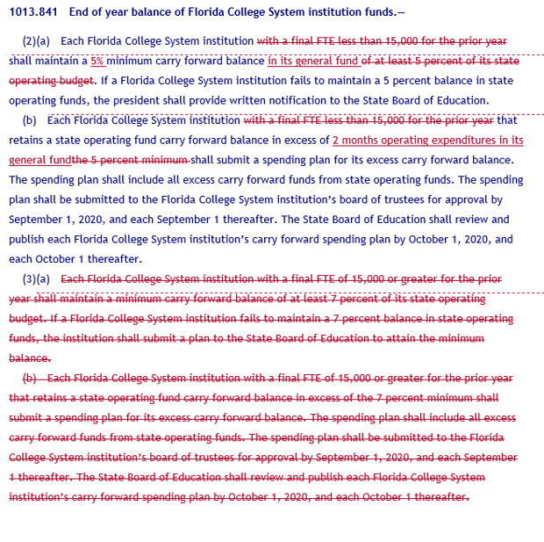

Slide 14
Thank You
Questions?

