Slide 1
Association of Florida Colleges
Florida College System Council of Presidents
November 8, 2018
Richard E. Norman III, Ed.S
Apprenticeship Program Director
Florida Department of Education
Division of Career and Adult Education

Slide 2
Overview
National Structure of Apprenticeship
Terminology
Enrollment
Registered Apprenticeship Sponsorship
Apprenticeship Models
Structure of Registered Apprenticeships in Florida
Registered Apprenticeship Funding

Slide 3
National Structure of Apprenticeship
Office of Apprenticeship (OA States) – State apprenticeship programs are run and managed by the USDOL (Office of Apprenticeship). (ex. Georgia, South Carolina, Indiana)
State Apprenticeship Agency (SAA States) – An agency of a State government that has responsibility and accountability for apprenticeship within the State recognized by the USDOL to register and oversee apprenticeship programs and agreements for Federal purposes. (ex. Florida, Washington, Kentucky)

Slide 4
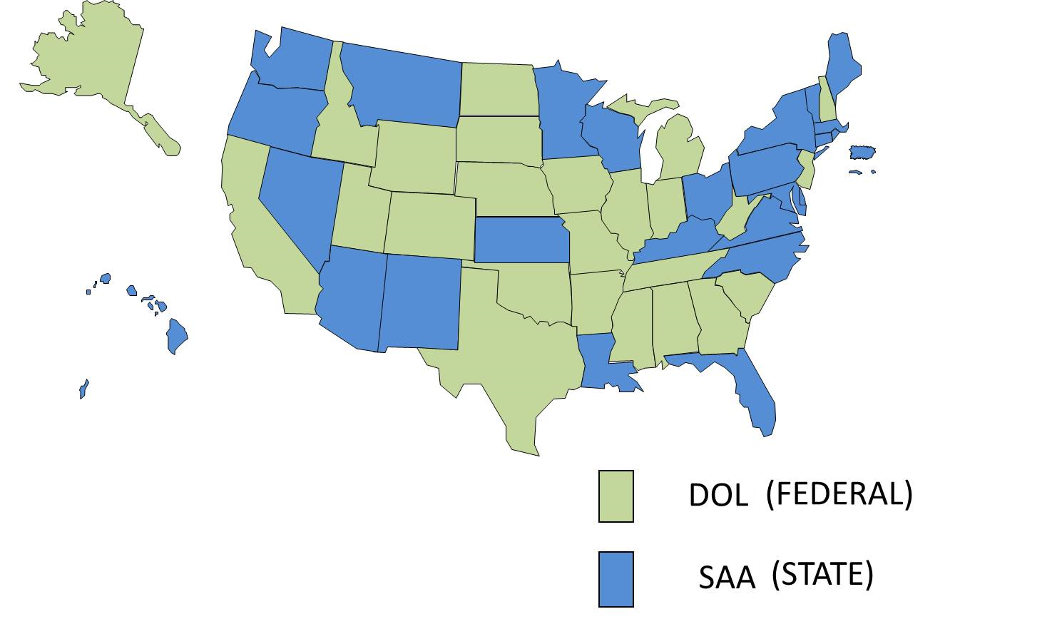

Slide 5
Common Terms
Related Technical Instruction (RTI) – An organized and systematic form of instruction designed to provide the apprentice with knowledge of the theoretical subjects related to a specific trade or occupation.
It can be spread out over the course of the apprenticeship, front-loaded, segmented, or articulated.
It can be delivered by an educational institution, in-house, on-line, correspondence, or any combination thereof.
Registration Agency – The entity approved for Federal Apprenticeship Purposes, which is the Florida Department of Education.

Slide 6
Apprenticeship Program Enrollment, 2016-17
Some Apprentices receive RTI without being enrolled in a District or State College

Slide 7
Registered Apprenticeship Sponsorship
Who can sponsor:
a single employer,
a group of employers,
an educational institution,
a trade association,
community or faith-based organization,
or other entity may choose to sponsor.

Slide 8
Registered Apprenticeship Models
** The length of an apprenticeship program varies from one to five years depending on the occupation training requirements.
Time-Based: Apprentices complete a required number of hours in on-the-job training.
Competency-Based: Apprentices progress at their own pace – they demonstrate competency in skills and knowledge through proficiency tests and applied practice validated by supervisor/mentor/journeyworker.

Slide 9
Registered Apprenticeship Models
Hybrid-Based: Using minimum and maximum range of hours, and the successful demonstration of identified and measured competencies.
**Career Lattice: The use of an interim credential to validate progression of an apprentice through a registered apprenticeship program within competency or hybrid based models ONLY. (industry certification, career certificate, company certificate)

Slide 10
Staffing
Central Office Staff
Program Director
Government Operations Consultant I
Program Specialist IV – (Region 1B)
Field Staff
Program Specialist IV
Apprenticeship Training Representative (ATR)
(Regions 1A, 2, 3, 4, 5)

Slide 11
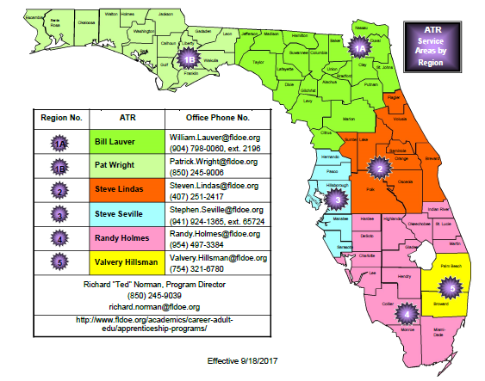

Slide 12
Registered Apprenticeship Funding

Slide 13
What is the Purpose of Funding (any)
Offset training costs for employers.
Training facilities (shop space, offsite training, etc.)
Training materials (consumables, books, equipment, etc)
Educational Curriculums (NCCER, MSSC, NIMS, etc.)
Instructors (in-house, contracted, training certifications)
Personnel (coordinators, administrators, support, etc.)
Offset education institution costs.
Teachers (full-time, adjunct, training certifications)
Operating costs (overhead, classrooms, labs, etc.)
Support staff (coordinators, data input, documentation)
Curriculum Development (customized, modified, etc.)

Slide 14
What is the Purpose of Funding (any)
Incentives (employer, institution, or individual)
Minimize or eliminate exposure (cost of doing business)
Money talks, what’s in it for me and my organization
Expansion (incentive to invest in workforce)
Motivation for public education institutions to partner with employers and registered apprenticeship sponsors
Potential candidates: to help offset personal expenses and to work and learn at the same time. No post-secondary education debt.
Hire veterans, minorities, physically or cognitively challenged

Slide 15
LEA’s & Related Technical Instruction?
There are a myriad of different local agreements or MOU’s between apprenticeship program sponsors and the LEA (school district, technical center/college, state college).
These differences could refer to:
where is RTI provided (public school, private facility, in-house)
who provides instruction (public school, third party, in-house employee, sponsor)
who coordinates and handles documentation (public school, third party, sponsor, employer)
The LEA is the only entity that submits instructional hours to the state.

Slide 16
State Funding Resources
State Colleges receive annual lump sum appropriations provided in the General Appropriations Act.
None of the funds are categorical to any particular program, like registered apprenticeship. It is a local decision as to what is funded for educational purposes.

Slide 17
State Funding Resources
Questions Related to Specific Situations or Scenarios should be directed to either:
Tara Goodman
tara.goodman@fldoe.org
(850) 245-9001
Or
Tara McLarnon
tara.mclarnon@fldoe.org
(850) 245-9005

Slide 18
Common Funding Sources
Federal Grants –
American Apprenticeship Initiative (AAI) - $5 million
Florida State College at Jacksonville – Fiscal Agent
St. Pete College and Broward College – Sub-grantees
**Funds are primarily used to support training related expenses.

Slide 19
Common Funding Sources
Federal Grants –
State Apprenticeship Expansion (SAE) - $1.5 & $1.8 mill.
Department of Economic Opportunity – Fiscal Agent
Expansion partnership with DEO, CareerSource Florida, DOE
$500,000 sub-grants awarded to 5 LWB’s
$1.75M awarded to several other LWB’s (non-SAE)
**Funds are primarily used for expansion research activities, but some funds are being used for new or expanding programs in Health, IT, Construction, Manufacturing and underserved populations.

Slide 20
Common Funding Sources
Veterans resources
Veterans can receive training benefits and in most cases employers can receive wage assistance.
Helmets to Hardhats – provides financial and employment assistance.
SkillBridge – Transitional services for service members with less than 6-months left of active duty.
Florida Department of Veterans Affairs
Veterans Florida – Up to $8,000 per qualified apprentice per year to employers ($100,000 cap).

Slide 21
Common Funding Sources (Other)
Federal Work-Study Program
Job Location and Development Program
CaPE Post-Secondary Industry Certification
Employer participation
Federal Grants
State Grants
Local Grants
WIOA – CareerSource Florida

Slide 22
Richard “Ted” Norman, Ed.S
State Director for Apprenticeship
(850) 245-9039
richard.norman@fldoe.org

