Slide 1
Florida KidCare & the Landscape of Uninsured Children:
How Florida Colleges Can Help
The Council of Presidents,
Florida Association of Colleges
01.12.18

Slide 2

Objectives
Overview
Florida’s Uninsured Children Population
How Florida KidCare Promotes Child Health and Wellness
Available Resources

Slide 3
FLORIDA’S HEALTH
INSURANCE LANDSCAPE

Slide 4
Florida’s Health Insurance Landscape
The most current U.S. Census data reports:
The number of uninsured children in Florida is on the decline.
Approximately 2.4 million children are covered through Florida KidCare.

Slide 5
Florida’s Health Insurance Landscape
The U.S. Census indicates that approximately 257,000 children ages birth through 18 in Florida are still uninsured.

Slide 6


Areas of High Uninsured
The five counties with the highest number of uninsured children:
Broward
Hillsborough
Miami-Dade
Orange
Palm Beach
Together, that’s more than 116,000 children, or more than 45% of all uninsured children in Florida.

Slide 7
The Good News
More than
147,000 children are eligible for
subsidized health insurance coverage
through Florida KidCare.
Most would pay nothing at all and
others pay as little as $15 or $20 a month.

Slide 8
THE PROGRAMS OF FLORIDA KIDCARE

Slide 9
The Programs of Florida KidCare
Florida KidCare includes:
Children’s Medicaid (ages birth through 18)
MediKids (ages 1 through 4)
Florida Healthy Kids (ages 5 through 18)
Children’s Medical Services Managed Care Plan
(ages birth through 18 with special health care needs)

Slide 10
Benefits Covered
Doctor
Visits
Vision & Hearing
Dental
Check-ups
& Shots
Prescriptions
Emergencies
Surgeries

Slide 11
Eligibility
Eligibility is based on household size, income,
and age of the child.
Eligible children include, but are not limited to:
Children ages birth through 18 residing in Florida
Applicants with unborn children
Lawfully residing immigrant children
Children with preexisting conditions
Children of state employees

Slide 12
Eligibility
MediKids Full-Pay
$157 monthly premium per child
Florida Healthy Kids Full-Pay
$230 monthly premium with dental per child
200%
MediKids
$15 or $20 monthly family premiums
Florida Healthy Kids
$15 or $20 monthly family premiums
133%
Federal Poverty Level**
Medicaid for Children
No monthly premium
Ages 0 to 1
Ages 1 through 4
Ages 5 through 18
CMS Plan*
*133% to 200% of the FPL have $15 or $20 monthly premiums.
**For a family of four, 133% of the FPL’s annual income is $32,718, and 200% is $49,200 as of April 2017.

Slide 13
Eligibility
Family Size | Medicaid for Children | MediKids / Florida Healthy Kids / CMS Plan |  | MediKids / Florida Healthy Kids
 | No monthly premium Up to 133% of the FPL | $15 monthly premium 133.01 – 158% of FPL | $20 monthly premium 158.01% - 200% of FPL | Full-pay program 200.01% of FPL & over
1 | Up to $16,044.00 | $16,044.01 - $19,056.00 | $19,056.01 – $24,120.00 | $24,120.01 & over
2 | Up to $21,600.00 | $21,600.01 – $25,668.00 | $25,668.01 - $32,844.00 | $32,844.01 & over
3 | Up to $27,168.00 | $27,168.01 - $32,268.00 | $32,268.01 – $40,848.00 | $40,848.01 & over
4 | Up to $32,724.00 | $32,724.01 - $38,868.00 | $38,868.01 - $49,200.00 | $49,200.01 & over
5 | Up to $38,280.00 | $38,280.01 - $45,480.00 | $45,480.01 - $57,564.00 | $57,564.01 & over
6 | Up to $43,848.00 | $43,848.01 - $52,080.00 | $52,080.01 - $65,928.00 | $65,928.01 & over
7 | Up to $49,404.00 | $49,404.01 - $58,692.00 | $58,692.01 - $74,280.00 | $74,280.01 & over
8 | Up to $54,960.00 | $54,960.01 - $65,292.00 | $65,292.01 - $82,644.00 | $82,644.01 & over
9 | Up to $60,576.00 | $60,576.01 - $71,892.00 | $71,892.01 - $91,008.00 | $91,008.01 & over
10 | Up to $66,074.00 | $66,074.01 - $78,504.00 | $78,504.01 - $99,360.00 | $99,360.01 & over

Slide 14
Full-Pay Options
Non-subsidized coverage is available through MediKids and Florida Healthy Kids.
MediKids $157 per month per child with dental
(ages 1 through 4)
Florida Healthy Kids $230 per month per child with dental
(ages 5 through 18) $215 per month per child without dental

Slide 15

No Wrong Door
Enrollment is open YEAR-ROUND and only one application is needed to apply for all programs.
Department of Children and Families
Federal Marketplace
Florida KidCare

Slide 16
How Do Families Apply?
Online Application:
www.floridakidcare.org
Download & Print:
www.floridakidcare.org
Request a Mailed Application:
1-888-540-5437 (toll-free)
Application by Fax:
1-866-867-0054 (toll-free)

Slide 17
WORKING TOGETHER

Slide 18
State Colleges Health and Dental Partnership
FHKC is seeking to establish formal partnerships with Florida state colleges to develop and execute community outreach campaigns, which will include, but not be limited to:
  Proactively identifying and engaging families with children, or students themselves, that may be eligible;
  Promoting Florida KidCare at college-sponsored and community heath fairs; through campus signage, websites, social media channels and distribution of promotional collateral;
  Integrating Florida KidCare curricula into applicable academic courses; and
  Engaging student life and faculty organizations to help develop and test new approaches to educating and enrolling families.

Slide 19

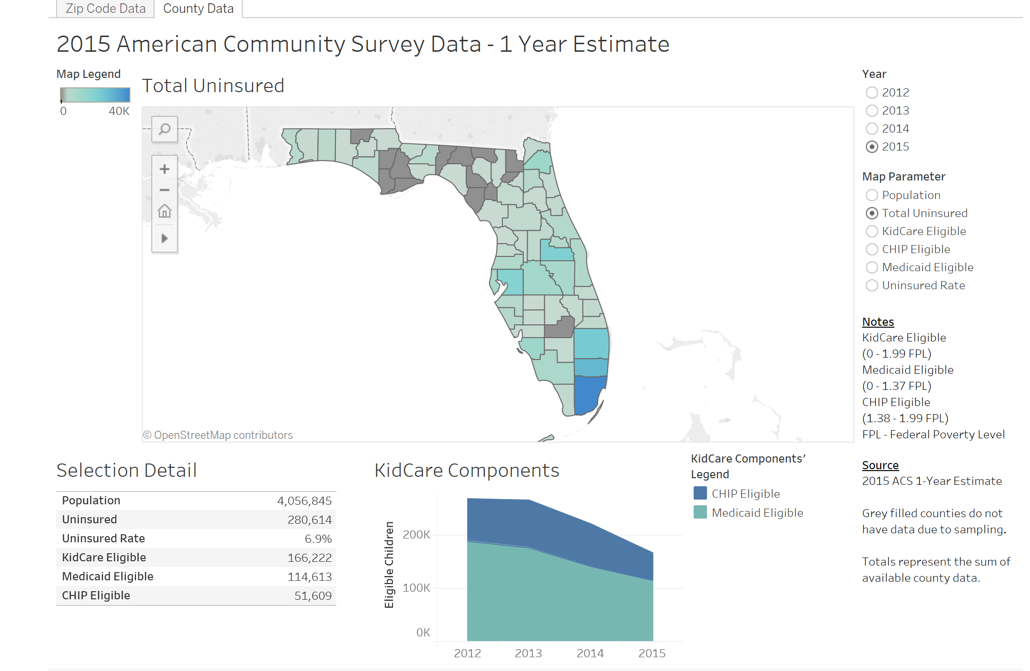
County and ZIP Code Data
County and ZIP Code level data, as well as enrollment by plan, are available on the Florida Healthy Kids website.

Slide 20

JOE DAVIS
Florida Healthy Kids, a partner
davisj@healthykids.org
850.701.6166

