Slide 1
Keeping Florida Competitive
Florida Secretary of Commerce Jamal Sowell
President & CEO, Enterprise Florida

Slide 2
Economic development arm of the state
Created In 1996
59-member board
Chaired by Governor Ron DeSantis
Representation from the public & private sector
Keeping Florida Competitive

Slide 3
Enterprise Florida’s Mission
Facilitating international trade and exporting
Marketing Florida as the premier business state in the nation
Supporting Minority & Small Businesses
Assisting with expansion of established businesses in Florida
Recruiting companies from all over the world to locate in Florida
Keeping Florida Competitive

Slide 4
Haitian American Business Summit
Notes:
Site Selection also ran a custom content piece in their November/December issue
Their story featured the state’s aviation/aerospace industry

Slide 5
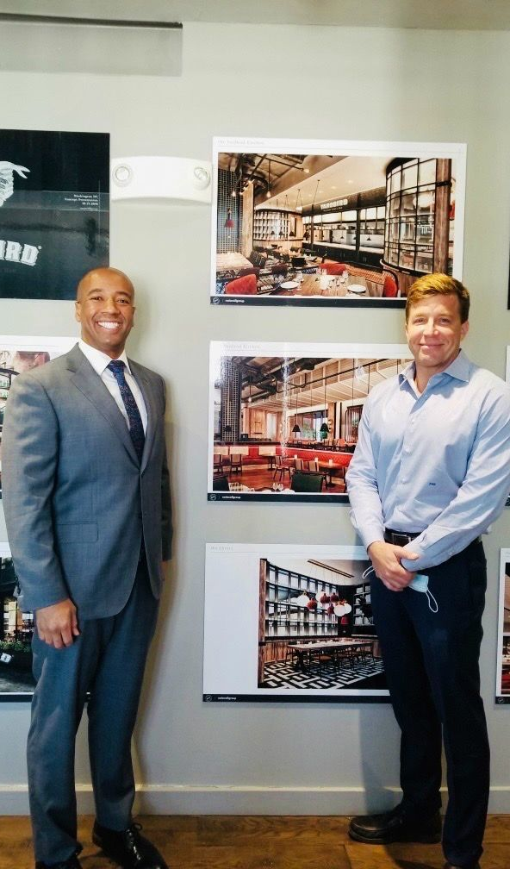
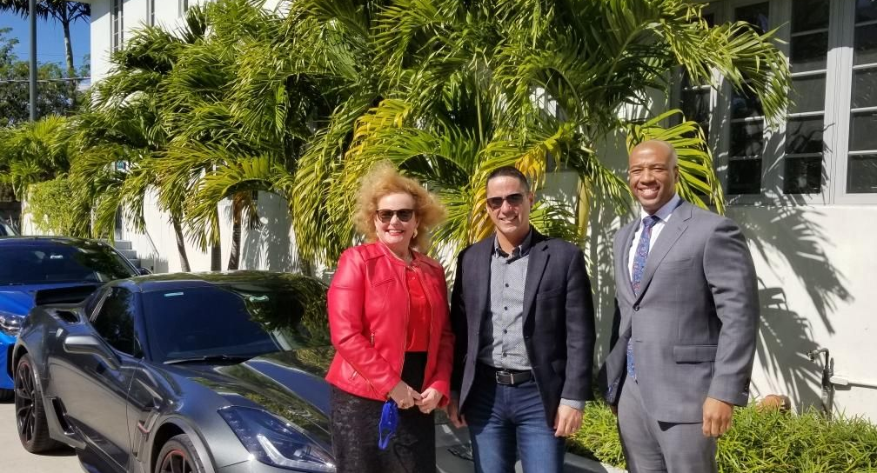
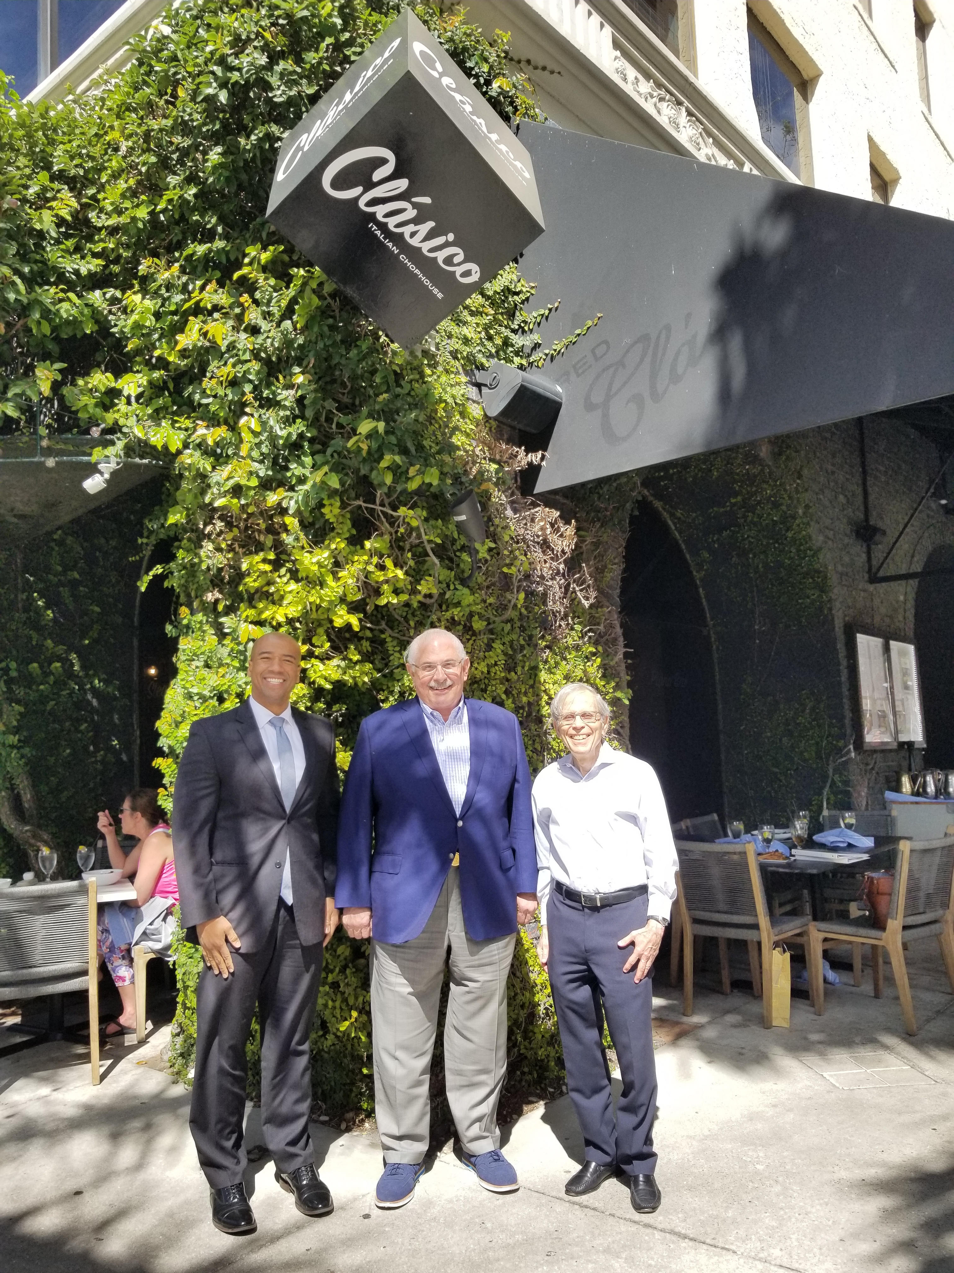
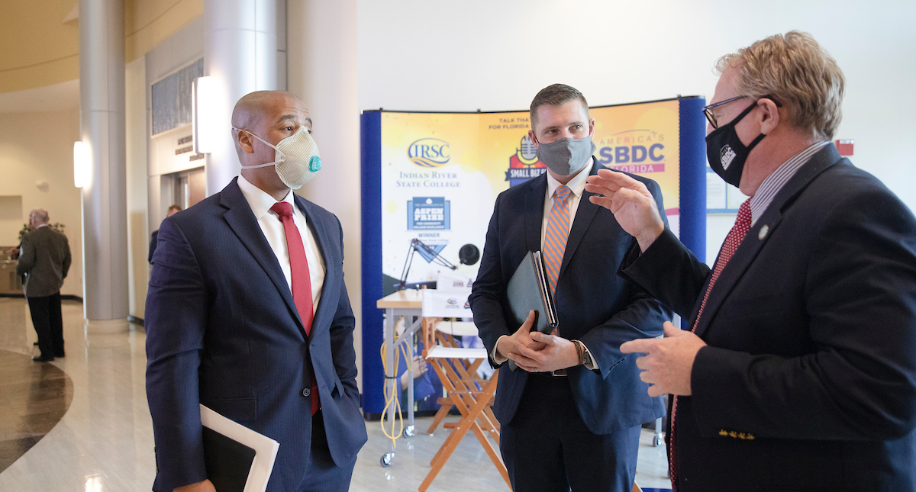

Slide 6
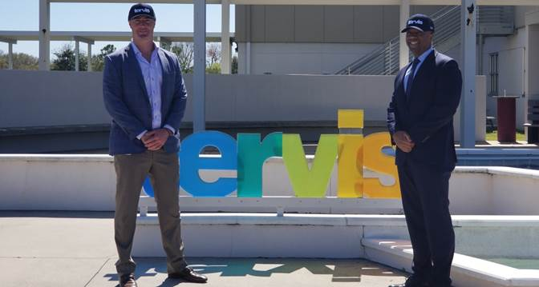
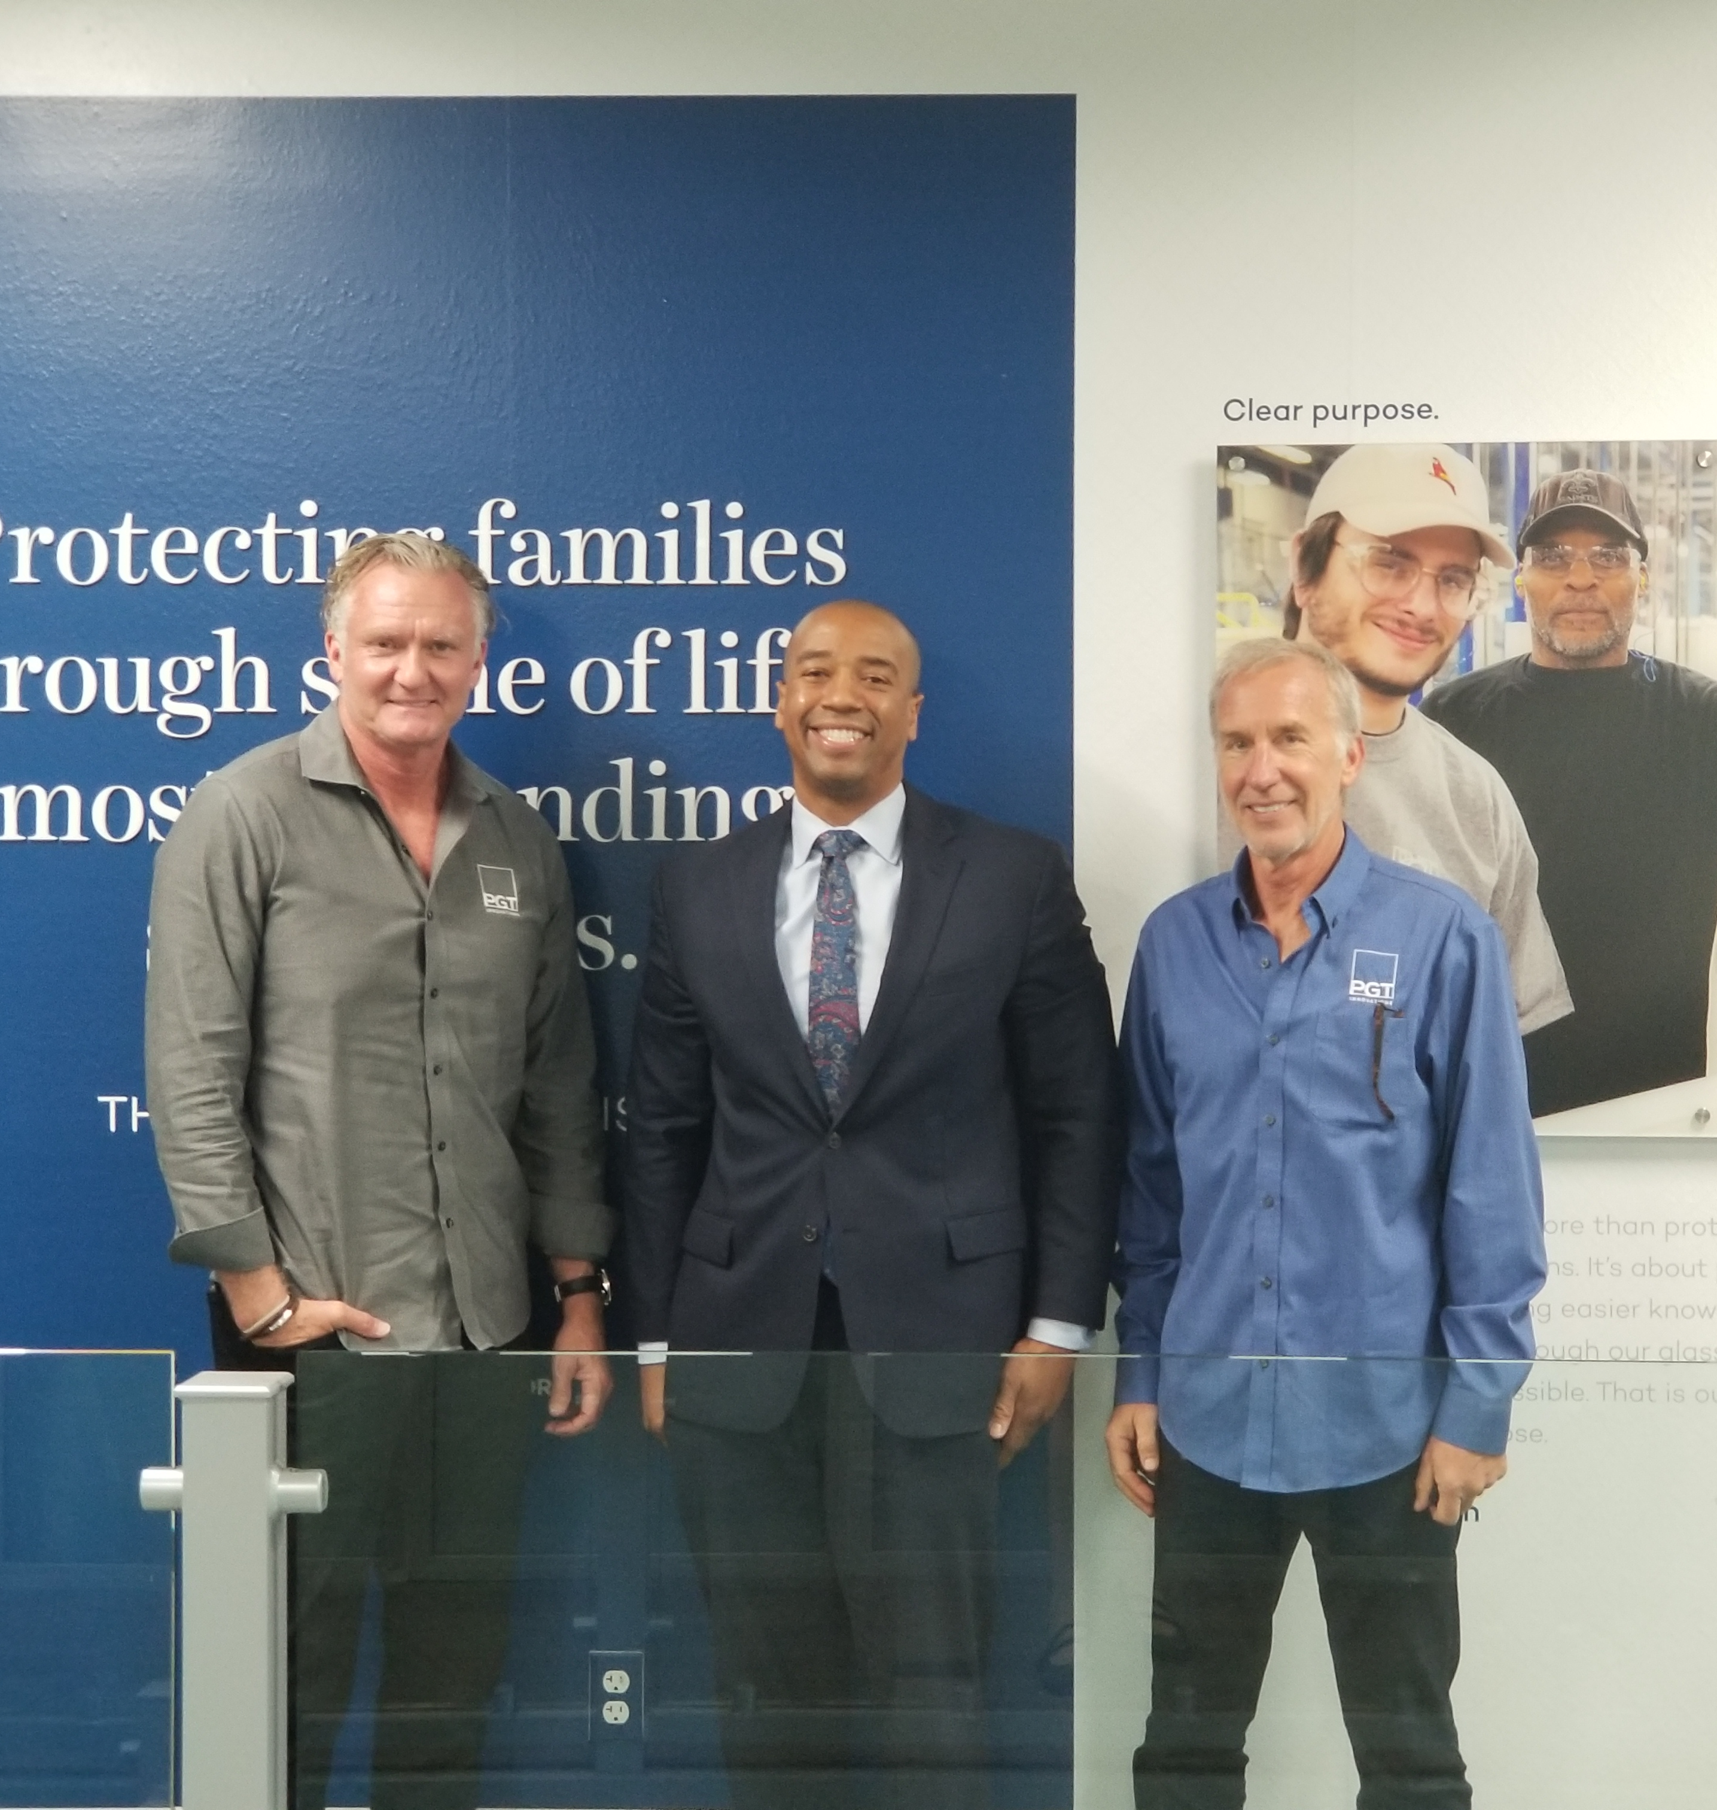
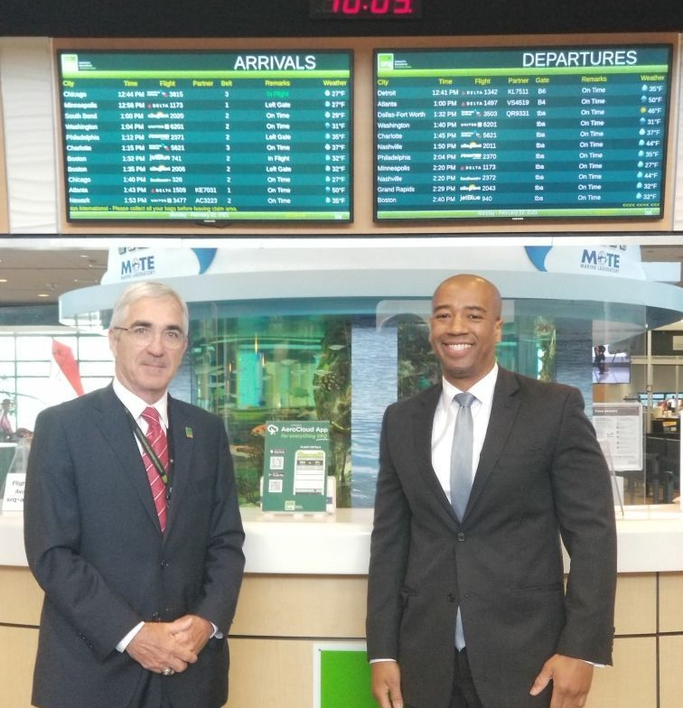
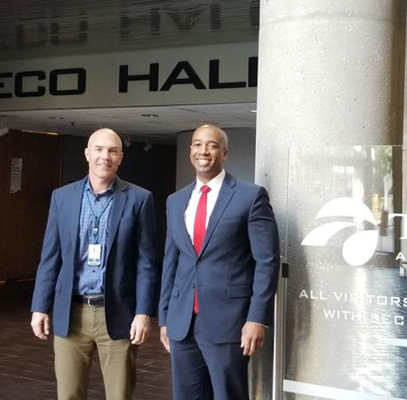

Slide 7
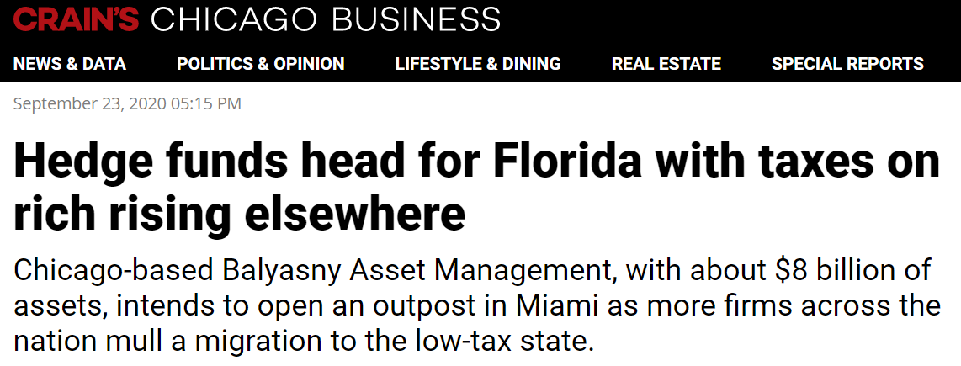
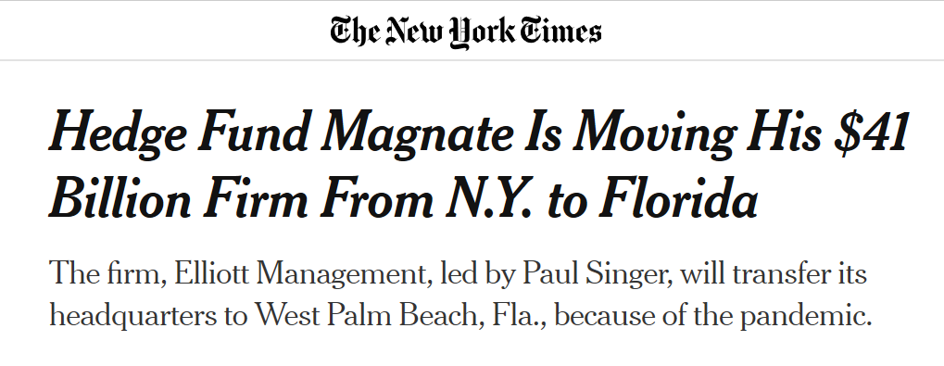

Slide 8
Keeping Florida Competitive

Slide 10
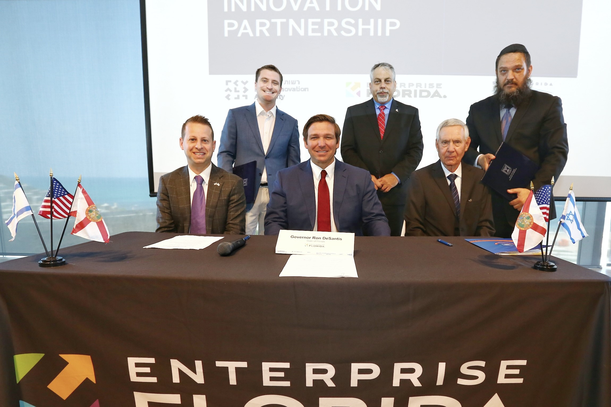
Keeping Florida Competitive
Florida Secretary of Commerce Jamal Sowell
President & CEO, Enterprise Florida

