Slide 1
Comprehensive Approach to Safe and Secure Campuses
Lara Zwilling, LMHC, Coordinator, SF Counseling Center
Lieutenant Ryan Woods, SF Police Department
Lola Christian, Employment Manager, SF Human Resources

Slide 2
Learning Outcomes
This presentation discusses the importance and impact of a holistic approach to safety and security on our college campuses.
This session will discuss safety and wellness initiatives that SF currently has in place. The latter part of the presentation focuses on the importance of campus training, education and messaging regarding safety issues.
Through this critical discussion, we hope to inspire our colleagues from other colleges to assist us in the development of this much needed Campus Safety Commission.

Slide 3




Comprehensive Sausdjfpfsive Safety & Security
ON SITE: Counseling &
Police Departments
ACTIVE:
Behavioral Intervention Team
HR: Title IX & Equity Coordinator
INCREASED:
Surveillance
PROACTIVE: Disciplinary Admissions
COORDINATION: Partners with area law enforcement agencies
CAMPUS WATCH:
Say Something Reporting
Well trained staff & students
SF ALERTS:
Emergency Notification System (ENS)
Notes:
You are a part of :
Talking points:
Q: Are we safe? A: Yes we are
SF has comprehensive & award winning programs in place.
…But we can never be safe enough, always improving.
Our biggest “threat” is internal so we must be aware.
Workplace violence or the potential should always be reported.

Slide 4
Do You Have A Police Department/Public Safety?
Santa Fe College Police Department:
17 Sworn Officers: Fully sworn police officers patrol the main campus and several centers 24/7 365 days a year.
RAD
Mutual Aid with LEO
Surveillance
ENS
Our police officers, dispatchers, supervisory staff, student work study members, and volunteers all care about helping to create a safe and secure environment where everyone can realize educational success.

Slide 5


Santa Fe College Police Department
SF was the first in the State College System to have a sworn police force (1993)
SF remains the largest & only 1 of only 4 in the State College system with a police force
Notes:
Others: Edison State, Pensacola, Tally. Even Miami Dade doesn’t have sworn with firearms. They contract out.
SF College PD has: lost and found, keys, escorts, parking. Award winning.

Slide 6
Comprehensive Look at Safety
Trespass
Behavioral Intervention
Liability & Risk
Safety & Security
Safe Learning Environment
Notes:
Branding key – Safe slogan of some kind
Think safe, look safe, act safe

Slide 7
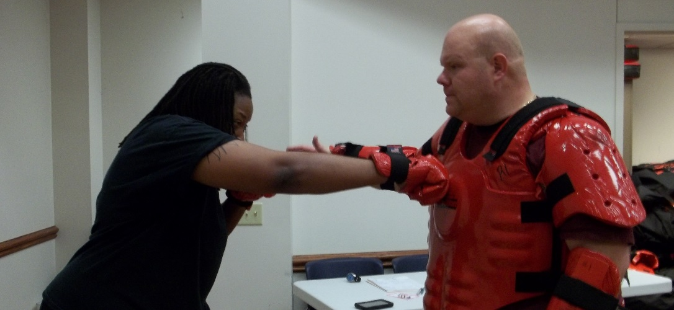
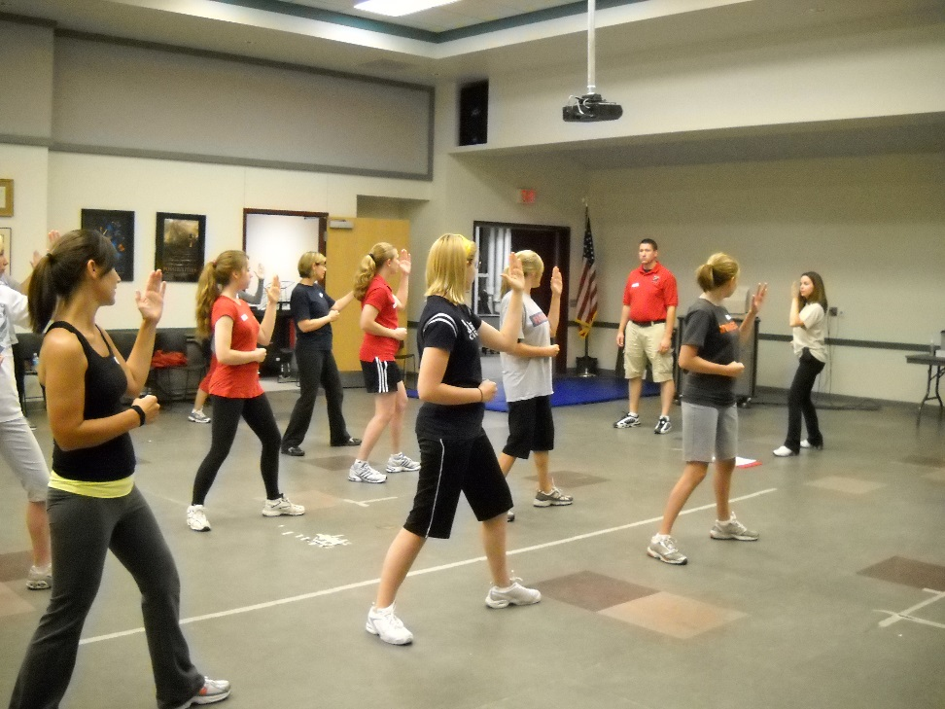
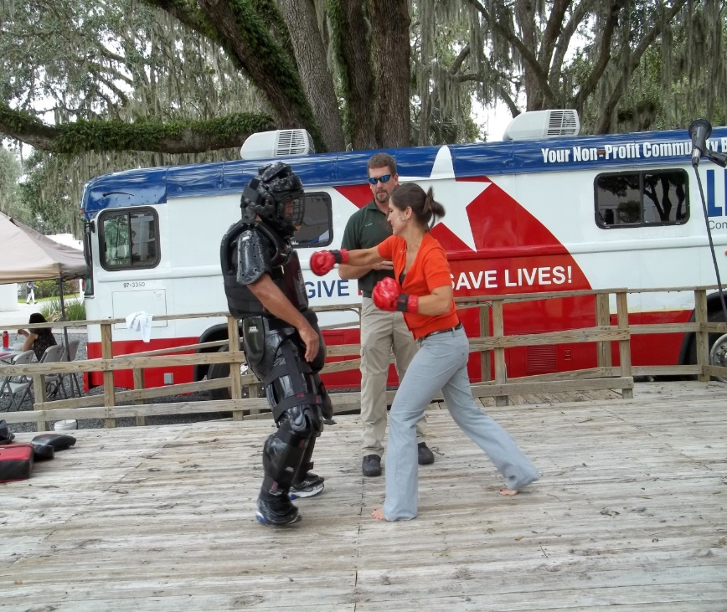
RAD

Slide 8
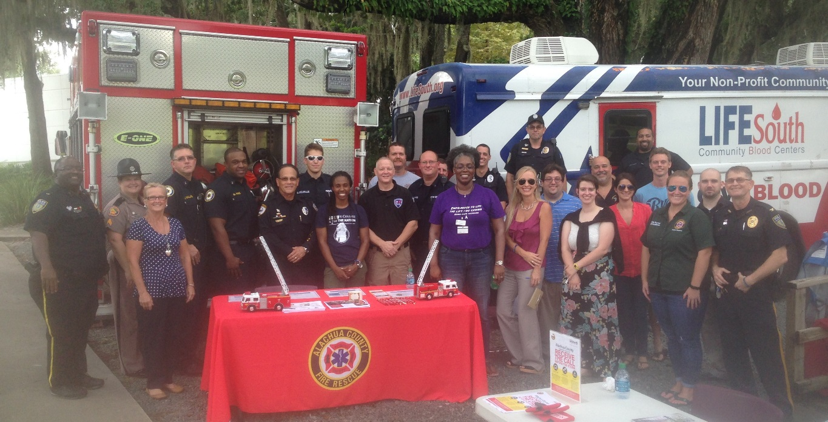
Community Policing = Problem Solving + Partnerships
Do You Have Community College / Community Police Philosophy?
Student Affairs / Student Life
Facilities / Physical Plant
  Custodians, Grounds, Maintenance, etc
Counseling
Students / SG
Mutual Aid
  Public Safety
    Fire, Police, EMS, EM
  Victim Services Agencies
Notes:
Community policing as a concept does not mean you have to have a police department. Develop relationships.
What other major partners should you have.
Share the work, share information dissemination
Story about facilities – front line staff
SG are leaders – make them accountable as leaders. Ask them frequently for ideas. Attend often. Attend when you have nothing to share.

Slide 9

How Do You Meet Student Mental Health Needs?
Santa Fe College Counseling Center
Provide short term, solution focused therapy
Education and training on campus for students, faculty and staff
Faculty/staff consultations regarding disruptive students and students with mental health concerns
Partner with Alachua County Crisis Center
Partner with PD as advocates for victims of crimes
Chair the college’s Trauma Response Team
Provide crisis intervention on campus

Slide 10
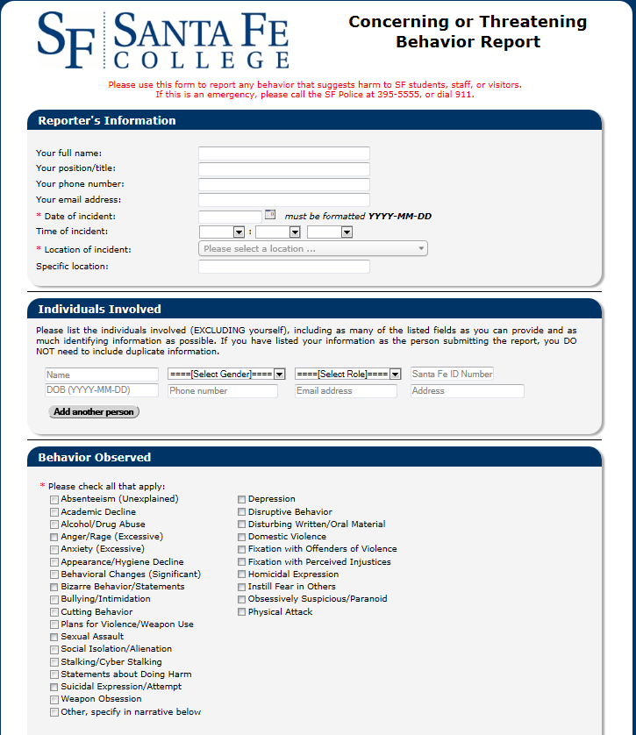
What Is Your TAMT/BIT Process?
Concern for well being?
Unusual, odd, or strange behaviors?
Threatening? Words, actions, writings….
Makes you, students, or staff nervous for he/she to be around?
Notes:
Talking Points:
SF has an active Behavioral Intervention / Threat Assessment & management team – meets regularly – decision makers from around the College – who follow up immediately.
New ONLINE reporting system – In emergency call police. Non-emergency – complete this simple form
When it is completed, it is sent instantly to mutli-disciplinary team of College officials who begin follow up immediately.
Must have this even for low level behaviors, disruption, odd behaviors etc. Do not “blow off” anything. Intervene early & often.
On SF BIT: PD, counseling, advisement, student affairs, student conduct officer, academic affairs, legal counsel, registrar, HR director

Slide 11
Santa Fe’s Behavioral Intervention Team
13 members
Authority over students, employees, visitors, and community members
Decision-making authority
To recommend suspension, expulsion, trespass
To refer to appropriate offices (Counseling, Disability, Veterans Affairs, Advisor, Ombudsperson, Conduct Officer)

Slide 12
Overview of Behavioral Intervention Teams
Behavioral intervention teams are designed with the goal of preventing escalating, potentially violent, behavior from students, faculty and staff.
The team receives reports of disruptive, concerning, or threatening behavior (from students, staff, faculty and visitors), then conducts an investigation by gathering additional information, performing a threat assessment, and deciding the next course of action regarding potential support, intervention, warning/notification and response.
Behavioral intervention teams manage cases for long periods of time utilizing software (oftentimes Symplify or Maxient) and continue with appropriate follow up of cases.

Slide 13
Do You Use A Disciplinary Admission Committee?
Communication made easy via Maxient, and having key people in key positons that overlap.
There are four people that sit on DAC (PD Lieutenant, CC coordinator, Academic Chair, and Conduct Officer) that also are BIT members.
This allows maximum communication regarding potential disruption and threat.

Slide 14

Disciplinary Admissions Committee
  Student Affairs
  Case Manager/LMHC
  Coord., Admissions
  Ombudsperson
  Academic Affairs
  2 Dept. Chairs
  1 Faculty
  SF PD Lieutenant
  AVP, Student Affairs
Notes:
Carole
Membership: 3 Academic Affairs, 3 Student Affairs, 1 SFPD, Chair = AVP Student Affairs
AA: 2 department chairs, 1 faculty
One chair is for Academic Foundations (Adult Ed/GED and Developmental Education → many get their start here!)
SA: Coordinator of Admissions, Coordinator of Counseling Center/Case Manager, AVP/Ombudsperson
Case Manager & Ombudsperson do a lot of the follow-up
Coordinator of Admissions = formerly with the DEA
PD: Lieutenant
Chair: AVP Student Affairs – only votes when there is a tie
AVP in charge of Enrollment Management & Student Conduct

Slide 15
Disciplinary Disclosure
Disciplinary Admissions - Language
  1. Are you currently, or have you ever been, charged with or subject to disciplinary action for scholastic or behavioral misconduct at any educational institution (do not include academic dismissal, academic suspension, or probation for poor grades)?
  2. Have you ever been charged with a violation of the law, misdemeanor or felony (even if adjudication was withheld) which resulted in, or could result in (if the case is still pending), probation, community service, restitution, a jail sentence, or the revocation or suspension of your driver's license (do not include traffic violations which only resulted in a fine)?
  If you have any criminal or disciplinary problems after being admitted to the College, you must disclose the incident to the Office of the Registrar using the Disciplinary History Disclosure Form, as soon as possible after the incident occurs.
Notes:
Dan
College Rule 7.1 gives provides for DD as part of Admissions this. Get verbiage from the Rule
As part of the Admissions and Re-Admissions process, students MUST answer two questions (Yes/No)
We also inform them of their responsibility to disclose future incidents
A “Yes” answer to these questions results in a DAC flag.
--DAC flag also triggered when a student is arrested – SF PD reviews all Alachua County arrests, compares to student database – current or not
--TAMT discussion of student *always* includes a criminal background check, if not-disclosed – DAC flag is triggered
--Highlight tis first linkage between TAMT & DAC

Slide 16
DADisess
Pre-Meeting review
  Weekly agenda sent by staff assistant
  Review applicants files via Maxient software
In meetings:
  Document Review & Decisions
  Interview selected applicants
Outcomes:
  Approve – often recommend/mandate interventions
  Table – less often
  Deny – document reason in case of appeal and future request(s)
Notes:
Carole
Prior to meeting, Admin Assistant sends out a spreadsheet with the names/ID# of the students we will discuss that week.
Committee members review all documentation uploaded into Maxient software
--Documents include Disciplinary Disclosure forms, CCIS records police reports, court documents, etc.
--Cloud-based, secure, accessible from everyone
At meeting, review documents and make group decisions:
1) Approve: minor misdemeanors, DUI, no history of violence, long time since most recent crime
2) Table (usually if a case is open, or someone just got placed on probation
3) Meet: long history, history of violent behaviors or gun use, kicked out of another college for behavior reasons, sexual offender
Interviews: What are we looking for?
1) Approve – often recommend/mandate interventions
2) Table – less often
3) Deny – document reason in case of appeal and future request(s)

Slide 17
Interventions: Case Management
Disciplinary Admissions - Support
Case management
Meeting with the case manager /counselor for as many sessions as determined appropriate by that counselor.
  When student’s needs are met, usually then don’t commit crimes or disrupt the college community.
Case management
  Reduces recidivism or relapse, encourages social reintegration, and enhances public safety.
Mentoring
Benefits of mentoring for these students. Develops a relationship with staff of the College.
Literature suggests mentoring has specific benefits for those with histories.
Organizations: Campus organizations as interventions.
  Career Pathways
  My Brothers Keeper
  Pathways to Persistence
Support groups:
Specifically for students with criminal histories.
Students in Recovery - On campus NA/AA
Notes:
Lara
Once the decision is made to admit, the committee will collectively discuss appropriate interventions. These can include, but are not limited to:
This case manager sits on the DAC and the TAMT and reports back to both committees regarding students’ compliance with meetings and referrals.
Ways to make DAC effective:
Threat reporting from faculty, staff, students
Follow media
Police reports from mutual aid agencies – ask them to send you when a student discloses
Crimereports.com for incidents around your campuses

Slide 18
EDUCATION, TRAINING, & MESSAGING
Create a campus wide culture of safety.
Interventions are critical, however, if the campus community isn’t aware of the interventions and other necessary campus regulations, the various committees and resources will not be utilized to their potential.
All members of campus community can contribute to education and training of campus.
The following are examples of SF’s presentations that assist in our campaign for safety.

Slide 19

VAWA/Campus SaVE Act Training
Clery
The Campus Sexual Violence Elimination Act, or Campus SaVE Act (SaVE), is a 2013 amendment to the federal Jeanne Clery Act. SaVE was designed by advocates along with victims/survivors and championed by a bi-partisan coalition in Congress as a companion to Title IX to bolster the response to and prevention of sexual violence in higher education.
President Obama signed the measure into law as part of the Violence Against Women Reauthorization Act of 2013 on March 7, 2013.
Violence Against Women Reauthorization Act of 2013
Campus SaVE Act – Amends Clery Reporting Requirements
Section 304
Notes:
As part of an unprecedented national effort to address alarming rates of sexual assault on college campuses, President Obama issued a Presidential Memorandum in January 2014 to establish the “White House Task Force to Protect Students from Sexual Assault.“
Today’s report states that students experience some of the highest rates of sexual assault. This violence, and the stress, fear, and mental health challenges that often follow, combine to increase dropout rates and limit opportunities for success in college for women and girls.

Slide 20

Bystander Intervention Training
Empathy based program
Why/why not intervene?
Bystander before/during/after
Scope of sexual violence/continuum
Importance of intervening as a
bystander in “low recognition”
behaviors
Community effect
Teaches decision making process & safety
#WhoWillYouHelp

Slide 21
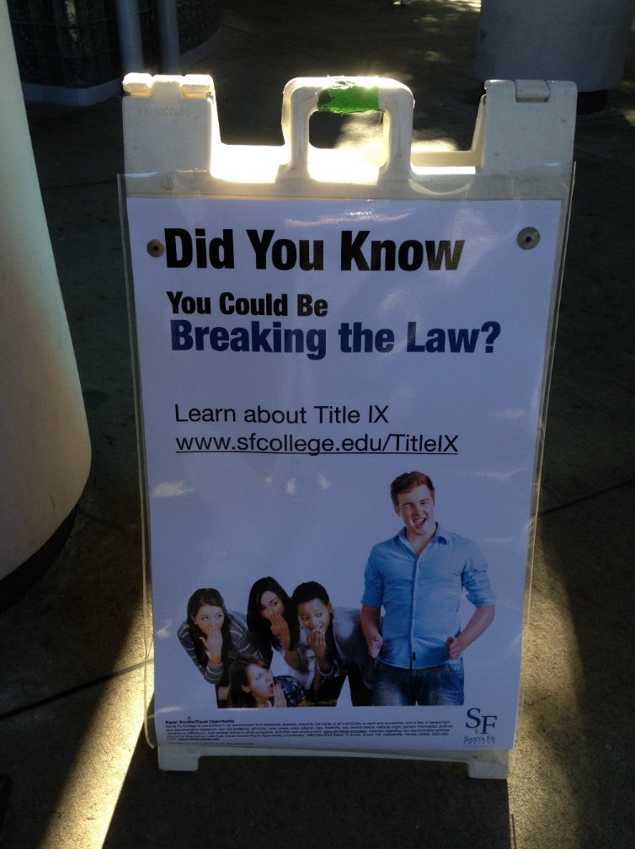
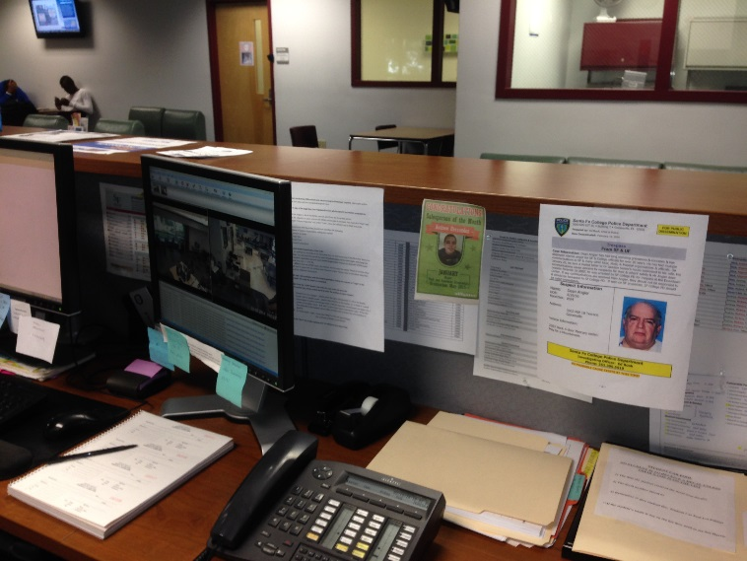
Develop Comprehensive Messaging
Website
Electronic messaging
E-Mail
A-frames & message boards
Hand outs
Bookmarks, Brochures, Flyers
“Promotional” Items
Bags, water bottles, whistles
Static Displays
Events
Trespass Gallery?
Notes:
Add safety videos from SF here.

Slide 23
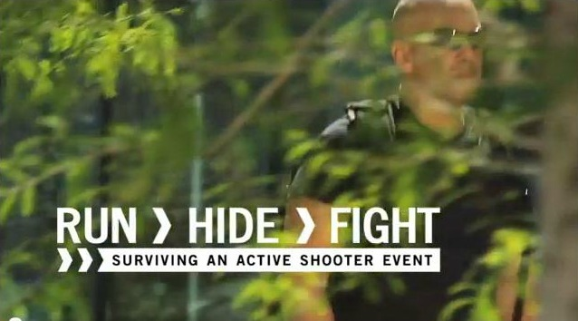

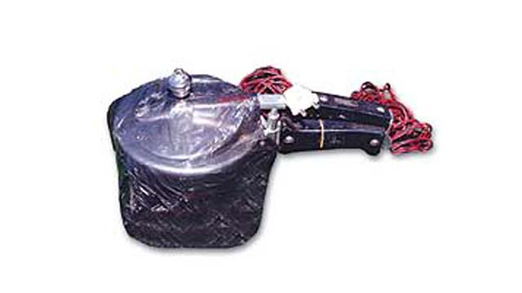


Front Line Safety Training
Notes:
Talking Points:
Teach & train = Professional Development
A professionally developed security force feels more professional, acts more professional, & rubs off on others. “Feel safe, act safe, be safe”
Take advantage of free or second dollar funding training from your police academies. Biggies today: interview & interrogations, front line supervisor, CIT, active shooter, crime prevention, first aid/TCCC (triple C)
Use what is available on the web for free training. (FDLE, center for campus safety)
Threats can occur anywhere, anytime – Examples: Sandy Hook, Aurora, Lone Star College, Vtech, Colombine….
Weapons can be anything – knife, gun, pressure cooker bomb (Boston Marathon).
We have to feel safe but be vigilant & alert.
Video online SF website – 6 minutes.
Police & counseling have trained over 300 persons in last 2 years in active threat & dealing with disruptive persons. Contact them if you want a session.

Slide 24

Working and Communicating With Disruptive Students/Conflict Resolution Training

Slide 25
Suicide Prevention – QPR Training
Question. Persuade. Refer. -- Three steps anyone can learn
to help prevent suicide.
We can all save lives.
The QPR mission is to reduce suicidal behaviors and save lives by providing innovative, practical and proven suicide prevention training. The signs of crisis are all around us. We believe that quality education empowers all people, regardless of their background, to make a positive difference in the life of someone they know.

Slide 26
The Importance of Employee Training
Staff must be encouraged to think of their personal safety, but also the collective safety and security of the entire college and promote such actively.
Campus safety, security, crime & violence prevention benefit from a comprehensive, coordinated, collaborative approach involving all campus stakeholders, however employees play a special role-Knowledge Ambassadors.
Employees are knowledge ambassadors of campus safety by being aware of applicable rules, policies, procedures, and reporting requirements related to campus safety, security and wellness and educating others about them.
Lead by example-Knowledge Ambassadors play an active role in their college’s safety, security and wellness initiatives using appropriate safety/security measures and proper protocols.
Knowledge Ambassadors are proactively prepared for the unexpected by taking advantage of training opportunities and collaborating with colleagues.

Slide 27
What You Should Know as a Knowledge Ambassador of Campus Safety?
Know where to find the basic safety, security and emergency protocols of your college campuses, as well as any mandatory reporting requirements.
Use common sense, be alert of your surroundings, and take precautions to protect yourselves and students from possible vulnerabilities.
Communication is key! Know your college rules, how to report suspicious activities, as well as disruptive, threatening, or disturbing behavior of students and staff. Most importantly, REPORT your concerns!
Know what resources your college and surrounding communities provide when concerning incidents of crime or crisis, keep contact information handy, and refer those in need to helpful resources.

Slide 28














Network!

Slide 29
Questions/Comments
Ryan Woods, Lieutenant, Santa Fe College Police Department
ryan.woods@sfcollege.edu
Lara Zwilling, LMHC, Coordinator, SF Counseling Center
lara.zwilling@sfcollege.edu
Lola Christian, Employment Manger, SF Human Resources
lola.christian@sfcollege.edu

