Slide 1
The Advisor's Edict:
Caring is a Core Value
Mark Duslak, M. Ed.
Lake-Sumter State College

Slide 2
Getting to Know You
Introduce yourself to the person next to you:
Where do you work
Job Title
Number of students you serve
New programs in your service area that impacted your ability to build relationships with students

Slide 3
What is Academic Advising?
Core Competencies of Academic Advising - Knowledge, Skills, and Dispositions of Advisors
Informational
Relational
Conceptual
Core Values - Professional Guidance
Caring
Commitment
Empowerment
Inclusivity
Integrity
Professionalism
Respect
Concept of Academic Advising - Goals of Advising
CAS Standards - Development, Assessment, and Improvement of Advising Programs

Slide 4
Core Values Task Force
15 individuals across the world in a variety of settings
Reworked the previous core values and established new core values
Stakeholder input from every NACADA Regional conference and the annual conference
Over a year to develop

Slide 5
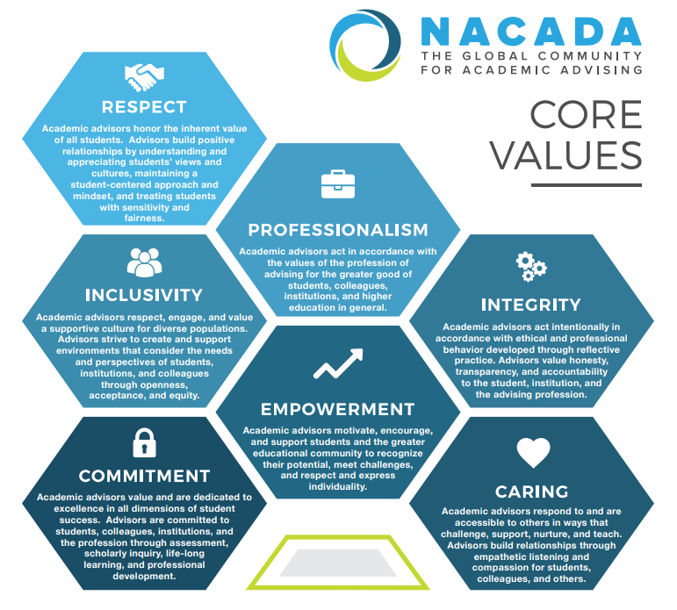

Slide 6
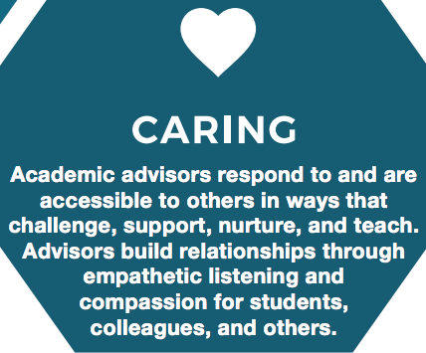

Slide 7
Why Does This Matter?
Academic advising positively impacts student academic outcomes (e.g. Kot, 2014)
A positive relationship with an academic advisor leads to increased student loyalty to the institution (Vianden & Barlow, 2015)
Students favored a relationship with an advisor more than a specific advising approach (Mottarella, Fritzsche, & Cerabino, 2004)
3 out of 5 of Jordan’s (2016) Common Tasks and Skills for advisors are linked to building relationships with students.

Slide 8
What is a Caring Advisor?
“[A caring advisor] demonstrates an interest in a student holistically; goes beyond helping and socializing to being interested in students’ academic progress and personal well-being” (Barnes, Williams, and Archer, 2010, p. 41)
Ideas to Consider:
Psychological attunement
Tuned-in to the academic cycle
Interest “hacks”

Slide 9
When is a time you felt cared for as a student?
What are some potential barriers to a caring relationship?

Slide 10
Threats to Advisors Creating Caring Relationships:
Caseloads are high: 441 at 2-year institutions (Robbins, 2013).
Program changes misalign the purpose of the advising program (Brigen, 2017).
Advisor burnout (91% of advisors for athletes report knowing someone experiencing burnout) (Rubin, 2017).

Slide 11
Problem 1: Caseloads
Symptoms:
Communication becomes less personal
Difficulty meeting student demands for individual meetings
Solutions:
Leverage student information sources
Psychological attunement

Slide 12
LSSC Response
Advisor Rostering
Advisor Canvas Pages

Slide 13
Problem 2: Program Alignment
Symptoms:
Performance funding stresses retention and completion
Programs are designed to serve a volume of students quickly
Solutions:
Engage administration in dialogue about the normative roles and values of advisors
Connect the mission of the advising program with the institutional mission in a way that allows for caring relationships to be forged

Slide 14
LSSC Response
More Admin support for advising (Asst. Dir. Stud. Dev.)
Meetings that are cross divisional
Presence at Planning Council

Slide 15
Problem 3: Burnout
Symptoms:
Stress from “processing” large numbers of students
Overload of duties
Solutions:
Huebner (2011), provides some great suggestions to combat burnout
Promote positive responses to stress
Engage in goal-directed behavior
Strengthen social resources
Create new meanings from work
McClellan’s (2007) Personal component of advisor training components

Slide 16
LSSC Response
Keep creativity alive
Feed and celebrate
Check-In

Slide 17
Care Assessment

Slide 18
Caseloads - What approaches maintain caring for large student workloads?
Program Alignment - How are program mission/vision communicated to administration? How are conflicts addressed?
Burnout - What is being done to support advisors approaching burnout in the profession?
Which of these three is the greatest threat to creating caring relationships with students?
What are some ideas for mitigating these threats?

Slide 19
References
Barnes, B.J., Williams, E.A., & Archer, S.A. (2010). Characteristics that matter most: Doctoral students' perceptions of positive and negative advisor attributes. NACADA Journal. 30(1), 34-46.
Bridgen, S. (2017). Using systems theory to understand the identity of academic advising: A case study. NACADA Journal, 37(2), 9–20. https://doi.org/10.12930/NACADA-15-038
Huebner, C. (2011). Caring for the Caregivers: Strategies to overcome the effects of job burnout. Retrieved from NACADA Clearinghouse of Academic Advising Resources website http://www.nacada.ksu.edu/Resources/Clearinghouse/
Mottarella, K. E., Fritzsche, B. A., & Cerabino, K. C. (2004). What do students want in advising? A policy capturing study. NACADA Journal, (1-2). 48-61. https://doi.org/10.12930/0271-9517-24.1-2.48
Kot, F. C. (2014). The impact of centralized advising on first-year academic performance and second-year enrollment behavior. Research in Higher Education, 55(6), 527-563. doi:10.1007/s11162-013-9325-4
Jordan, P., (2016) Theory as the foundation of advising. In Grites, T. J., Miller, M. A., & Voller, J. G., (Eds.). Beyond foundations: Developing as a master academic advisor. (pp. 21-42). Hoboken, NJ: John Wiley & Sons
Lowe, A., & Toney, M. (2000). Academic Advising: Views of the Givers and Takers. Journal of College Student Retention: Research, Theory & Practice, 2(2), 93–108. https://doi.org/10.2190/D5FD-D0P8-N7Q2-7DQ1
McClellan, J.L. (2007). Content Components for Advisor Training: Revisited. Retrieved from NACADA Clearinghouse of Academic Advising Resources Web site: http://www.nacada.ksu.edu/Resources/Clearinghouse/View-Articles/Advisor-Training-Components.aspx
NACADA: The Global Community for Academic Advising. (2006). NACADA concept of academic advising. Retrieved from https://www.nacada.ksu.edu/Resources/Pillars/Concept.aspx
NACADA: The Global Community for Academic Advising. (2017). NACADA academic advising core competencies model. Retrieved from https://www.nacada.ksu.edu/Resources/Pillars/CoreCompetencies.aspx
Rubin, L.M. (2017). Who are athletic advisors? State of the profession. NACADA Journal 37(1), 37-50. https://doi.org/10.12930/NACADA-15-046
Robbins, R. (2013). Implications of advising load. In Carlstrom, A., 2011 national survey of academic advising. (Monograph No. 25). Manhattan, KS: National Academic Advising Association. Retrieved from the NACADA Clearinghouse of Academic Advising Resources website http://www.nacada.ksu.edu/tabid/3318/articleType/ArticleView/articleId/94/article.aspx.
Vianden, J., & Barlow, P. J. (2015). Strengthen the Bond: Relationships Between Academic Advising Quality and Undergraduate Student Loyalty. NACADA Journal, 35(2), 15–27. https://doi.org/10.12930/NACADA-15-026

