Slide 1
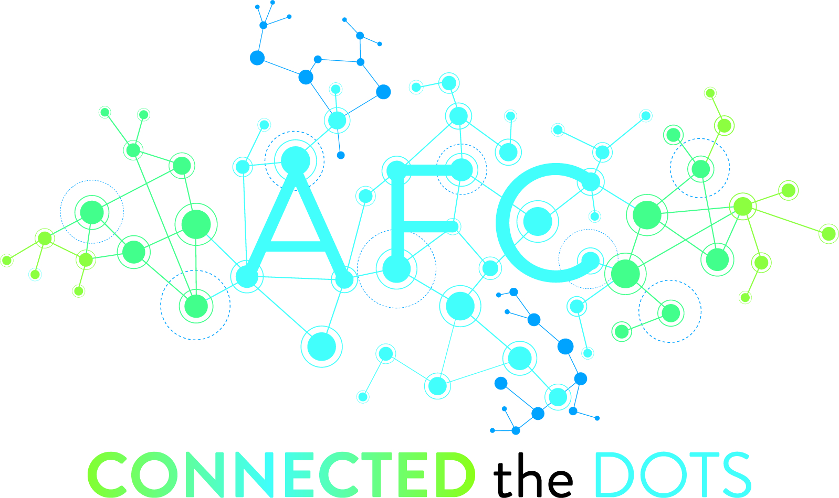
IRSC and the Digital Archive: Digitizing Local History
Mia Tignor
Emerging Technologies Librarian/Assistant Professor
Indian River State College

Slide 2
Background

Slide 4
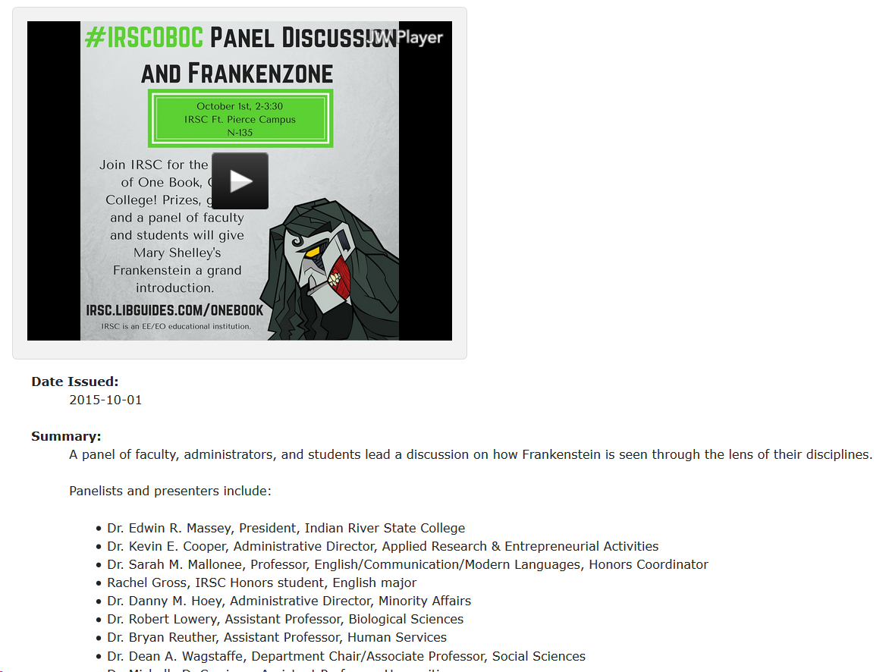

Slide 5
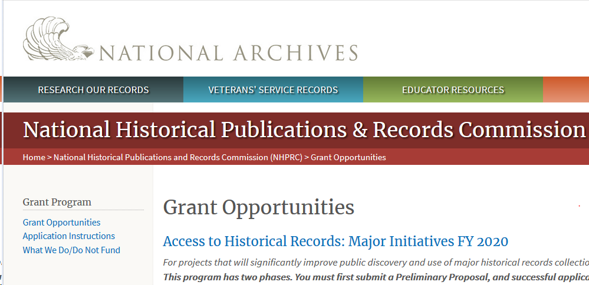
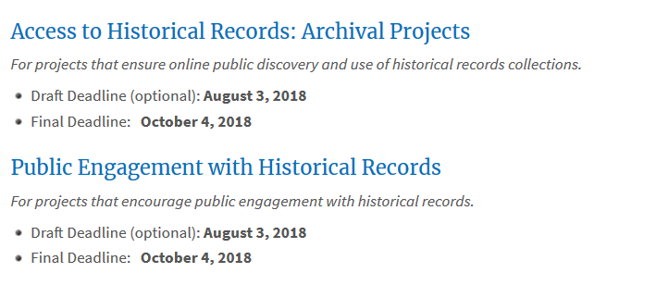

Slide 6
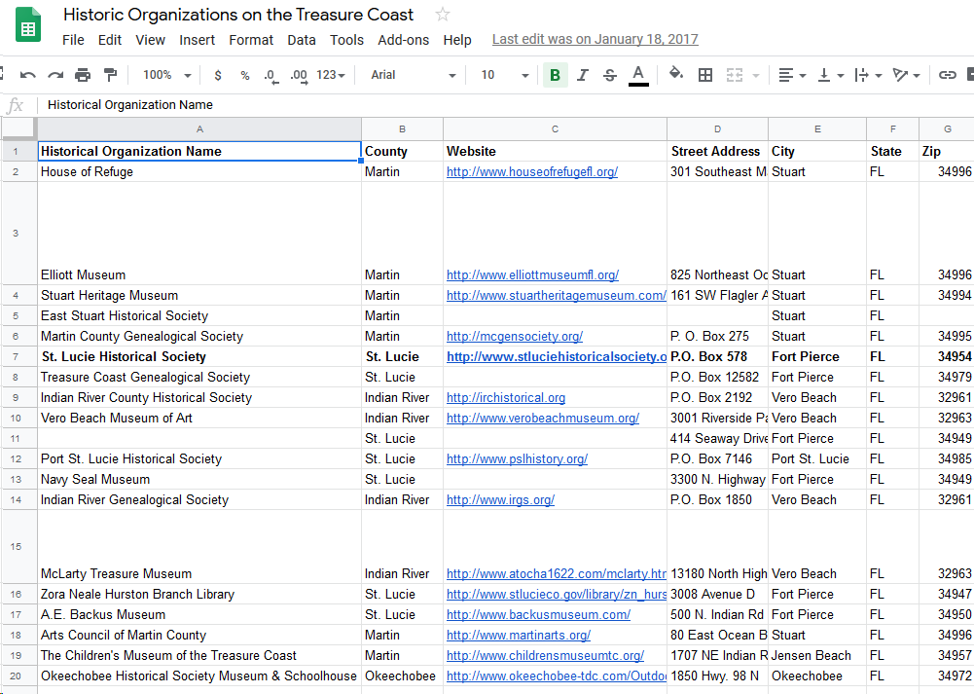

Slide 7
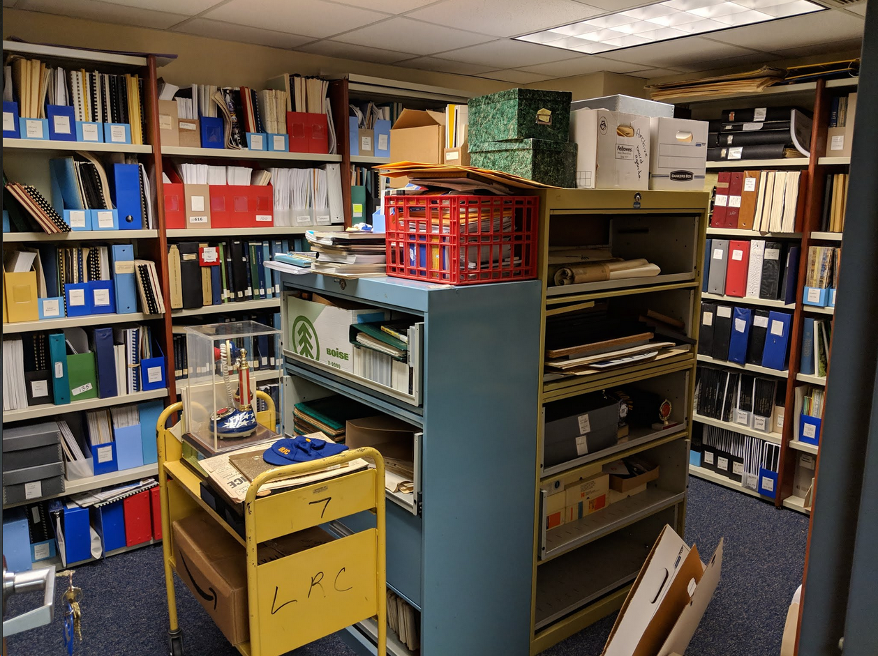

Slide 9
AMH 2020

Slide 10
Florida College System Mission
The mission of the Florida College System is to provide access to high-quality, affordable academic and career educational programs that maximize student learning and success, develop a globally competitive workforce and respond rapidly to diverse state and community needs.

Slide 11
Purpose
Conducting archival research and cataloguing primary sources provides first-hand experience in historical research. It shows how historians find evidence for the narratives that they write and the significance of time and place - context.

Slide 12
Outcomes
Develop historical thinking skills
Increase information literacy
Strengthen organization and communication skills
Gain experience in the digital humanities by creating digital resources

Slide 13
Class Sessions

Slide 14
Critical Cataloging Presentation
What do librarians do, anyway?
Why is it important to mindfully catalog and describe items?
How are digital collections created?

Slide 15
Critical Cataloging Presentation
Based on the ACRL Frame Information Has Value
“...understand how and why some individuals or groups of individuals may be underrepresented or systematically marginalized within the systems that produce and disseminate information” (ACRL 2016).

Slide 16
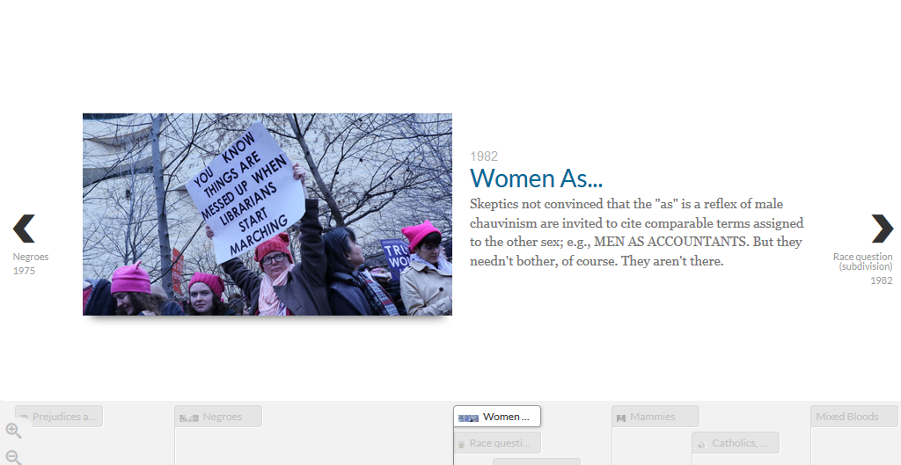

Slide 18
Item Selection & Digitization
Two groups of students:
Pioneer Press (IRSC Collection)
Hallstrom House (Indian River Historical Society)

Slide 19
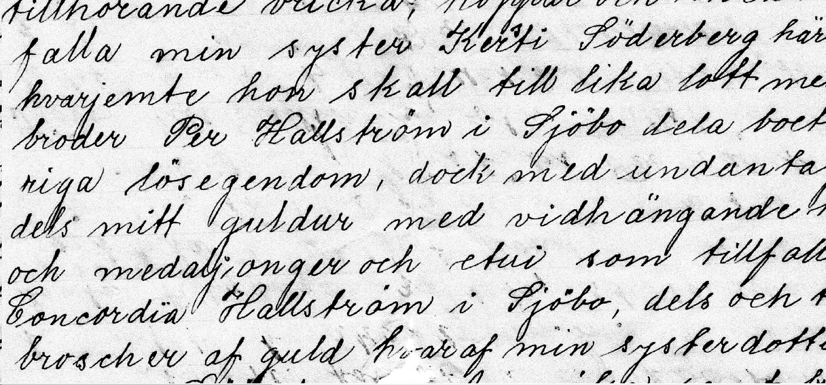

Slide 20
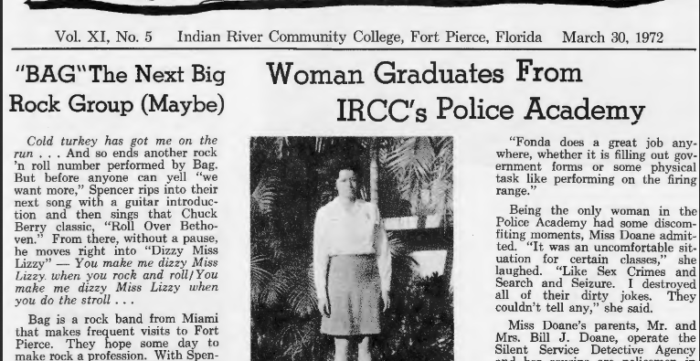

Slide 21
Item Description
& Cataloging
Standard database instruction for secondary sources
Lab sessions (2-4)
Each item and description approved by history professor and librarian before submission

Slide 22
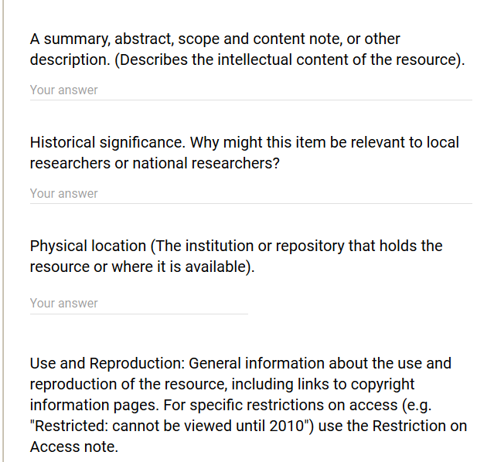

Slide 23
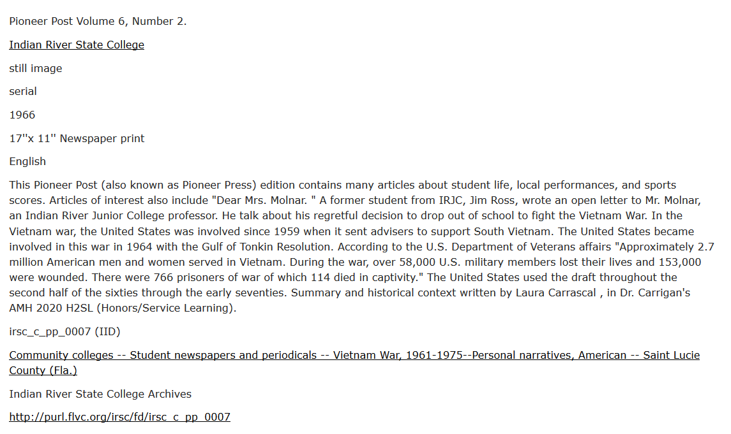

Slide 24
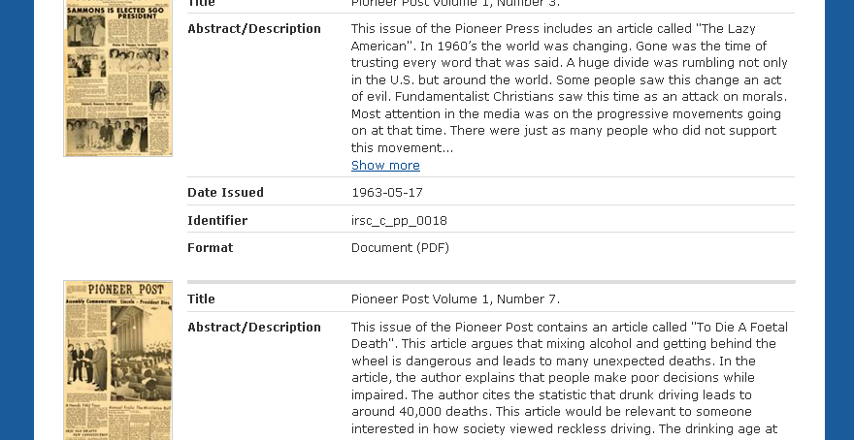

Slide 25
Adaptability

Slide 26
Materials
One (1) flatbed scanner (<$120)
Computer lab on description days
Archival collections
Time!

Slide 27
Lessons Learned
Back up everything as often as possible
Groups are great for larger classes
The more instructions, the better

Slide 28
Response

Slide 29
Student Responses & Reflection Papers
“...absolutely loved this course. As someone who has never been very interested in history, this course completely changed my mind and has even made me consider minoring in history. The discussions in class were very engaging and deep, opening my eyes and challenging me to think outside of the box. Digitizing archives was such an amazing experience, and I enjoyed working with my classmates on this project.”

Slide 30
Student Responses & Reflection Papers
“In addition to teaching me how to organize and catalogue historical documents, this project has given me insight to what a ‘college student's’ life was like between the 1960s and 1970s. From opinion-editorials relating to politics and hippie/rebel subcultures, to informational pieces about the school’s advancement towards desegregation, I have been exposed to authentic material that has enriched my understanding of local history.”

Slide 31
Project Overview and Future
24 full Pioneer Press scans with descriptions
5 Hallstrom house binders
3 classes (2 honors, 1 regular) in 2018
2 classes (1 honors, 1 regular) in Spring 2019
Panel presentation at Florida Digital Humanities Conference March 29-30 in Jacksonville, FL
Extra Credit project Fall 2019

Slide 32
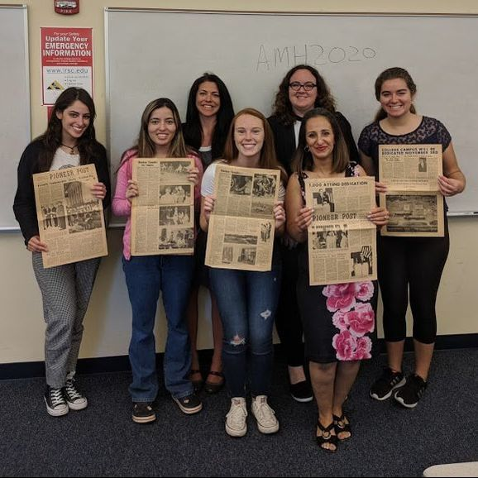

Slide 33
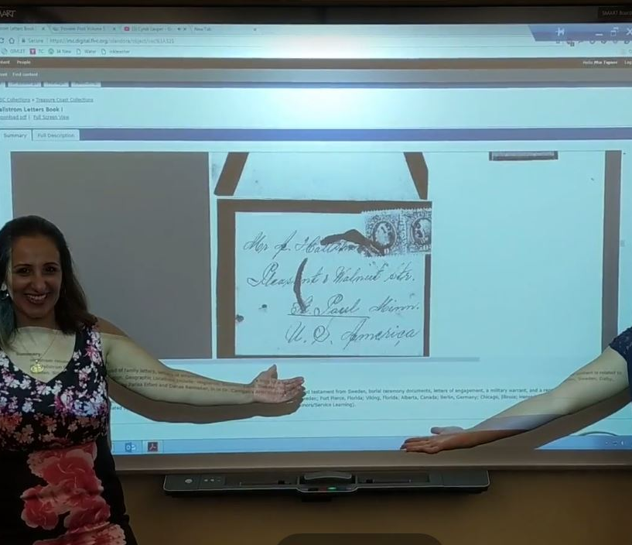
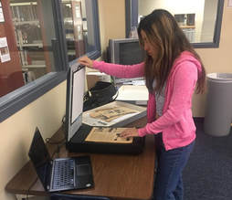
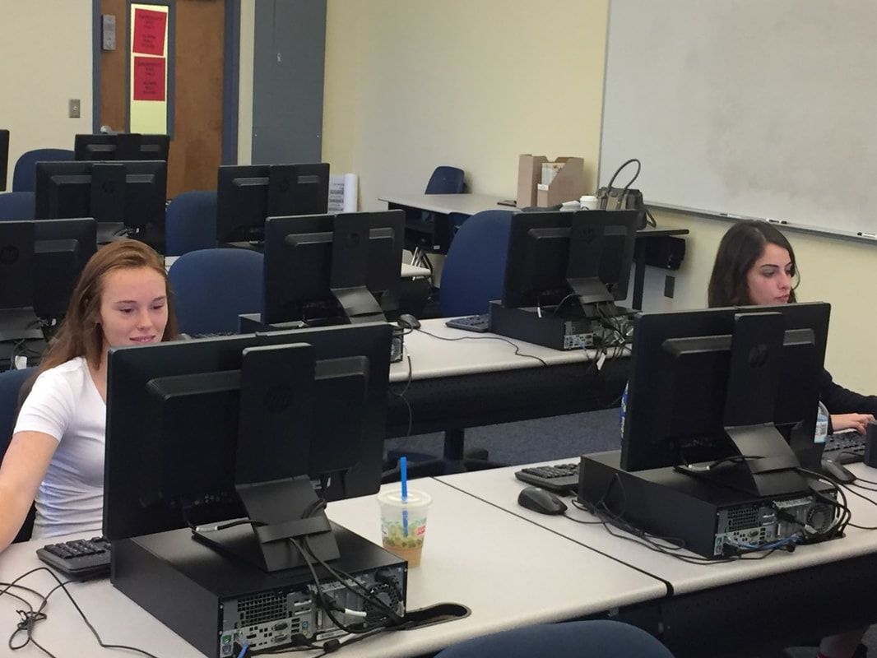
Questions?

