Slide 1
Learning Resources- Making Connections
70th AFC Annual Meeting & Conference
November 7, 2019
Presenter:
Nora Morales, Associate Director of Learning Resources
Miami Dade College, Kendall Campus

Slide 2
Today’s Presentation
Initial concept
Implementation
Assessment
Programming Ideas
Collaboration

Slide 3
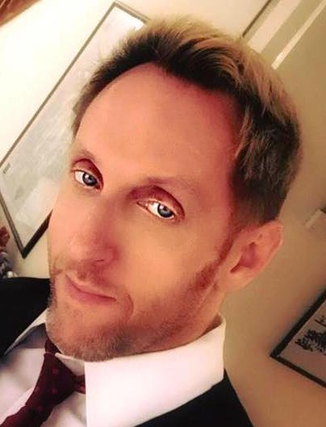
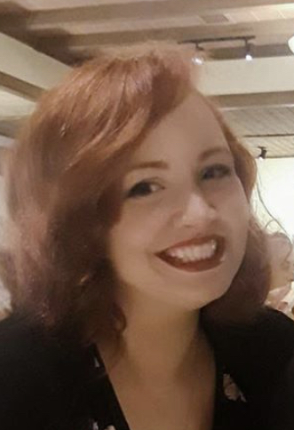
Meet the Team
Nora Morales
Associate Director
Charles Meehan
Academic Writing Coach
Leslie Alfonso
Associate Instructor

Slide 4
Picture It…

Slide 5
Communication

Slide 6
Opportunity
Professor feedback about 10-minute orientations to academic writing support lab
Improve attendance for Student Support Lab workshops

Slide 7
The Solution

Slide 8
Connecting the Dots
Writing Coach schedules faculty for 10 minute orientation
Faculty are invited to choose from Learning Resources offerings
Message shared with Associate Instructor to arrange final confirmation with faculty.

Slide 9
Learning Resources Sampler Menu
Writing Orientation
Library Tour
Library Instruction
Project Development Skill Workshops
Career Builder Workshops

Slide 10
Summer 2018 Pilot Statistics
15 offerings with an average of 21 students per class
Total of 315 students served
Library Instruction:5
Library Tour: 5
Project Development Skills: 2
Career Builder Series: 3

Slide 11
Fall 2018 Pilot Statistics
85 offerings with an average of 21 students per class
Total of 1,785 students served
Library Instruction: 31
Library Tour: 17
Project Development Skills: 17
Career Builder Series: 20

Slide 12
Pilot Survey Results

Slide 13
Takeaways for…
Strategy
Unity
Communication
Creativity
Effectiveness
Support
Survey
Notes:
Show students how everything is interrelated. These collaborative efforts will have a long-lasting impact in strengthening the relationship with the different departments on future projects as well.

Slide 14
Challenges Encountered
Streamline communication between departments
Buy-In is crucial
Continued Marketing

Slide 15
Adaptability
It’s so easy that you can do it too!

Slide 16
Programming Ideas
Pop-Up Libraries
Tailored offerings for targeted/specific audiences
Host initiatives and invite other areas
Term Themes (ex. Game of Thrones) https://libraryguides.mdc.edu/GoT

Slide 17
Final Thoughts
Set an objective​
Open communication
Be flexible
Don’t give up

Slide 18
Questions?

Slide 19
Thank you for participating!
Nora Morales
nmorales@mdc.edu
305-237-2293

