Slide 1
Membership Development
Rochelle Popp-Finch
rfinch@irsc.edu
772-462-7476

Slide 2
Let’s Give Them Something To Talk About
Membership Development:
Retention, Recruitment & Re-Engagement (3Rs)

Slide 3
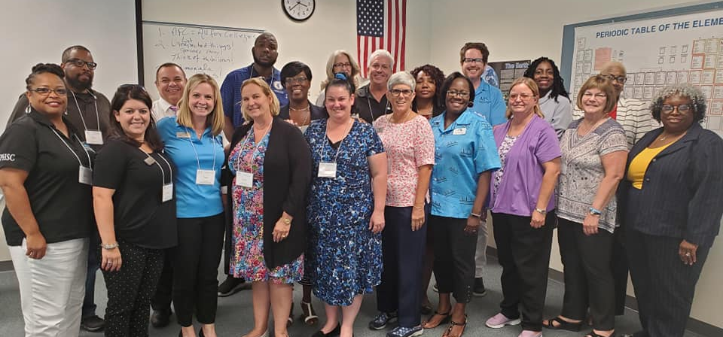
Step 1
Develop a Membership Team

Slide 4
Recruit A Strong Membership Committee
Skills of Team Members
Comfortable talking to other people
Knowledgeable about AFC, Chapters, & Commissions
Encouraging & inviting
Tenacious ~ WON’T take NO for an answer

Slide 5
Build Your Campaign “Plan it Out"
Create incentives for current members to bring in new members
Create a targeted campaign of potential members from data you receive from HR
Create a plan to attend each departmental meeting to recruit new members
Create a member mentor program
Create a schedule for information sessions on each campus & get on the agenda at department meetings
Create a competition between departments, divisions, campuses (who can recruit the most new members)

Slide 6
Designing A Campaign
Follow up with potential members with an email, brochures, flyers, & personal contact
Develop a quarterly chapter/commission newsletter & forward it to new members
Utilize the AFC website & social media to list your meeting schedules & activities

Slide 7
NEWS FLASH: AFC DUES CHANGED!!!!!
As of July 1, 2020
All NEW regular members pay $50 annually to join the AFC
All adjunct faculty & part-time employees will pay $25 annually
All regular members paying above $50 may elect to lower their rate

Slide 8
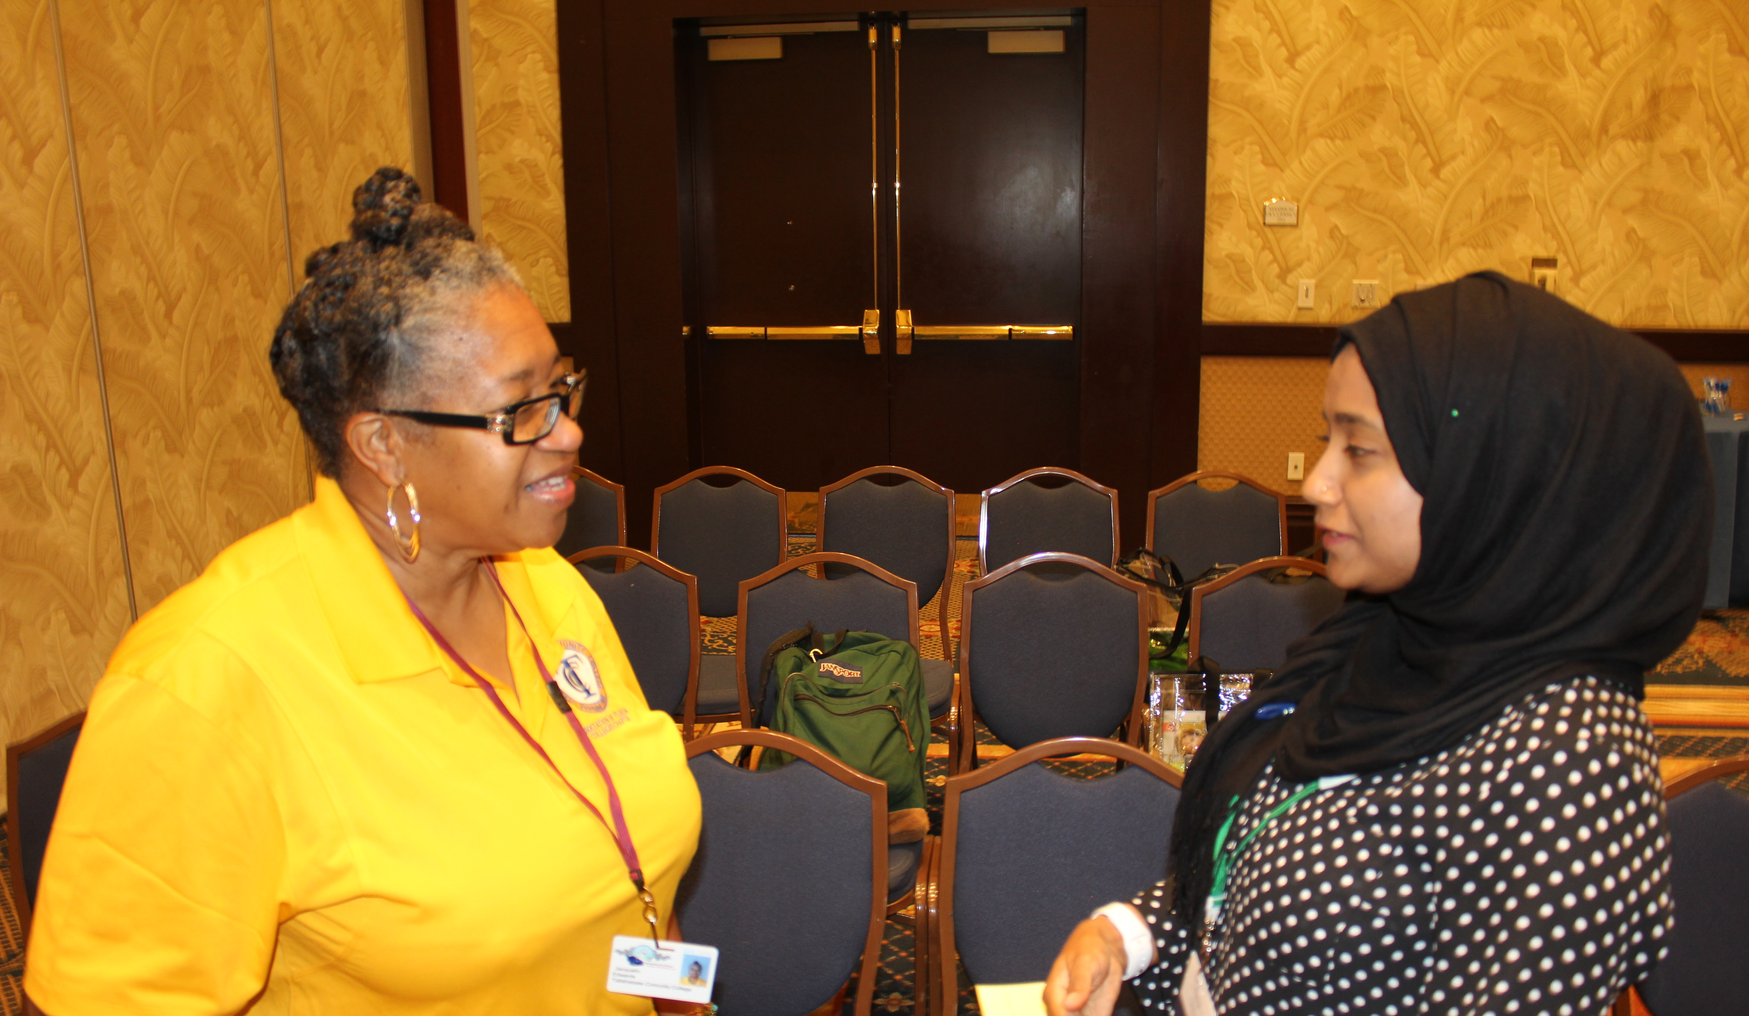
Retention: Who Are Your Members?

Slide 9
Actively Engage Members
Who Do You Know?
What Do You Say?
Tell them what’s new
Acknowledge that we want them active
Find out why they haven’t been active
Share YOUR AFC Story
Find someone in AFC they know
Recognize them when they DO Engage

Slide 10
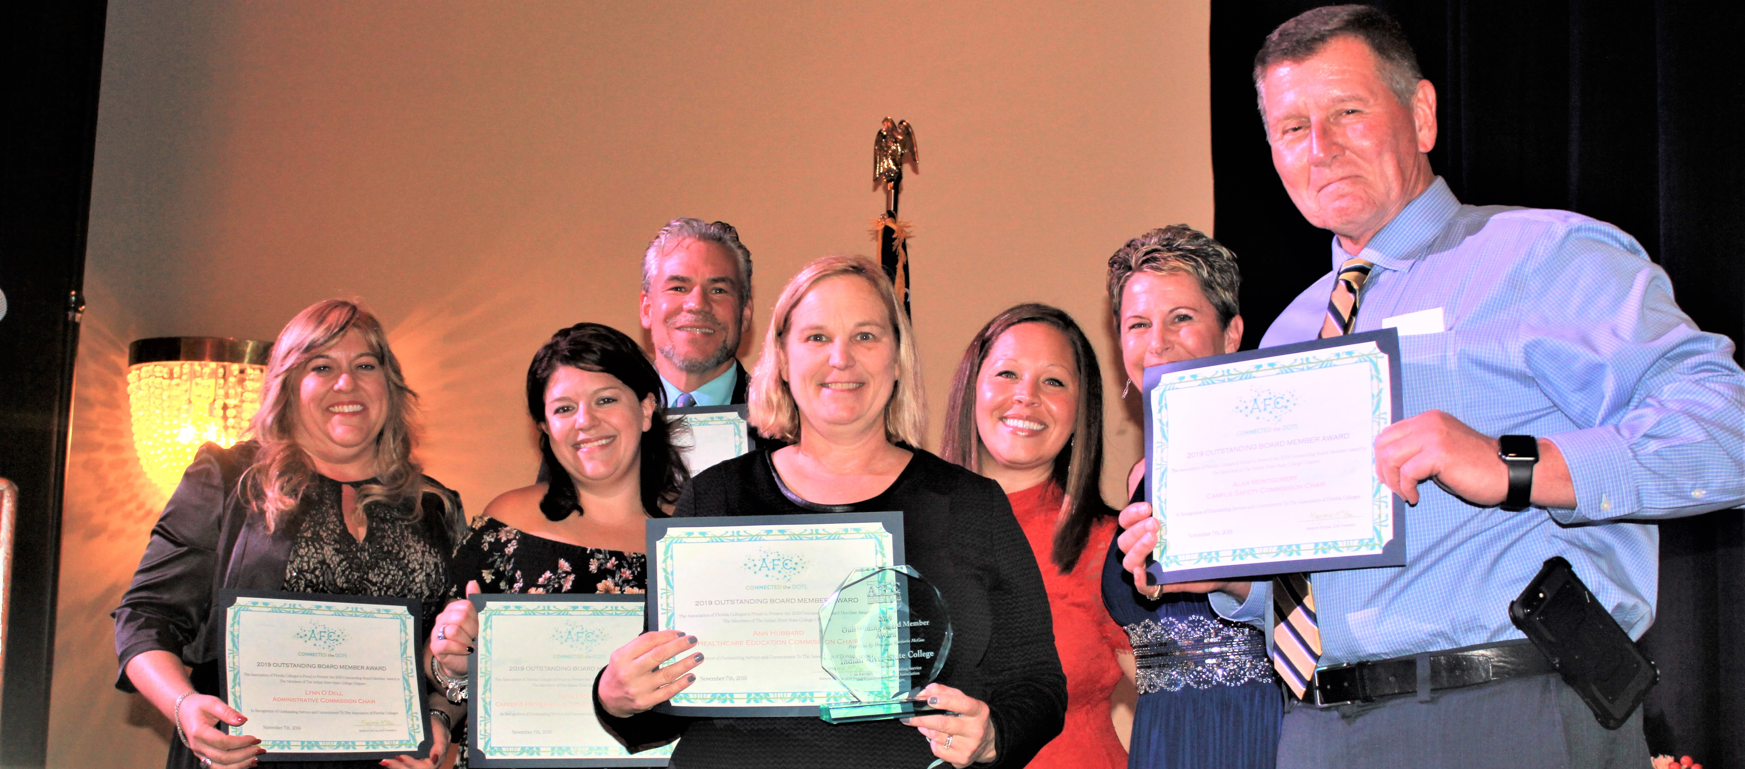
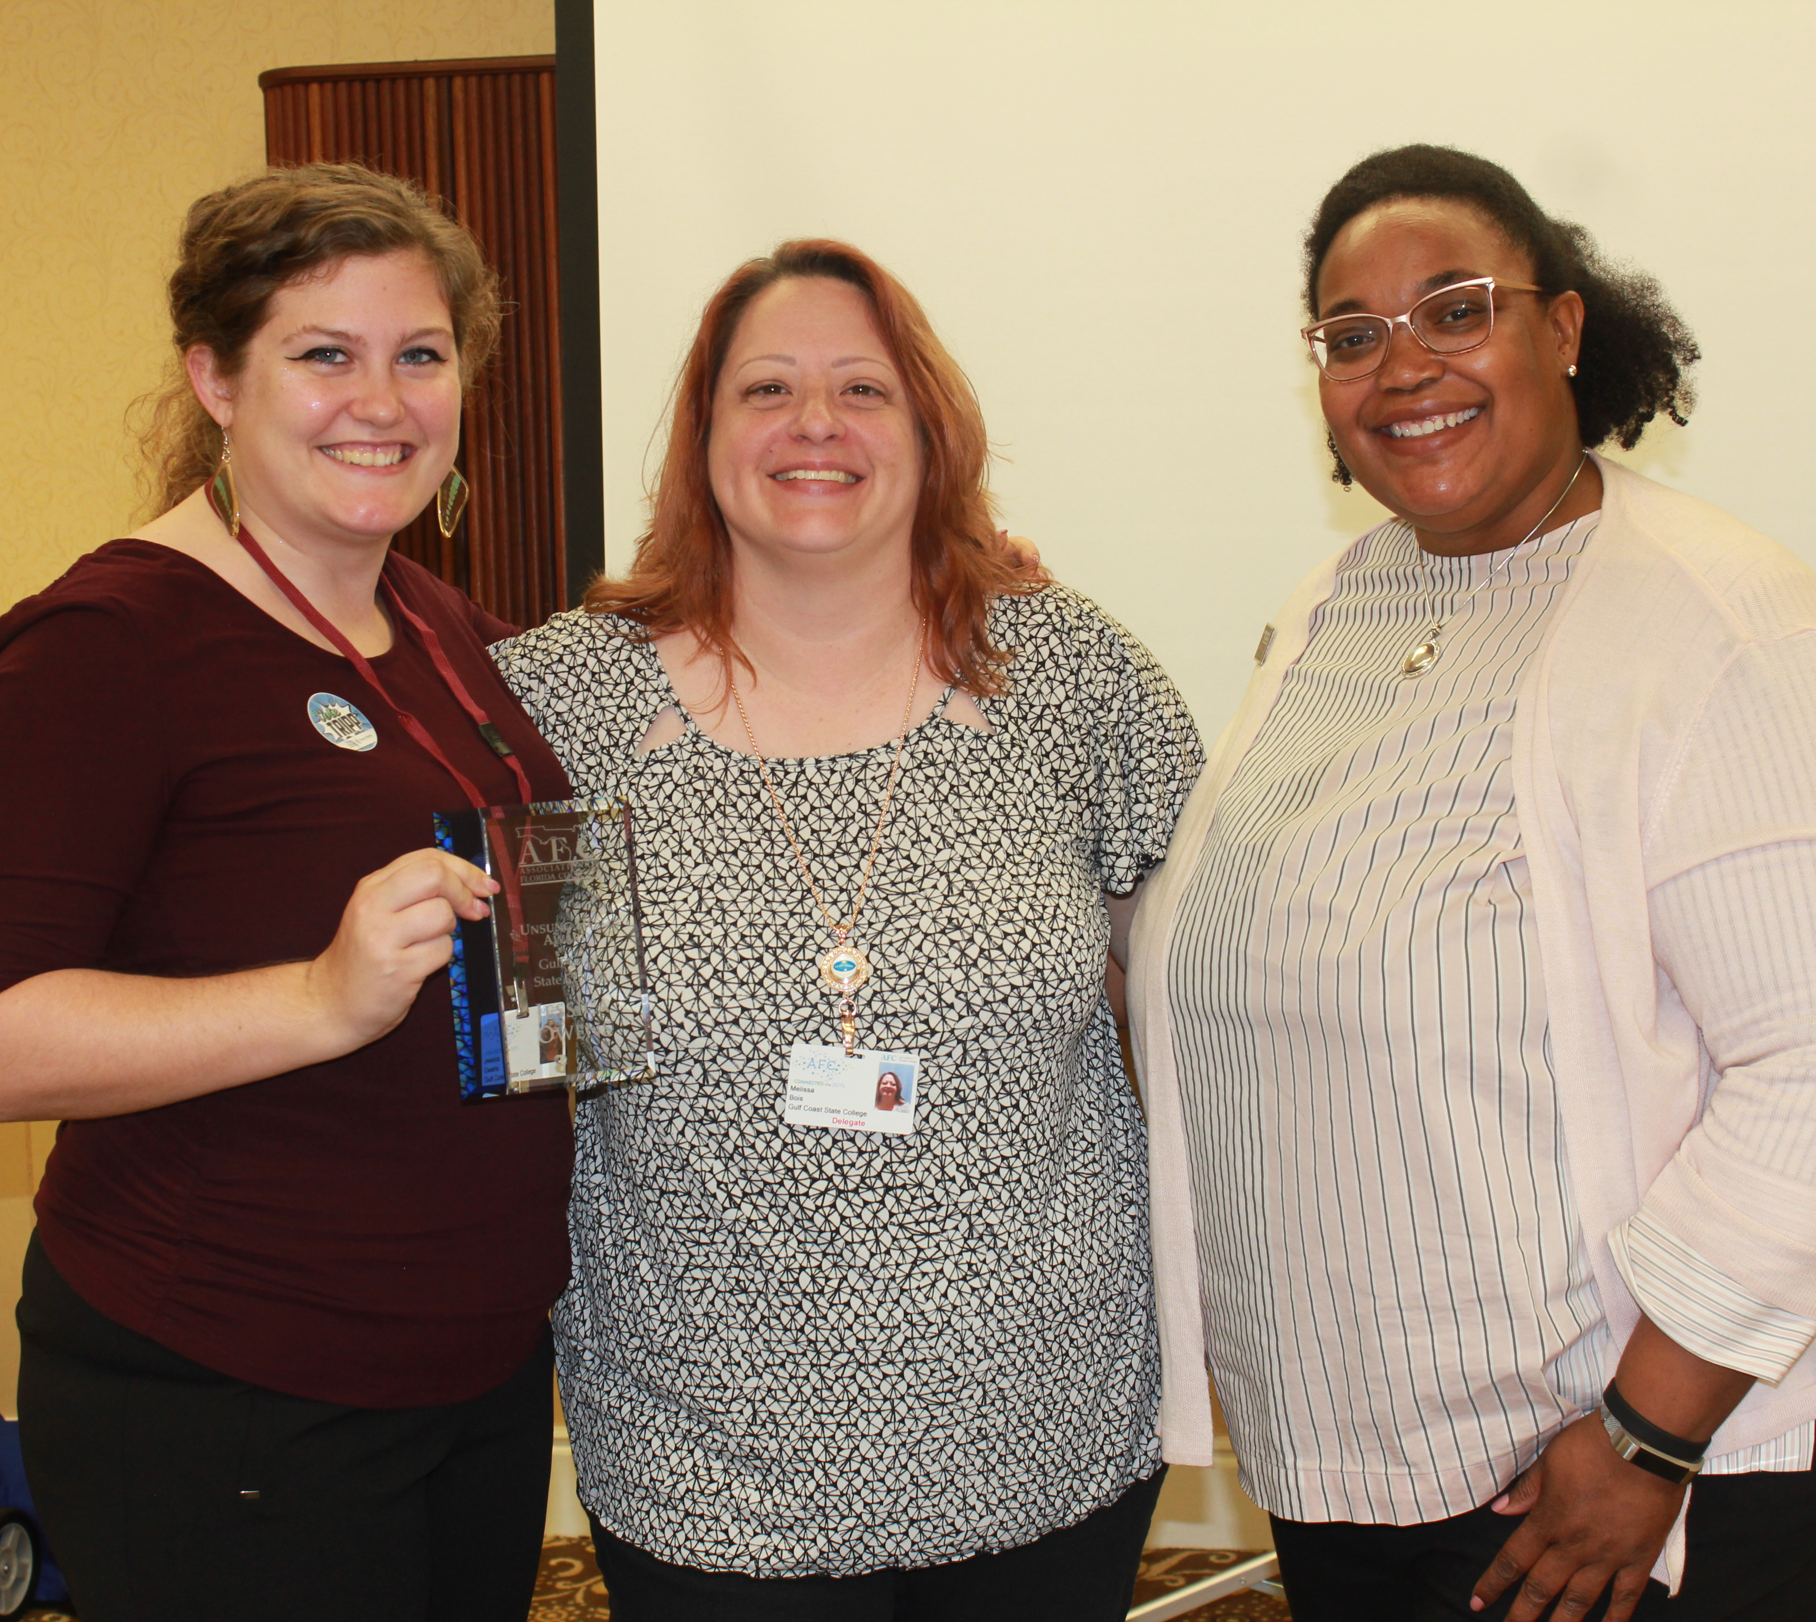
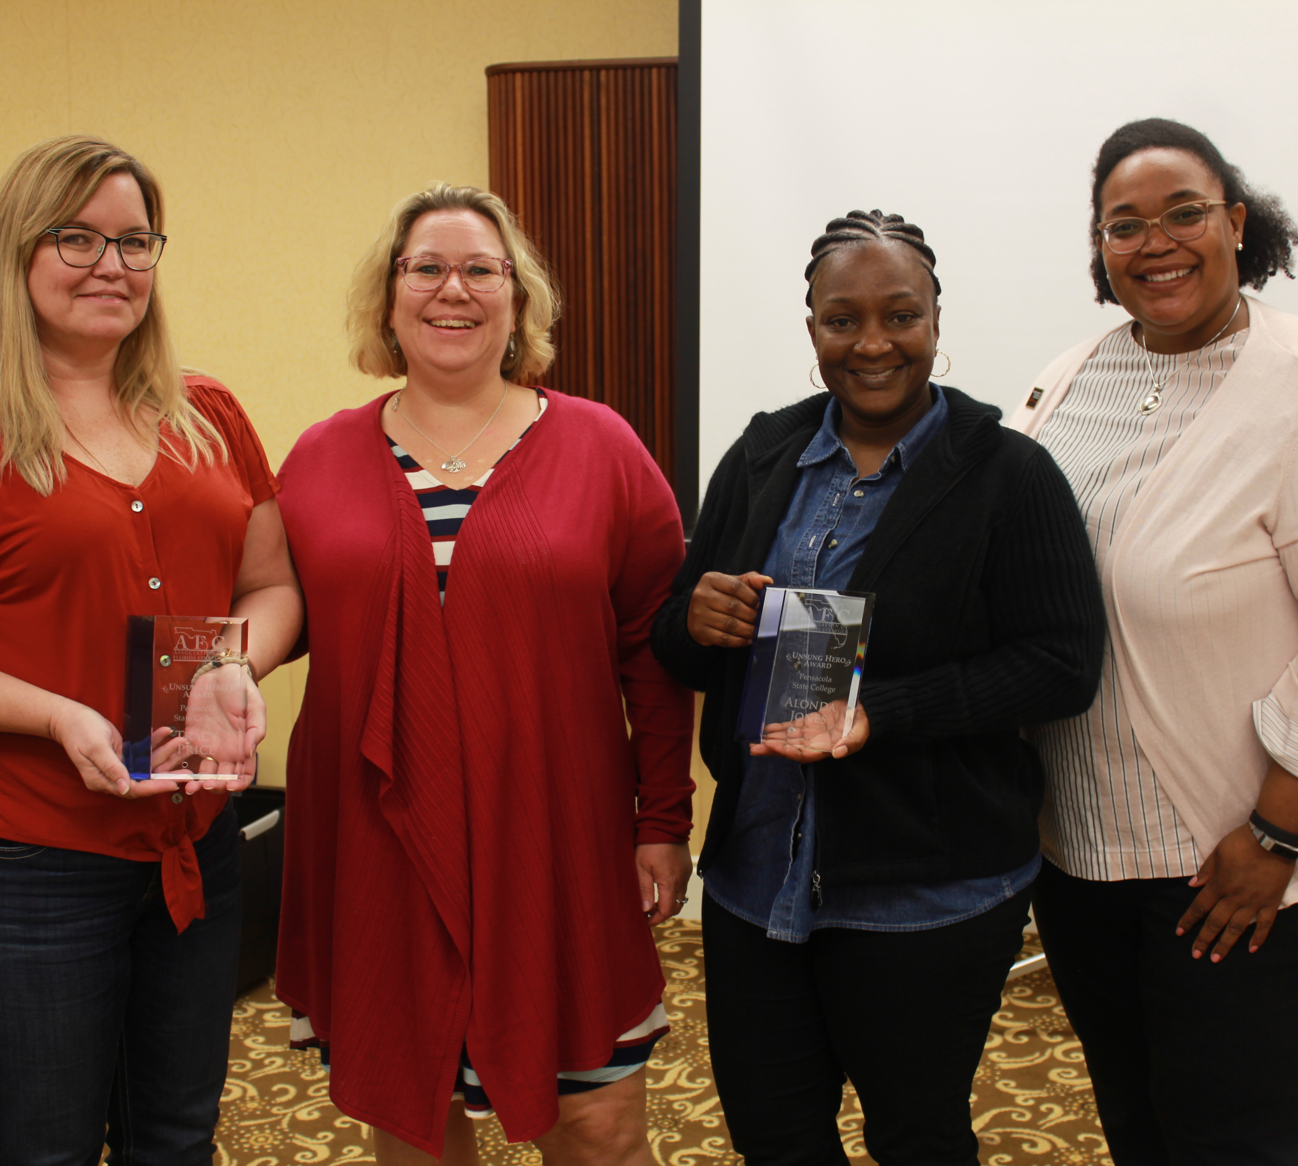
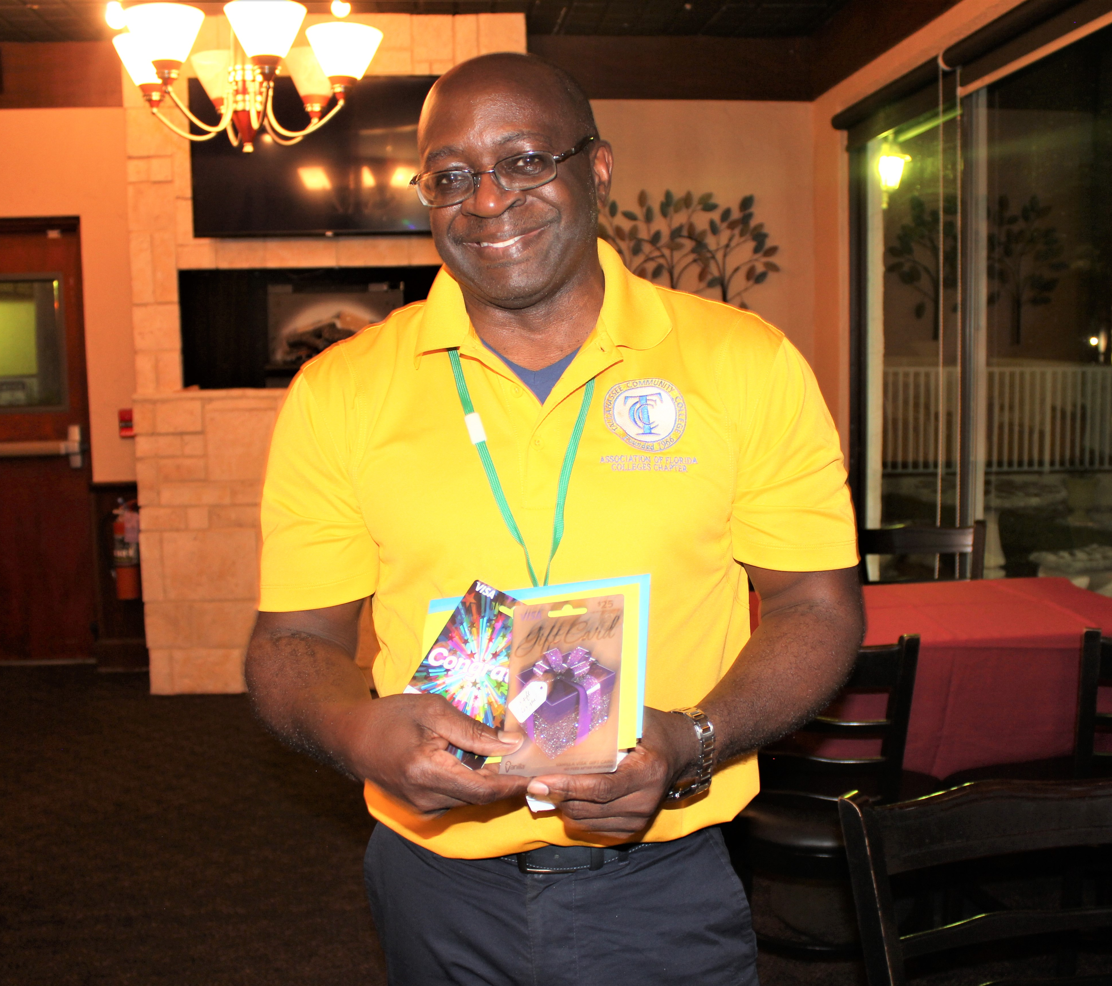
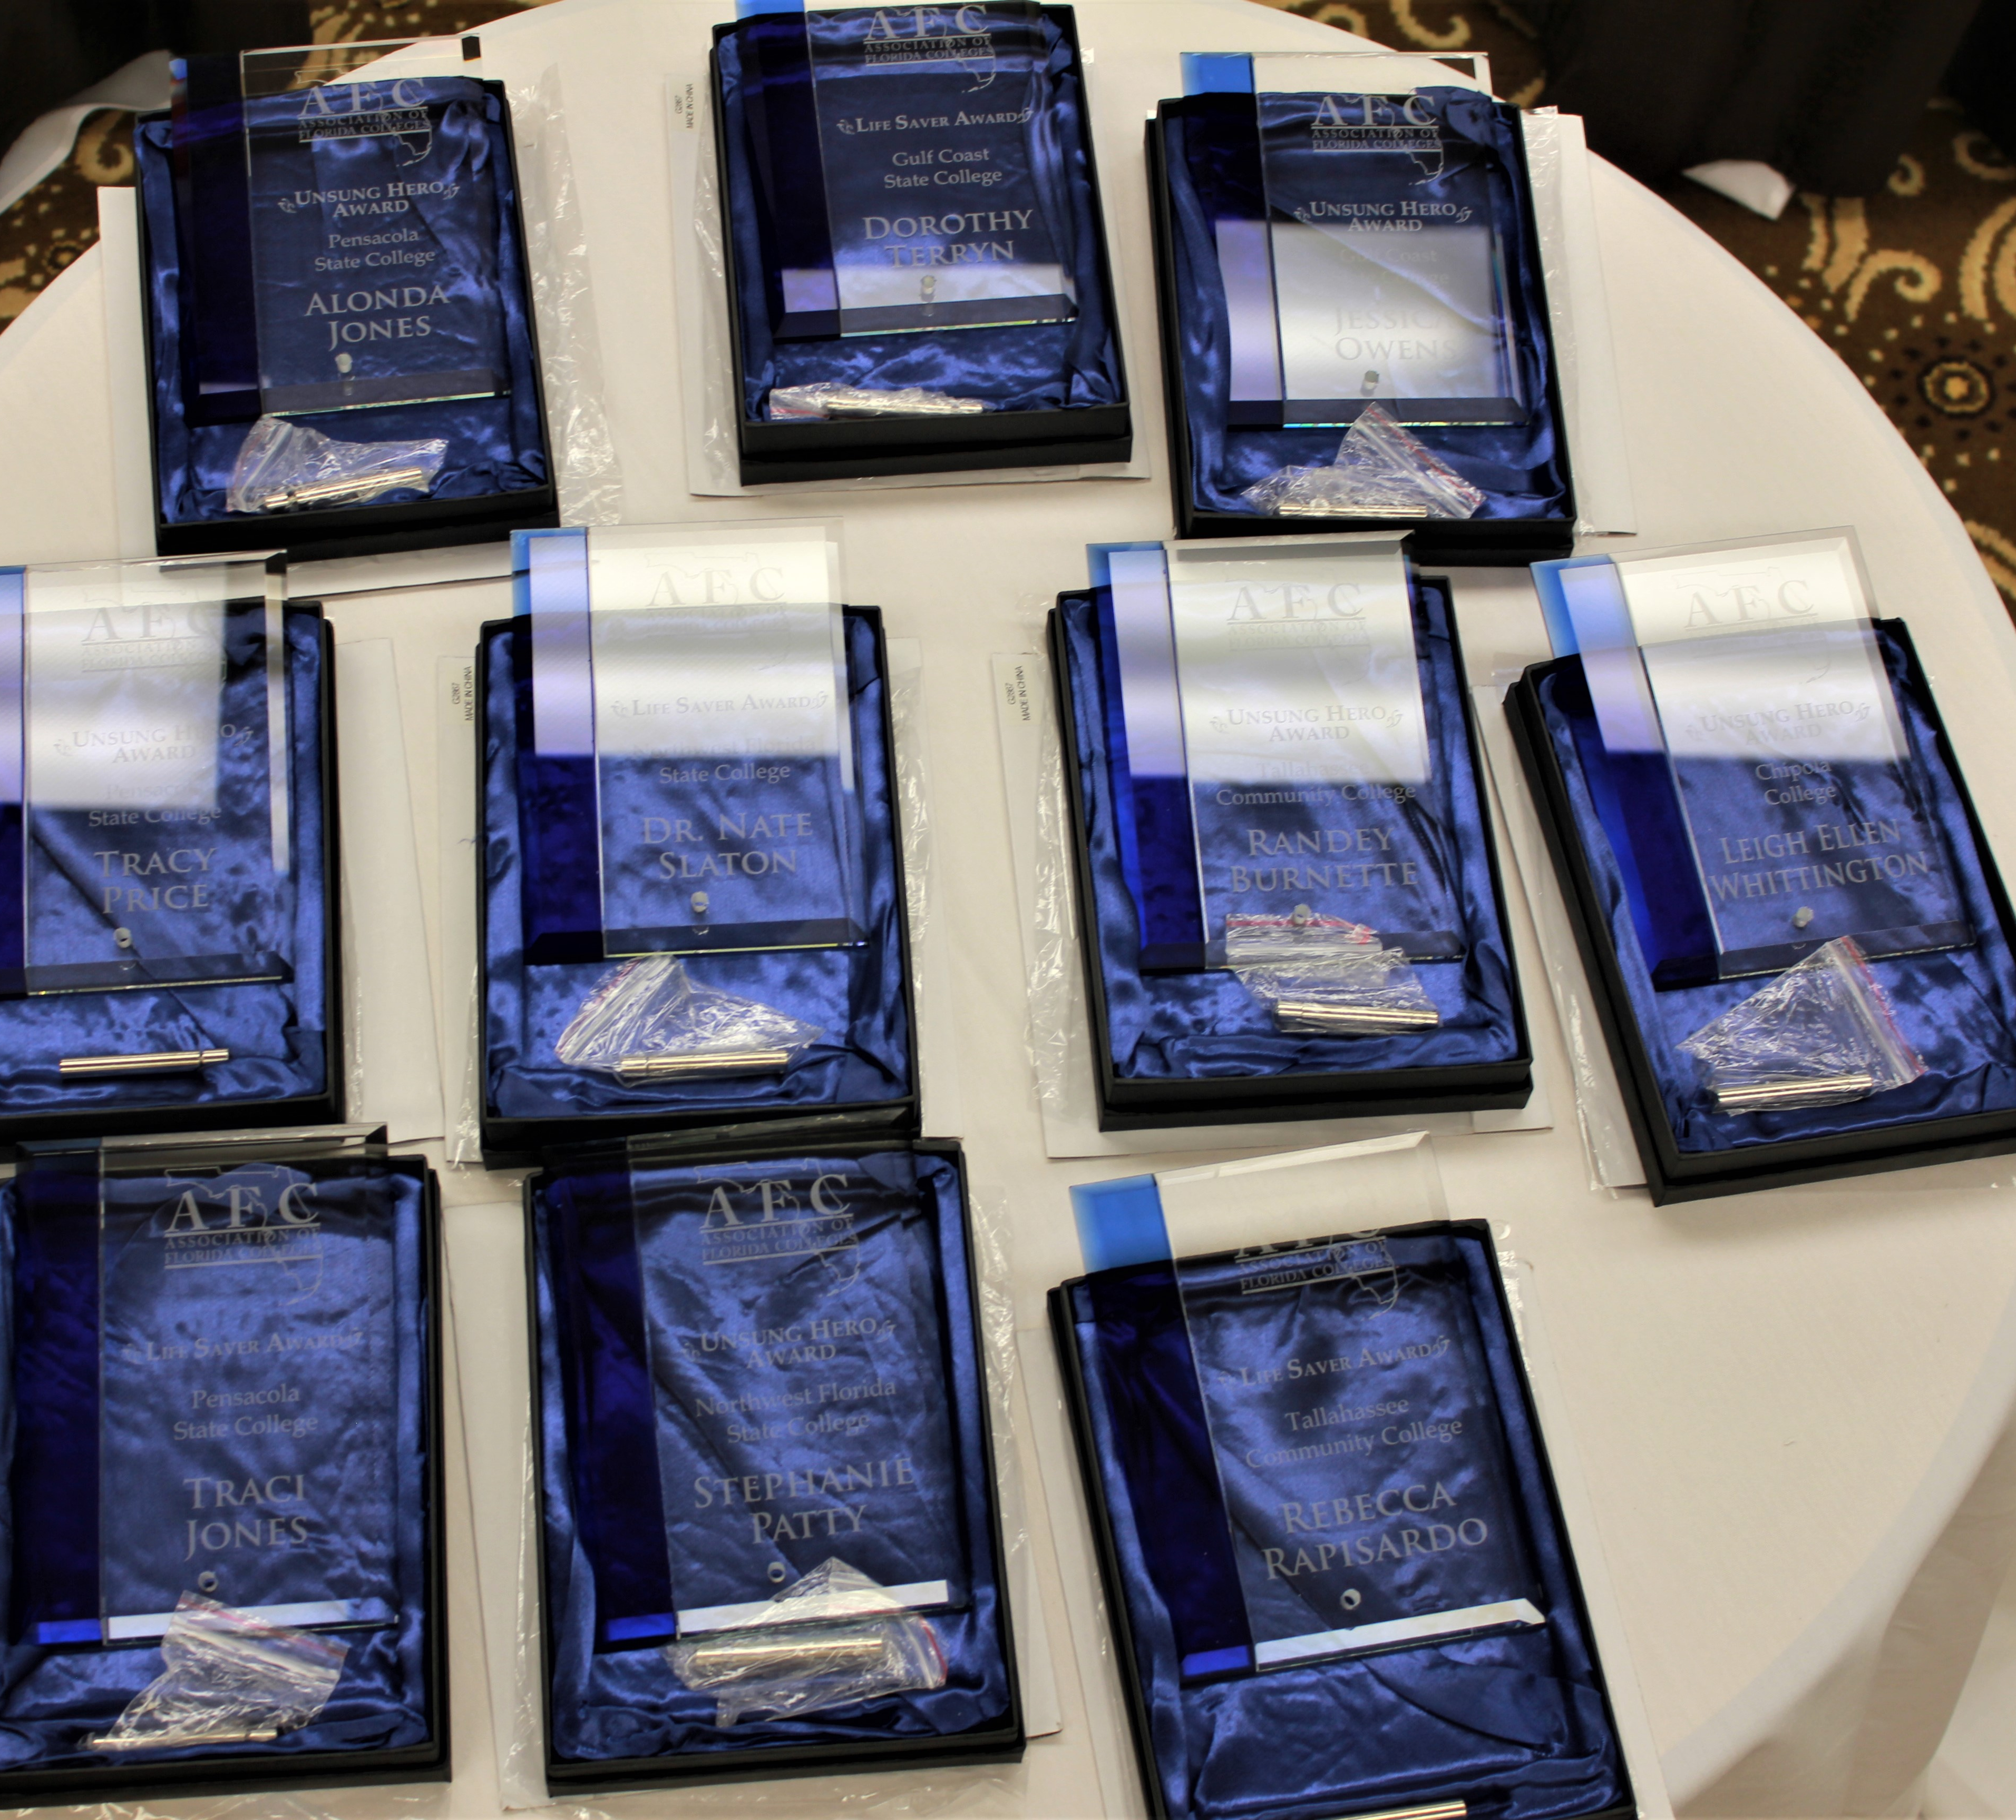
RECOGNITION
Give some form of recognition to those who get involved
Every time someone gets involved on all levels, including programs & meetings, someone needs to say “thank you”

Slide 11
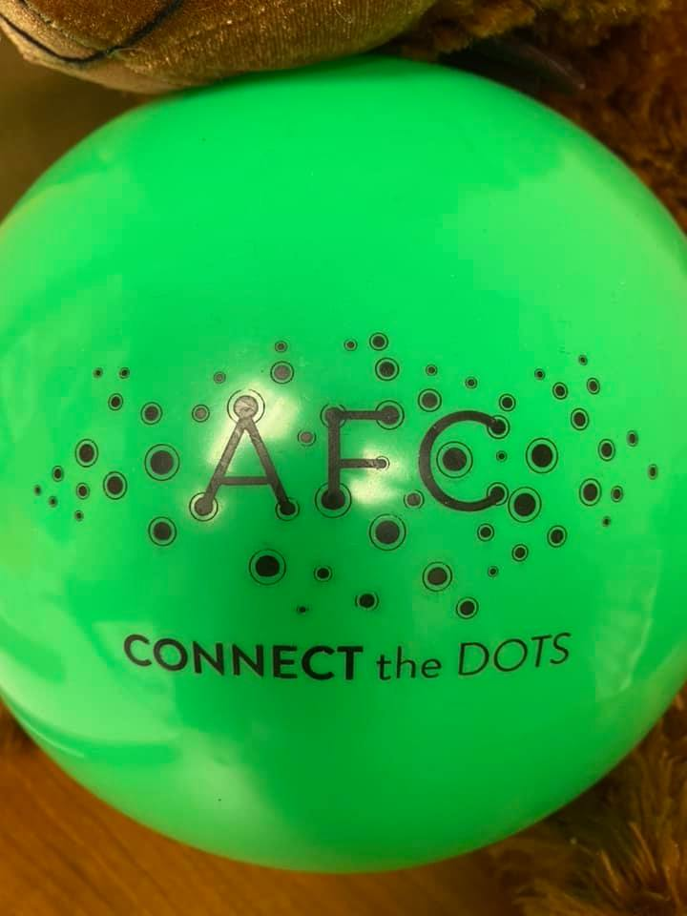
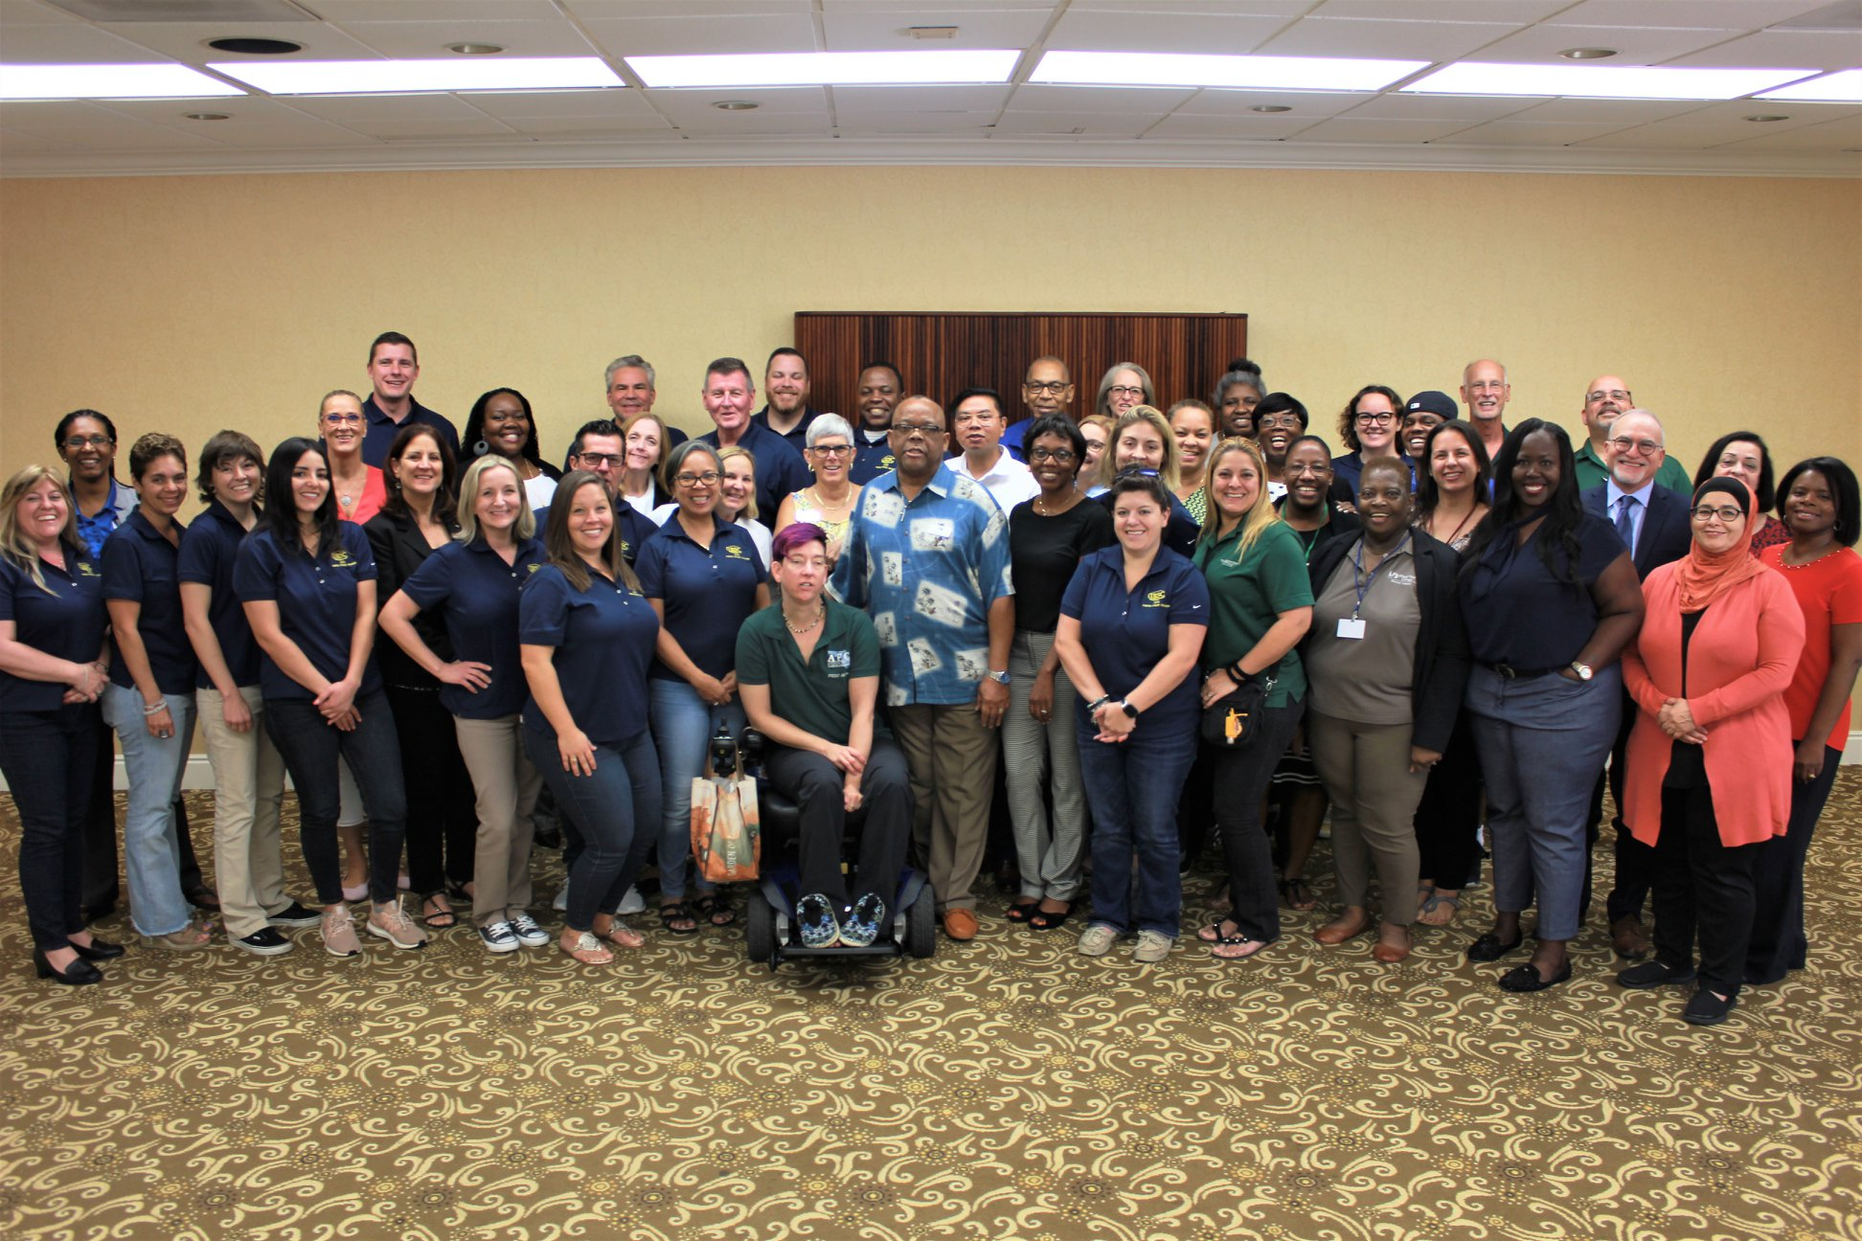
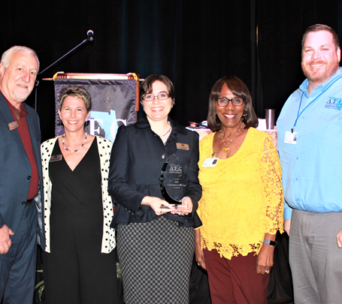
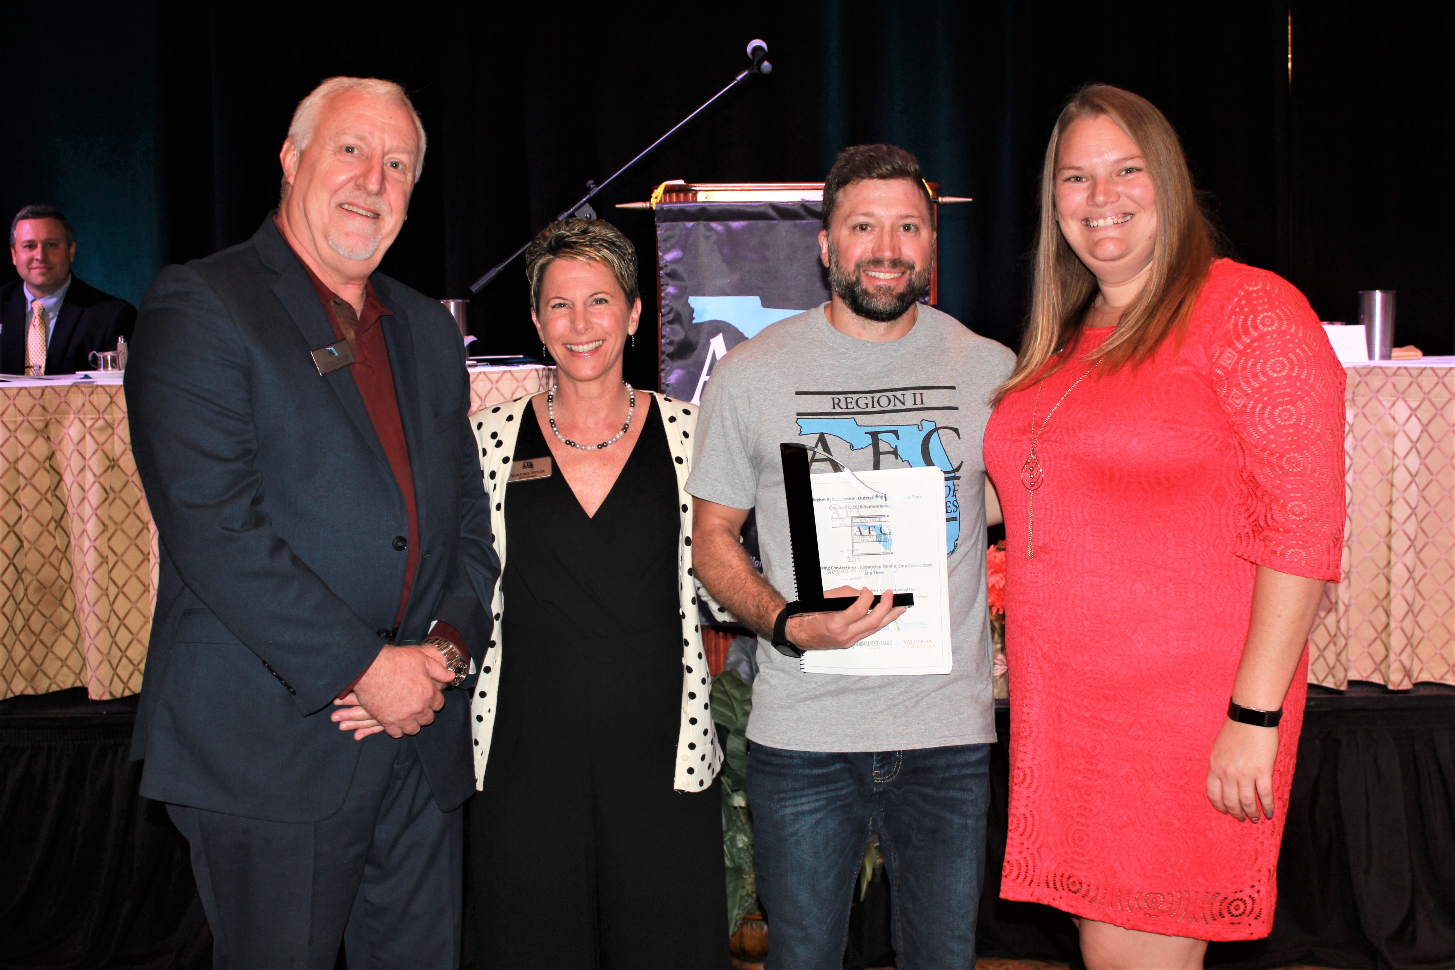
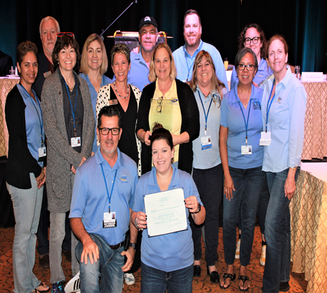
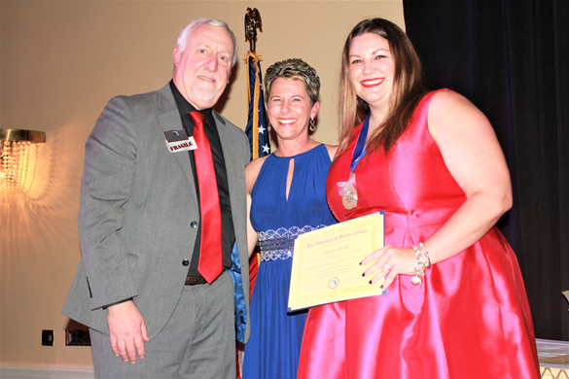
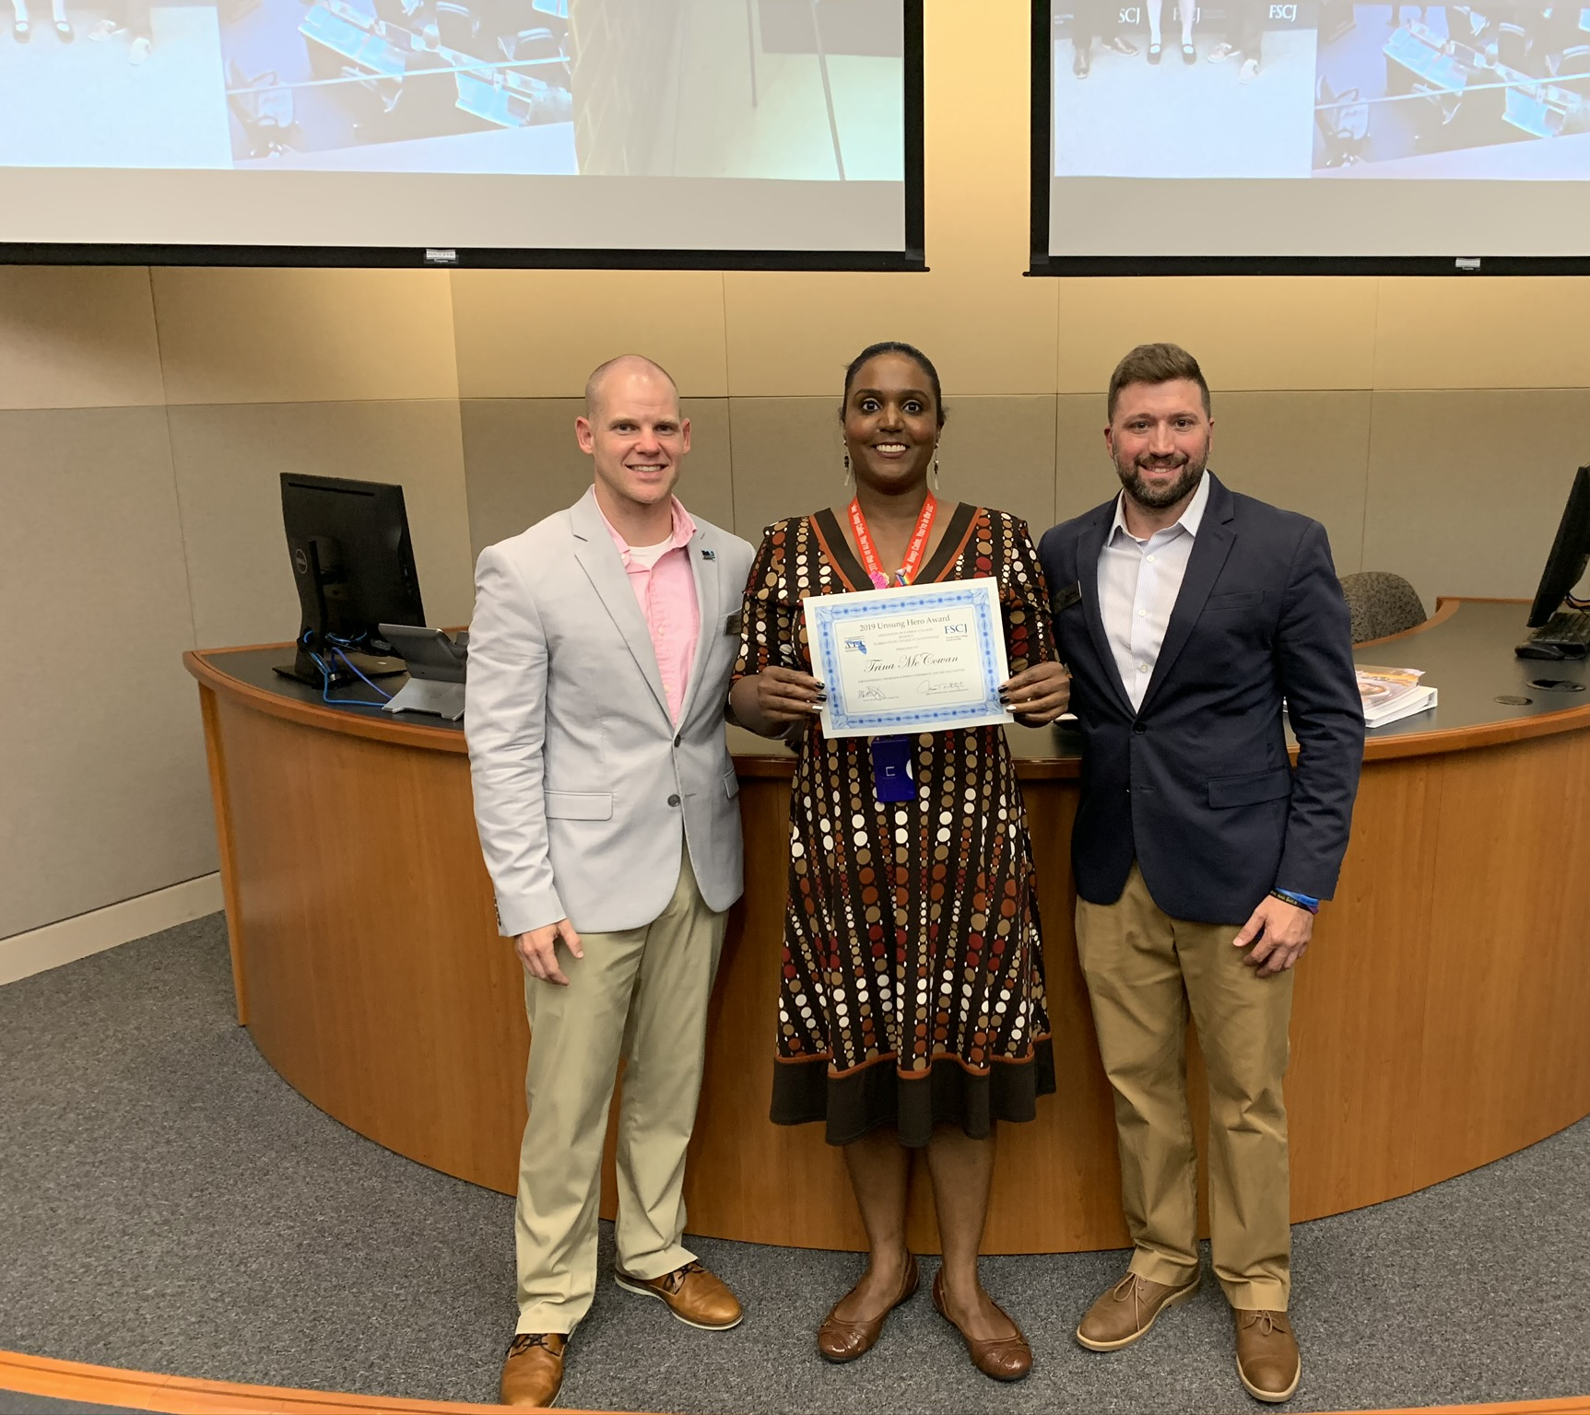
Let’s Talk About It & Let’s Share It!
#BeTheChange2021

Slide 12
Overcoming Objections
How do you respond when a potential member does not understand the value of AFC?
“It cost too much & I can’t afford it.”
I don’t have time.
AFC doesn’t really do anything? It’s for the career staff & not for faculty or administrators. It’s just not for me.

Slide 13
The 3F’s: FEEL, FELT, FOUND
I know how you feel.
I may have felt the same way initially.
However, I found that My AFC Membership really was a great investment.

Slide 14
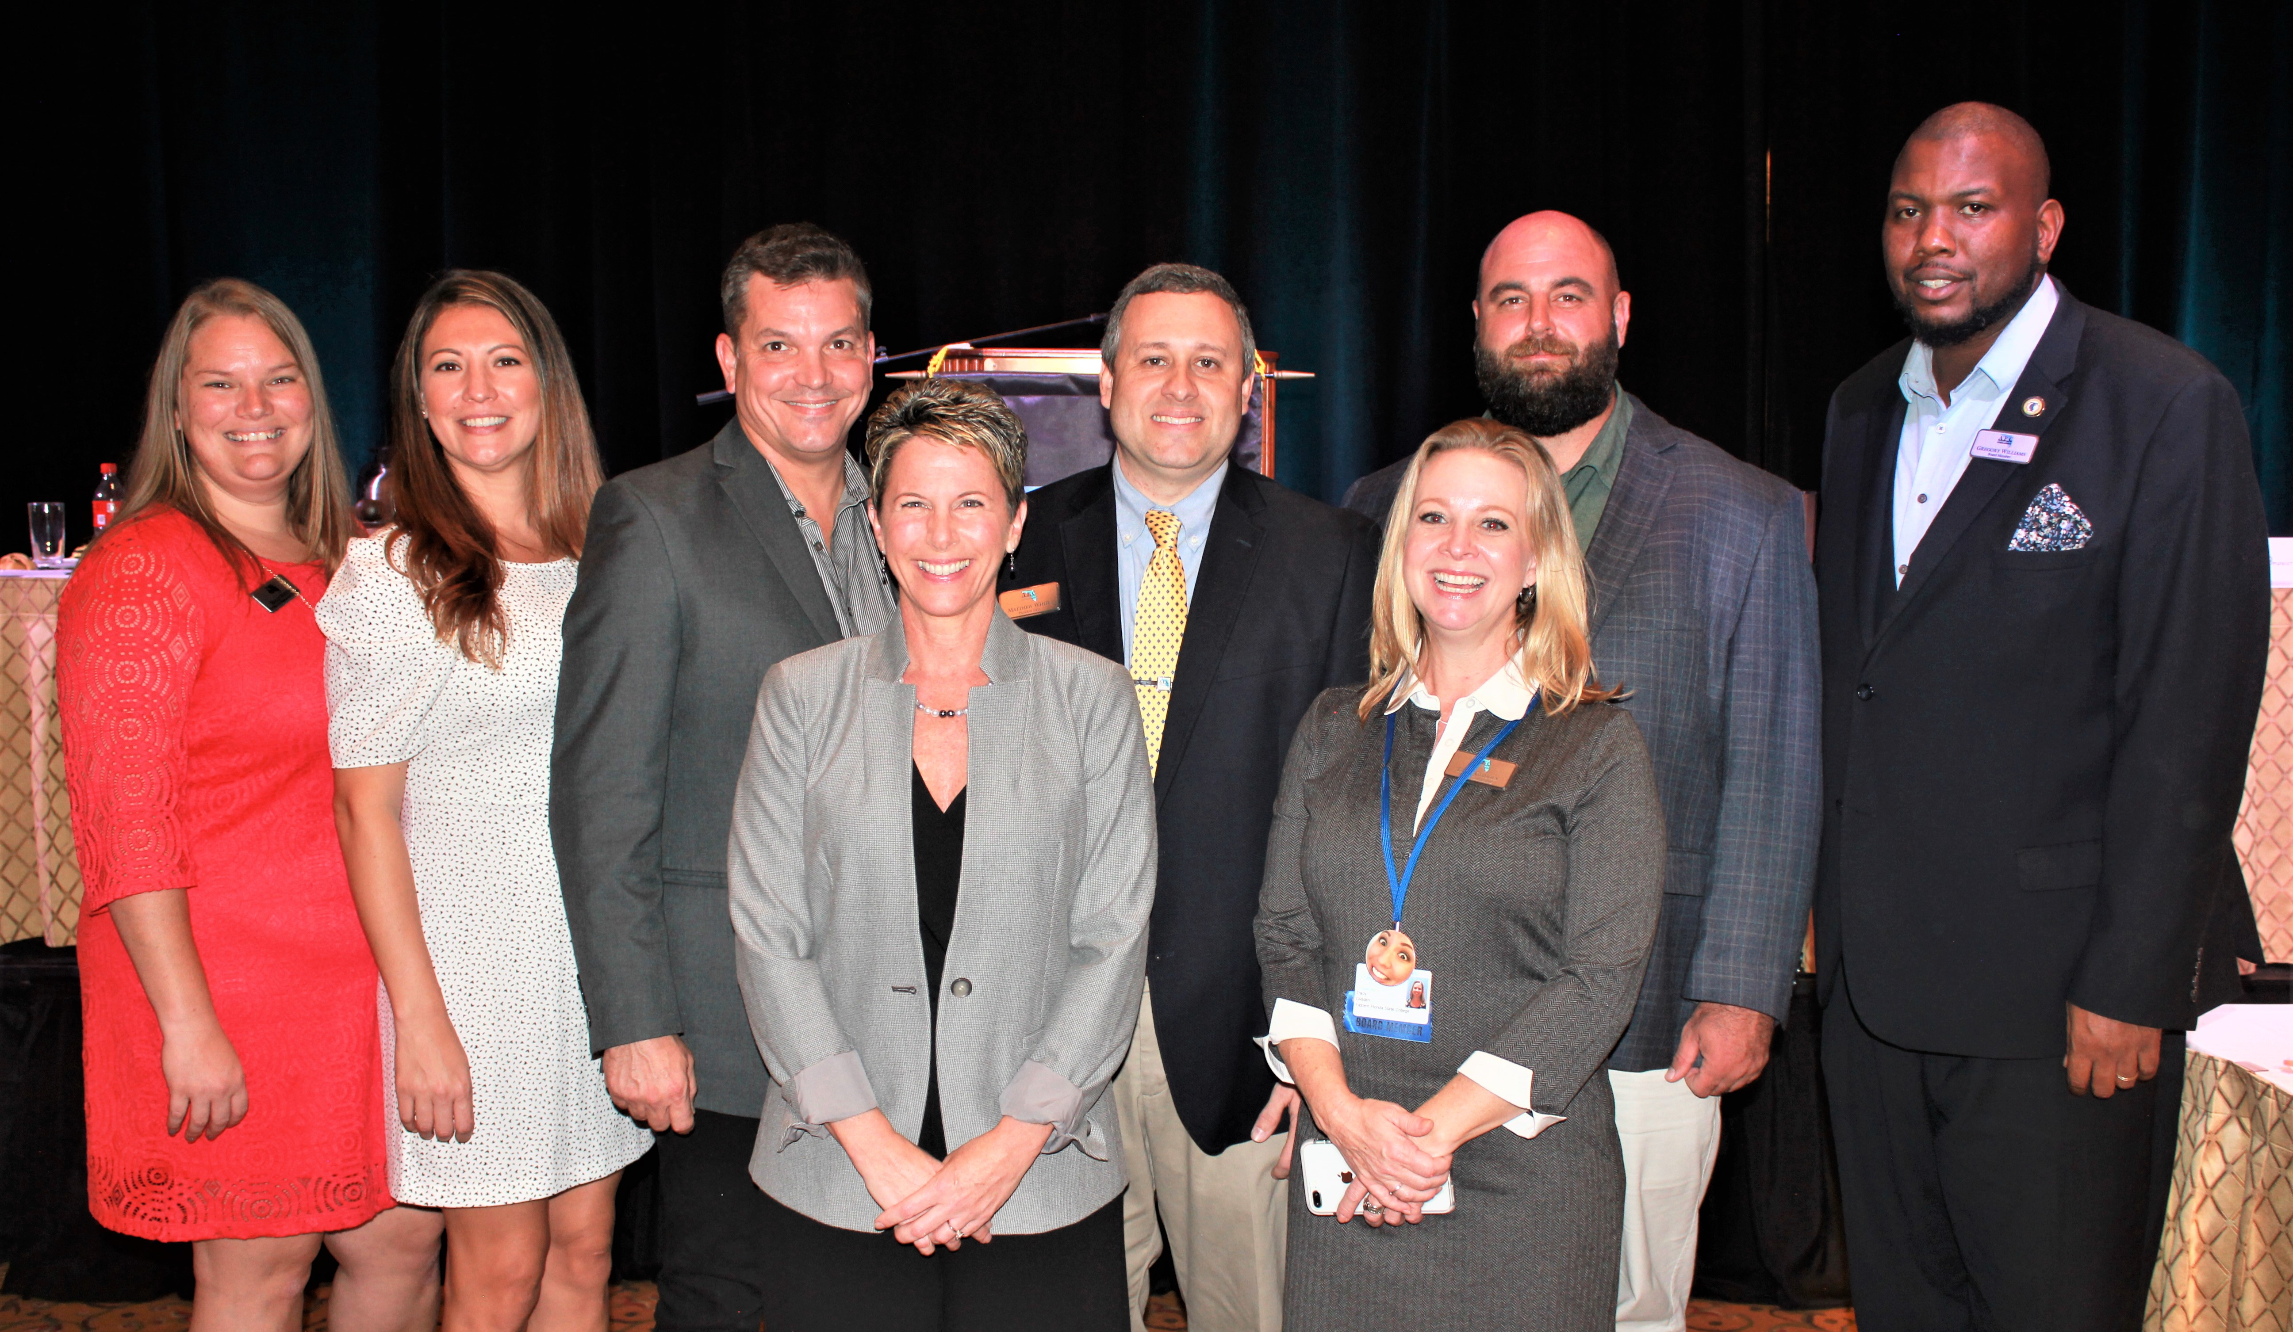
UTILIZE YOUR RESOURCES~ WE CAN HELP YOU!

Slide 15
Membership Development Rochelle Popp-Finch rfinch@irsc.edu 772-462-7476

