Slide 1
Optimizing LibGuide Content
Marketing yourself and your work online (with or without Libguides)
By Alexis Carlson, MLIS Library & Information Science
Indian River State College
acarlson@irsc.edu

Slide 2
IRSC Libraries’ APA style LibGuide
Academic Year | Number of Views | Increase
2011-2012 | 11,349
2012-2013 | 24,174 | 113%
2013-2014 | 66,738 | 176%
2014- 2015 | 138,051 | 107%
Overall Increase |  | 1,116%
From July 1, 2015-November 10, 2015 there are a total of 77,693 views.
www.irsc.libguides.com/apa created on January 5, 2011

Slide 3
How well is the APA LibGuide doing?
Included are the ten largest colleges in the state. Not included are Valencia (does not use LibGuides) and Hillsborough who uses LibGuides as their library website (with 312,578 views.)

Slide 4
So How did this happen?
Search Engine Optimization Techniques

Slide 5
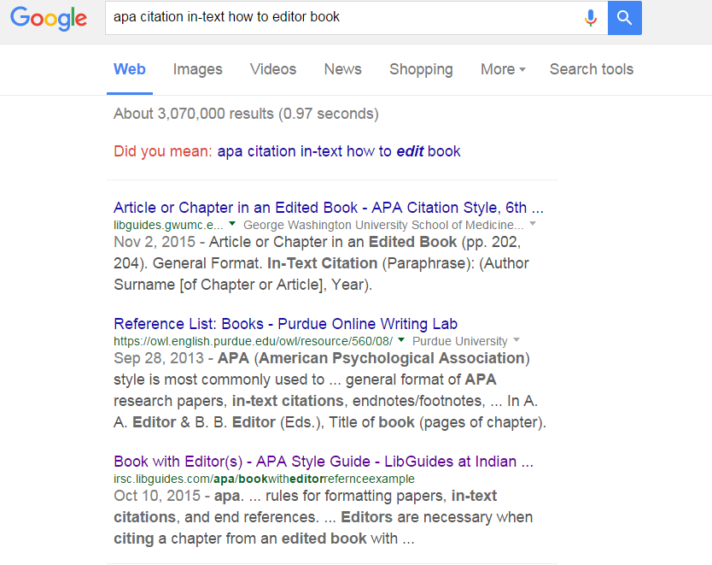
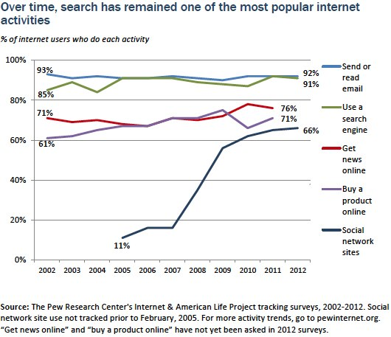
Words matter
Internet “users rarely look beyond the first 10-20 documents retrieved” (Langville & Meyer, 2012, p. 10).
#3 in the results!

Slide 6
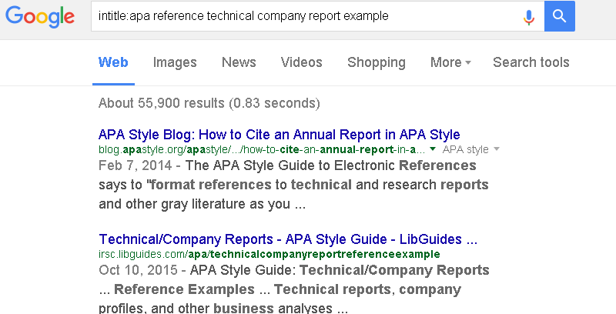
Titles matter
Every page of the APA Style LibGuide has a unique/friendly URL.
#2 Google search result here

Slide 7
Links between websites matter-Social media

Slide 8
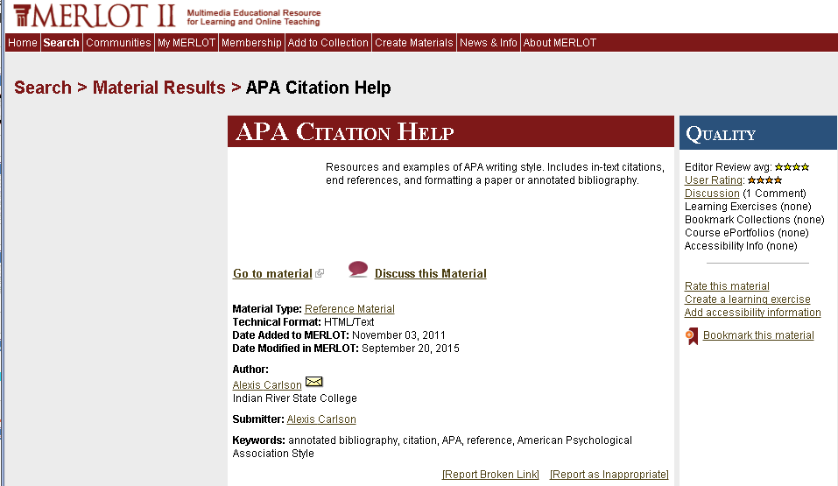
Links between websites matter-repositories

Slide 9
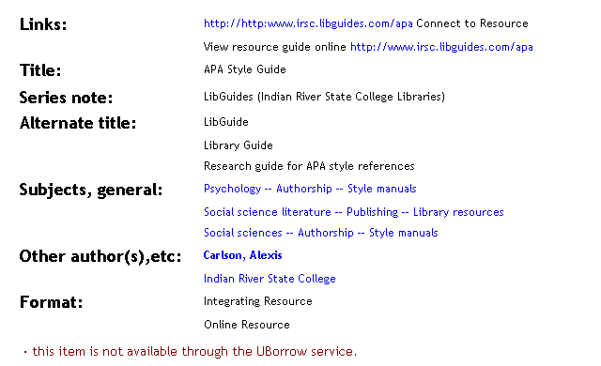
Links between websites matter-opac
Catalog sources of information, once in the local catalog, becomes a part of the Union catalog. ALL Florida public colleges and universities now have access.

Slide 10
Words used in links matter
A linked word=this is what the website is all ABOUT

Slide 11
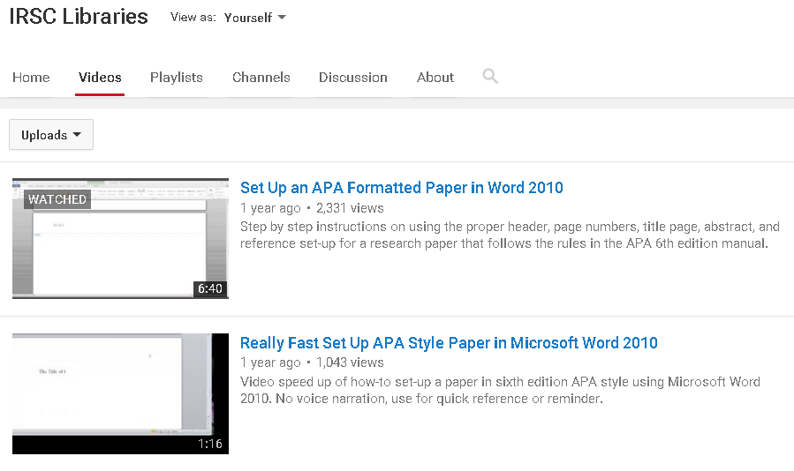
Reputation matters
Regular updates to the site, removal of “dead” links
Links back to new & excellent content on the Web
Video content can help explain and add engagement to your site (see Rampton, 2014 for more details).

Slide 12
Organic search
Word cloud of the most commonly used keywords people typed into a search engine to access our site through the organic search.
2013-2015 data for user acquisition to our site. Organic search refers to the number of people entering our LibGuide site through keywords entered into a search engine as opposed to clicking a link or typing in a URL.

Slide 13
references
Langville, A. N. & Meyer, C. D. (2012). Google's pagerank and beyond : The science of search engine rankings. Princeton, NJ: Princeton University.
Rampton, J. (2014, June 12). Video SEO guide: Optimization best practices. Forbes/Tech. Retrieved from http://www.forbes.com/sites/johnrampton/2014/06/12/video-seo-guide-optimization-best-practices/

